Slide 1
Karnaugh Maps (K-map)
A K-map is a collection of squares
The collection of squares is a graphical representation of a Boolean function
Each square represents a minterm
Adjacent squares differ in the value of one variable
The K-map can be viewed as
A reorganized version of the truth table

Slide 2
Some Uses of K-Maps
Provide a means for:
Finding optimum or near optimum
SOP and POS standard forms, and
Visualizing concepts related to manipulating Boolean expressions, and
Demonstrating concepts used by computer-aided design programs to simplify large circuits

Slide 3
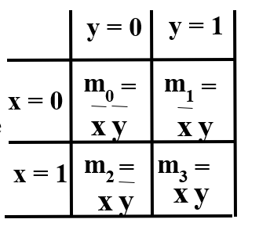
Two Variable Maps
A 2-variable Karnaugh Map:
Note that minterm m0 and
minterm m1 are “adjacent”
and differ in the value of the
variable y
Similarly, minterm m0 and
minterm m2 differ in the x variable.
Also, m1 and m3 differ in the x variable as well.
Finally, m2 and m3 differ in the value of the variable y

Slide 4
K-Map and Truth Tables
The K-Map is just a different form of the truth table.
Example – Two variable function:
We choose a,b,c and d from the set {0,1} to implement a particular function, F(x,y).
Function Table
K-Map
Input
Function
Values
Value
y = 0
y = 1
(x,y)
F(x,y)
x = 0
a
b
0 0
a
0 1
b
x = 1
c
d
1 0
c
1 1
d

Slide 5
K-Map Function Representation
Example: F(x,y) = x
For function F(x,y), the two adjacent cells containing 1’s can be combined using the Minimization Theorem:
F = x
y = 0
y = 1
x = 0
0
0
x = 1
1
1
F
(
x
,
y
)
=
x
y
+
x
y
=
x

Slide 6

K-Map Function Representation
Example: G(x,y) = x + y
For G(x,y), two pairs of adjacent cells containing 1’s can be combined using the Minimization Theorem:
G = x+y
y = 0
y = 1
x = 0
0
1
x = 1
1
1

