Slide 1
VISUALISATIONS

Slide 2
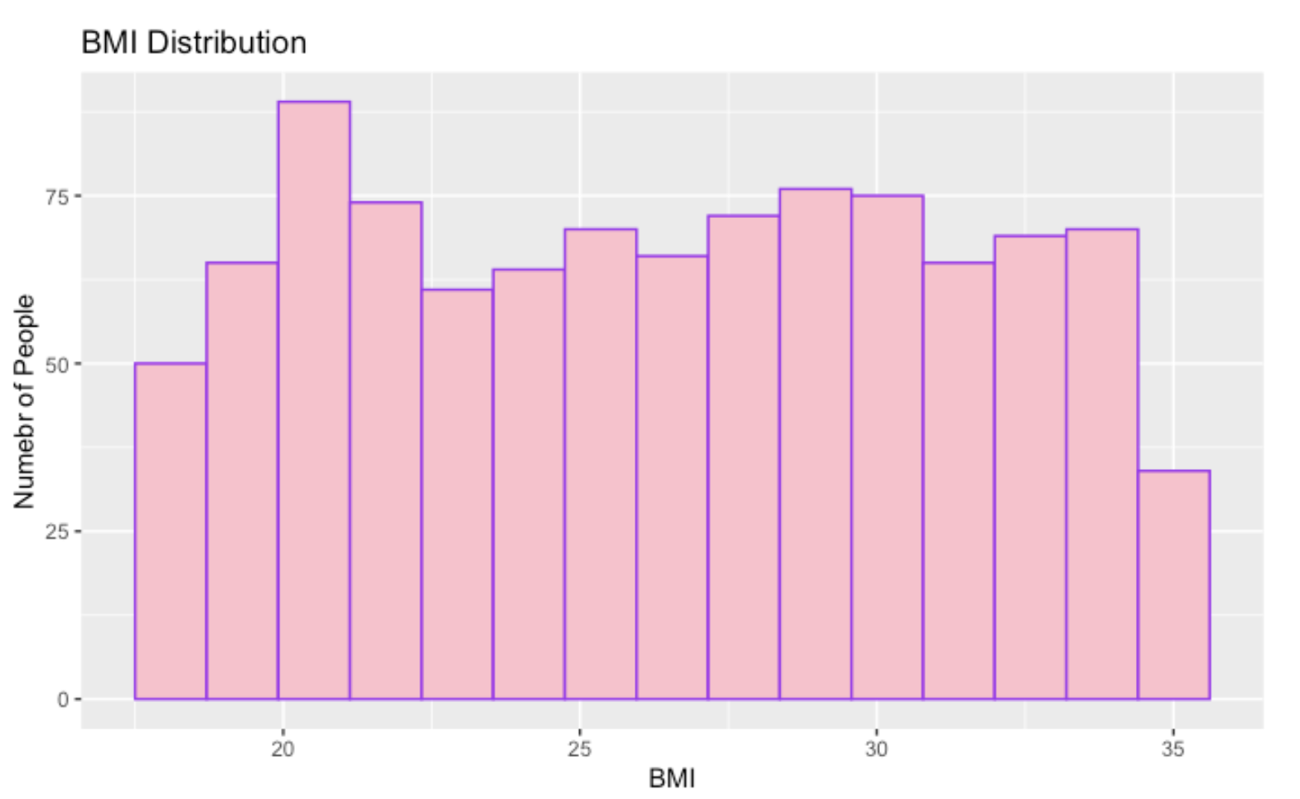
HISTOGRAM 1
The most common BMI range is around 20 – 23 which shows that the large number of people in the dataset come under this range.
The values are almost evenly distributed but are slightly skewed towards right.
The range is around 17 – 36
As seen, after 35 the number of people drops which means that less people are in very high BMI range.
Since BMI is varying feature and its also relevant and there is no major data imbalanace so its useful for modelling.

Slide 3
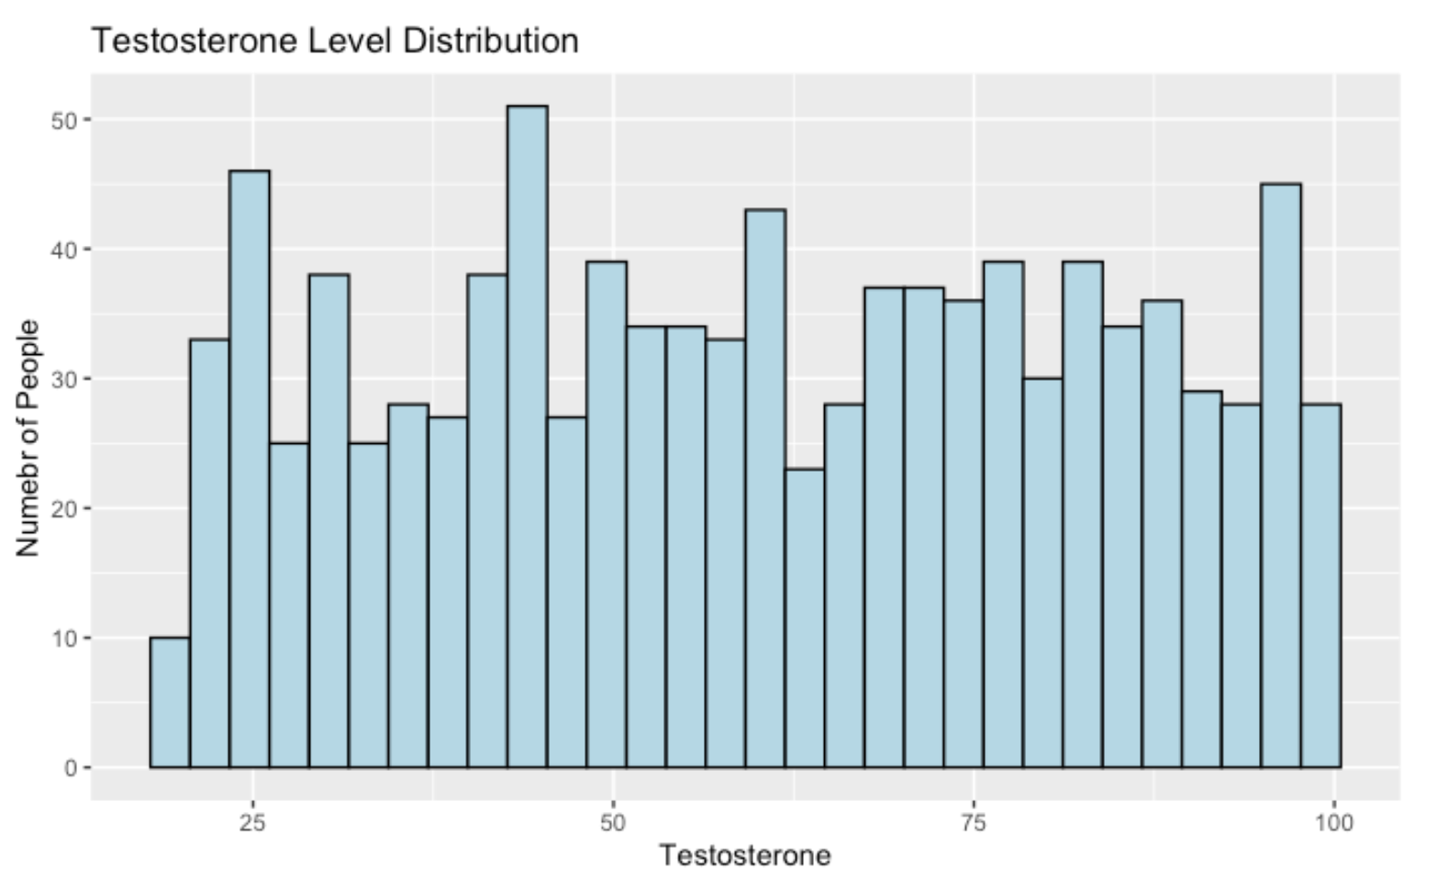
HISTOGRAM 2
The range of testosterone level is around 17 to 100 ng/dL.
The distribution is uniform with some small peaks and dips.
Usually higher testosterone levels are diagnosed when PCOS is true
It’s a useful predictor for Naïve Bayes and decision tree because its varies widely in the dataset

Slide 4
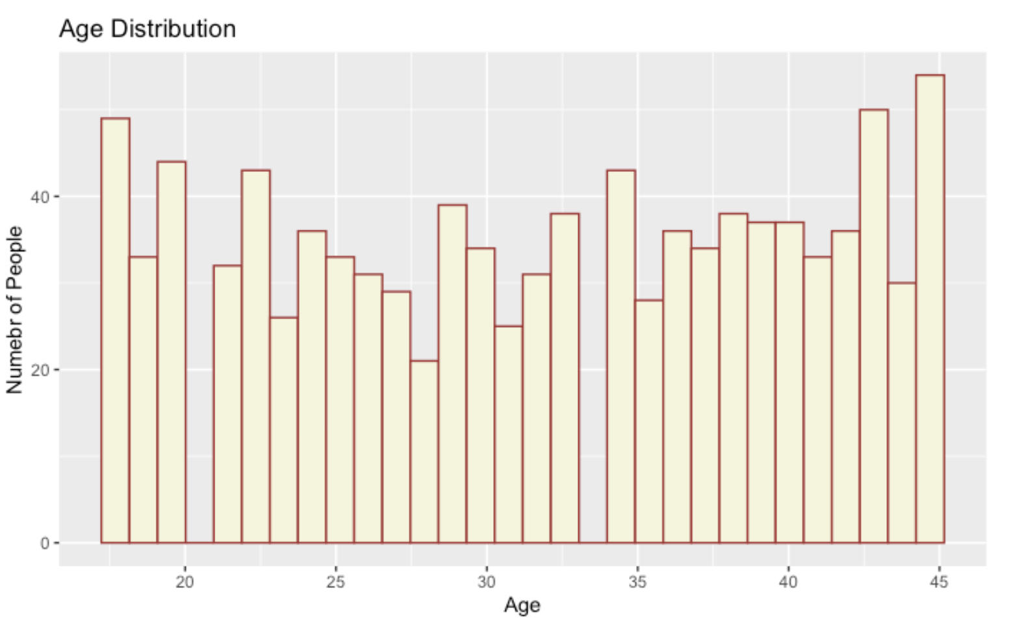
HISTOGRAM 3
The range of the ages are around 17 – 45.
The histogram is fairly distributed but after 20 and 35 it dips and during 18-20 and 42 -45 it spikes.
Other than that the data is balanced
The symptoms of PCOS are commonly from late teens to early 30s so having a wider range can help detect PCOS differently at multiple age groups.

Slide 5
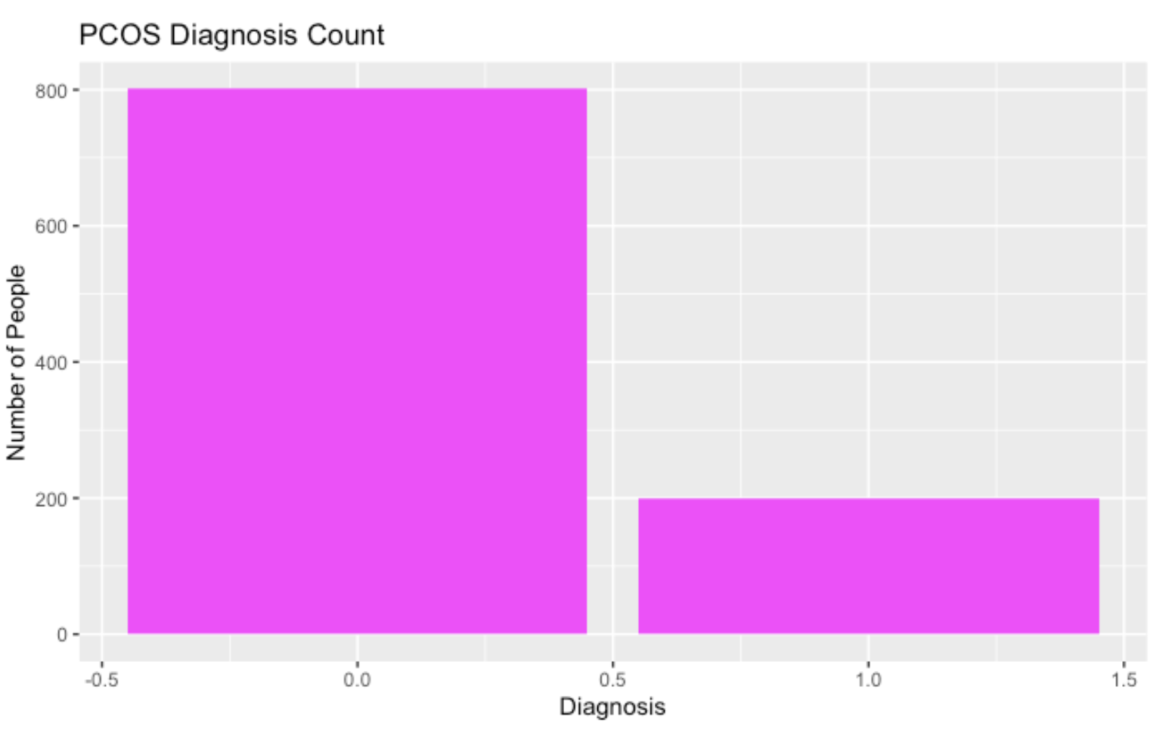
BAR GRAPH
The bar compares the number of people with PCOS and without PCOS.
0 = no PCOS, around 800 people
1 = PCOS, around 200 people
Even though this data is imbalanced I split both classes using initial_split() (which I learned from split_train_test lecture pdf.) which ensures both classes are propotionally represented in training and test sets.

Slide 6
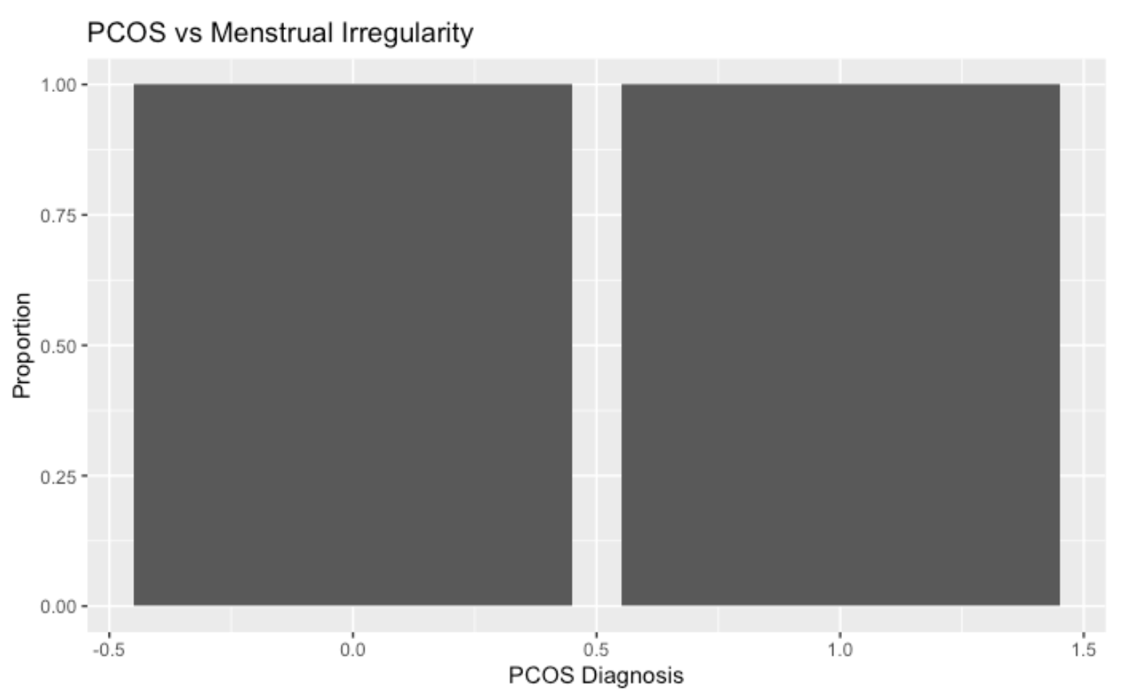
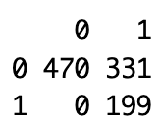
BAR GRAPH (Why I removed Menstrual Irregularity feature)
Every person with PCOS also has menstrual irregularity.
This shows 100% of PCOS cases had irregularity
There is no variation in PCOS group and it overlaps with the target variable which created problems in Naïve bayes.

Slide 7
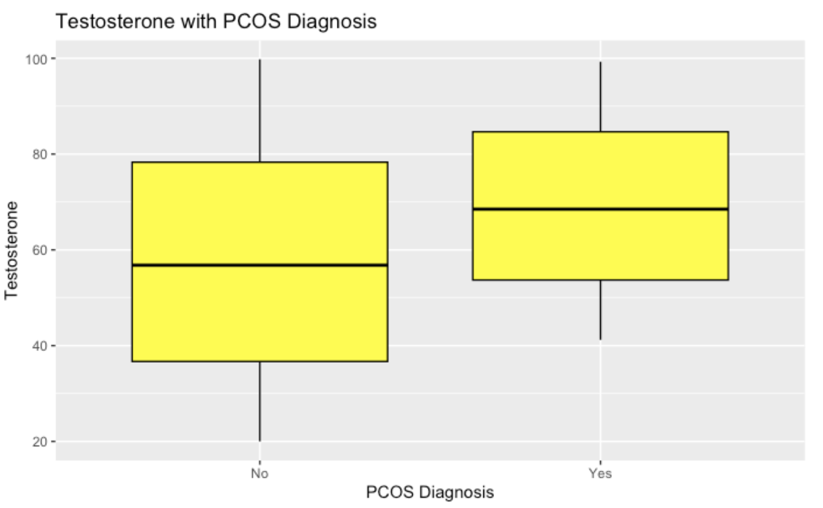
BOX PLOT
The median testosterone level is higher in PCOS (yes) than in non-PCOS.
There is some overlap but PCOS(yes) has a higher value of testosterone level making it strong predictive feature for classification of PCOS.
That’s why is could be a key predictor for Naïve Bayes and decision tree

Slide 8
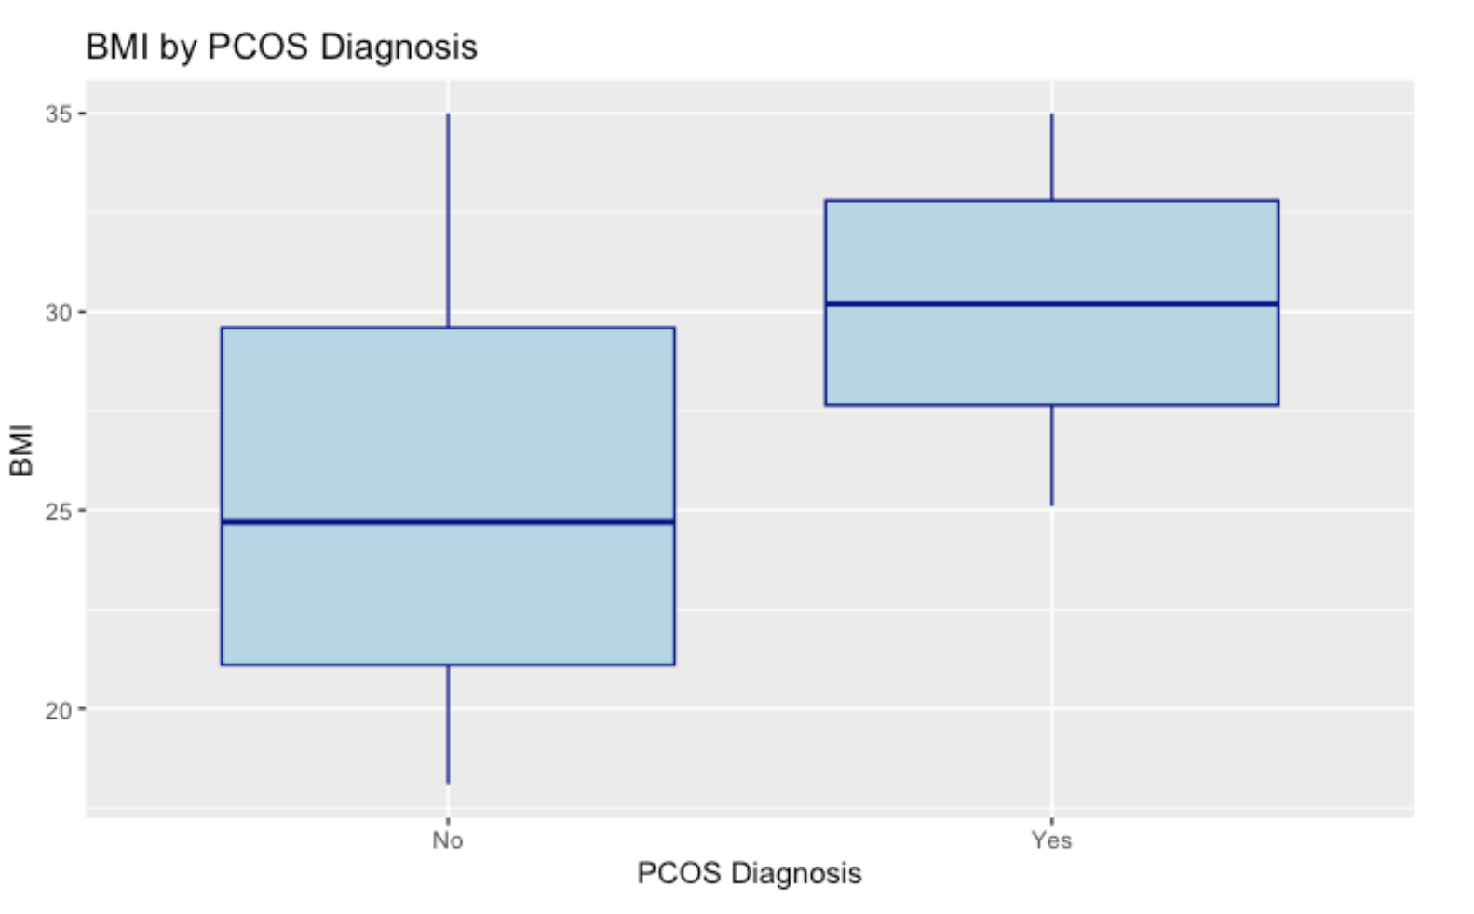
BOX PLOT
The median BMI is higher in individuals with PCOS (Yes) than with non-PCOS (No).
There is some overlap between the two groups, but the PCOS group clearly shows elevated BMI levels, making it a strong predictive feature for classification
That’s why BMI could be a key predictor for both the Naïve Bayes and Decision Tree.

Slide 9
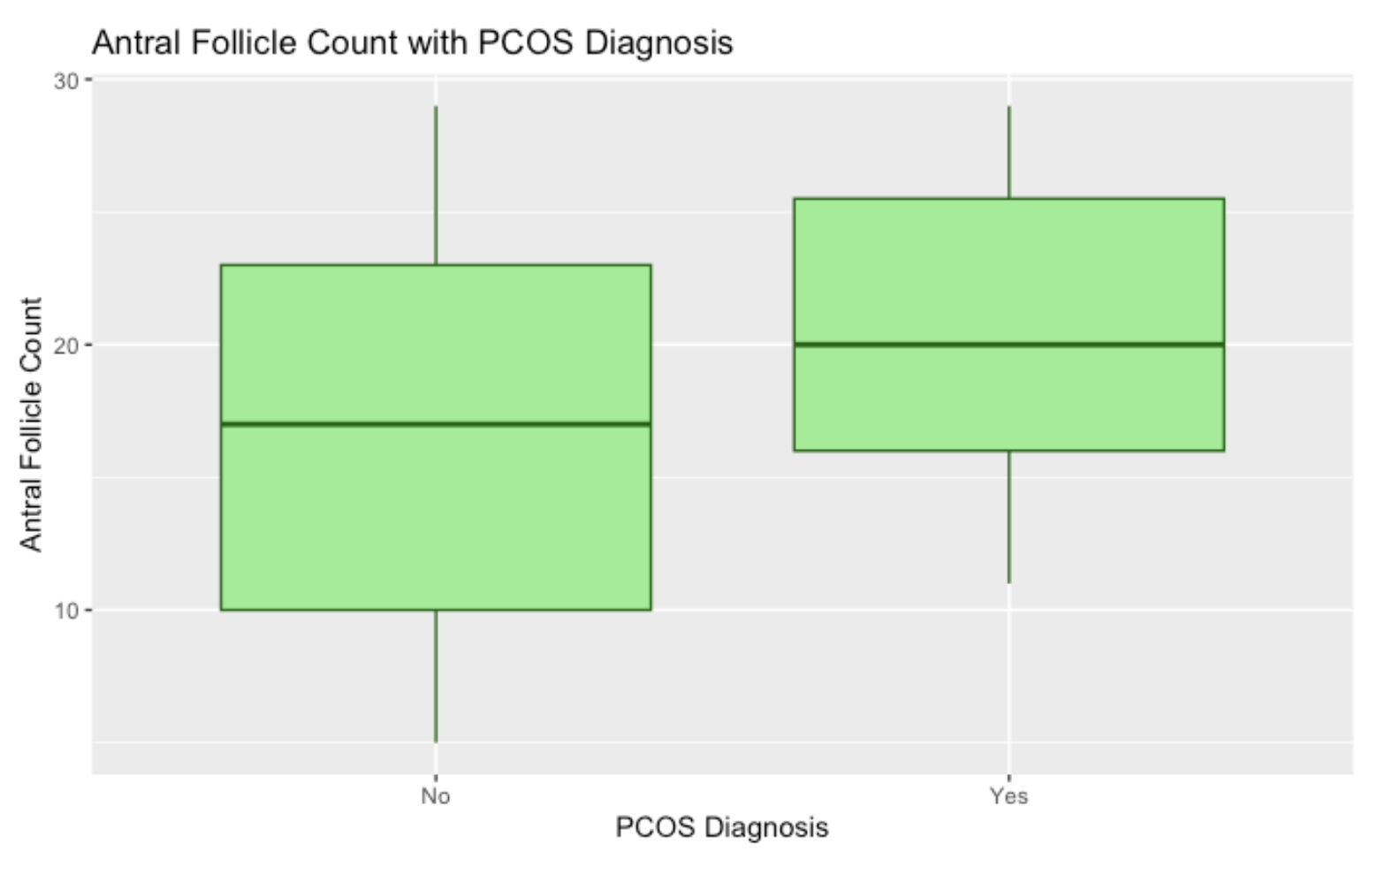
BOX PLOT
The median antral follicle count is higher in individuals with PCOS (Yes) than with non-PCOS (No).
While there is some overlap between the groups, PCOS-diagnosed individuals consistently show elevated follicle counts. This is similar to boxplot with testosterone level
This makes antral follicle count a strong feature(clinical) and a valuable predictor in both Naïve Bayes and Decision Tree models.

Slide 10
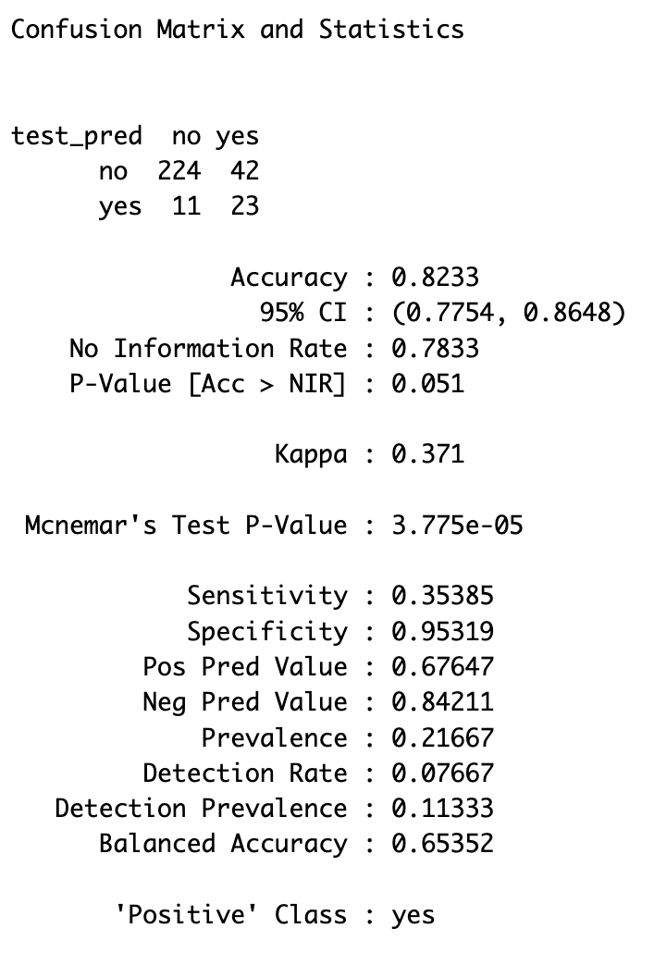
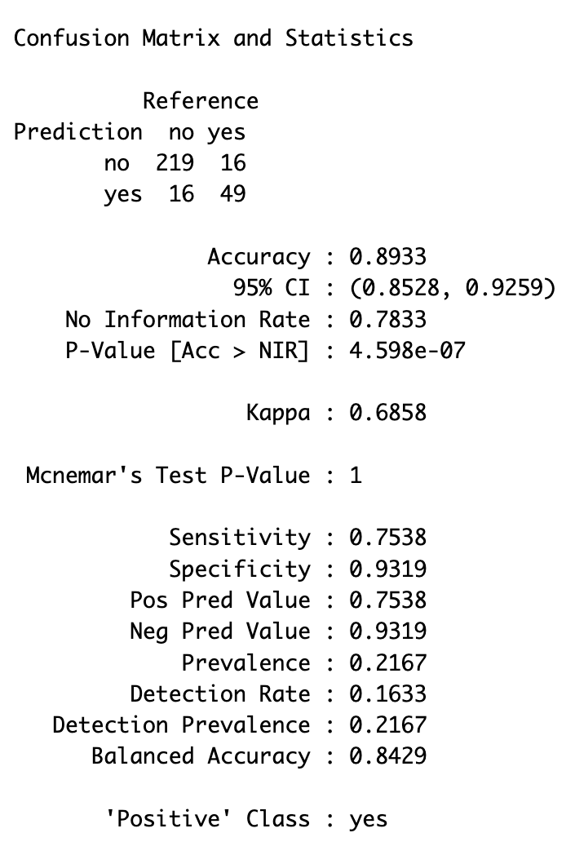
NAÏVE BAYES DECISION TREE (prediction)

Slide 11
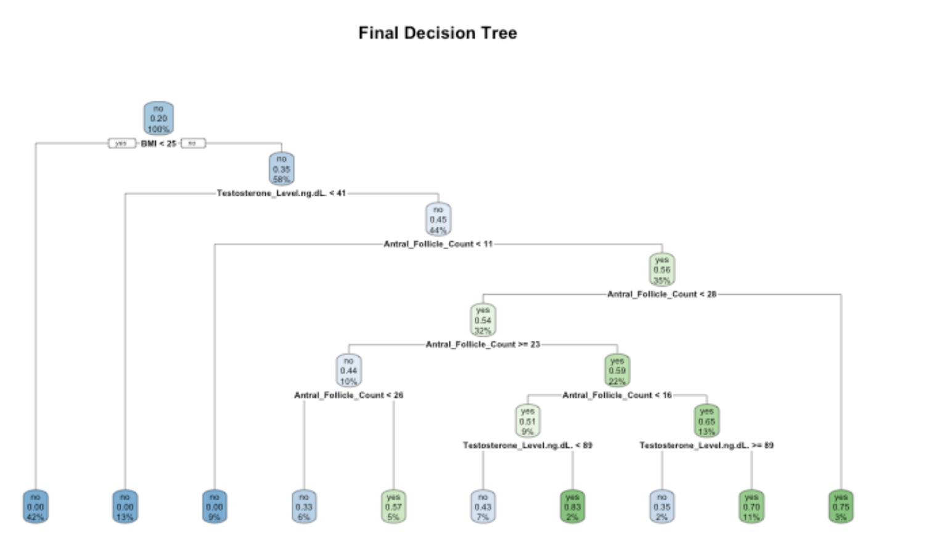
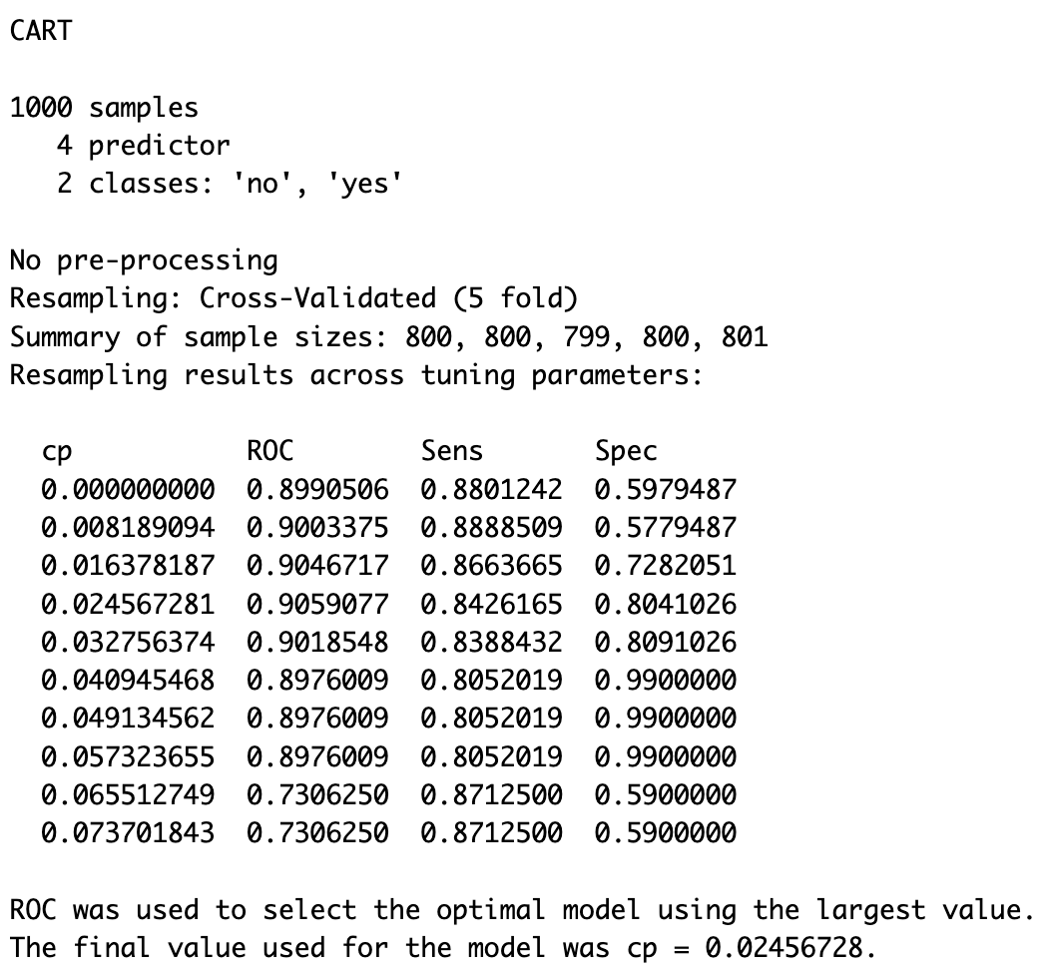
DECISION TREE WITH CROSS-VALIDATION(5FOLD)

Slide 12
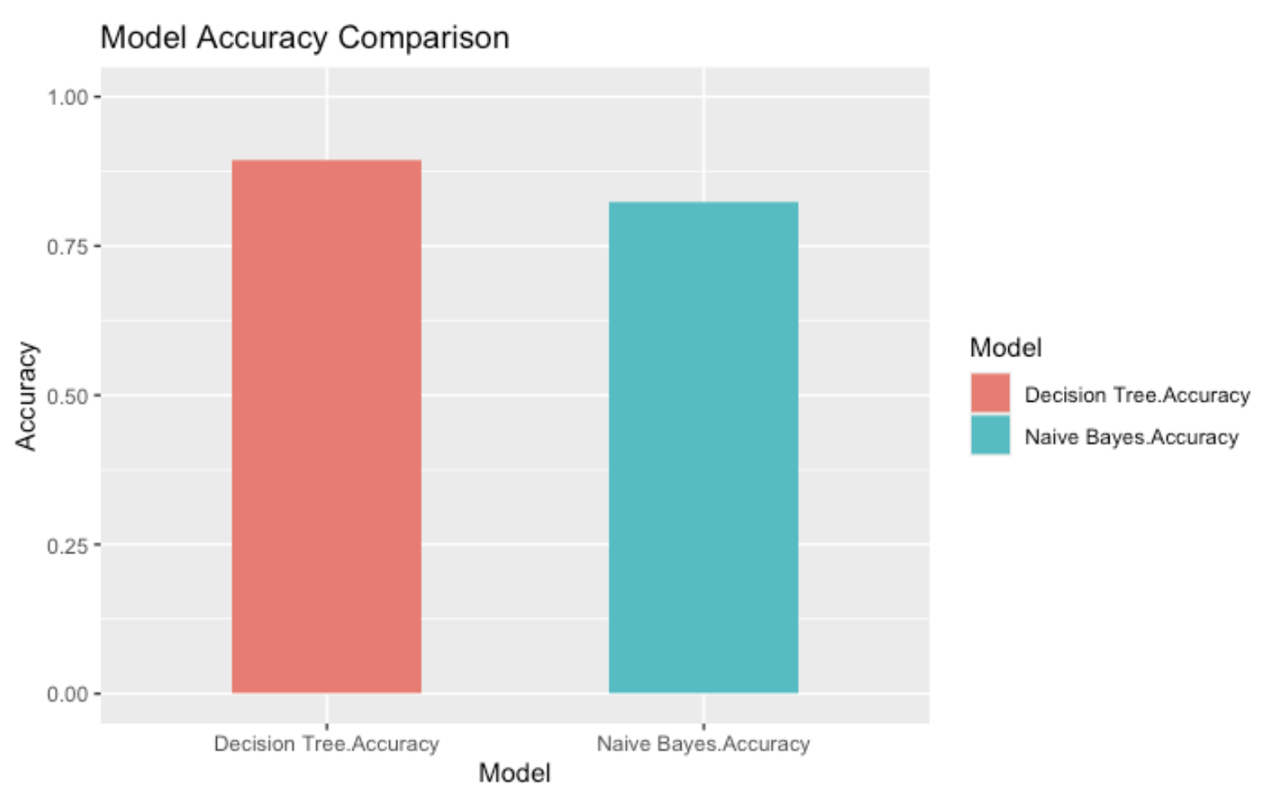

MODEL ACCURACY EVALUATION

Slide 13
DISSCUSSION

Slide 14
NAÏVE BAYES MODEL
ACCURACY: With an accuracy of 82.33%, the Naive Bayes model accuracy was a little less than the Decision Tree model. Naïve Bayes basically assumes that each feature affects the output either its PCOS or not. And since features like follicle count, testosterone, and BMI are interrelated to diagnose PCOS, it may reduce the this models ability to calculate the combined effect of all features
INDEPENDENT FEATURE CALCULATION: this model classified the patients by calculating each feature separately so features such as testosterone level and BMI were calculated separately and considered individual risk. The Naïve Bayes model was therefore unable to predict properly since all features are connected medically.
KEY PREDICTORS: This model had some powerful features like testosterone level and antral follicle count as also seen in the boxplot. due to this they by themselves had a big impact on successful prediction of the model but due to some class imbalance and overlapping feature distributions, this naïve bayes model could not predict more than 35% of true PCOS cases.
LIMITATIONS: The model favored non-PCOS cases due to class imbalance, resulting in high accuracy for non-PCOS but poor detection of actual PCOS cases.

Slide 15
DECISION TREE MODEL
ACCURACY: With an accuracy of 89.33%, the Decision Tree model performed much better than the Naive Bayes model. This is because the Decision Tree can detect complex patterns and relationships between features, like how high testosterone and high BMI together would increase the chance of PCOS.
Feature Spliting: Unlike Naive Bayes, the Decision Tree model does not assume that all features are independent but instead, it chooses that the most useful features to split the data is by building a tree based on important thresholds. This helps the model learn how features connect with each other in a medical dataset.
KEY PREDICTORS: In this model, BMI, antral follicle count, and testosterone level played a big role in classifying the data. And in the tree these were used as decision points that made it separate PCOS and non-PCOS cases clearly.
Improved Sensitivity and Balance: This model did performed better than Naïve bayes for both PCOS and non-PCOS predictions because it had a sensitivity of 75.38% and a specificity of 93.19%. Even in the class imbalance, this model had a balanced accuracy of around 84.29% and a Kappa score of 0.6858 which showed that it was more consistent and reliable.

