Slide 1
Project Title:
Mental Health Prediction
Team Member and Roll No.
DANISH AWASTHI 2210990247
BISMAN DHILLON 2210990230

Slide 2
INDEX
Objective
Introduction
Approach & Technique
Algorithm
Result
Source Code (screenshots)
Conclusion
Reference

Slide 3
OBJECTIVE
The objective of this project is to develop a machine learning model that accurately predicts the risk of mental health conditions, such as depression and anxiety, using data from specified sources, enabling early detection and intervention to improve mental health outcomes and provide actionable insights for healthcare providers. It will predict whether a person has a mental disorder or does not have a mental disorder.

Slide 4
INTRODUCTION
﻿Mental disorders, such as depression and anxiety, significantly impact individuals' well-being and daily functioning. These conditions can lead to severe consequences if not addressed promptly, including impaired social and occupational functioning, and increased risk of comorbidities. Early identification and intervention are vital for mitigating these effects. This project utilizes machine learning to predict mental health issues from various data sources, aiming to enhance early detection, provide timely support, and improve overall mental health outcomes. By analyzing patterns and trends within the data, we hope to offer a proactive approach to mental health care, ultimately contributing to better management and prevention strategies.

Slide 5
APPROACH & TECHNIQUES
1.Matplotlib: Matplotlib is a comprehensive Python library for creating static, animated, and interactive visualizations in data science and machine learning.
2. Scikit-learn: Scikit-learn is a powerful Python library for machine learning, offering tools for data preprocessing, model training, evaluation, and validation.
3. Pandas: Pandas is a versatile Python library for data manipulation and analysis, providing data structures like DataFrames for handling structured data efficiently.
4. Logistic Regression: Logistic Regression will be implemented to predict the probability of diabetes based on the input features.

Slide 6
ALGORITHMS
Data Preprocessing : - Handling Missing Values: Missing values will be imputed using appropriate techniques such as mean, median, or mode imputation.
Feature Selection: - Correlation Analysis: Pearson correlation coefficient will be computed to identify highly correlated features and remove redundant ones.
Model Development: Logistic Regression
Model Evaluation : The models will be evaluated using metrics such as accuracy, precision, recall, F1-score, and confusion matrix to assess their performance in predicting diabetes status.
Implementation: The proposed design and methodology will be implemented using Python programming language and relevant libraries such as scikit-learn, pandas, and matplotlib

Slide 7
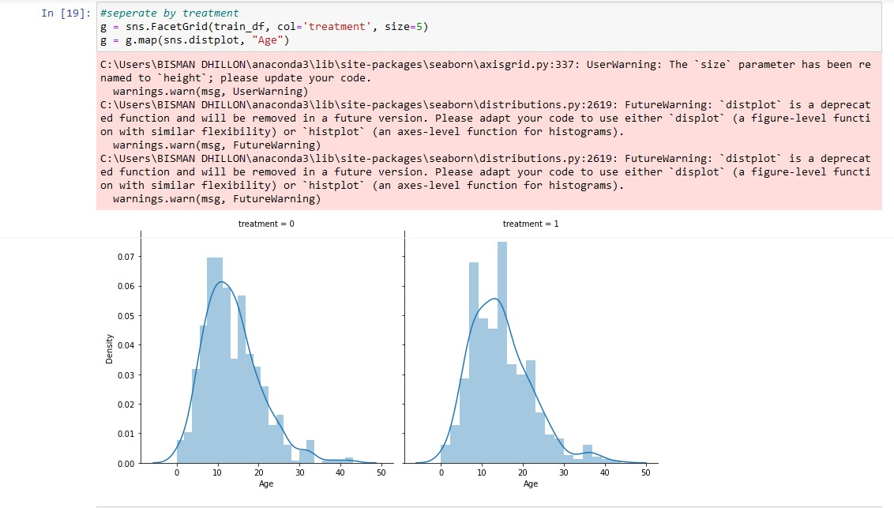
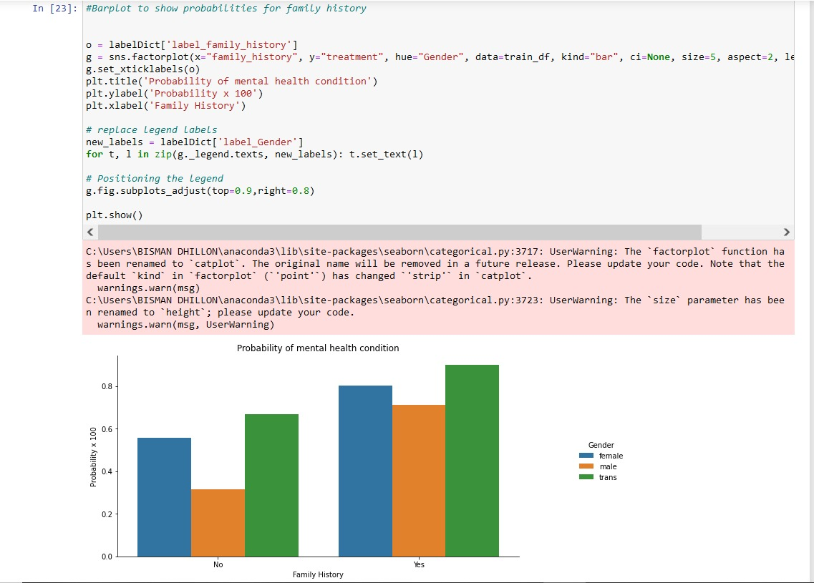
SCREENSHOT

Slide 8
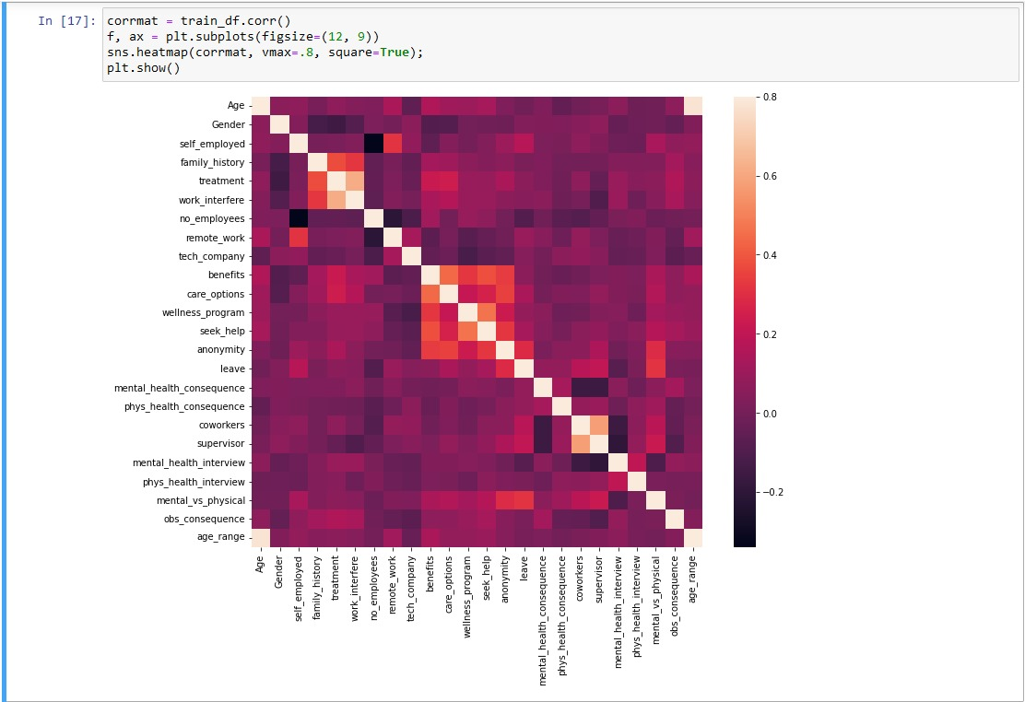
SCREENSHOT

Slide 9
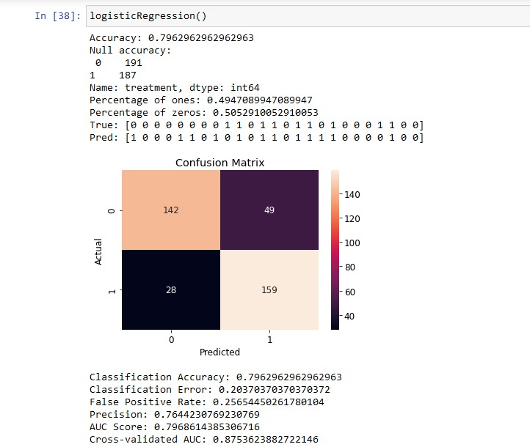
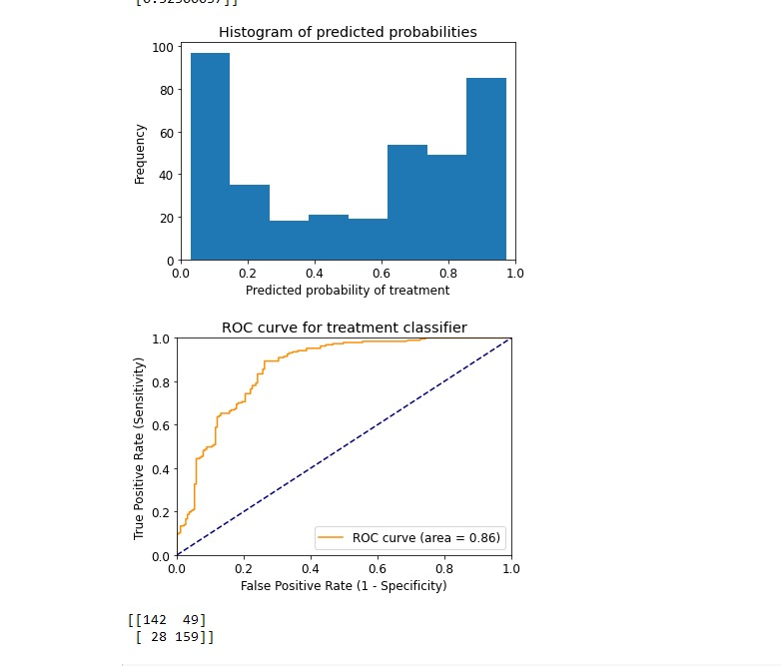
RESULT

Slide 10
CONCLUSION
In conclusion, this project successfully developed a machine learning model using logistic regression to predict mental health conditions like depression and anxiety. By leveraging diverse data sources and employing robust evaluation metrics, we achieved accurate and reliable predictions. This model can aid in early detection and intervention, potentially improving mental health outcomes and providing valuable insights for healthcare providers and support systems. Future work will focus on further enhancing model accuracy and exploring additional data sources.

Slide 11
REFERENCE
https://www.youtube.com/
https://www.geeksforgeeks.org/python-for-machine-learning/?ref=shm

Slide 12
Thank you!

