Slide 1
The BISMark Project:
Broadband Measurements from the Network Gateway
Nick Feamster
Georgia Tech
with Srikanth Sundaresan, Walter de Donato,
Renata Teixeira, Antonio Pescape,
Dave Taht, Sam Crawford

Slide 2
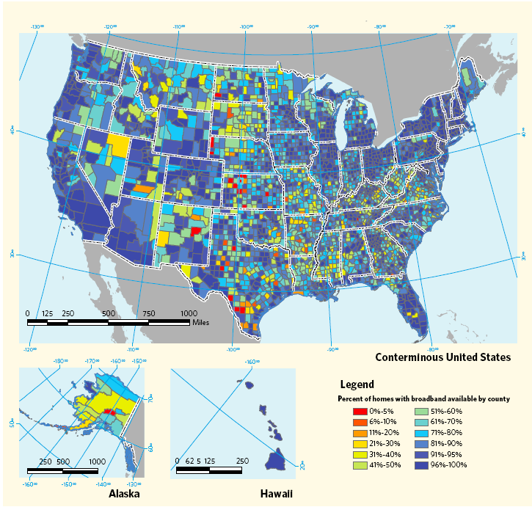
The Network has Come Home
Increasing number of devices connected to the Internet through home
These networks require continual administration to maintain availability and security
We have little understanding of how these networks operate.

Slide 3

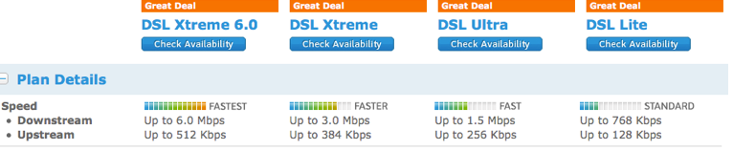
Speeds Are (Reportedly) Increasing

Slide 4
Challenges and Opportunities
Auditing and accountability
  “Am I getting what I’m paying for?”
  Application performance monitoring
Management
  Usage caps
  Debugging performance problems
  Security

Slide 5
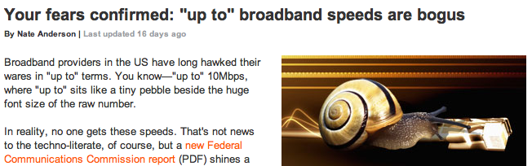
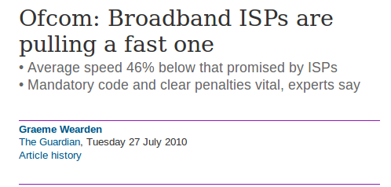
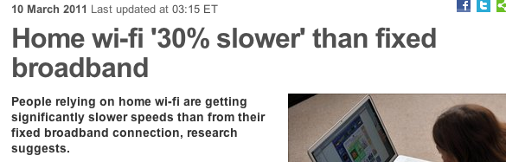
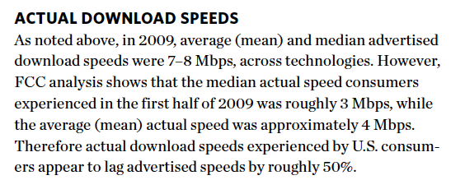
Goal: Improving Home Networks

Slide 6
BISMark Project: Goals
Measuring access link performance
  What factors affect performance?
Measuring application performance
  Study of Web download times
Representing performance to users
  Performance does not just depend on throughput
  What other factors matter?
  How to represent them to users?

Slide 7
Previous Studies
Study from outside
  Dischinger et al. (IMC 2008)
  Problem: Not continuous, not many per user, no view into home
Study from inside
  Grenouille project
  Netalyzr (IMC 2010)
  Problems: Measurements from hosts inside network
    Hard to account for device diversity
    Hard to account for home network characteristics

Slide 8
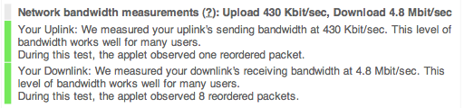
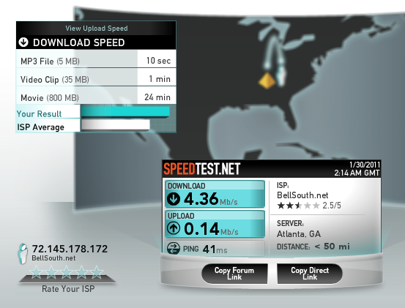
Challenge: Confounding Factors
From Gateway
Downstream | Upstream
5.62 Mbit/s | 452 Kbits/s

Slide 9
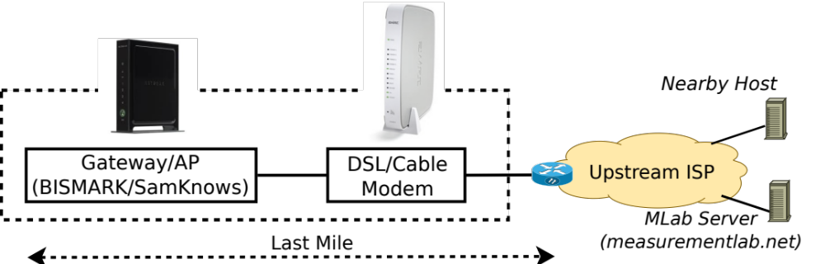
BISMark: A View from the Gateway
Periodic measurements to last mile and end-to-end
Measure directly at the gateway device
Adjust for confounding factors

Slide 10
Why a Gateway?
Observes all traffic passing through network
Can isolate individual factors affecting network performance
  Wireless
  Cross traffic
  Load on measurement host
  End-to-end path
  Configuration and hardware
Can isolate user behavior

Slide 11
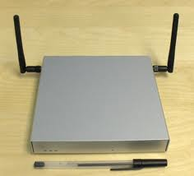
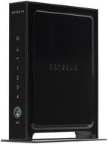
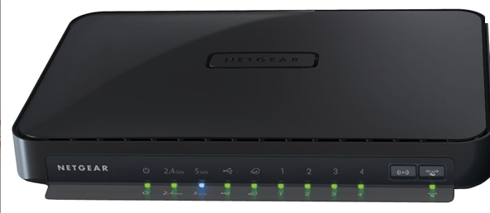
BISMark
Deploy programmable gateways in homes
Deployment
  NOX Box
  NetGear WNDR 3700, others
SamKnows about 10,000 around the U.S.
NoxBox
Netgear 3500L
Netgear WNDR 3700

Slide 12
Initial Deployment
16 boxes deployed
10 in ATT, 4 in Comcast, 2 ClearWire
Most of the deployments within Atlanta
All measurements to server at Georgia Tech

Slide 13
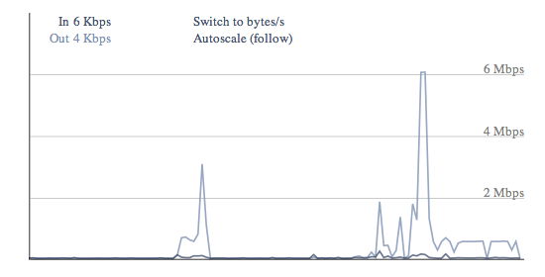
Current Features on Gateway
Guest LAN
Bandwidthd for tracking per-device usage
QoS/Rate limiting
Caching Web proxy
(Soon): Ad Blocking on Proxy

Slide 14
Current BISMark Platform
Custom OpenWRT installation
  Custom measurement/management packages
  http://www.bufferbloat.net/projects/bismark
  Tested on NetGear WNDR 3700
Portal (in development)
Forty boxes planned for initial stage of next deployment
Sign up: Email me (signup on Web site soon)

Slide 15
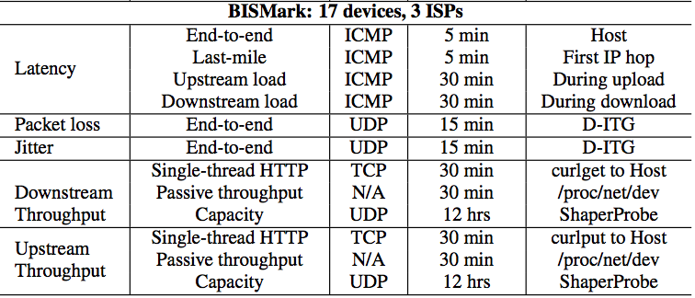
Active Measurements

Slide 16
Results
Throughput
  Depending on how throughput measurements are conducted, they may vary considerably across users
  Different throughput techniques capture different aspects of throughput
Latency
  Latencies vary within the same ISP
  Last-mile latencies are significant
  Modem buffers are too large
  Modifying data transfer using using traffic shaping might mitigate the problem in the short term

Slide 17
Main Takeaways
Buffering introduces latency during uploads
  Applications interact poorly with one another
  Need for better traffic shaping techniques
Latency can vary significantly
  Error correction on DSL can introduce latency
  These affects and interfere with some applications
ISPs use variable traffic shaping across users
  With buffering, can also introduce significant latency

Slide 18
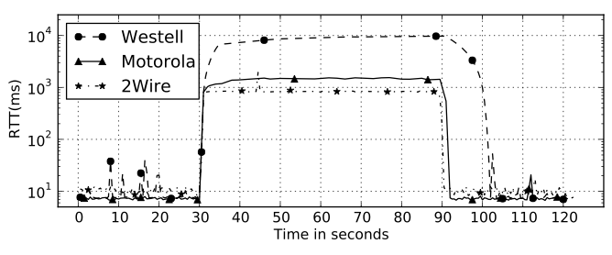
Buffering Is Excessive
Buffering appears in various places along path
Numbers depend on where/how measurements are taken
Westell Modem
Netalyzr
Morotola Modem
BISMark

Slide 19
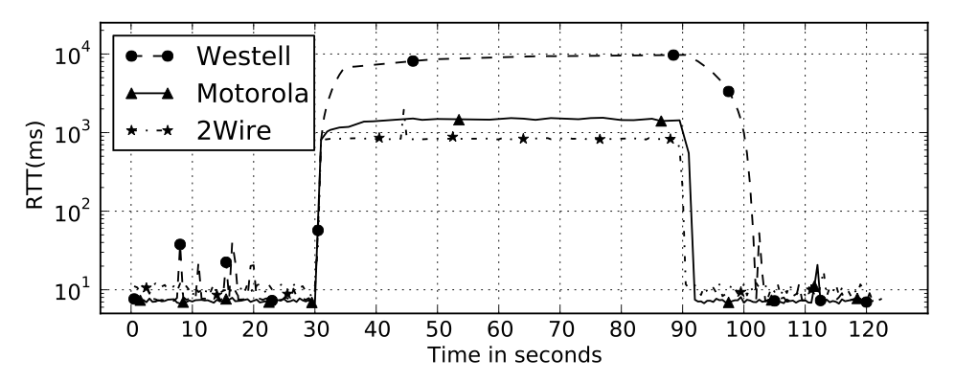
Modem Buffers are Too Large
Buffering in modems can be as high as ten seconds!
Can be empirically modeled with token-bucket filter

Slide 20
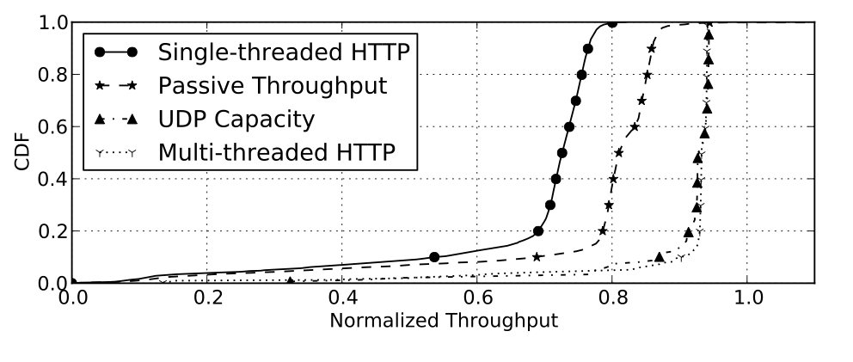
Effect #2: Measurement Technique
Throughput measurements yield variable results
Single-threaded HTTP varies across users/access links (likely due to interleaving)

Slide 21
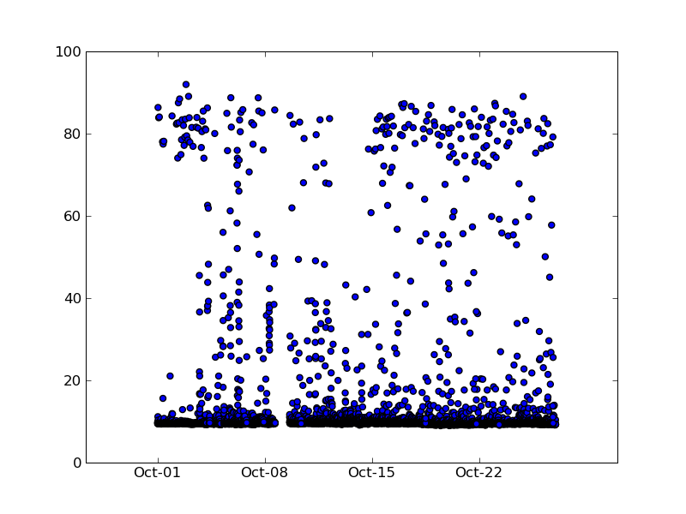
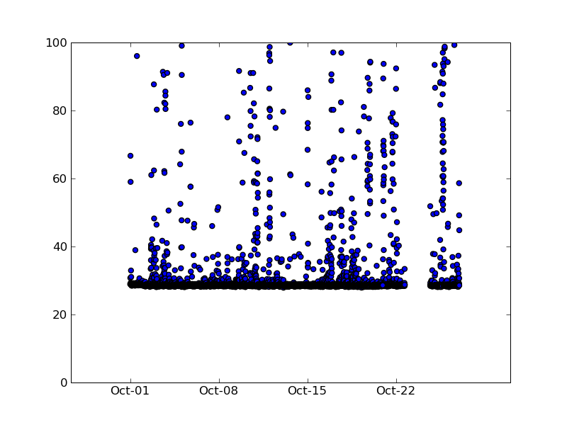
Latency Varies Significantly
RTT(ms)
RTT(ms)
Baselines Different for 2 ATT customers

Slide 22
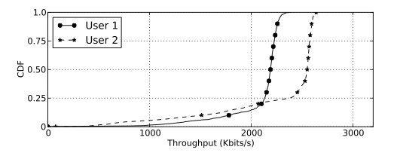
Cause: Interleaving
Interleaving on a DSL link can affect both last-mile latency and throughput
Netalyzr
BISMark

Slide 23
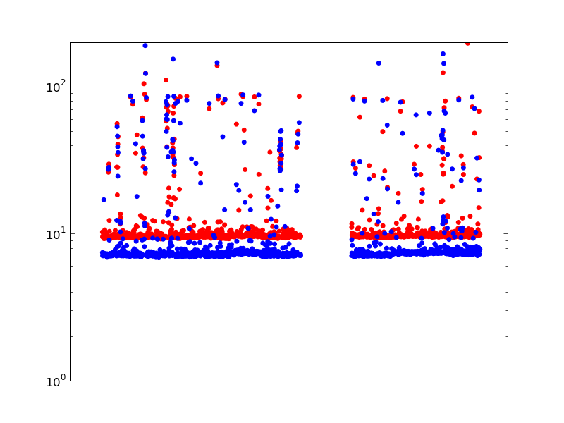
_x0005_Last-Mile Latencies are Significant
All but 2ms comes from last mile
ADSL last mile – 8 to 25ms, WiMAX – ~ 75ms!
End-to-end
latency
Last mile
latency
High correlation (0.95) with end-to-end latency

Slide 24
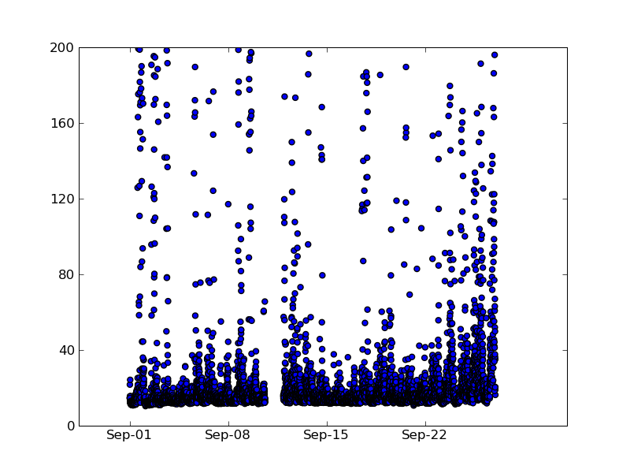
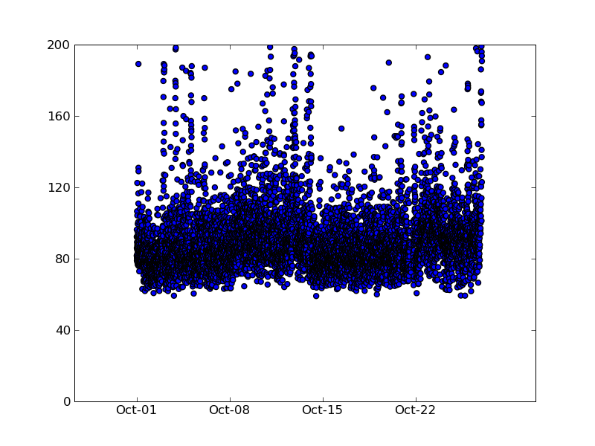
Cause: Access Link Technology
High variation in WiMax and Cable
ADSL latencies are more tightly bound
RTT(ms)
RTT(ms)
Comcast
Clear

Slide 25
Effects of Latency and Loss
Same service plan & ISP, different loss profile
  User 2 has interleaving enabled
User 1 sees more loss, much lower latency

Slide 26


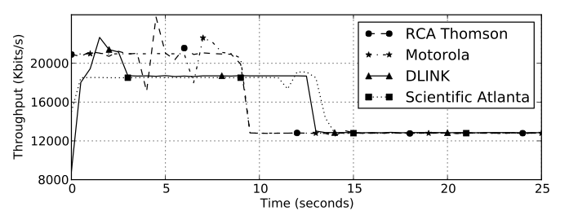
Traffic Shaping is Variable
Different burst magnitudes
Different lengths of time

Slide 27
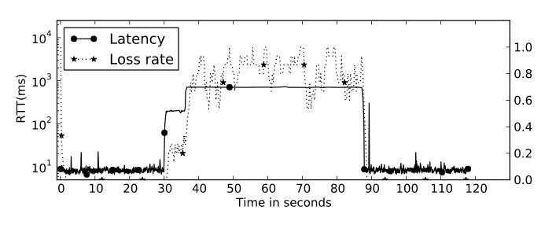
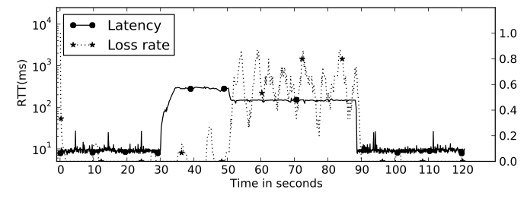
Traffic Shaping Affects Latency
After different periods of time, latency and loss profiles change dramatically

Slide 28
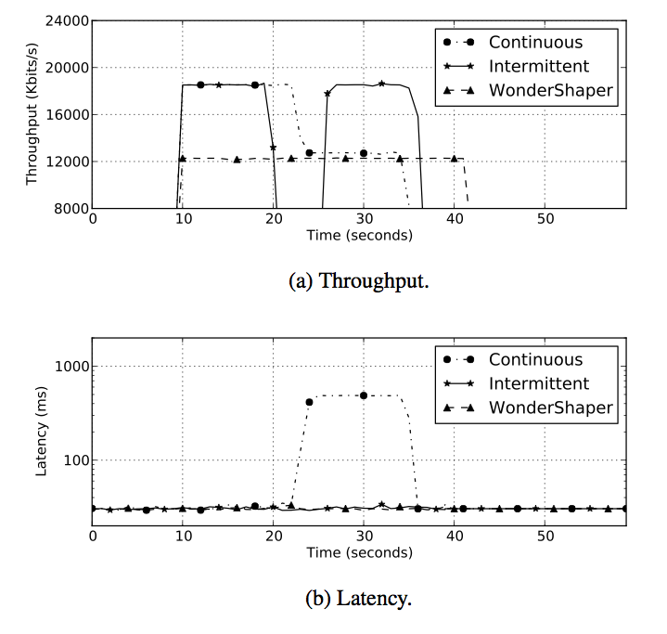
Keeping Latency Under Control
Intermittent or shaped traffic can maintain high throughput without harming latency

Slide 29
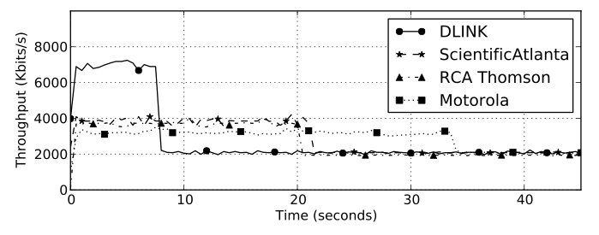
PowerBoost Upload Behavior

Slide 30
Takeaway Lessons
One measurement does not fit all
  Different measurements yield different results
  Different ISPs have different shaping behaviors
One ISP does not fit all
  There is no “best” ISP for all users
  Different users may prefer different ISPs
  There is a need for a “nutrition label”
Home network equipment can significantly affect performance

Slide 31
BISMark Project: Goals
Measuring access link performance
  What factors affect performance?
Measuring application performance
  Study of Web download times
Representing performance to users
  Performance does not just depend on throughput
  What other factors matter?
  How to represent them to users?

Slide 32
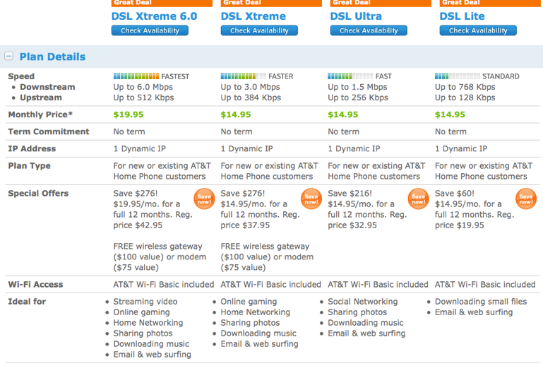

Slide 33
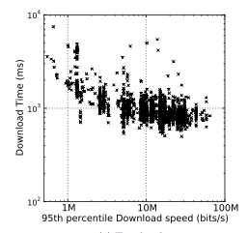
It’s Not (Only) About Throughput
After throughput exceeds about 8 Mbits/s, download time stops improving.
Why? Connection is limited by latency.

Slide 34
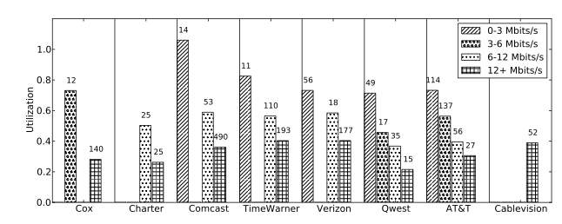
Diminishing Returns of Throughput
As the throughput of the service plan increases, the benefit to download time decreases.

Slide 35
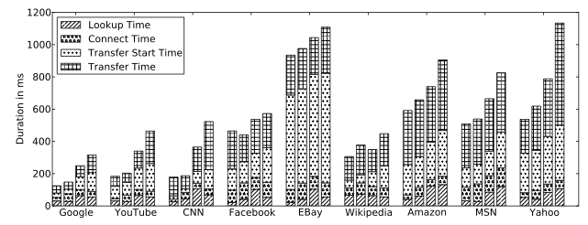
Connection Overhead is Costly
Throughput only helps reduce transfer time
As downstream throughput increases, other components dominate transfer time

Slide 36
Improving Web Performance
Server-side
  Initial congestion window setting
  TCP Fast Open
Client side (old tricks)
  Content caching
  Connection caching
  Prefetching
  Split TCP
???

Slide 37
BISMark Project: Goals
Measuring access link performance
  What factors affect performance?
Measuring application performance
  Study of Web download times
Representing performance to users
  Performance does not just depend on throughput
  What other factors matter?
  How to represent them to users?

Slide 38
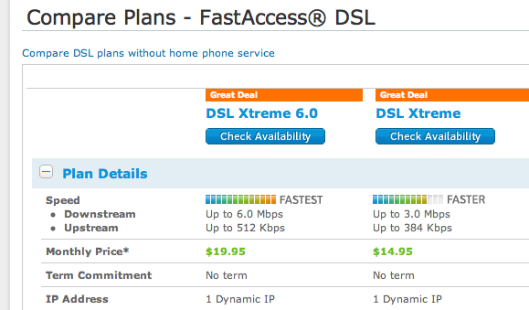
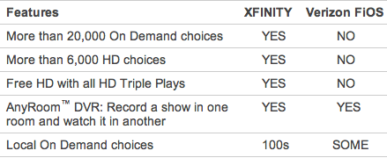
An Internet “Nutrition Label”
Towards performance metrics that are
  Understandable
  Comprehensive
  Accurate
A “nutrition label” for home networks
also with Tony Tang, Beki Grinter, Keith Edwards, Marshini Chetty

Slide 39
Metrics That Matter
Throughput
  Minimum
  Sustainable
  Short-term
Last-mile latency
  Baseline
  Maximum (i.e., under load)
Loss
  Rate
  Burst Length

Slide 40
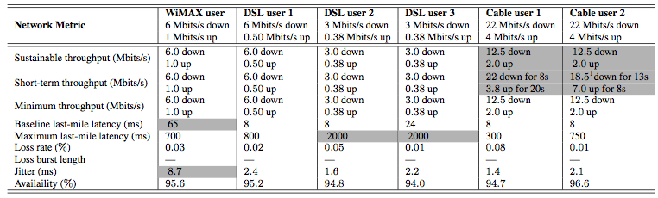
Towards a Nutrition Label
PowerBoost varies across users
Last-mile latency, jitter vary, too

Slide 41
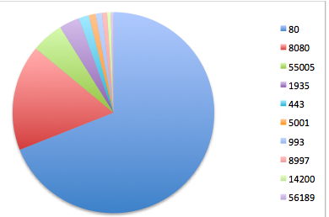
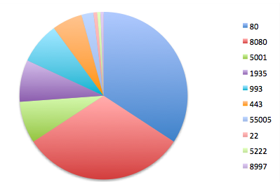
Next Step: Understanding Users
Different users have different usage patterns
What do usage patterns tell us about user behavior?
  Activity within the home
  Use of various applications

Slide 42
How Can Google Help
Could we also measure censorship from these boxes? (Might be tricky.)
Data archival and processing
(a la Measurement Lab)
Gateway deployment
Suggestions for valuable measurements

Slide 43
Conclusion
High-speed Internet access has come home
  Little is known about its performance
  Old problems resurfacing
Measuring the home requires different techniques than conventional measurement
Better measurements will help transparency

