Slide 1
COVID-19 WEBMAP FOR GHANA
Presented by: Bismark Ade
MOTIVATION
DATA AND LIBRARY
FEATURES
FINAL WEBMAP

Slide 2
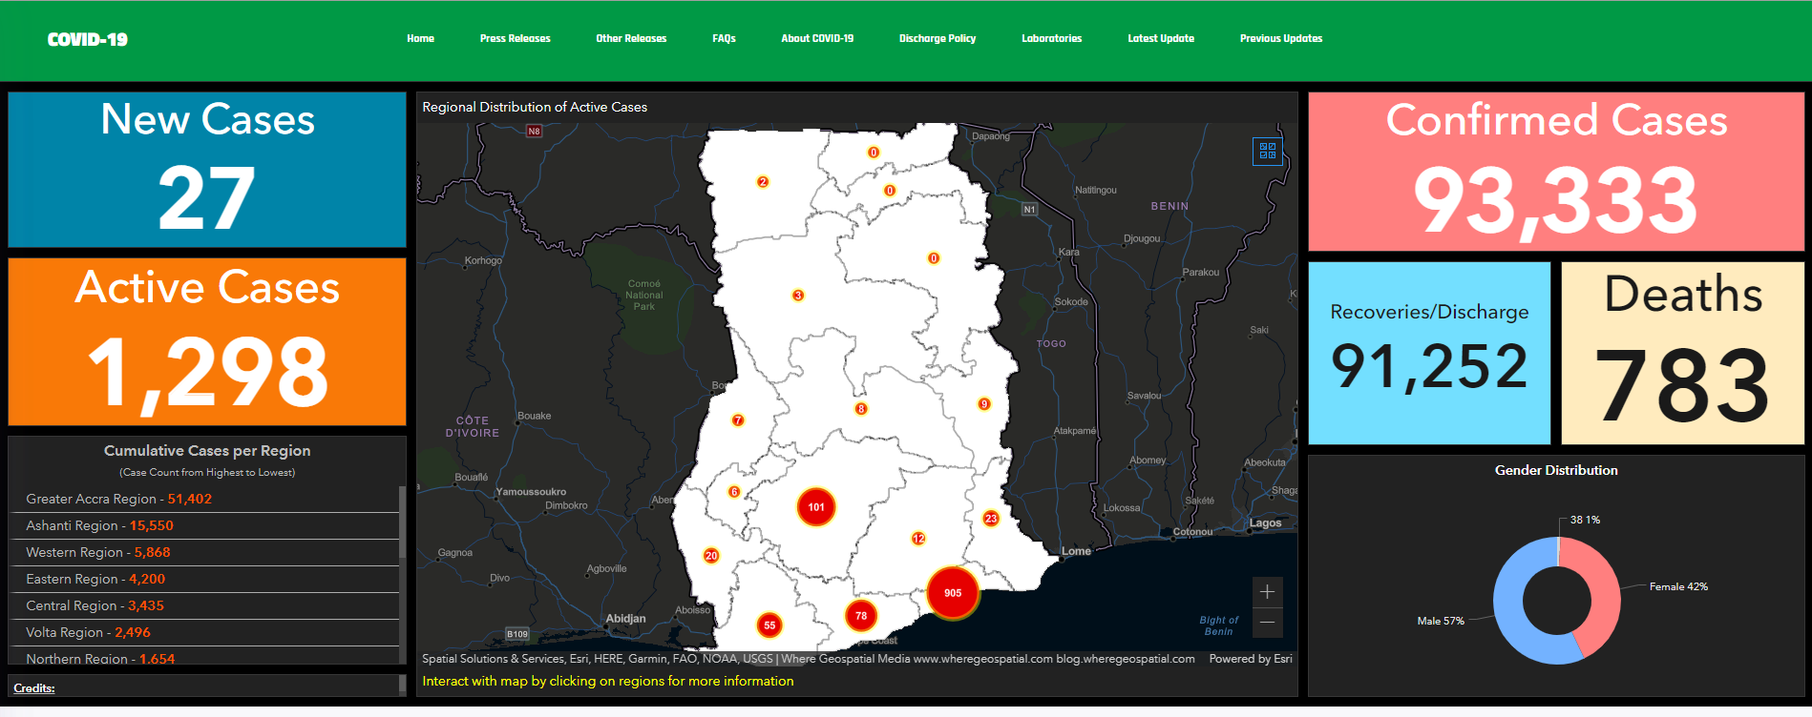
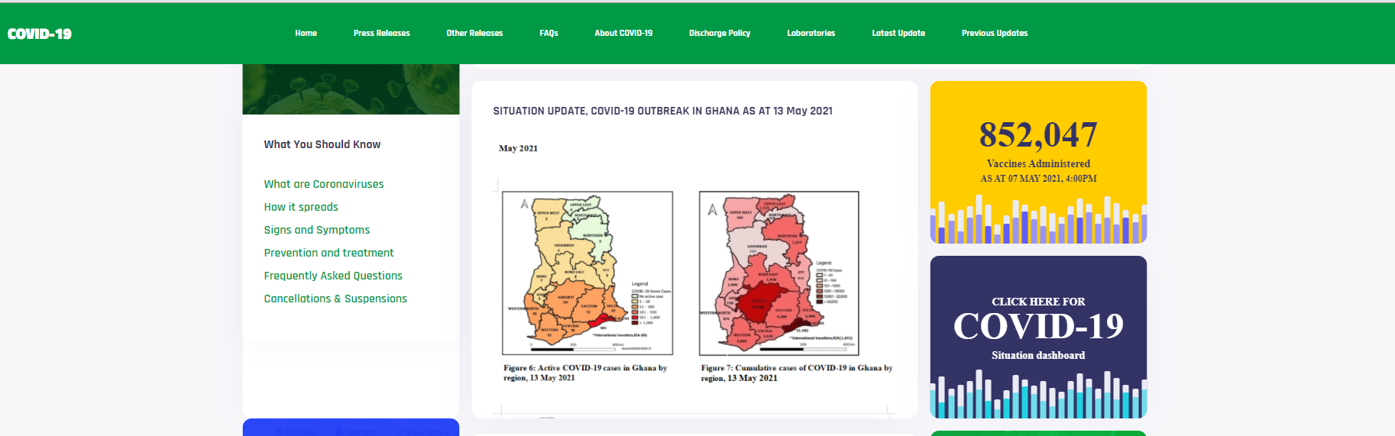
MOTIVATION
COVID-19
COUNTRY SPECIFIC VIZ
HEALTH DISTRIBUTION

Slide 3







WORKFLOW
Data Sources
Data processing
Leaflet
Web-Map
GH-MOH
Layer Groups
Base Maps
Marker Cluster
Choropleth Map
OCHA
Hover
Heath Cluster
Popup
LIVE DEMO

