Slide 1
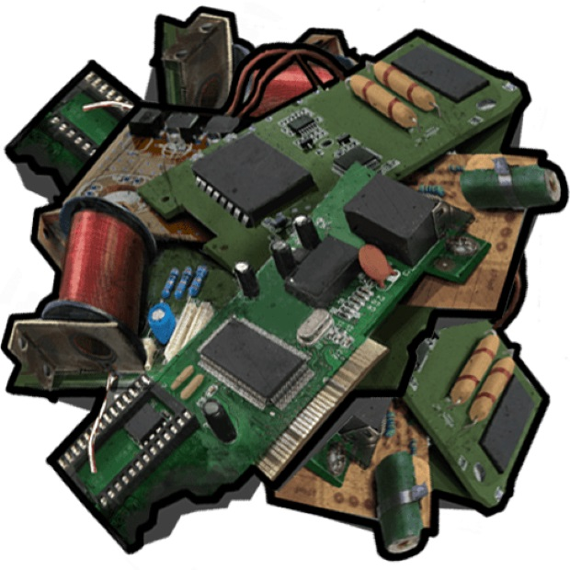
Electric and electronic components
By Savva Popov

Slide 2

What is the difference?

Slide 3
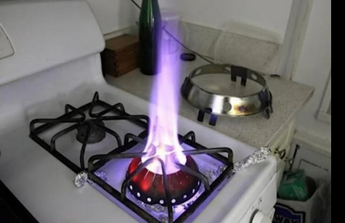
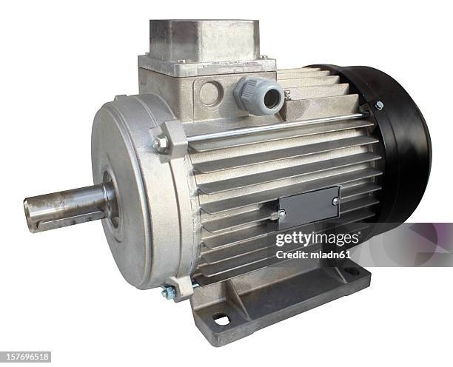
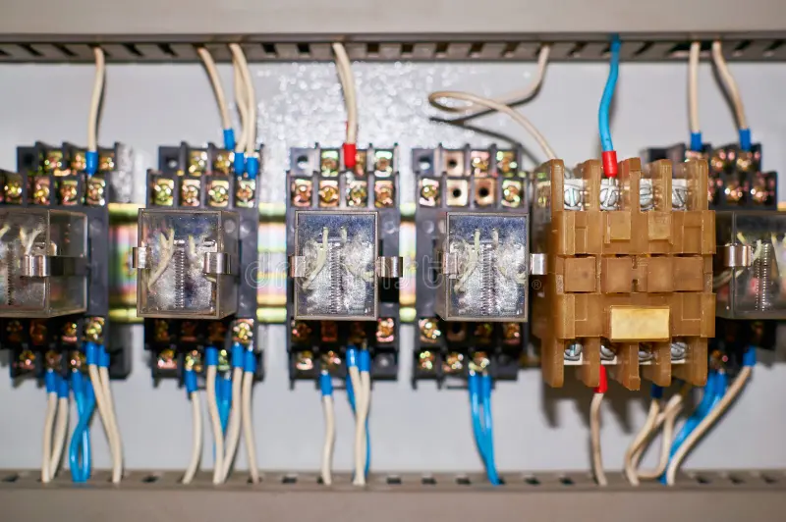

Electric components
Electric components: convert electrical energy into the other form of energy like heat, light, sound, etc
Mainly on AC voltage
High power consumption
Examples: Relays, Transformers, AC motors,
heating elements

Slide 4
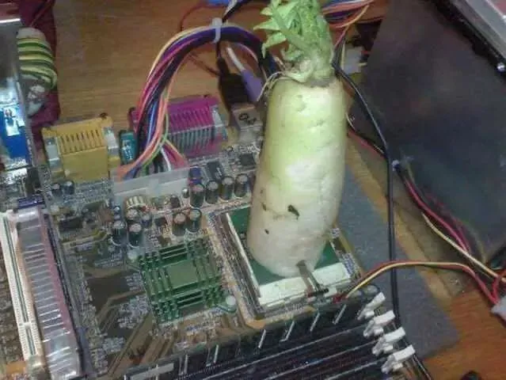
Electronic components
An electronic device is a gadget employing semiconductive elements, such as silicon, germanium, and the like, to facilitate electrical flow and execute specific functions
Mostly DC
Uses electrical energy to complete tasks and processes
Low voltage
Examples: microprocessors, ICs, passive a
nd active components

Slide 5
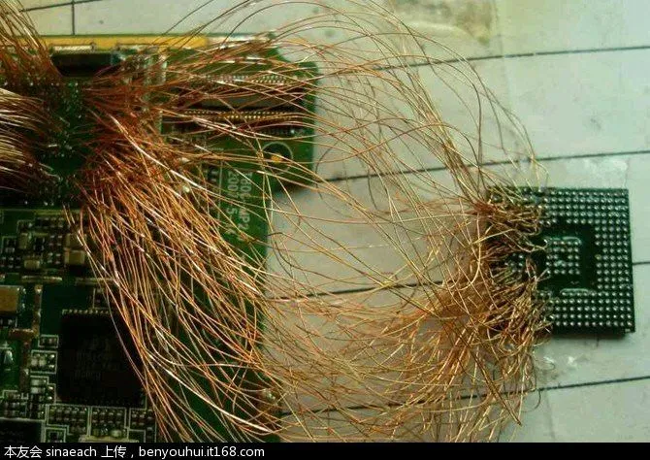
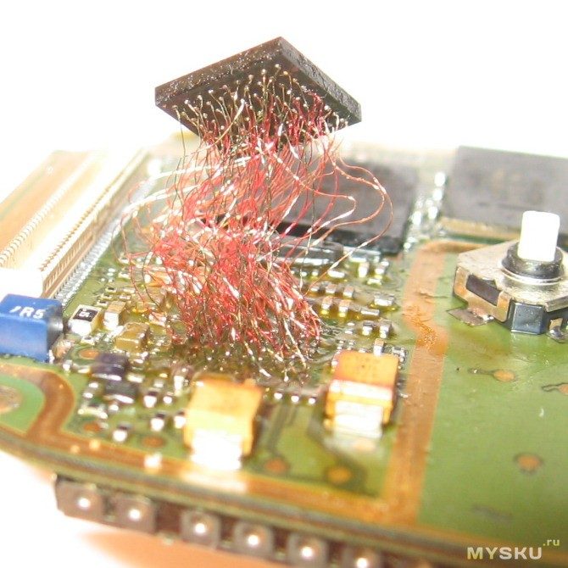
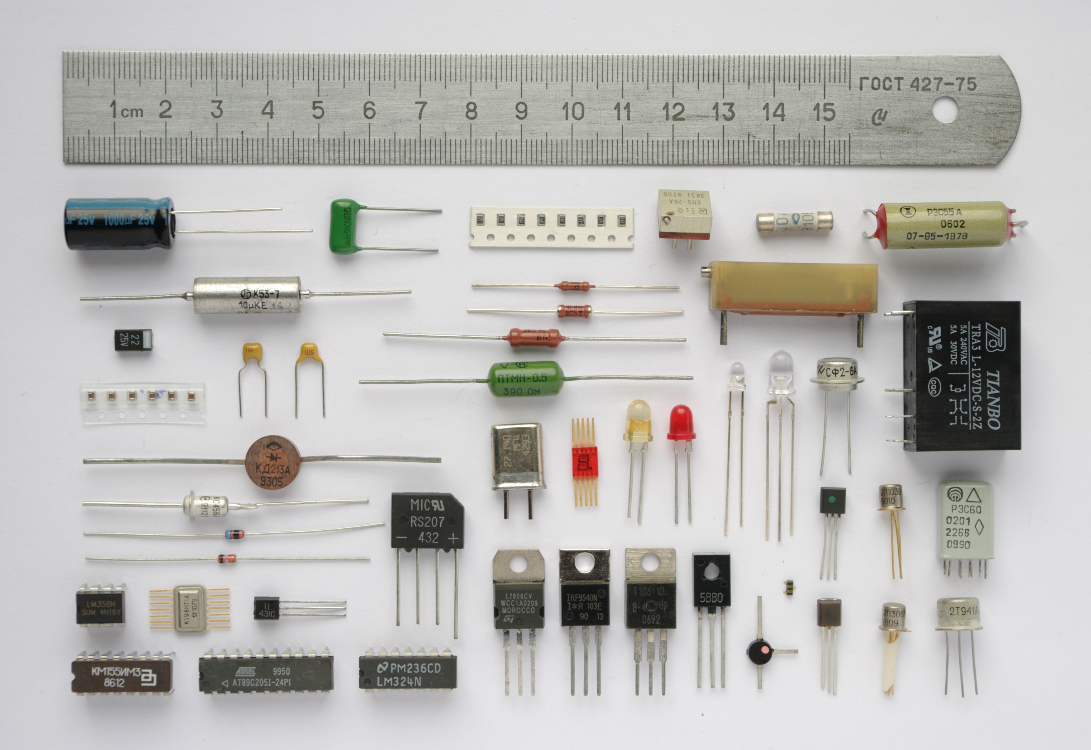
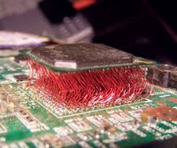
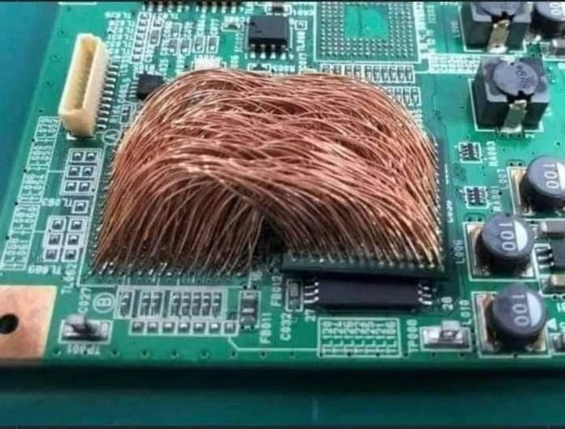
Categorizing electronic components
Passive and active components
ICs and semiconductor devices
Optoelectronics
Piezoelectric components

Slide 6

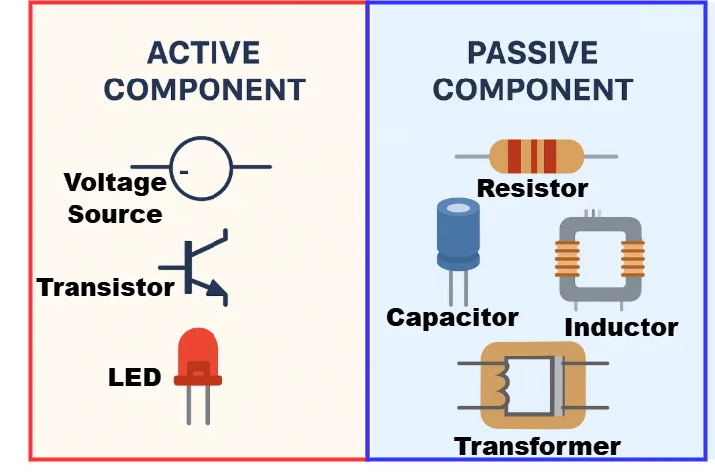
Passive components:
Active components
Resistors
Capacitors
Inductors
Diodes
unipolar and bisexual transistors
lGBT transistors
Amplifiers
LDOs
ADC/DACs
ICs
Optocouplers
Comparators
MCUs

Slide 7
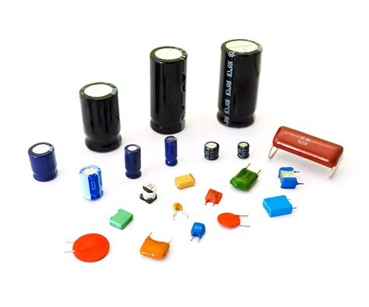
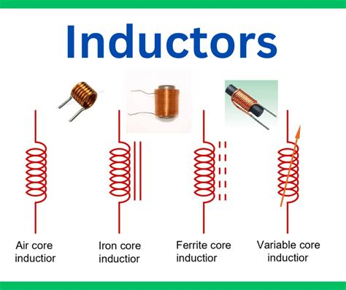
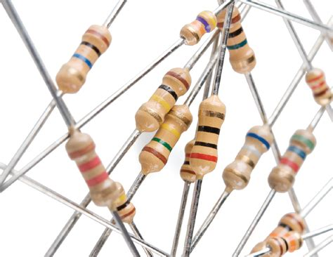
Passive components
Resistors = passive electronic components that limit the flow of electric current in a circuit
Capacitors: device that stores electrical energy by accumulating electric charges on two closely spaced surfaces that are insulated
Inductors: a passive two-terminal electrical component that stores energy in a magnetic field when an electric current flows through it

Slide 8
Active components
Bottom text

Slide 9



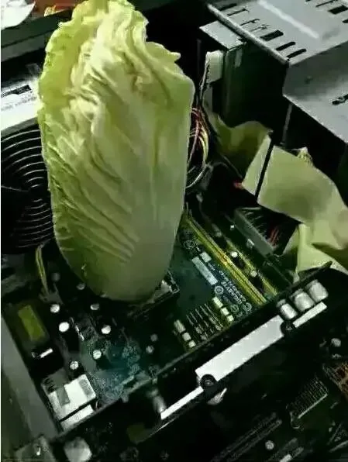


Thank you for watching
best regards,
me

