Slide 1

MORAVIA
Popov, Kollmann, Balcar, Hejný

Slide 2


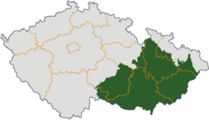


MORAVIA – basic info
East of Czech Republic
Second biggest region of Czech Republic
Population: 3 Million
Area: 22,623.41 km²

Slide 3
BRNO
Second biggest city of Czech Republic

