Slide 1

Meetup- Homesite Quote Conversion Kaggle Challenge
Bismayan Chakrabarti
Data Scientist- airis.DATA

Slide 2
We are Hiring!!
Come talk to us if you are a data scientist/data engineer and want to do some exciting work!

Slide 3

Who am I?
Data Scientist at airis.Data
Basic academic background – Computational Physics
Picked up almost all of my data science machine learning knowledge from the web tutorials/ online courses.
Moral of the Story- If I can pick it up, so can you!

Slide 4
Homesite Quote Conversion Challenge
Link to competition
Kaggle- Great place to test out your skills.
The aim is to predict whether a particular customer will purchase a given quote - Binary (0/1) Classification Problem
The evaluation metric is the “ROC-AUC Score” on the test dataset.
Serious Money to be won (20k for first place)

Slide 5
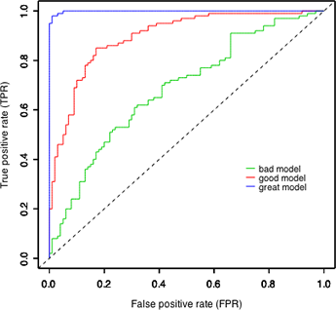
What is the ROC AUC score
In any Binary Classification Task, we can group the classification results
ROC Curve- Plot of the True Positive Rate vs. False Positive Rate.
The AUC score is the area under the curve of the ROC curve.
We ideally want our classifier to have a score of as close to 1.0 as possible.
If our classifier was completely useless, we would get a score of around 0.5 (Random Classification)
Prediction Actual | 0 | 1
0 | True Negative | False Positive
1 | False Negative | True Positive
$$Precision= \frac{TP}{TP+FP}, Recall= \frac{TP}{TP+FN} , F1=\frac{2∗P∗R}{P+R}$$

Slide 6
Let’s get started…
Download all the files from https://github.com/bismayan/meetup_kaggle
Unzip files
Install dependencies:
Jupyter notebook
Numpy
Scikit-learn
Pandas
Matplotlib
Open up Meetup_kaggle.ipynb

Slide 7
Thank You

