Slide 1
Introduction to Sequence to Sequence Networks
Bismayan Chakrabarti
Data Scientist
AirisData Inc.

Slide 2
Why are sequences interesting?
Most standard machine learning tasks deal with unordered data.
The features (columns) that make up a data element (row) have no concept of ordering.
Can freely interchange the order without altering the underlying meaning
e-g- we can save the characteristics of a person as (height, weight) or (weight, height)
In a sequence, order matters so we have to take it into account.
Time series Data- Reversing the order of temperature data would imply global cooling !
Language- “I left her but still she loved me” “I loved her but still she left me”
Life and the universe itself is time-ordered!

Slide 3
Sequence to Sequence Learning- Where one sequence begets another
The comparatively simpler challenge in sequence related machine learning involves producing a single output per input sequence-
Predicting tomorrow’s closing stock price based on last 30 days of data
Predicting the sentiment of an input sentence
Predicting the number of views of a Youtube video
A more complicated problem (Sequence to Sequence Learning) is one in which we have to predict a sequence of outputs based on an input sequence-
Predicting the stock prices for the next fifteen days based on the last 30 days of data
Translating a sentence from English to French
The input and output (predicted) sequences can be sequences of different kinds of data
Speech to text converters
Automatic captioning of Videos

Slide 4
Building blocks of Sequence to Sequence Networks

Slide 5










Recurrent Neural Networks
Normal fully connected neural networks don’t have a concept of order of inputs.
Recurrent Neural Networks were designed to work with ordered data.
We can use either just the final output after the whole sequence has been processed or consider all the intermediate outputs.
$${ y}_{t}$$
$${ y}_{0}$$
$${ y}_{1}$$
$${ y}_{2}$$
$${ y}_{n}$$
RNN
RNN
RNN
RNN
RNN
=
$$x_{t}$$
$$x_{0}$$
$$x_{1}$$
$$x_{2}$$
$$x_{n}$$

Slide 6
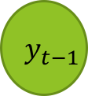


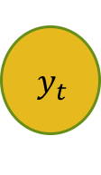
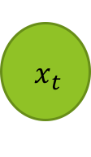
Inside the (basic) RNN Block
$${ y}_{t}$$
Output vector for current timestep
Output vector from previous timestep
$$y_{t−1}$$
$$U$$
+
tanh
$$W$$
$${ x}_{t}$$
Input vector for current timestep

Slide 7


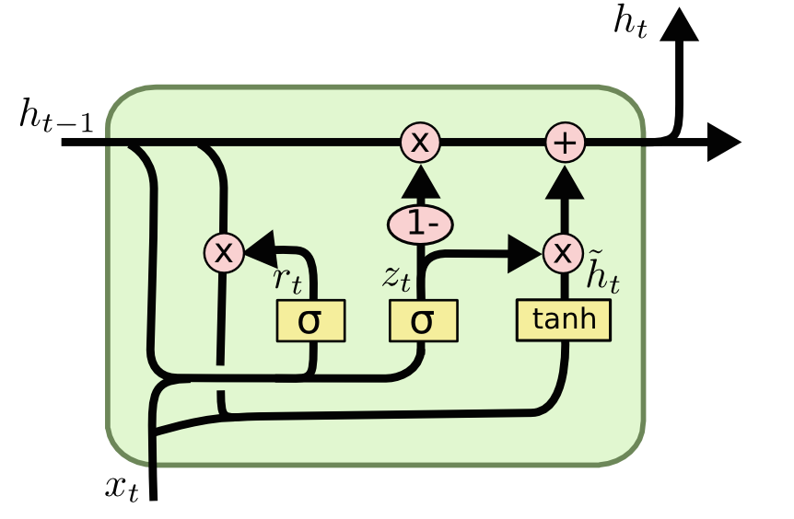








Improvements to the simple RNN
The simple RNN described earlier has problems with long term memory due to the Vanishing Gradients problem
In order to address this GRU and LSTM were developed as improvements.
$$y_{t}$$
$${ y}_{t}$$
$$y_{t−1}$$
$$c_{t−1}$$
$${ c}_{t}$$
$$y_{t−1}$$
$$x_{t}$$
$${ x}_{t}$$

Slide 8
Vector Embedding of Words/ Entities
How do we pass in the inputs to the RNN?
In case the sequence is numeric, we can pass in the data as is (vectors of length 1)
In the case of categorical/ natural language data, we need a way to represent each unit numerically.
Each unique word/ character/ categorical level is first given a unique numeric ID (Tokenization)
For each numeric ID, we then represent it as a unique vector of numbers – Embeddings
These Embeddings can either be learned as part of the network, or pre-trained embeddings can used from other networks trained on same data (transfer learning)
Input Element
Vector of Numbers representing Element

Slide 9


The Embedding Process (NLP example)
Input Sequence
Tokenized Sequence
Embedding Lookup
Embedded Sequence
my
12
Embedding
Matrix
Embedding Row 12
name
56
Embedding Row 56
$$N_{words}$$
32
Embedding Row 32
is
Embedding Row 72
tom
72
$$N_{embed}$$

Slide 10
Putting the blocks together :Sequence to Sequence learning
Broadly speaking, Sequence to sequence architecture can be summarized as
Output
RNN
Output
Seq
Vector Representation of Input Sequence
DECODER
Input
Seq
Input
RNN
ENCODER

Slide 11










A More In-Depth View
$$y_{0}$$
$$y_{1}$$
$$y_{2}$$
$$y_{3}$$
Projection
Projection
Projection
Projection
RNN 2
RNN 2
RNN 2
RNN 2
ENCODER
Embedding
Embedding
Embedding
Embedding
RNN 1
RNN 1
RNN 1
S
$$y_{0}$$
$$y_{1}$$
$$y_{2}$$
Embedding
Embedding
Embedding
DECODER
$$x_{0}$$
$$x_{1}$$
$$x_{2}$$

Slide 12
Example- A translator
les
pommes
sont
rouges
Projection
Projection
Projection
Projection
RNN 2
RNN 2
RNN 2
RNN 2
ENCODER
Embedding
Embedding
Embedding
Embedding
RNN 1
RNN 1
RNN 1
S
les
pommes
sont
Embedding
Embedding
Embedding
DECODER
apples
are
red

Slide 13
Inside the Projector- a One layer Neural Net
Take Most Probable element (y)
Probabilities for each element in the Vocabulary
W_{P}
RNN Output Vector

Slide 14
Teacher Forcing- Making Training Better
In the earlier slide we saw that in the Decoder, we use the predictions of previous time step as inputs of the current timestep
However this is usually not ideal for training,
One error in the middle can make the rest of the training sequence meaningless as we will be learning based on the wrong sequence after that
The usual solution is teacher forcing
During training we instead use the actual elements of the output sequence as inputs to the Decoder
During Inference however since we don’t have access to the actual outputs, we revert to the non-teacher forced approach.
Can dramatically speed up training, especially initially

Slide 15



Teacher Forcing in Detail
$$y_{0}$$
$$y_{1}$$
$$y_{2}$$
$$y_{3}$$
Projection
Projection
Projection
Projection
RNN 2
RNN 2
RNN 2
RNN 2
Embedding
Embedding
Embedding
Embedding
RNN 1
RNN 1
RNN 1
S
$$Y_{0}$$
$$Y_{1}$$
$$Y_{2}$$
Embedding
Embedding
Embedding
$$x_{0}$$
$$x_{1}$$
$$x_{2}$$

Slide 16
Some Applications of Sequence to Sequence Learning
Application | Example Input Sequence | Example Output Sequence
Neural Translation | Words of English sentence | Words of French sentence
Automatic Summarization | Words of input text to be summarized | Words of Summary of text
Speech to text | Input audio sample snippets | Words/ characters of text
Automatic Video Captioning | Input frames of Images (CNN Embedding) | Words of the generated Caption

Slide 17
Problems of Current approach and Improvements
Some Major drawbacks of current approach-
Single vector transferring information between the Encoder and the Decoder is a huge bottleneck
The Decoder predictions are greedy and might not produce the best overall output sequence
Single Encoder/Decoder RNN might not be enough to capture complex sequence properties
Improvements
Attention Mechanism- Addresses information bottleneck problem
Beam Search- Addresses greedy decoding problem
Multi RNN layer Encoder Decoder Networks
Bidirectional Encoders- Employ 2 RNNs in Encoder. One looks at normal forward input sequence while other looks at reversed sequence . Outputs are then combined
Batch Normalization- Ensures every mini batch of data is normalized to have similar mean and variance. Helps with training a lot.

Slide 18
Where to Learn More
Andrew Ng’s course on Coursera- Course 5 of deep learning specialization
Fast.ai MOOC (2017 lectures for Keras/ Tensorflow)
Natural Language Processing course on Coursera (Course 3 of Advanced Machine Learning Specialization by Higher School of Economics, National Research University)
Tutorials on sequence to sequence learning in Tensorflow/ Pytorch Tutorials
Books on Deep Learning
Deep Leaning in Python by Francois Chollet
Hands on Machine Learning with Scikit-Learn and TensorFlow- Aurelion Geron
Deep Learning- Courville, GoodFellow and Bengio
Blogs, Research papers, Youtube

Slide 19
Hands On session

Slide 20
While we wait…
Clone github repository for the meetup - https://github.com/bismayan/meetup_seq2seq.git
Install all the libraries in the README file, if you don’t have them
The presentation we will be going through first is in the repository
Once you have your environment set up, open the meetup_v1.ipynb notebook and check if import statements work. (Don’t need to run other cells just yet)

