Slide 1

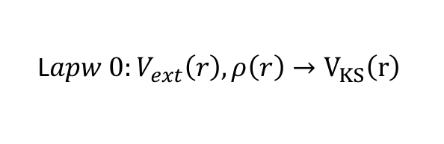
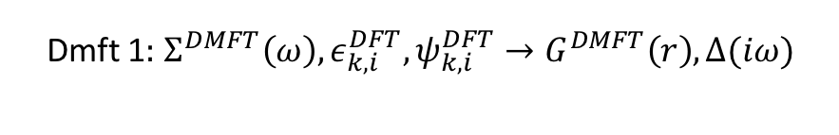

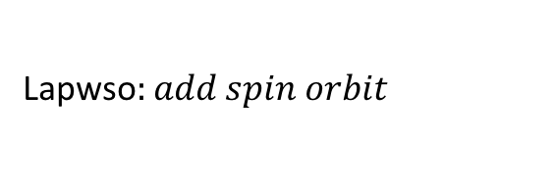
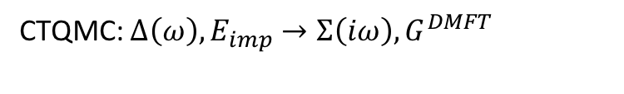
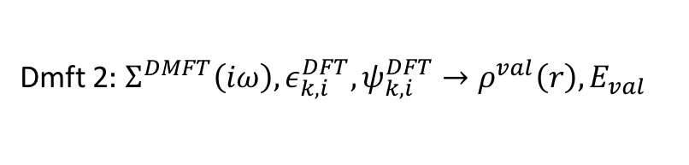
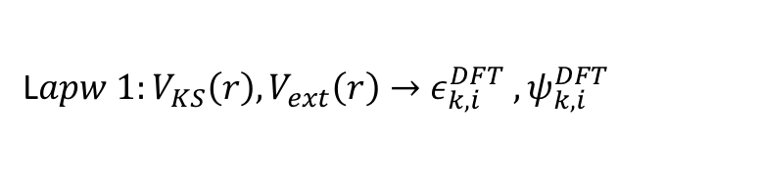
L$apw 0:V_{ext}\left(r\right), ρ\left(r\right)→V_{KS}\left(r\right)$
Mixer$:ρ^{val}+ρ^{core}, ρ^{old}\left(r\right)→ρ^{new}\left(r\right)$
L$apw 1:V_{KS}\left(r\right), V_{ext}\left(r\right)→ε_{k,i }^{DFT} , ψ_{k,i }^{DFT}$
charge self consistency Loop
core$:V_{KS}\left(r\right)V_{ext}\left(r\right)→ρ_{core}\left(r\right), E_{core}$
Lapwso$:add spin orbit$
Dmft 2$:$ $Σ^{DMFT}\left(iω\right),ε_{k,i }^{DFT},ψ_{k,i }^{DFT}→ρ^{val}\left(r\right),E_{val}$
Dmft 1$:$ $Σ^{DMFT}\left(ω\right),ε_{k,i }^{DFT},ψ_{k,i }^{DFT}→G^{DMFT}\left(r\right), Δ(iω)$
impurity solver loop
CTQMC: $Δ\left(ω\right), E_{imp}→Σ\left(iω\right), G^{DMFT}$

