Slide 1
Smart Mask Inhaler System
Using Oxygen + Medical Puff with Arduino Controller
Presented by:

Slide 2
Introduction
A wearable smart mask designed for asthma patients.
Provides automatic oxygen supply and inhaler puff during emergencies.

Slide 3
Objective
Provide quick relief during asthma attacks
Automate inhaler usage
Monitor health continuously

Slide 4
Components Used
Arduino Uno
Oxygen mask
Inhaler (puff)
Solenoid valve
Relay module
SpO2 & Heart rate sensor
Battery

Slide 5
System Architecture
Sensors → Arduino → Relay → Oxygen Valve & Inhaler
Optional: Bluetooth → Mobile App

Slide 6
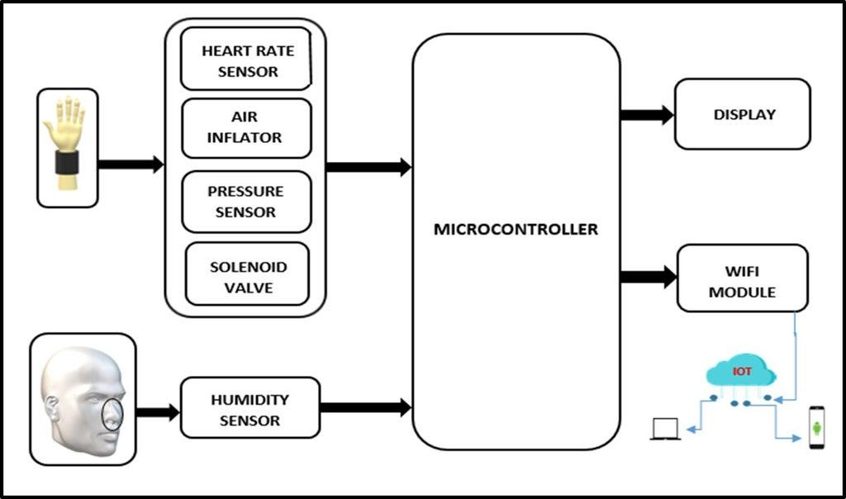

Slide 7
Working Principle
User wears mask
Sensors monitor SpO2 & heart rate
If abnormal condition detected
Inhaler activated automatically

Slide 8
Advantages
Fast response in emergency
Hands-free operation
Portable design
Continuous monitoring

Slide 9
Challenges
Sensor accuracy
Safe oxygen control
Proper dosage of inhaler
Battery life

Slide 10
Future Scope
Use ESP32 for IoT
Mobile app integration
AI prediction of asthma attacks
Compact design improvements

Slide 11
Conclusion
Smart mask inhaler improves safety and provides immediate relief.
Useful for asthma patients in emergencies.

