Slide 1

Building and Deploying Serverless AI on AWS Cloud

Slide 2
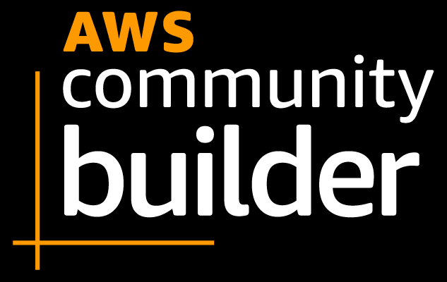
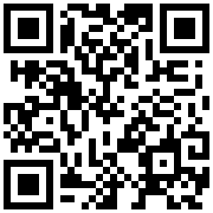
About me
I’m Bismillah Kani
AWS Community Builder - Machine Learning
Staff AI/ML Scientist at Waygate Technologies (GE Inspection)

Slide 3
Agenda
SAM – Serverless Application Model
Deploy AI models using SAM
Sagemaker Serverless

Slide 4

Serverless Application Model - SAM
The AWS Serverless Application Model (AWS SAM) is a framework built to facilitate the development and deployment of serverless applications on AWS.
It is an open-source tool that aims to streamline the building and management of resources, effectively minimizing the typical complexities found in traditional architectures.

Slide 5
Serverless Application Model - SAM
SAM Templates
configuration files, written in YAML or JSON, serve as blueprints for the resources utilized in your AWS serverless application. They extend the functionality of AWS CloudFormation templates and offer a simplified syntax for defining serverless resources like Lambda functions, API Gateway APIs, and DynamoDB tables.
SAM Command Line Interface
The SAM CLI plays a crucial role in facilitating local development and testing of serverless applications.
It offers a comprehensive set of commands that cover all stages of the development lifecycle, enabling tasks such as local debugging and deploying code to the AWS cloud.

Slide 6
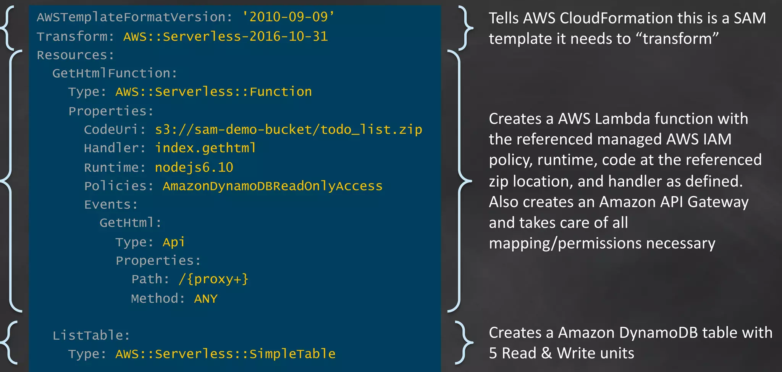
SAM Template

Slide 7
SAM serverless resources
AWS::Serverless::Api
AWS::Serverless::Application
AWS::Serverless::Connector
AWS::Serverless::Function
AWS::Serverless::GraphQLApi
AWS::Serverless::HttpApi
AWS::Serverless::LayerVersion
AWS::Serverless::SimpleTable
AWS::Serverless::StateMachine

Slide 8
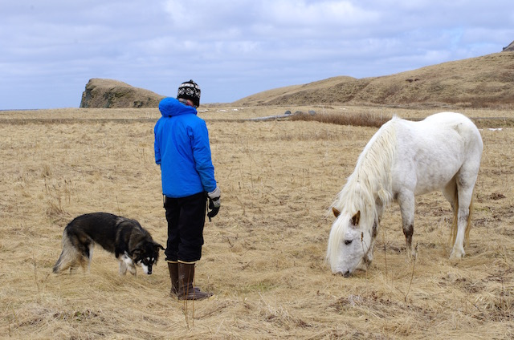
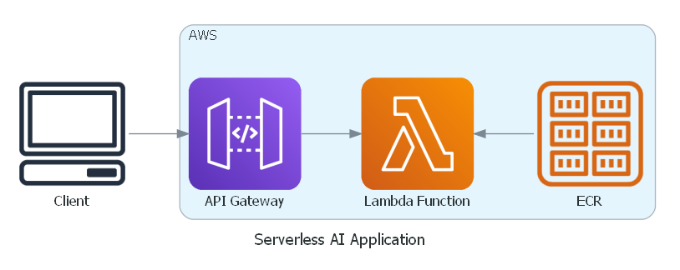
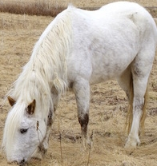
Deploy AI model using SAM
CLIP CROP
“horse”
https://github.com/vijishmadhavan/Crop-CLIP#Simple-App

Slide 9

Sagemaker Serverless
Sagemaker inference types:
Real-time Inference - for inference workloads where you have real-time, interactive, low latency requirements.
Batch Transform - get inferences from large datasets.
Asynchronous Inference - that queues incoming requests and processes them asynchronously. Near real-time.
Serverless Inference - is ideal for workloads which have idle periods between traffic spurts and can tolerate cold starts.

Slide 10
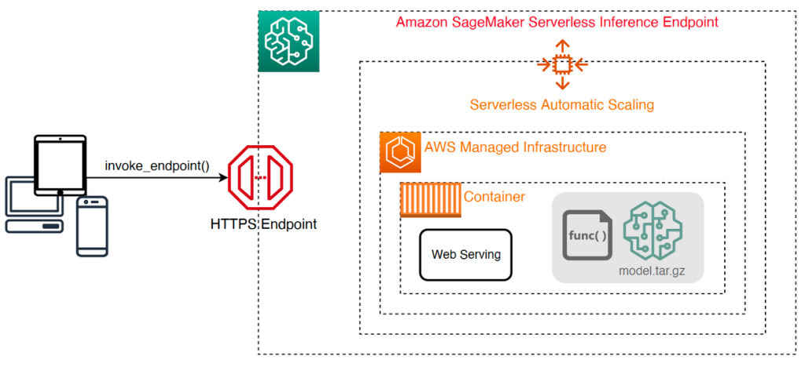
Sagemaker Serverless

Slide 11
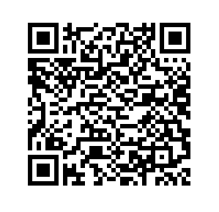
AWS Skill Builder – Free Learning Content
Access 600+ Free Digital Courses with AWS Skill Builder
Focus on the cloud skills and services that are most relevant to you across 30+ AWS solutions, including digital self-paced learning plans and Ramp-Up Guides.
Build your future in the AWS Cloud at your own pace
Validate your cloud expertise with AWS Certification.
Visit explore.skillbuilder.aws

Slide 12
Earning AWS Learning Badges
Earn digital badges to share your AWS knowledge and skills
AWS digital badges are shareable on social networks to help you stand out to recruiters and prospective hiring managers
AWS digital badges are free to earn and share
Register
Register for a free AWS Skill Builder Account
(explore.skillbuilder.aws)
Enroll
Enroll in select learning plans that offer a digital badge upon passing the corresponding assessment.
Earn
Complete the assessment associated with the learning plan with at least 80% score
Claim
Create a Credly account to claim your digital badge

