Slide 1

Online Admission System
Presented
By
Bisnu Chandra Sarkar
ID: 16CSE039
Dept. of CSE, BSMRSTU
Supervised
By
Md. Akkas Ali
Assistant Professor
And Chairman
Dept. of CSE,BSMRSTU

Slide 2
Presentation Outlines
Introduction
Related Works
Objectives
Methodology
Implementing tools
Implementation
Conclusion
Future Work
References

Slide 3
INTRODUCTION
The main objective of Online admission system application is getting admission and see the admission status through online.
It will be helpful to inspiring the admission system to be online.

Slide 4
Related Works
Online hotel booking.
Online Examination System.
Onine book store

Slide 5
OBJECTIVES
To make admission system easier for users.
Saving time and energy of users.
Make the system much more authentic.

Slide 6
METHODOLOGY
start
(User Flow Chart)
Admission
Personal informatin already given
Yes
Complete payment
No
Enter transaction Id
Give personal info
Complete admission
End

Slide 7
Implementing Tools
Eclipse as platform
Java as language
JSP for generating web pages
HTML for web page design
Xampp as database server
Tomcat as java servlet container

Slide 8
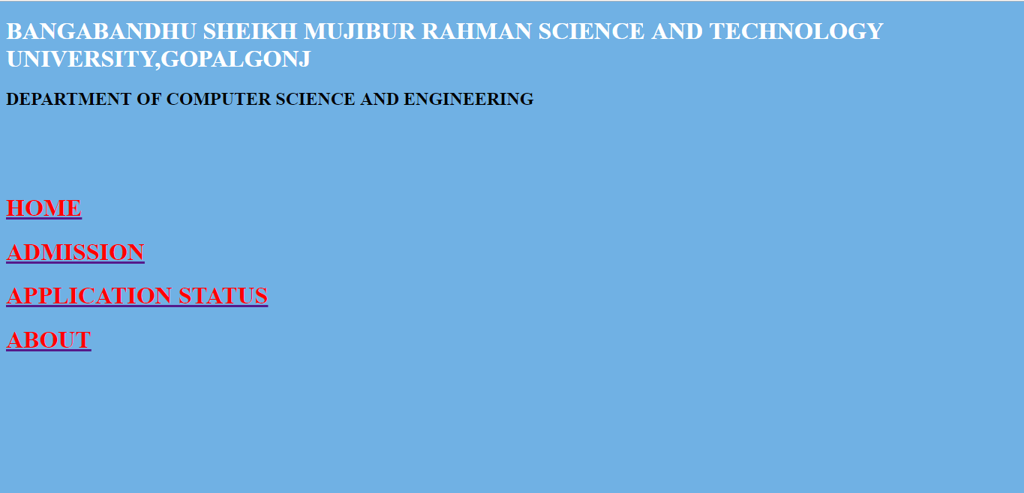
IMPLEMENTATION
Home page
At first user can choose any options

Slide 9
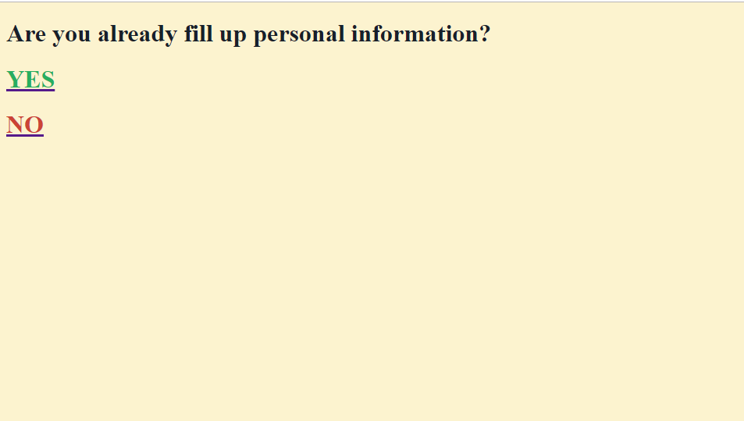
If user click on Admission, then this page will be shown

Slide 10
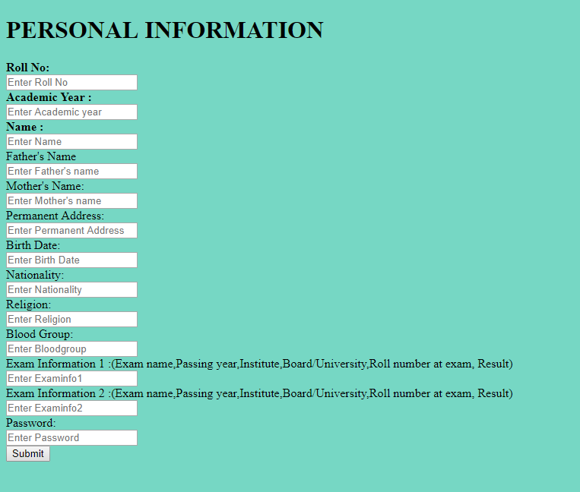
After Clicking No this page will be show

Slide 11
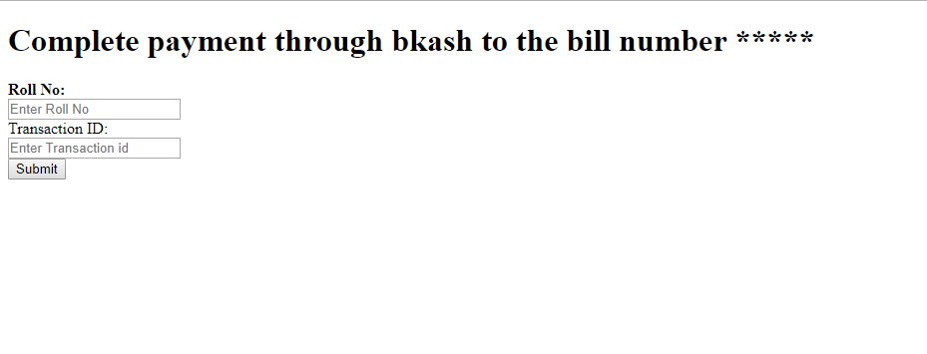
After fill up personal information this page will be show

Slide 12
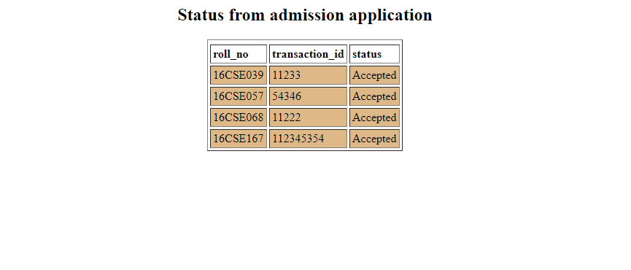
We can see admission status by clicking on admission status

Slide 13
CONCLUSION
I tried so much to maintain all the worst cases that can happen. But I don’t able to handle all of them. Actually when I firstly started to do it I don’t think that I will be fall into the ocean of problems. But I tried to getting out the problems as much as I can from the project.

Slide 14
FUTURE WORK
I confess that my application has lots of limitations. Actually I wanted to connect the database with bkash and according to the information the database will be updated. I don’t able to it. The another limitation is I don’t add any delete option that the information can be deleted. In future, I want to resolves such big problems and make it as real life applicable application.

Slide 15
REFERENCES
http://www.telusko.com/
https://www.javatpoint.com/servlet-tutorial
https://www.javatpoint.com/jsp-tutorial
https://www.javatpoint.com/dbms-tutorial
https://www.w3schools.com/html/default.asp
https://www.wikipedia.org/

Slide 16
THANKS TO ALL

