Slide 1
The BISPL Awards
BISPL awards was created in 2013 to recognize the contributions of BISPL researchers during the year. The criterion for the selection is based on the research, services, etc. There are three categories:
- Best Researcher of the Year Best researchers among postdoc, researchers and graduate students
Prize money: 4 million KW
- Best Doctoral Student of the Year Best researcher among Ph.D. students
Prize money: 3 million KW
- Best Master Student of the Year Best researcher among M.S. students
Prize money: 2 million KW

Slide 2
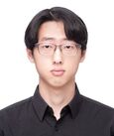
Best Master Student of the Year
Journal + Top Tier Conf Publications
1 papers (30pts)
Journal + Top Tier Conf Submissions
2 papers (50pts)
Other International Conf Publications
1 papers (10pts)
International award
NeurIPS travel (20pts)
Total Score: 110

Slide 3
Best Master Student of the Year
Published
Energy-Based Contrastive Learning of Visual Representations , NeurIPS 2022, 1st author
Semi-Implicit Hybrid Gradient Methods with Application to Adversarial Robustness (Accepted to AISTATS 2022)
Submitted
Denoising MCMC for Accelerating Diffusion-Based Generative Model
Mitigating Out-of-Distribution Data Density Overestimation in Energy-Based Models

Slide 4
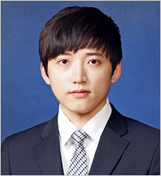
Best Doctoral Student of the Year
Journal + Top Tier Conf Publications
4 papers (95pts)
Journal + Top Tier Conf Submissions
4 papers (100 pts)
Other International Conf Publications/Submissions
2 papers (20pts)
Domestic Publications/Submissions
2 papers (10pts)
Patents
1 international (5 pts) / 5 domestic (20pts)
Domestic Awards
2 awards (20 pts) / KoSAIM Best Paper Spring, Fall
Total Score: 270

Slide 5
Best Doctoral Student of the Year
Published
Multi-Task Distributed Learning using Vision Transformer with Random Patch Permutation, IEEE TMI (first)
Enhanced diagnosis of plaque erosion by deep learning in patients with acute coronary syndromes, JACC Int. (first)
Self-evolving vision transformer for chest X-ray diagnosis through knowledge distillation, Nature Coms (first)
Optical coherence tomography in coronary atherosclerosis assessment and intervention, Nature Review Cardiology (other)
Submitted
MS-DINO: Efficient Distributed Training of Vision Transformer Foundation Model in Medical Domain through Masked Sampling, MEDIA (first)
Vision-Language Pretraining Enables Radiographs and Reports to be Learned without Curation, Nature BME (first)
Position-invariant detection of pneumoperitoneum in abdominal radiography by deep learning-enabled knowledge distillation, KJR (first)
Diagnosis of Coronary Layered Plaque by Deep Learning, Scientific Reports (first)

Slide 6
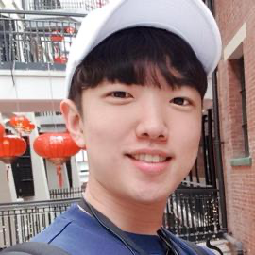
Best Researcher of the Year
Journal + Top Tier Conf Publications
5 papers (150pts)
Journal + Top Tier Conf Submissions
4 papers (80pts)
Other International Conf Publications/Submissions
3 papers (25pts)
Domestic Publications/Submissions
2 papers (10pts)
Domestic Patents
5 applications (25 pts)
Total Score: 290

Slide 7
Best Researcher of the Year
Published
Hyungjin Chung, Byeongsu Sim, and Jong Chul Ye. "Come-closer-diffuse-faster: Accelerating conditional diffusion models for inverse problems through stochastic contraction." CVPR. 2022.
Hyungjin Chung and Jong Chul Ye, “Score-based diffusion models for accelerated MRI”, Medical Image Analysis, 2022.
Hyungjin Chung, Eun Sun Lee, and Jong Chul Ye. "MR Image Denoising and Super-Resolution Using Regularized Reverse Diffusion." IEEE TMI, 2022.
Hyungjin Chung*, Byeongsu Sim, Dohoon Ryu, and Jong Chul Ye. "Improving Diffusion Models for Inverse Problems using Manifold Constraints." NeurIPS, 2022
Eunju Cha*, Hyungjin Chung*, Jaeduck Jang, Junho Lee, Eunha Lee, and Jong Chul Ye. "Low-Dose Sparse-View HAADF-STEM-EDX Tomography of Nanocrystals Using Unsupervised Deep Learning." ACS nano, 2022.
Submitted
ICLR (1), CVPR (2), AAAI (1)

Slide 8
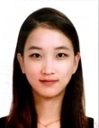
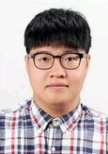
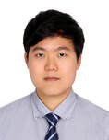
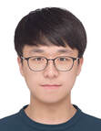
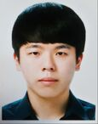
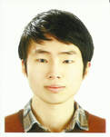
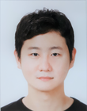
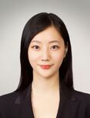
Honorable Mention (>100)
Total Score: 110
2 publication
2 submission
1 patents
1 project leader
Total Score: 105
1 publications
2 submission
1 project leader
1 lab manager
Total Score: 105
2 publications
2 submission
1 patent.
1 project leader
1 lab manager
Total Score: 250
3 publications
5 submission
1 international conf.
1 domestic conf
1 domestic award
2 patents
2 project leader
Total Score: 165
2 publication
3 submission
1 project leader
Total Score: 120
2 publication
2 submission
1 intern. award
1 project leader
Total Score: 120
1 publication
3 submission
1 project leader
Total Score: 110
2 publication
1 submission
2 patents
1 project leader

Slide 9
Changing of Lab Leaders
Outgoing lab leaders
Byeongsu Sim, 1/3
Yujin Oh, 2/3
Jaeyoung Huh, 3/3
Incoming lab leaders
Hyungjin Chung, 1/3
Kwangyoung Kim, 2/3
Gyutaek Oh, 3/3

