Slide 1
ROM Hacking & Localization Follies
(Some) English prepositions:
aboard about above absent across after against along alongside amid among around as astride at on atop bar before behind below beneath beside besides between beyond but by circa come despite down during except for from in inside into less like minus near notwithstanding of off on onto opposite out outside over past per save short since than through throughout to towards under underneath unlike until up upon upside versus via with within without worth

Slide 2
ROM Hacking & Localization Follies
(Some) English prepositions:
aboard about above absent across after against along alongside amid among around as astride at on atop bar before behind below beneath beside besides between beyond but by circa come despite down during except for from in inside into less like minus near notwithstanding of off on onto opposite out outside over past per save short since than through throughout to towards under underneath unlike until up upon upside versus via with within without worth

Slide 3
ROM Hacking & Localization Follies
Conjugation in Finnish
Kävellä

Slide 4
ROM Hacking & Localization Follies
Conjugation in Finnish
Kävellä
Kävelen
Kävelin
Kävelemällä
Kävellessäni
Käveltyäni
Kävelevänäkään

Slide 5
ROM Hacking & Localization Follies
Conjugation in Finnish
“daughter” “my daughter”
= tytär = tyttäreni
“to walk” “he/she walked”
= kävellä = käveli

Slide 6
ROM Hacking & Localization Follies
Conjugation in Finnish
“daughter” “my daughter”
= tytär = tyttäreni
“to walk” “he/she walked”
= kävellä = käveli

Slide 7
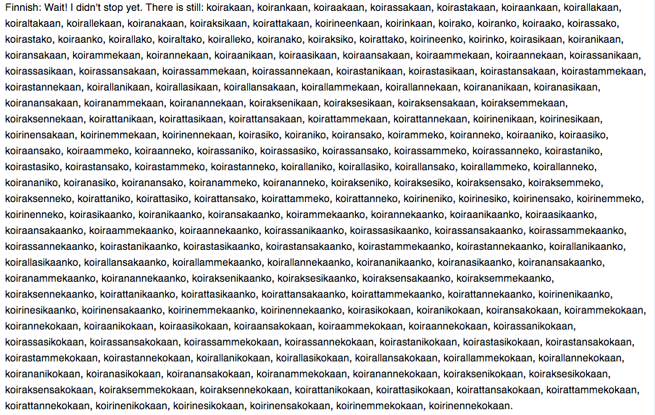
ROM Hacking & Localization Follies
Conjugation in Finnish

Slide 8
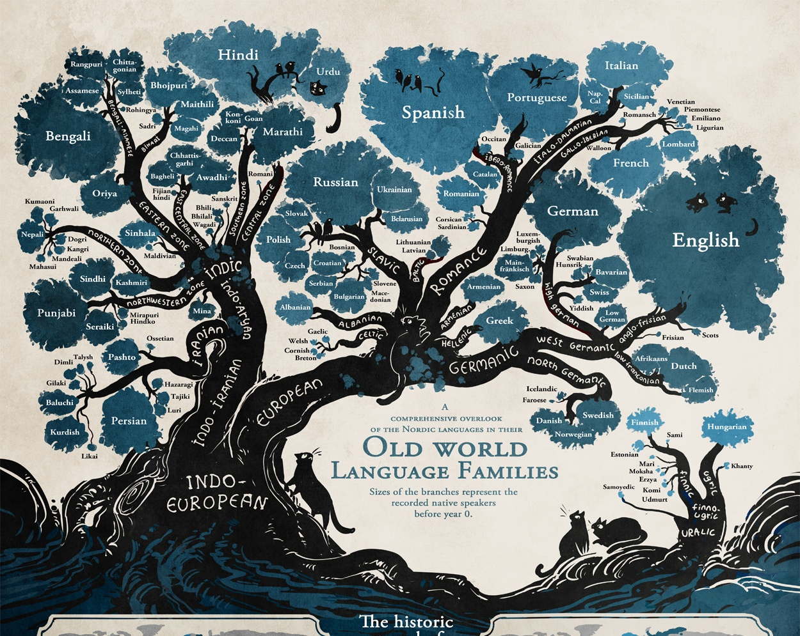
ROM Hacking & Localization Follies
Conjugation in Finnish

Slide 9
ROM Hacking & Localization Follies
Conjugation in Finnish

Slide 10
ROM Hacking & Localization Follies
Conjugation in Finnish

Slide 11
ROM Hacking & Localization Follies
Conjugation in Finnish

Slide 12
ROM Hacking & Localization Follies
Conjugation in Finnish

Slide 13
ROM Hacking & Localization Follies

Slide 14
ROM Hacking & Localization Follies
You found 1 Horn!

Slide 15
ROM Hacking & Localization Follies
You found 1 Horn!
You found 1 Feather!

Slide 16
ROM Hacking & Localization Follies
You found 1 Horn!
You found 1 Feather!
You found 1 Mop!

Slide 17
ROM Hacking & Localization Follies
You found 1 Horn!
You found 1 Feather!
You found 1 Mop!
You found 1 Star Sword!

Slide 18
ROM Hacking & Localization Follies
You found 1 Horn!
You found 1 Feather!
You found 1 Mop!
You found 1 Star Sword!
You found 1 >ITEM_NAME<

Slide 19
ROM Hacking & Localization Follies
You found 1 Horn!
You found 1 Feather!
You found 1 Mop!
You found 1 Star Sword!
Löysit 1 >ITEM_NAME<

Slide 20
ROM Hacking & Localization Follies
Löysit 1 Horn!
Löysit 1 Feather!
Löysit 1 Mop!
Löysit 1 Star Sword!
Löysit 1 >ITEM_NAME<

Slide 21
ROM Hacking & Localization Follies
Löysit 1 Sarvi!
Löysit 1 Sulka!
Löysit 1 Moppi!
Löysit 1 Tähtimiekka!
Löysit 1 >ITEM_NAME<

Slide 22
ROM Hacking & Localization Follies
Löysit 1 Sarvi!
Löysit 1 Sulka!
Löysit 1 Moppi!
Löysit 1 Tähtimiekka!
Löysit 1 >ITEM_NAME<

Slide 23
ROM Hacking & Localization Follies
Löysit 1 Sarven!
Löysit 1 Sulan!
Löysit 1 Mopin!
Löysit 1 Tähtimiekan!
Löysit 1 >ITEM_NAME<

Slide 24
ROM Hacking & Localization Follies
Repussasi on:
Leivän *15
Sarven *4
Sulan *2
Mopin *1
Tähtimiekan *1
…
Repussasi on:
Leipä *15
Sarvi *4
Sulka *2
Moppi *1
Tähtimiekka *1
…

Slide 25
ROM Hacking & Localization Follies
1 Sarvi löytyi!
1 Sulka löytyi!
1 Moppi löytyi!
1 Tähtimiekka löytyi!
1 >ITEM_NAME< löytyi!

Slide 26
ROM Hacking & Localization Follies
1 Sarvi löytyi!
1 Sulka löytyi!
1 Moppi löytyi!
1 Tähtimiekka löytyi!
1 >ITEM_NAME< löytyi!
= 1 Horn was found
= 1 Feather was found
= 1 Mop was found
= 1 Star Sword was found

Slide 27
ROM Hacking & Localization Follies
Löysit 1 esineen nimeltä Sarvi!
Löysit 1 esineen nimeltä Sulka!
Löysit 1 esineen nimeltä Moppi!
Löysit 1 esineen nimeltä Tähtimiekka!
Löysit 1 esineen nimeltä >ITEM_NAME<!

Slide 28
ROM Hacking & Localization Follies
English locale:
Copying %1 from %2 to %3
Finnish locale:
Kopioidaan tiedosto %1 kansiosta %2 kansioon %3
Literal translation back to English:
Copying file %1 from folder %2 into folder %3

Slide 29
ROM Hacking & Localization Follies
Conjugation in Chrono Trigger FIN
nominative accusative partitive adessive essive illative
---------- ---------- --------- -------- ------- --------
Crono Cronon Cronoa Cronolla Cronona Cronoon
Marle Marlen Marlea Marlella Marlena Marleen
Mikko Mikon Mikkoa Mikolla Mikkona Mikkoon
Magus Maguksen Magusta Maguksella Maguksena Magukseen
Brow Brow’n Brow’ta Brow’lla Brow’na Brow’hun
XYZ XYZ:n XYZ:nta XYZ:lla XYZ:na XYZ:aan
---------- ---------- --------- -------- ------- --------
<your name here>
<all conjugations dynamically generated at runtime>

