Slide 1
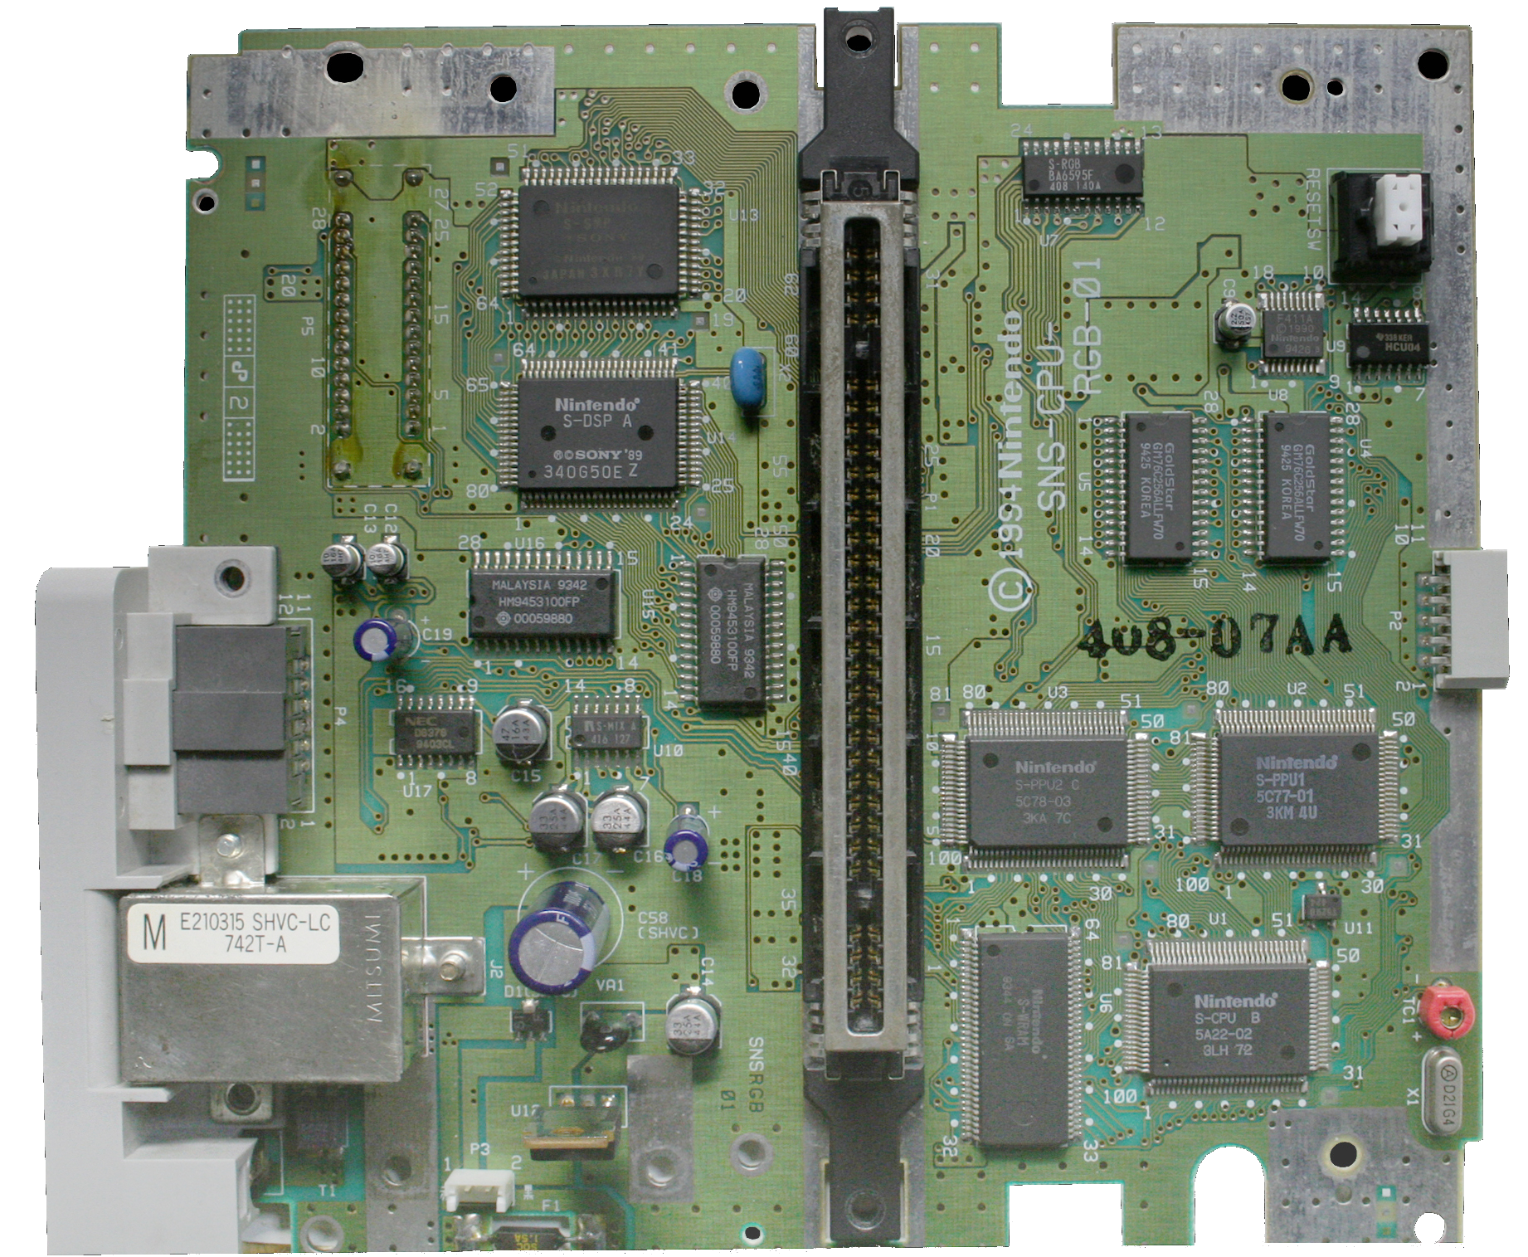

Slide 2

Pointers

Slide 3
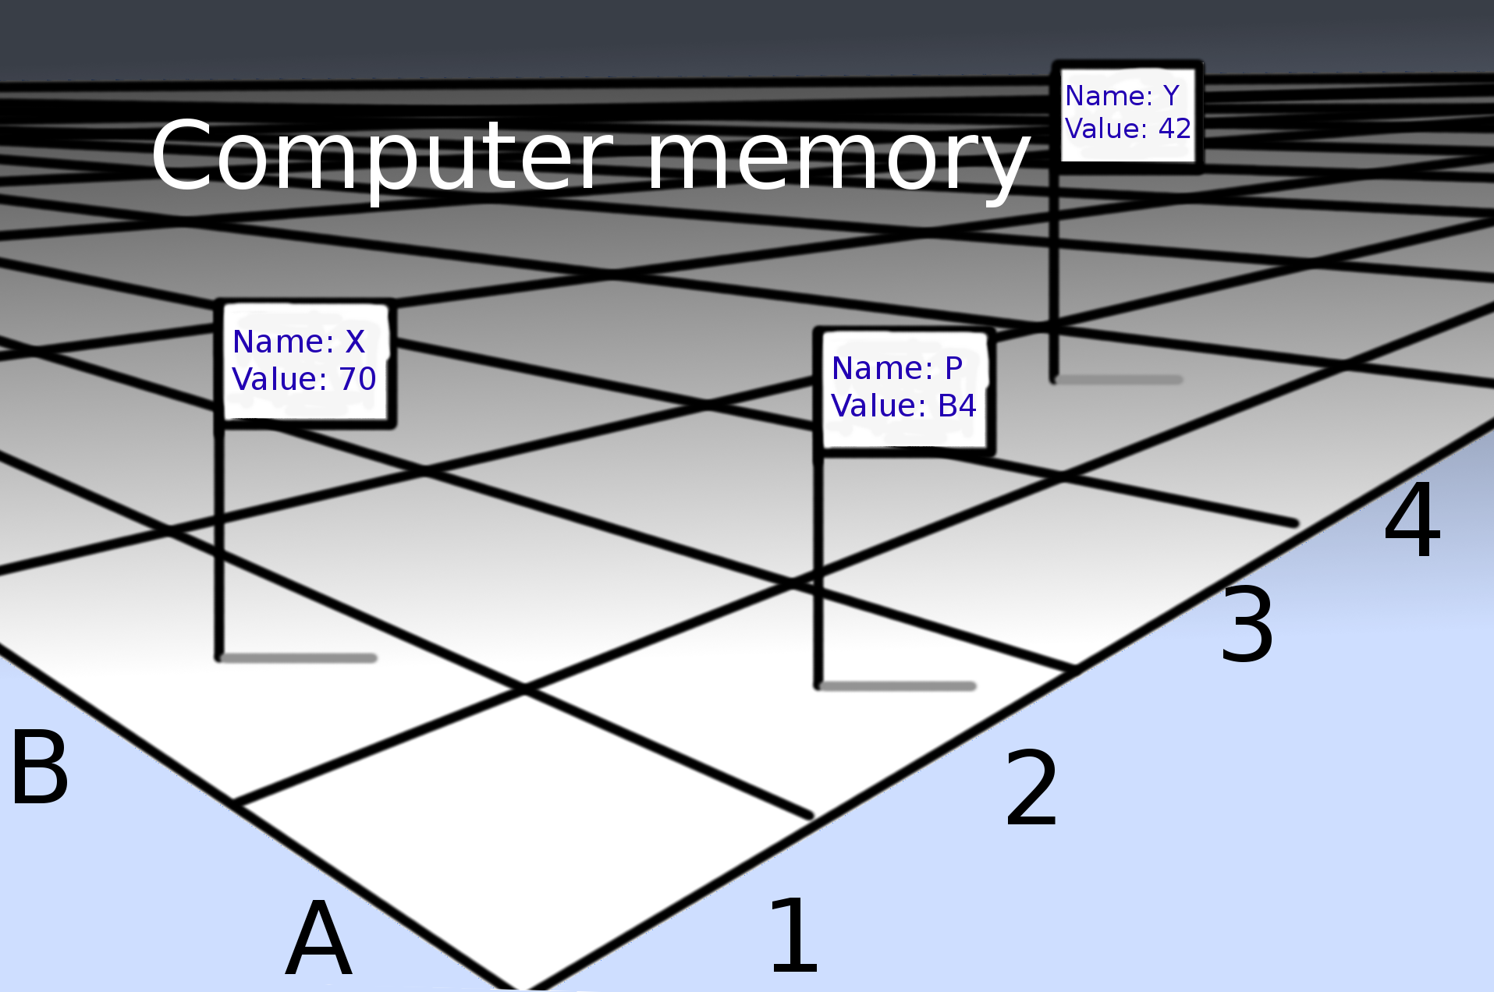
Pointers
// value-of
// (arbitrary examples):
x is 70
y is 42
p is B4
// dereferencing:
*p is 42
// address of:
&x is B1
&y is B4
&p is A2
// combine both:
&(*p) is B4
*(&p) is B4
*(&x) is 70

Slide 4
List of grammar tokens

Slide 5
List of grammar tokens

Slide 6
List of grammar tokens

Slide 7
List of grammar tokens

Slide 8
Identifiers
IsAbbrev s:
{
var len = Length(s);
if(len == 1) return 1;
while(len)
{
--len;
if(IsNumber(s[len])) return 1;
if(IsVowel(s[len])) return 0;
}
return 1;
}
Identifiers
Identifiers
Identifiers

Slide 9
Integer literals
IsAbbrev s:
{
var len = Length(s);
if(len == 1) return 1;
while(len)
{
--len;
if(IsNumber(s[len])) return 1;
if(IsVowel(s[len])) return 0;
}
return 1;
}
Integer literals
Integer literals

Slide 10
String literals (string constants)
PartitiveStem output,s:
{
var c = LastCharN(s, 1), t = "flmnrswxFLMNRSWX479", n = "01234568";
if(IsAlien(s)) return stpcpy(stpcpy(output,s), "'t");
if(IsAbbrev(s))
{
if(find(c, t)) return stpcpy(stpcpy(output,s), ":ä");
if(find(c, "zZ")) return stpcpy(stpcpy(output,s), ":a");
if(find(c, n)) return stpcpy(stpcpy(output,s), ":");
return stpcpy(stpcpy(output,s), ":t");
}
if(IsEs(s)) return stpcpy(stpcpy(output,s), "t");
if(IsDe(s)) return stpcpy(stpcpy(output,s), "tt");
if(AkiEnd(s)) return stpcpy(stpcpyn(output,s,1), "e");
if(EndsWithVowel(s)) return stpcpy(output,s);
return stpcpy(stpcpy(output,s), "i");
}
String literals

Slide 11

String literals are actually pointers (in some languages)
000006b0 01 48 39 dd 75 ea 48 83 c4 08 5b 5d 41 5c 41 5d |.H9.u.H...[]A\A]|
000006c0 41 5e 41 5f c3 90 66 2e 0f 1f 84 00 00 00 00 00 |A^A_..f.........|
000006d0 f3 c3 00 00 48 83 ec 08 48 83 c4 08 c3 00 00 00 |....H...H.......|
000006e0 01 00 02 00 48 65 6c 6c 6f 2c 20 77 6f 72 6c 64 |....Hello, world|
000006f0 21 00 00 00 01 1b 03 3b 38 00 00 00 06 00 00 00 |!......;8.......|
00000700 0c fe ff ff 84 00 00 00 2c fe ff ff ac 00 00 00 |........,.......|
00000710 3c fe ff ff 54 00 00 00 46 ff ff ff c4 00 00 00 |<...T...F.......|
00000720 6c ff ff ff e4 00 00 00 dc ff ff ff 2c 01 00 00 |l...........,...|
00000730 14 00 00 00 00 00 00 00 01 7a 52 00 01 78 10 01 |.........zR..x..|
There it is!

Slide 12
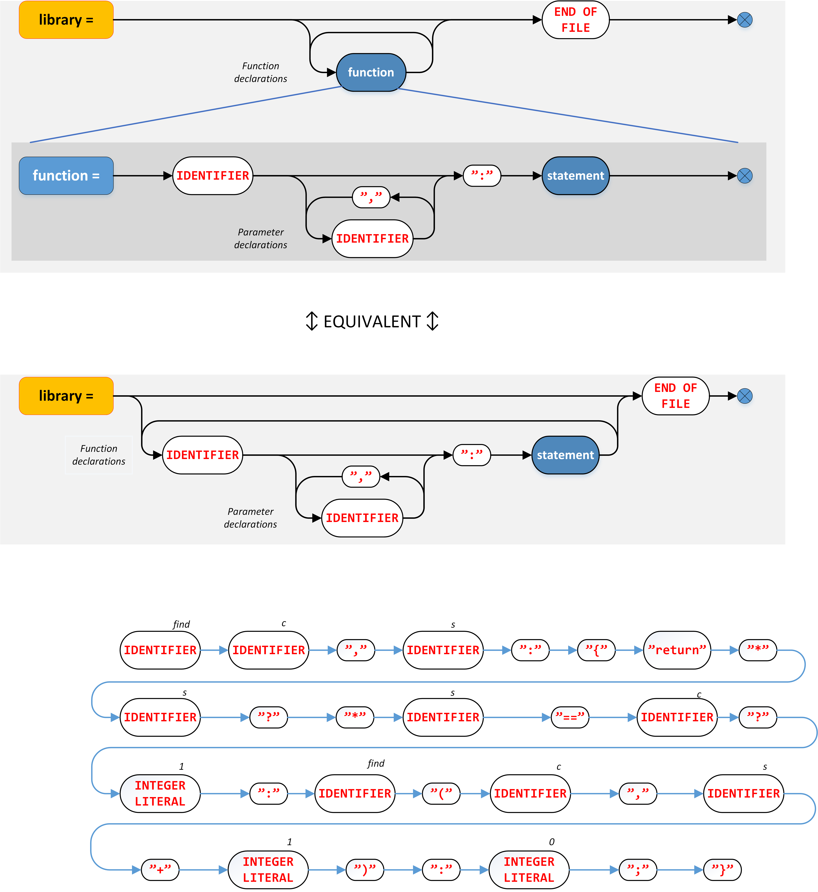
Tokenization
find c,s:
{
return *s ? *s==c ? 1 : find(c,s+1) : 0;
}

Slide 13
Grammar specification

Slide 14
Grammar specification

Slide 15
–--------------------------------------------------------------------------------------------------------------
↕↕ EQUIVALENT ↕↕
–--------------------------------------------------------------------------------------------------------------

Slide 16
Grammar specification

Slide 17
Grammar specification

Slide 18
Grammar specification

Slide 19
Grammar specification

Slide 20
Grammar specification

Slide 21
Grammar specification

Slide 22
Grammar specification

Slide 23
Grammar specification

Slide 24
Grammar specification

Slide 27
Expressions
IsAbbrev s:
{
var len = Length(s);
if(len == 1) return 1;
while(len)
{
--len;
if(IsNumber(s[len])) return 1;
if(IsVowel(s[len])) return 0;
}
return 1;
}
Expressions
Note: Not all expressions
are indicated
Expressions

Slide 28
Grammar specification

Slide 30
yacc / byacc / GNU Bison grammar

Slide 31
yacc / byacc / GNU Bison grammar
statement:

Slide 32
yacc / byacc / GNU Bison grammar
statement: "return" expression ';' ;

Slide 33
yacc / byacc / GNU Bison grammar
statement: "return" expression ';' ;
RULE

Slide 34
yacc / byacc / GNU Bison grammar
statement: "return" expression ';'
| "var" var_decls ';'
;

Slide 35
yacc / byacc / GNU Bison grammar
statement: "return" expression ';'
| "var" var_decls ';'
| "if" '(' expression ')' statement
;

Slide 36
yacc / byacc / GNU Bison grammar
statement: "return" expression ';'
| "var" var_decls ';'
| "if" '(' expression ')' statement
| ';'
;

Slide 37
yacc / byacc / GNU Bison grammar
statement: "return" expression ';'
| "var" var_decls ';'
| "if" '(' expression ')' statement
| ';';
↕↕ EQUIVALENT ↕↕
statement: "return" expression ';' ;
statement: "var" var_decls ';' ;
statement: "if" '(' expression ')' statement;
statement: ';' ;

Slide 38
yacc / byacc / GNU Bison grammar
↕↕ EQUIVALENT ↕↕
statement: "return" expression ';' ;
statement: "var" var_decls ';' ;
statement: "if" '(' expression ')' statement;
statement: ';' ;

Slide 39
yacc / byacc / GNU Bison grammar
statement: "return" expression ';' ;
statement: "var" var_decls ';' ;
statement: "if" '(' expression ')' statement;
statement: ';' ;

Slide 40
yacc / byacc / GNU Bison grammar
statement: "return" expression ';' ;
statement: "var" var_decls ';' ;
statement: "if" '(' expression ')' statement;
statement: ';' ;

Slide 41
yacc / byacc / GNU Bison grammar
statement: "return" expression ';' ;
statement: "var" var_decls ';' ;
statement: "if" '(' expression ')' statement;
statement: ';' ;

Slide 42
GNU Bison parser algorithm
std::stack<bison::token> stack;
int current_state = 0;
bison::token next_token = read_next_token();
for(;;) // Parser loop
{
bison::action_info a = choose_action(next_token, current_state);
switch(a.what_to_do)
{
case action_types::shift:
stack.push_back(next_token);
current_state = a.next_state;
next_token = read_next_token();
break;
case action_types::reduce:
// execute_rule: 1. Executes contingent code
// 2. Pops the components of the rule from stack
// 3. Pushes the product of the rule into the stack
execute_rule(a.rule_number, stack);
current_state = a.next_state;
}
}

Slide 43
GNU Bison parser algorithm
std::stack<bison::token> stack;
int current_state = 0;
bison::token next_token = read_next_token();
for(;;) // Parser loop
{
bison::action_info a = choose_action(next_token, current_state);
switch(a.what_to_do)
{
case action_types::shift:
stack.push_back(next_token);
current_state = a.next_state;
next_token = read_next_token();
break;
case action_types::reduce:
// execute_rule: 1. Executes contingent code
// 2. Pops the components of the rule from stack
// 3. Pushes the product of the rule into the stack
execute_rule(a.rule_number, stack);
current_state = a.next_state;
}
}

Slide 44
GNU Bison parser algorithm
std::stack<bison::token> stack;
int current_state = 0;
bison::token next_token = read_next_token();
for(;;) // Parser loop
{
bison::action_info a = choose_action(next_token, current_state);
switch(a.what_to_do)
{
case action_types::shift:
stack.push_back(next_token);
current_state = a.next_state;
next_token = read_next_token();
break;
case action_types::reduce:
// execute_rule: 1. Executes contingent code
// 2. Pops the components of the rule from stack
// 3. Pushes the product of the rule into the stack
execute_rule(a.rule_number, stack);
current_state = a.next_state;
}
}

Slide 45
GNU Bison parser algorithm
std::stack<bison::token> stack;
int current_state = 0;
bison::token next_token = read_next_token();
for(;;) // Parser loop
{
bison::action_info a = choose_action(next_token, current_state);
switch(a.what_to_do)
{
case action_types::shift:
stack.push_back(next_token);
current_state = a.next_state;
next_token = read_next_token();
break;
case action_types::reduce:
// execute_rule: 1. Executes contingent code
// 2. Pops the components of the rule from stack
// 3. Pushes the product of the rule into the stack
execute_rule(a.rule_number, stack);
current_state = a.next_state;
}
}

Slide 46
GNU Bison parser algorithm
std::stack<bison::token> stack;
int current_state = 0;
bison::token next_token = read_next_token();
for(;;) // Parser loop
{
bison::action_info a = choose_action(next_token, current_state);
switch(a.what_to_do)
{
case action_types::shift:
stack.push_back(next_token);
current_state = a.next_state;
next_token = read_next_token();
break;
case action_types::reduce:
// execute_rule: 1. Executes contingent code
// 2. Pops the components of the rule from stack
// 3. Pushes the product of the rule into the stack
execute_rule(a.rule_number, stack);
current_state = a.next_state;
}
}

Slide 47
GNU Bison parser algorithm
std::stack<bison::token> stack;
int current_state = 0;
bison::token next_token = read_next_token();
for(;;) // Parser loop
{
bison::action_info a = choose_action(next_token, current_state);
switch(a.what_to_do)
{
case action_types::shift:
stack.push_back(next_token);
current_state = a.next_state;
next_token = read_next_token();
break;
case action_types::reduce:
// execute_rule: 1. Executes contingent code
// 2. Pops the components of the rule from stack
// 3. Pushes the product of the rule into the stack
execute_rule(a.rule_number, stack);
current_state = a.next_state;
}
}

Slide 48
GNU Bison parser algorithm
std::stack<bison::token> stack;
int current_state = 0;
bison::token next_token = read_next_token();
for(;;) // Parser loop
{
bison::action_info a = choose_action(next_token, current_state);
switch(a.what_to_do)
{
case action_types::shift:
stack.push_back(next_token);
current_state = a.next_state;
next_token = read_next_token();
break;
case action_types::reduce:
// execute_rule: 1. Executes contingent code
// 2. Pops the components of the rule from stack
// 3. Pushes the product of the rule into the stack
execute_rule(a.rule_number, stack);
current_state = a.next_state;
}
}

Slide 49
GNU Bison parser algorithm
std::stack<bison::token> stack;
int current_state = 0;
bison::token next_token = read_next_token();
for(;;) // Parser loop
{
bison::action_info a = choose_action(next_token, current_state);
switch(a.what_to_do)
{
case action_types::shift:
stack.push_back(next_token);
current_state = a.next_state;
next_token = read_next_token();
break;
case action_types::reduce:
// execute_rule: 1. Executes contingent code
// 2. Pops the components of the rule from stack
// 3. Pushes the product of the rule into the stack
execute_rule(a.rule_number, stack);
current_state = a.next_state;
}
}

Slide 50
GNU Bison parser algorithm
std::stack<bison::token> stack;
int current_state = 0;
bison::token next_token = read_next_token();
for(;;) // Parser loop
{
bison::action_info a = choose_action(next_token, current_state);
switch(a.what_to_do)
{
case action_types::shift:
stack.push_back(next_token);
current_state = a.next_state;
next_token = read_next_token();
break;
case action_types::reduce:
// execute_rule: 1. Executes contingent code
// 2. Pops the components of the rule from stack
// 3. Pushes the product of the rule into the stack
execute_rule(a.rule_number, stack);
current_state = a.next_state;
}
}

Slide 51
yacc / byacc / GNU Bison grammar
statement: "return" expression ';' ;
statement: "var" var_decls ';' ;
statement: "if" '(' expression ')' statement;
statement: ';' ;
RULE 0
RULE 1
RULE 3
RULE 2

Slide 52
yacc / byacc / GNU Bison grammar
statement: "return" expression ';' ;
statement: "var" var_decls ';' ;
statement: "if" '(' expression ')' statement;
statement: ';' ;
RULE 0
RULE 1
RULE 3
RULE 2
state 0: "return" shift, goto state 1
"var" shift, goto state 2
"if" shift, goto state 3
';' reduce using RULE 3
state 1: <conditions related to parsing «expression»>, eventually state 5
state 2: <conditions related to parsing «var_decls»>, eventually state 6
state 3: '(' shift, goto state 4
state 4: <conditions related to parsing «expression»>, eventually state 7
state 5: ';' reduce using RULE 0
state 6: ';' reduce using RULE 1
state 7: ')' shift, goto state 8
state 8: <same as state 0, but now with a default-rule that reduces using RULE 2>

Slide 53
yacc / byacc / GNU Bison grammar
DISCLAIMER
This brief explanation was likely full of mistakes.
Do not attempt to create your own yacc clone, or any
other LALR(1) parser engine using this explanation
alone. For exact details, read the GNU Bison manual.
It explains the workings in very deep detail. These slides
aim to give just an introductory impression of what
happens behind the scenes.

Slide 54
yacc / byacc / GNU Bison grammar
statement: "return" expression ';' ;
statement: "var" var_decls ';' ;
statement: "if" '(' expression ')' statement;
statement: ';' ;
RULE 0
RULE 1
DISCLAIMER
This brief explanation was likely full of mistakes.
Do not attempt to create your own yacc clone, or any
other LALR(1) parser engine using this explanation
alone. For exact details, read the GNU Bison manual.
It explains the workings in very deep detail. These slides
aim to give just an introductory impression of what
happens behind the scenes.
RULE 3
RULE 2
state 0: "return" shift, goto state 1
"var" shift, goto state 2
"if" shift, goto state 3
';' reduce using RULE 3
state 1: <conditions related to parsing «expression»>, eventually state 5
state 2: <conditions related to parsing «var_decls»>, eventually state 6
state 3: '(' shift, goto state 4
state 4: <conditions related to parsing «expression»>, eventually state 7
state 5: ';' reduce using RULE 0
state 6: ';' reduce using RULE 1
state 7: ')' shift, goto state 8
state 8: <same as state 0, but now with a default-rule that reduces using RULE 2>

Slide 55
Recursion in yacc/byacc/GNU Bison
product1: THING;
/*-----------------------------------------------------------------------------------*/
product2: THING THING;
/*-----------------------------------------------------------------------------------*/
product2_delim: THING ',' THING;
/*-----------------------------------------------------------------------------------*/
product_opt: THING
| %empty;
/*-----------------------------------------------------------------------------------*/
products1: products1 THING
| THING;
/*-----------------------------------------------------------------------------------*/
products_opt: products_opt THING
| %empty;
/*-----------------------------------------------------------------------------------*/
products1_delim: products1_delim ',' THING
| THING;
/*-----------------------------------------------------------------------------------*/
products1_delim_opt: products1_delim
| %empty;
// 1 thing
// 2 things
// 2 things, comma delimited
// 0 or 1 things
// 1 or more things
// 0 or more things
// 1 or more things, comma delimited
// 0 or more things, comma delimited

Slide 56
Recursion in yacc/byacc/GNU Bison
product1: THING;
/*-----------------------------------------------------------------------------------*/
product2: THING THING;
/*-----------------------------------------------------------------------------------*/
product2_delim: THING ',' THING;
/*-----------------------------------------------------------------------------------*/
product_opt: THING
| %empty;
/*-----------------------------------------------------------------------------------*/
products1: products1 THING
| THING;
/*-----------------------------------------------------------------------------------*/
products_opt: products_opt THING
| %empty;
/*-----------------------------------------------------------------------------------*/
products1_delim: products1_delim ',' THING
| THING;
/*-----------------------------------------------------------------------------------*/
products1_delim_opt: products1_delim
| %empty;
// 1 thing
// 2 things
// 2 things, comma delimited
// 0 or 1 things
// 1 or more things
// 0 or more things
// 1 or more things, comma delimited
// 0 or more things, comma delimited

Slide 57
Recursion in yacc/byacc/GNU Bison
product1: THING;
/*-----------------------------------------------------------------------------------*/
product2: THING THING;
/*-----------------------------------------------------------------------------------*/
product2_delim: THING ',' THING;
/*-----------------------------------------------------------------------------------*/
product_opt: THING
| %empty;
/*-----------------------------------------------------------------------------------*/
products1: products1 THING
| THING;
/*-----------------------------------------------------------------------------------*/
products_opt: products_opt THING
| %empty;
/*-----------------------------------------------------------------------------------*/
products1_delim: products1_delim ',' THING
| THING;
/*-----------------------------------------------------------------------------------*/
products1_delim_opt: products1_delim
| %empty;
// 1 thing
// 2 things
// 2 things, comma delimited
// 0 or 1 things
// 1 or more things
// 0 or more things
// 1 or more things, comma delimited
// 0 or more things, comma delimited

Slide 58
Recursion in yacc/byacc/GNU Bison
product1: THING;
/*-----------------------------------------------------------------------------------*/
product2: THING THING;
/*-----------------------------------------------------------------------------------*/
product2_delim: THING ',' THING;
/*-----------------------------------------------------------------------------------*/
product_opt: THING
| %empty;
/*-----------------------------------------------------------------------------------*/
products1: products1 THING
| THING;
/*-----------------------------------------------------------------------------------*/
products_opt: products_opt THING
| %empty;
/*-----------------------------------------------------------------------------------*/
products1_delim: products1_delim ',' THING
| THING;
/*-----------------------------------------------------------------------------------*/
products1_delim_opt: products1_delim
| %empty;
// 1 thing
// 2 things
// 2 things, comma delimited
// 0 or 1 things
// 1 or more things
// 0 or more things
// 1 or more things, comma delimited
// 0 or more things, comma delimited

Slide 59
Recursion in yacc/byacc/GNU Bison
product1: THING;
/*-----------------------------------------------------------------------------------*/
product2: THING THING;
/*-----------------------------------------------------------------------------------*/
product2_delim: THING ',' THING;
/*-----------------------------------------------------------------------------------*/
product_opt: THING
| %empty;
/*-----------------------------------------------------------------------------------*/
compound_stmt: compound_stmt stmt
| '{';
/*-----------------------------------------------------------------------------------*/
products_opt: products_opt THING
| %empty;
/*-----------------------------------------------------------------------------------*/
products1_delim: products1_delim ',' THING
| THING;
/*-----------------------------------------------------------------------------------*/
products1_delim_opt: products1_delim
| %empty;
// 1 thing
// 2 things
// 2 things, comma delimited
// 0 or 1 things
// '{', followed by 0 or more stmts
// Note: Same pattern as products_opt
// 0 or more things
// 1 or more things, comma delimited
// 0 or more things, comma delimited

Slide 60
Recursion in yacc/byacc/GNU Bison
product1: THING;
/*-----------------------------------------------------------------------------------*/
product2: THING THING;
/*-----------------------------------------------------------------------------------*/
product2_delim: THING ',' THING;
/*-----------------------------------------------------------------------------------*/
product_opt: THING
| %empty;
/*-----------------------------------------------------------------------------------*/
products1: products1 THING
| THING;
/*-----------------------------------------------------------------------------------*/
products_opt: products_opt THING
| %empty;
/*-----------------------------------------------------------------------------------*/
products1_delim: products1_delim ',' THING
| THING;
/*-----------------------------------------------------------------------------------*/
products1_delim_opt: products1_delim
| %empty;
// 1 thing
// 2 things
// 2 things, comma delimited
// 0 or 1 things
// 1 or more things
// 0 or more things
// 1 or more things, comma delimited
// 0 or more things, comma delimited

Slide 61
Recursion in yacc/byacc/GNU Bison
product1: THING;
/*-----------------------------------------------------------------------------------*/
product2: THING THING;
/*-----------------------------------------------------------------------------------*/
product2_delim: THING ',' THING;
/*-----------------------------------------------------------------------------------*/
product_opt: THING
| %empty;
/*-----------------------------------------------------------------------------------*/
products1: products1 THING
| THING;
/*-----------------------------------------------------------------------------------*/
products_opt: products_opt THING
| %empty;
/*-----------------------------------------------------------------------------------*/
products1_delim: products1_delim ',' THING
| THING;
/*-----------------------------------------------------------------------------------*/
products1_delim_opt: products1_delim
| %empty;
// 1 thing
// 2 things
// 2 things, comma delimited
// 0 or 1 things
// 1 or more things
// 0 or more things
// 1 or more things, comma delimited
// 0 or more things, comma delimited

Slide 62
Recursion in yacc/byacc/GNU Bison
product1: THING;
/*-----------------------------------------------------------------------------------*/
product2: THING THING;
/*-----------------------------------------------------------------------------------*/
product2_delim: THING ',' THING;
/*-----------------------------------------------------------------------------------*/
product_opt: THING
| %empty;
/*-----------------------------------------------------------------------------------*/
products1: products1 THING
| THING;
/*-----------------------------------------------------------------------------------*/
products_opt: products_opt THING
| %empty;
/*-----------------------------------------------------------------------------------*/
products1_delim: products1_delim ',' THING
| THING;
/*-----------------------------------------------------------------------------------*/
products1_delim_opt: products1_delim
| %empty;
// 1 thing
// 2 things
// 2 things, comma delimited
// 0 or 1 things
// 1 or more things
// 0 or more things
// 1 or more things, comma delimited
// 0 or more things, comma delimited

Slide 63
Recursion in yacc/byacc/GNU Bison
products_opt: products_opt THING
| %empty;
// 0 or more things

Slide 64
Recursion in yacc/byacc/GNU Bison
products_opt: products_opt THING
| %empty;
RULE 1
// 0 or more things
RULE 2

Slide 65
Recursion in yacc/byacc/GNU Bison
Tokens: THING THING THING OBJECT THING end-of-file
Parser position: ^
Stack:
products_opt: products_opt THING
| %empty;
RULE 1
// 0 or more things
RULE 2

Slide 66
Recursion in yacc/byacc/GNU Bison
Tokens: THING THING THING OBJECT THING end-of-file
Parser position: ^
Stack: products_opt
products_opt: products_opt THING
| %empty;
RULE 1
// 0 or more things
RULE 2

Slide 67
Recursion in yacc/byacc/GNU Bison
Tokens: THING THING THING OBJECT THING end-of-file
Parser position: ^
Stack: products_opt THING
products_opt: products_opt THING
| %empty;
RULE 1
// 0 or more things
RULE 2

Slide 68
Recursion in yacc/byacc/GNU Bison
Tokens: THING THING THING OBJECT THING end-of-file
Parser position: ^
Stack: products_opt
products_opt: products_opt THING
| %empty;
RULE 1
// 0 or more things
RULE 2

Slide 69
Recursion in yacc/byacc/GNU Bison
Tokens: THING THING THING OBJECT THING end-of-file
Parser position: ^
Stack: products_opt THING
products_opt: products_opt THING
| %empty;
RULE 1
// 0 or more things
RULE 2

Slide 70
Recursion in yacc/byacc/GNU Bison
Tokens: THING THING THING OBJECT THING end-of-file
Parser position: ^
Stack: products_opt
products_opt: products_opt THING
| %empty;
RULE 1
// 0 or more things
RULE 2

Slide 71
Recursion in yacc/byacc/GNU Bison
Tokens: THING THING THING OBJECT THING end-of-file
Parser position: ^
Stack: products_opt OBJECT
products_opt: products_opt THING
| %empty;
RULE 1
// 0 or more things
RULE 2

Slide 72
Recursion in yacc/byacc/GNU Bison
product1: THING;
/*-----------------------------------------------------------------------------------*/
product2: THING THING;
/*-----------------------------------------------------------------------------------*/
product2_delim: THING ',' THING;
/*-----------------------------------------------------------------------------------*/
product_opt: THING
| %empty;
/*-----------------------------------------------------------------------------------*/
products1: products1 THING
| THING;
/*-----------------------------------------------------------------------------------*/
products_opt: products_opt THING
| %empty;
/*-----------------------------------------------------------------------------------*/
products1_delim: products1_delim ',' THING
| THING;
/*-----------------------------------------------------------------------------------*/
products1_delim_opt: products1_delim
| %empty;
// 1 thing
// 2 things
// 2 things, comma delimited
// 0 or 1 things
// 1 or more things
// 0 or more things
// 1 or more things, comma delimited
// 0 or more things, comma delimited

Slide 73
Recursion in yacc/byacc/GNU Bison
product1: THING;
/*-----------------------------------------------------------------------------------*/
product2: THING THING;
/*-----------------------------------------------------------------------------------*/
product2_delim: THING ',' THING;
/*-----------------------------------------------------------------------------------*/
product_opt: THING
| %empty;
/*-----------------------------------------------------------------------------------*/
products1: products1 THING
| THING;
/*-----------------------------------------------------------------------------------*/
products_opt: products_opt THING
| %empty;
/*-----------------------------------------------------------------------------------*/
products1_delim: products1_delim ',' THING
| THING;
/*-----------------------------------------------------------------------------------*/
products1_delim_opt: products1_delim
| %empty;
// 1 thing
// 2 things
// 2 things, comma delimited
// 0 or 1 things
// 1 or more things
// 0 or more things
// 1 or more things, comma delimited
// 0 or more things, comma delimited

Slide 74
Recursion in yacc/byacc/GNU Bison
product1: THING;
/*-----------------------------------------------------------------------------------*/
product2: THING THING;
/*-----------------------------------------------------------------------------------*/
product2_delim: THING ',' THING;
/*-----------------------------------------------------------------------------------*/
product_opt: THING
| %empty;
/*-----------------------------------------------------------------------------------*/
products1: products1 THING
| THING;
/*-----------------------------------------------------------------------------------*/
products_opt: products_opt THING
| %empty;
/*-----------------------------------------------------------------------------------*/
products1_delim: products1_delim ',' THING
| THING;
/*-----------------------------------------------------------------------------------*/
products1_delim_opt: products1_delim
| %empty;
// 1 thing
// 2 things
// 2 things, comma delimited
// 0 or 1 things
// 1 or more things
// 0 or more things
// 1 or more things, comma delimited
// 0 or more things, comma delimited
Refers to

Slide 75
Using more non-terminals to simplify grammar
var_defs: "var" IDENTIFIER '=' expr
| "var" IDENTIFIER
| var_defs ',' IDENTIFIER '=' expr
| var_defs ',' IDENTIFIER ;
–--------------------------------------------------------------------------------------------------------------
↕↕ EQUIVALENT ↕↕
–--------------------------------------------------------------------------------------------------------------
var_defs: "var" var_def1
| var_defs ',' var_def1 ;
var_def1: IDENTIFIER '=' expr
IDENTIFIER ;

Slide 76
Operator precedence
5 - 3 ÷ 4 ÷ 5
/*-----------------------------------------------------------------------------------*/
((5 - 3) ÷ 4) ÷ 5 If - has higher priority than ÷
=0.1 and ÷ is left-associative
(5 - 3) ÷ (4 ÷ 5) If - has higher priority than ÷
=2.5 and ÷ is right-associative
5 - ((3 ÷ 4) ÷ 5) If ÷ has higher priority than -
=4.85 and ÷ is left-associative
5 - (3 ÷ (4 ÷ 5)) If ÷ has higher priority than -
=1.25 and ÷ is right-associative

Slide 77
Well-formed grammar
somefunction(5, 3, 4)

Slide 78
Well-formed grammar
somefunction(5, 3, 4)
Is this…
— A function call with three parameters?
— A function call with one parameter,
that is a comma expression?

Slide 79
Well-formed grammar
somefunction(5, 3, 4)
Is this…
— A function call with three parameters?
— A function call with one parameter,
that is a comma expression?
How about this?
somefunction((5, 3, 4))

Slide 80
Semantic actions in yacc/byacc/GNU Bison

Slide 81
Semantic actions in yacc/byacc/GNU Bison
[mixer]
rate = 48000
blocksize = 8192
prebuffer = 300
[sblaster]
sbbase = 0x220
irq = 7
dma = 1
hdma = 5
[gus]
gusrate = 48000
gusbase = 0x240
gusirq = 5
gusdma = 3

Slide 82
Semantic actions in yacc/byacc/GNU Bison
%code requires{
std::map<std::string, std::map<std::string, int>> settings;
// ↑ Collect the configuration data here: {section → {setting → value}}
%}
%token IDENTIFIER INTEGERVALUE
%%
configuration_file: configuration_file section
| %empty
;
section: section IDENTIFIER '=' INTEGERVALUE
| '[' IDENTIFIER ']'
;

Slide 83
Semantic actions in yacc/byacc/GNU Bison
%code requires{
std::map<std::string, std::map<std::string, int>> settings;
// ↑ Collect the configuration data here: {section → {setting → value}}
%}
%token IDENTIFIER INTEGERVALUE
%%
configuration_file: configuration_file section
| %empty
;
section: section IDENTIFIER '=' INTEGERVALUE
{
settings[$1][$2] = $4;
$$ = std::move($1);
}
| '[' IDENTIFIER ']'
{
$$ = std::move($2);
}
;

Slide 84
Semantic actions in yacc/byacc/GNU Bison
%code requires{
std::map<std::string, std::map<std::string, int>> settings;
// ↑ Collect the configuration data here: {section → {setting → value}}
%}
%token IDENTIFIER INTEGERVALUE
%%
configuration_file: configuration_file section
| %empty
;
section: section IDENTIFIER '=' INTEGERVALUE
{
settings[$1][$2] = $4;
$$ = std::move($1);
}
| '[' IDENTIFIER ']'
{
$$ = std::move($2);
}
;

Slide 85
Semantic actions in yacc/byacc/GNU Bison
%code requires{
std::map<std::string, std::map<std::string, int>> settings;
// ↑ Collect the configuration data here: {section → {setting → value}}
%}
%token IDENTIFIER INTEGERVALUE
%%
configuration_file: configuration_file section
| %empty
;
section: section IDENTIFIER '=' INTEGERVALUE
{
settings[$1][$2] = $4;
$$ = std::move($1);
}
| '[' IDENTIFIER ']'
{
$$ = std::move($2);
}
;

Slide 86
Semantic actions in yacc/byacc/GNU Bison
%code requires{
std::map<std::string, std::map<std::string, int>> settings;
// ↑ Collect the configuration data here: {section → {setting → value}}
%}
%token IDENTIFIER INTEGERVALUE
%type<std::string> IDENTIFIER section
%type<int> INTEGERVALUE
%%
configuration_file: configuration_file section
| %empty
;
section: section IDENTIFIER '=' INTEGERVALUE
{
settings[$1][$2] = $4;
$$ = std::move($1);
}
| '[' IDENTIFIER ']'
{
$$ = std::move($2);
}
;
// Note: Use «bison -Slalr1.cc -Dapi.value.type=variant» when building this example

Slide 87
Semantic actions in yacc/byacc/GNU Bison
%code requires{
std::map<std::string, std::map<std::string, int>> settings;
// ↑ Collect the configuration data here: {section → {setting → value}}
%}
%token IDENTIFIER INTEGERVALUE
%type<std::string> IDENTIFIER section
%type<int> INTEGERVALUE
%%
configuration_file: configuration_file section
| %empty
;
section: section IDENTIFIER '=' INTEGERVALUE
{
settings[$1][$2] = $4;
$$ = std::move($1);
}
| '[' IDENTIFIER ']'
{
$$ = std::move($2);
}
;
// Note: Use «bison -Slalr1.cc -Dapi.value.type=variant» when building this example

Slide 88
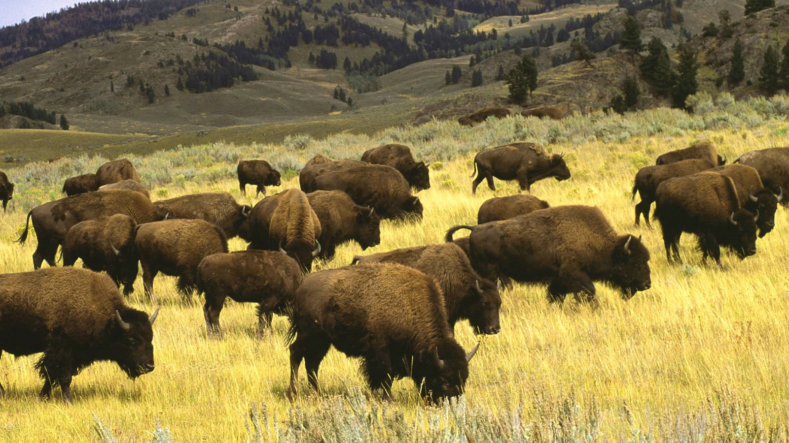
Code generators ※ Case study ※ re2c

