Slide 1
Creating a Compiler – Episode 2

Slide 2
Creating a Compiler – Episode 2
Length s:
{
var result = 0;
while(*s++) { ++result; }
return result;
}
Original code

Slide 3
Creating a Compiler – Episode 2
Length s:
{
var result = 0;
while(*s++) { ++result; }
return result;
}
Original code
The tree generated by the compiler
function Length:
├─comma
│ ├─comma
│ │ └─copy
│ │ ├─number 0
│ │ └─ident V0"result"
│ ├─loop
│ │ ├─deref
│ │ │ └─comma
│ │ │ ├─nop
│ │ │ ├─copy
│ │ │ │ ├─ident P0"s"
│ │ │ │ └─ident V1"$I2"
│ │ │ ├─copy
│ │ │ │ ├─add
│ │ │ │ │ ├─ident P0"s"
│ │ │ │ │ └─number 1
│ │ │ │ └─ident P0"s"
│ │ │ └─ident V1"$I2"
│ │ └─comma
│ │ └─comma
│ │ ├─nop
│ │ └─copy
│ │ ├─add
│ │ │ ├─ident V0"result"
│ │ │ └─number 1
│ └─ret └─ident V0"result"
│ └─ident V0"result"
└─ret
└─number 0

Slide 4
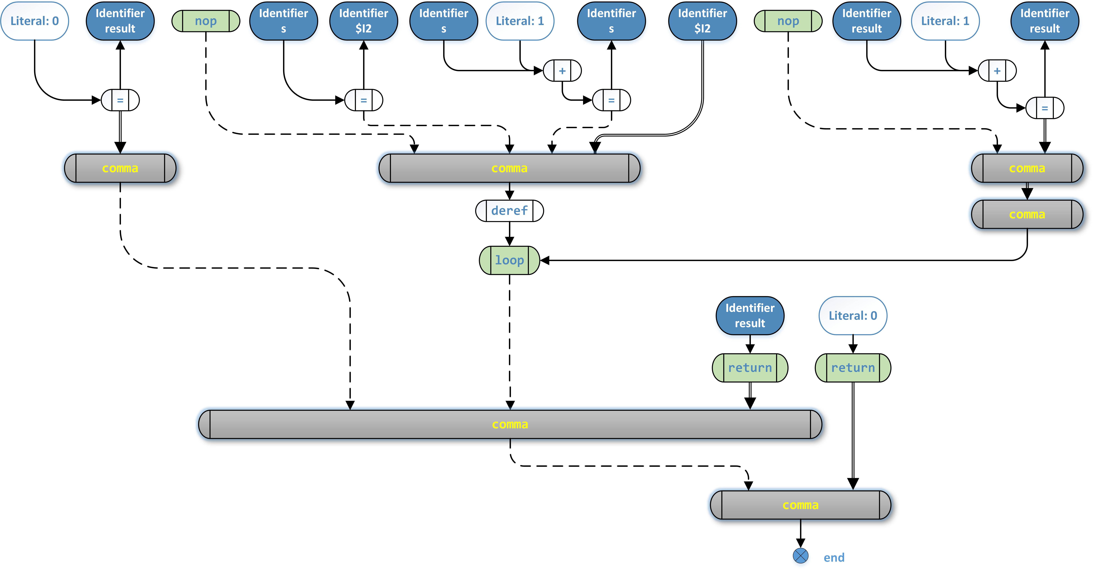
Creating a Compiler – Episode 2
Length s:
{
var result = 0;
while(*s++) { ++result; }
return result;
}
Original code
The tree generated by the compiler
function Length:
├─comma
│ ├─comma
│ │ └─copy
│ │ ├─number 0
│ │ └─ident V0"result"
│ ├─loop
│ │ ├─deref
│ │ │ └─comma
│ │ │ ├─nop
│ │ │ ├─copy
│ │ │ │ ├─ident P0"s"
│ │ │ │ └─ident V1"$I2"
│ │ │ ├─copy
│ │ │ │ ├─add
│ │ │ │ │ ├─ident P0"s"
│ │ │ │ │ └─number 1
│ │ │ │ └─ident P0"s"
│ │ │ └─ident V1"$I2"
│ │ └─comma
│ │ └─comma
│ │ ├─nop
│ │ └─copy
│ │ ├─add
│ │ │ ├─ident V0"result"
│ │ │ └─number 1
│ └─ret └─ident V0"result"
│ └─ident V0"result"
└─ret
└─number 0
(Graphical illustration,
information is same
as on the left)

Slide 5
X-macro: #define trick to avoid content repetition
#define ENUM_EXPRESSIONS(o) \
o(nop) o(string) o(number) o(ident) /* atoms */ \
o(add) o(neg) o(eq) /* transformation */ \
o(cor) o(cand) o(loop) /* logic. Loop is: while(param0) { param1..n } */ \
o(addrof) o(deref) /* pointer handling */ \
o(fcall) /* function param0 call with param1..n */ \
o(copy) /* assign: param1 <<- param0 */ \
o(comma) /* a sequence of expressions */ \
o(ret) /* return(param0) */
#define o(n) n,
enum class ex_type { ENUM_EXPRESSIONS(o) };
#undef o
#define o(n) \
template<typename... T> \
inline expression e_##n(T&&... args) { return expression(ex_type::n, std::forward<T>(args)...); }
ENUM_EXPRESSIONS(o)
#undef o
enum class ex_type { nop,string,number,ident,add,neg,eq,cor,cand,loop,addrof,deref,fcall,copy,comma,ret, };
template<typename... T> inline expression e_nop(T&&... args) { return expression(ex_type::nop, std::forward<T>(args)...); }
template<typename... T> inline expression e_string(T&&... args) { return expression(ex_type::string, std::forward<T>(args)...); }
template<typename... T> inline expression e_number(T&&... args) { return expression(ex_type::number, std::forward<T>(args)...); }
template<typename... T> inline expression e_ident(T&&... args) { return expression(ex_type::ident, std::forward<T>(args)...); }
template<typename... T> inline expression e_add(T&&... args) { return expression(ex_type::add, std::forward<T>(args)...); }
template<typename... T> inline expression e_neg(T&&... args) { return expression(ex_type::neg, std::forward<T>(args)...); }
template<typename... T> inline expression e_eq(T&&... args) { return expression(ex_type::eq, std::forward<T>(args)...); }
template<typename... T> inline expression e_cor(T&&... args) { return expression(ex_type::cor, std::forward<T>(args)...); }
template<typename... T> inline expression e_cand(T&&... args) { return expression(ex_type::cand, std::forward<T>(args)...); }
template<typename... T> inline expression e_loop(T&&... args) { return expression(ex_type::loop, std::forward<T>(args)...); }
template<typename... T> inline expression e_addrof(T&&... args) { return expression(ex_type::addrof, std::forward<T>(args)...); }
template<typename... T> inline expression e_deref(T&&... args) { return expression(ex_type::deref, std::forward<T>(args)...); }
template<typename... T> inline expression e_fcall(T&&... args) { return expression(ex_type::fcall, std::forward<T>(args)...); }
template<typename... T> inline expression e_copy(T&&... args) { return expression(ex_type::copy, std::forward<T>(args)...); }
template<typename... T> inline expression e_comma(T&&... args) { return expression(ex_type::comma, std::forward<T>(args)...); }
template<typename... T> inline expression e_ret(T&&... args) { return expression(ex_type::ret, std::forward<T>(args)...); }
This…
…is exactly as if you had typed:

Slide 6
Pure functions
int sum(int a, int b) { return a + b; }
int magic()
{
int x = 5, y = 7;
return sum(x, y) + sum(x, y));
}
int sum(int a, int b) { return a + b; }
int magic()
{
int x = 5, y = 7;
//return sum(x, y) + sum(x, y));
return 2 * sum(x, y);
}
Because sum() is a pure function,
all of these are valid replacements
that produce exactly same result,
and magic() is a pure function too.
A function is pure, if the only outcome it produces is its return value.
//int sum(int a, int b) { return a + b; }
int magic()
{
//int x = 5, y = 7;
//return 2 * sum(x, y);
return 24;
}

Slide 7
Creating a Compiler – Episode 2

