Slide 1

IR register to CPU register mapping
IR x86_64 65c816 IR x86_64 IR x86_64
R0 RDI X R19 - R38 -
R1 RSI Y R20 - R39 -
R2 RDX A R21 - R40 -
R3 RCX - R22 - R41 -
R4 R8 - R23 - R42 -
R5 R9 - R24 - R43 -
R6 RAX - R25 - R44 -
R7 R10 - R26 - R45 -
R8 R11 - R27 - R46 -
R9 R12 - R28 - R47 -
R10 R13 - R29 - R48 -
R11 R14 - R30 - R49 -
R12 R15 - R31 - R50 -
R13 RBX - R32 - R51 -
R14 RBP - R33 - R52 -
R15 - - R34 - R53 -
R16 - - R35 - R54 -
R17 - - R36 - R55 -
R18 - - R37 - R56 -

Slide 2
IR register to CPU register mapping
IR x86_64 65c816 IR x86_64 IR x86_64
R0 RDI X R19 MM4 R38 XMM15 low
R1 RSI Y R20 MM5 R39 XMM0 high
R2 RDX A R21 MM6 R40 XMM1 high
R3 RCX - R22 MM7 R41 XMM2 high
R4 R8 - R23 XMM0 low R42 XMM3 high
R5 R9 - R24 XMM1 low R43 XMM4 high
R6 RAX - R25 XMM2 low R44 XMM5 high
R7 R10 - R26 XMM3 low R45 XMM6 high
R8 R11 - R27 XMM4 low R46 XMM7 high
R9 R12 - R28 XMM5 low R47 XMM8 high
R10 R13 - R29 XMM6 low R48 XMM9 high
R11 R14 - R30 XMM7 low R49 XMM10 high
R12 R15 - R31 XMM8 low R50 XMM11 high
R13 RBX - R32 XMM9 low R51 XMM12 high
R14 RBP - R33 XMM10 low R52 XMM13 high
R15 MM0 - R34 XMM11 low R53 XMM14 high
R16 MM1 - R35 XMM12 low R54 XMM15 high
R17 MM2 - R36 XMM13 low R55 -
R18 MM3 - R37 XMM14 low R56 -

Slide 3
Data Classes
— Actual CPU registers
— Memory variables

Slide 4
Data Classes
— Actual CPU registers
Not all CPU registers are equal
— Memory variables

Slide 5
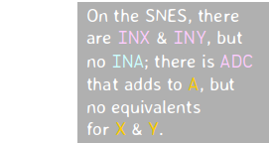
Data Classes
— Actual CPU registers
Not all CPU registers are equal
— Memory variables
Global variables?

Slide 6
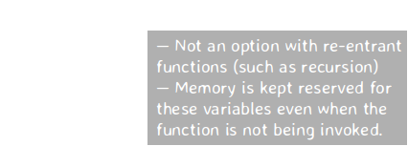
Data Classes
— Actual CPU registers
Not all CPU registers are equal
— Memory variables
Global variables?
Stack-relative

Slide 7
Data Classes
— Actual CPU registers
Not all CPU registers are equal
— Memory variables
Global variables
Stack-relative
— Immediate parameters (number literals & addresses)
Different literals fit in different number of bits

Slide 8
IR statement to CPU instruction mapping

Slide 9
IR statement to CPU instruction mapping
COPY tgt,src
ADD tgt,src1,src2
NEG tgt,src
IFNZ src,JMP tgt
READ tgt,src

Slide 10
IR statement to CPU instruction mapping
COPY tgt,src
ADD tgt,src1,src2
NEG tgt,src
IFNZ src,JMP tgt
READ tgt,src

Slide 11
IR statement to CPU instruction mapping
COPY tgt,src
mov tgt, src lda src
ADD tgt,src1,src2
lea tgt, [src1+src2] clc
adc src
NEG tgt,src
mov tgt, src eor #-1
neg tgt sec
adc #0
IFNZ src,JMP tgt
test src, src cmp #1
jnz tgt bcs tgt
READ tgt,src
movzx tgt, byte [src] ldy #0
lda (source),y
and #255

Slide 12
IR statement to CPU instruction mapping
COPY tgt,src
mov tgt, src lda src
ADD tgt,src1,src2
lea tgt, [src1+src2] clc
adc src
NEG tgt,src
mov tgt, src eor #-1
neg tgt sec
adc #0
IFNZ src,JMP tgt
test src, src cmp #1
jnz tgt bcs tgt
READ tgt,src
movzx tgt, byte [src] ldy #0
lda (source),y
and #255

Slide 13
IR statement to CPU instruction mapping
COPY tgt,src
mov tgt, src

Slide 14
IR statement to CPU instruction mapping
COPY tgt,src
mov tgt, src
MOV basereg, basereg
MOV basereg, mem
MOV mem, basereg
XOR basereg, basereg
MOV basereg, immed
LEA basereg, [REL sym+offs]
MOV mem, immed

Slide 15
IR statement to CPU instruction mapping
COPY tgt,src
mov tgt, src
MOV basereg, basereg PXOR mmreg, mmreg
MOV basereg, mem PXOR xmmhi, xmmhi*
MOV mem, basereg PXOR xmmlo, xmmlo*
XOR basereg, basereg PEXTRQ basereg,xmmhi,1
MOV basereg, immed PINSRQ xmmhi,basereg,1
LEA basereg, [REL sym+offs] PINSRQ xmmlo,basereg,0
MOV mem, immed
MOVQ basereg, mmreg MOVDQ2Q mmreg, xmmlo
MOVQ basereg, xmmlo MOVQ2DQ xmmlo, mmreg*
MOVQ mem, mmreg MOVDQA xmmlo, xmmlo*
MOVQ mem, xmmlo MOVDQA xmmhi, xmmhi*
MOVQ mmreg, basereg MOVDQU xmmlo, mem*
MOVQ mmreg, mem MOVLPD xmmlo, mem
MOVQ mmreg, mmreg MOVHPD xmmhi, mem
MOVQ xmmmlo, basereg* MOVHPD mem, xmmhi
PBLENDW xmmhi, xmmhi, 240 PUNPCKHQDQ xmmlo,xmmhi
PBLENDW xmmlo, xmmlo, 15 PUNPCKLQDQ xmmhi,xmmlo
*) Clobbers the other half of the XMM register

Slide 16
IR statement to CPU instruction mapping
COPY tgt,src
mov tgt, src lda src
ADD tgt,src1,src2
lea tgt, [src1+src2] clc
adc src
NEG tgt,src
mov tgt, src eor #-1
neg tgt sec
adc #0
IFNZ src,JMP tgt
test src, src cmp #1
jnz tgt bcs tgt
READ tgt,src
movzx tgt, byte [src] ldy #0
lda (source),y
and #255
For some types of operands…
But wait, there’s also XOR,LEA,MOVQ,
PXOR,MOVLPD,MOVHPD,MOVDQA,MOVDQU,
PINSRQ,PEXTRQ,MOVQ2DQ,MOVDQ2Q,
PUNPCKHQDQ,PUNPCKLQDQ, and PBLENDW!

Slide 17
IR statement to CPU instruction mapping
COPY tgt,src
mov tgt, src lda src
ADD tgt,src1,src2
lea tgt, [src1+src2] clc
adc src
NEG tgt,src
mov tgt, src eor #-1
neg tgt sec
adc #0
IFNZ src,JMP tgt
test src, src cmp #1
jnz tgt bcs tgt
READ tgt,src
movzx tgt, byte [src] ldy #0
lda (source),y
and #255
For some types of operands…
But wait, there’s also XOR,LEA,MOVQ,
PXOR,MOVLPD,MOVHPD,MOVDQA,MOVDQU,
PINSRQ,PEXTRQ,MOVQ2DQ,MOVDQ2Q,
PUNPCKHQDQ,PUNPCKLQDQ, and PBLENDW!

Slide 18
IR statement to CPU instruction mapping
COPY tgt,src
mov tgt, src lda src
ADD tgt,src1,src2
lea tgt, [src1+src2] clc
adc src
NEG tgt,src
mov tgt, src eor #-1
neg tgt sec
adc #0
IFNZ src,JMP tgt
test src, src cmp #1
jnz tgt bcs tgt
READ tgt,src
movzx tgt, byte [src] ldy #0
lda (source),y
and #255
For some types of operands…
But wait, there’s also XOR,LEA,MOVQ,
PXOR,MOVLPD,MOVHPD,MOVDQA,MOVDQU,
PINSRQ,PEXTRQ,MOVQ2DQ,MOVDQ2Q,
PUNPCKHQDQ,PUNPCKLQDQ, and PBLENDW!
Only valid if all three
operands are base registers
or if one of the sources is a
number literal that fits
in a 32-bit signed integer

Slide 19
IR statement to CPU instruction mapping
COPY tgt,src
mov tgt, src lda src
ADD tgt,src1,src2
lea tgt, [src1+src2] clc
adc src
NEG tgt,src
mov tgt, src eor #-1
neg tgt sec
adc #0
IFNZ src,JMP tgt
test src, src cmp #1
jnz tgt bcs tgt
READ tgt,src
movzx tgt, byte [src] ldy #0
lda (source),y
and #255
For some types of operands…
But wait, there’s also XOR,LEA,MOVQ,
PXOR,MOVLPD,MOVHPD,MOVDQA,MOVDQU,
PINSRQ,PEXTRQ,MOVQ2DQ,MOVDQ2Q,
PUNPCKHQDQ,PUNPCKLQDQ, and PBLENDW!
Only valid if all three
operands are base registers
or if one of the sources is a
number literal that fits
in a 32-bit signed integer

Slide 20
IR statement to CPU instruction mapping
COPY tgt,src
mov tgt, src lda src
ADD tgt,src1,src2
lea tgt, [src1+src2] clc
adc src
NEG tgt,src
mov tgt, src eor #-1
neg tgt sec
adc #0
IFNZ src,JMP tgt
test src, src cmp #1
jnz tgt bcs tgt
READ tgt,src
movzx tgt, byte [src] ldy #0
lda (source),y
and #255
For some types of operands…
But wait, there’s also XOR,LEA,MOVQ,
PXOR,MOVLPD,MOVHPD,MOVDQA,MOVDQU,
PINSRQ,PEXTRQ,MOVQ2DQ,MOVDQ2Q,
PUNPCKHQDQ,PUNPCKLQDQ, and PBLENDW!
LDA mem copies mem→A
LDA #imm copies imm→A
Only valid if all three
operands are base registers
or if one of the sources is a
number literal that fits
in a 32-bit signed integer

Slide 21
IR statement to CPU instruction mapping
COPY tgt,src
mov tgt, src lda src
ADD tgt,src1,src2
lea tgt, [src1+src2] clc
adc src
NEG tgt,src
mov tgt, src eor #-1
neg tgt sec
adc #0
IFNZ src,JMP tgt
test src, src cmp #1
jnz tgt bcs tgt
READ tgt,src
movzx tgt, byte [src] ldy #0
lda (source),y
and #255
For some types of operands…
But wait, there’s also XOR,LEA,MOVQ,
PXOR,MOVLPD,MOVHPD,MOVDQA,MOVDQU,
PINSRQ,PEXTRQ,MOVQ2DQ,MOVDQ2Q,
PUNPCKHQDQ,PUNPCKLQDQ, and PBLENDW!
LDA mem copies mem→A
LDA #imm copies imm→A
Then there’s LDX,LDY,STA,
STX,STY,STZ,TAX,TAY,
TXA,TYA,TXY,TYX,TCD…
Only valid if all three
operands are base registers
or if one of the sources is a
number literal that fits
in a 32-bit signed integer

Slide 22
IR statement to CPU instruction mapping
COPY tgt,src
mov tgt, src lda src
ADD tgt,src1,src2
lea tgt, [src1+src2] clc
adc src
NEG tgt,src
mov tgt, src eor #-1
neg tgt sec
adc #0
IFNZ src,JMP tgt
test src, src cmp #1
jnz tgt bcs tgt
READ tgt,src
movzx tgt, byte [src] ldy #0
lda (source),y
and #255
For some types of operands…
But wait, there’s also XOR,LEA,MOVQ,
PXOR,MOVLPD,MOVHPD,MOVDQA,MOVDQU,
PINSRQ,PEXTRQ,MOVQ2DQ,MOVDQ2Q,
PUNPCKHQDQ,PUNPCKLQDQ, and PBLENDW!
LDA mem copies mem→A
LDA #imm copies imm→A
Then there’s LDX,LDY,STA,
STX,STY,STZ,TAX,TAY,
TXA,TYA,TXY,TYX,TCD…
Only valid if all three
operands are base registers
or if one of the sources is a
number literal that fits
in a 32-bit signed integer

Slide 23
IR statement to CPU instruction mapping
COPY tgt,src
mov tgt, src lda src
ADD tgt,src1,src2
lea tgt, [src1+src2] clc
adc src
NEG tgt,src
mov tgt, src eor #-1
neg tgt sec
adc #0
IFNZ src,JMP tgt
test src, src cmp #1
jnz tgt bcs tgt
READ tgt,src
movzx tgt, byte [src] ldy #0
lda (source),y
and #255
For some types of operands…
But wait, there’s also XOR,LEA,MOVQ,
PXOR,MOVLPD,MOVHPD,MOVDQA,MOVDQU,
PINSRQ,PEXTRQ,MOVQ2DQ,MOVDQ2Q,
PUNPCKHQDQ,PUNPCKLQDQ, and PBLENDW!
LDA mem copies mem→A
LDA #imm copies imm→A
Then there’s LDX,LDY,STA,
STX,STY,STZ,TAX,TAY,
TXA,TYA,TXY,TYX,TCD…
Only valid if all three
operands are base registers
or if one of the sources is a
number literal that fits
in a 32-bit signed integer

Slide 24
IR statement to CPU instruction mapping
COPY tgt,src
mov tgt, src lda src
ADD tgt,src1,src2
lea tgt, [src1+src2] clc
adc src
NEG tgt,src
mov tgt, src eor #-1
neg tgt sec
adc #0
IFNZ src,JMP tgt
test src, src cmp #1
jnz tgt bcs tgt
READ tgt,src
movzx tgt, byte [src] ldy #0
lda (source),y
and #255
For some types of operands…
But wait, there’s also XOR,LEA,MOVQ,
PXOR,MOVLPD,MOVHPD,MOVDQA,MOVDQU,
PINSRQ,PEXTRQ,MOVQ2DQ,MOVDQ2Q,
PUNPCKHQDQ,PUNPCKLQDQ, and PBLENDW!
LDA mem copies mem→A
LDA #imm copies imm→A
Then there’s LDX,LDY,STA,
STX,STY,STZ,TAX,TAY,
TXA,TYA,TXY,TYX,TCD…
Only valid if all three
operands are base registers
or if one of the sources is a
number literal that fits
in a 32-bit signed integer
Stores into A,
but also clobbers Y!

Slide 25
IR statement to CPU instruction mapping
COPY tgt,src
mov tgt, src lda src
ADD tgt,src1,src2
lea tgt, [src1+src2] clc
adc src
NEG tgt,src
mov tgt, src eor #-1
neg tgt sec
adc #0
IFNZ src,JMP tgt
test src, src cmp #1
jnz tgt bcs tgt
READ tgt,src
movzx tgt, byte [src] ldy #0
lda (source),y
and #255
For some types of operands…
But wait, there’s also XOR,LEA,MOVQ,
PXOR,MOVLPD,MOVHPD,MOVDQA,MOVDQU,
PINSRQ,PEXTRQ,MOVQ2DQ,MOVDQ2Q,
PUNPCKHQDQ,PUNPCKLQDQ, and PBLENDW!
LDA mem copies mem→A
LDA #imm copies imm→A
Then there’s LDX,LDY,STA,
STX,STY,STZ,TAX,TAY,
TXA,TYA,TXY,TYX,TCD…
Only valid if all three
operands are base registers
or if one of the sources is a
number literal that fits
in a 32-bit signed integer
Stores into A,
but also clobbers Y!
And it only
works if source
is a memory
operand.

Slide 26
ABI: Application Binary Interface

Slide 27
ABI: Application Binary Interface
— Data formats (bit-wise representation)
— Function call convention (parameters, return values)
— Resource allocation (local variables)
— System calls
— Thread-local resources
­— Guard variables
— Program models
— Stack unwinding algorithm
— Executable, object, and library file formats
etc.

Slide 28
ABI: Application Binary Interface
— Function call convention (parameters, return values)

Slide 29
ABI: Application Binary Interface
Function call convention
Function parameters
Return values
Local variables
CPU registers
Stack

Slide 30
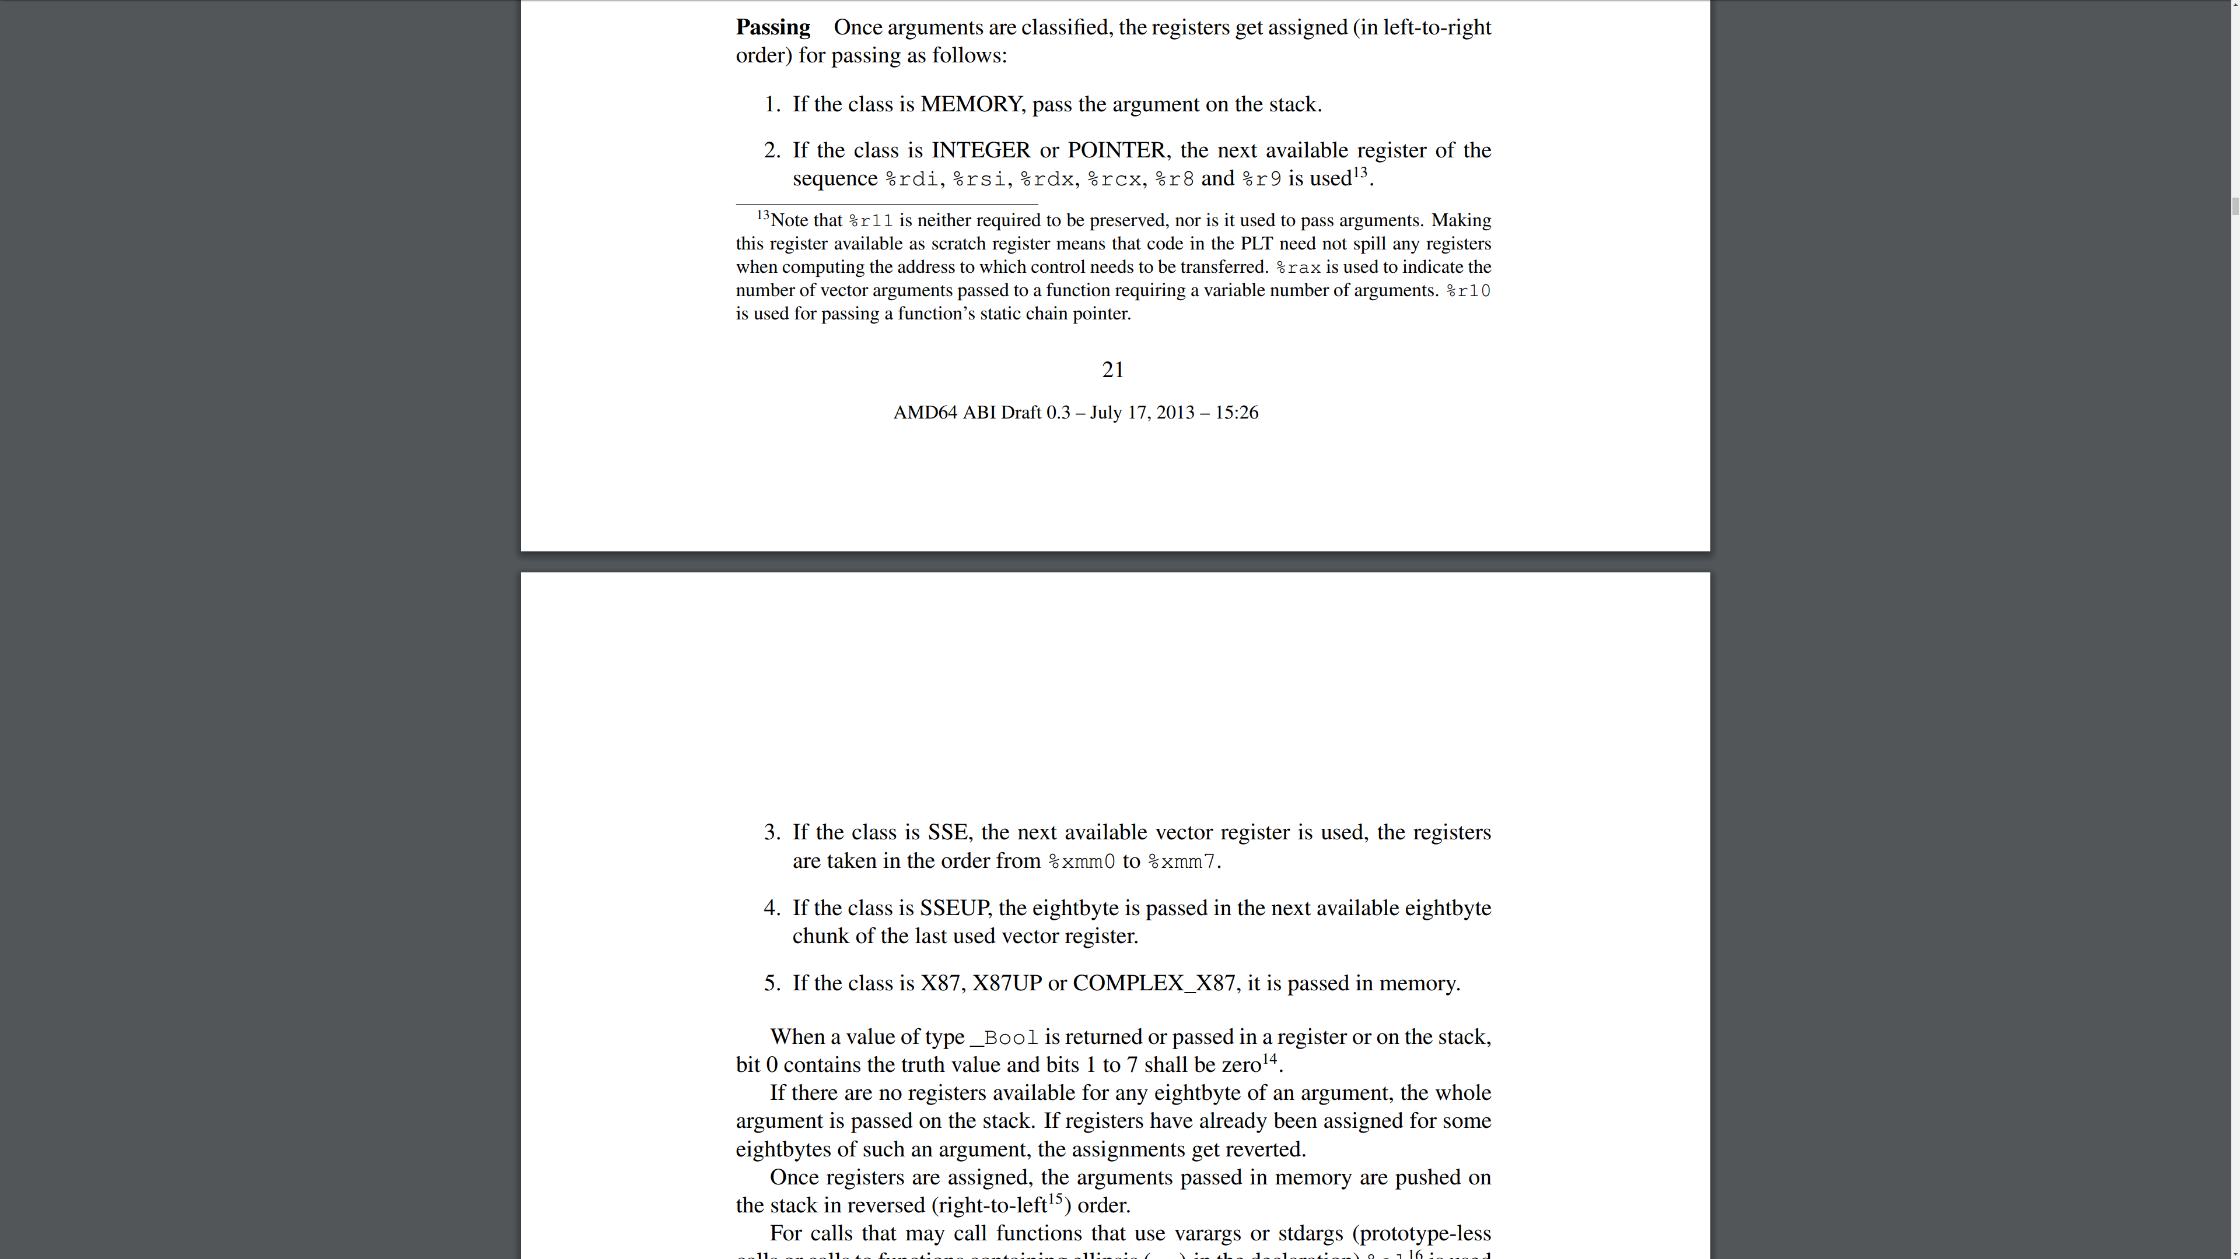
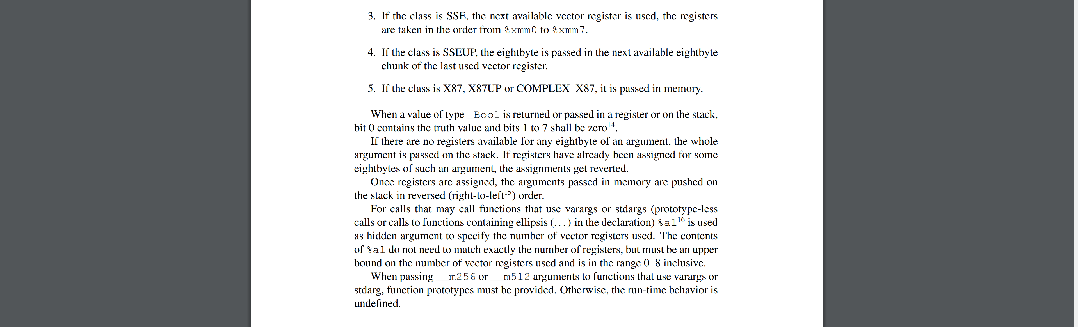
Chapter 3.2.3: Parameter Passing
mpx-linux64-abi.pdf
System V Application
Binary Interface,
AMD64 Architecture
Processor Supplement
Draft Version 0.3
Pages 21–22

Slide 31
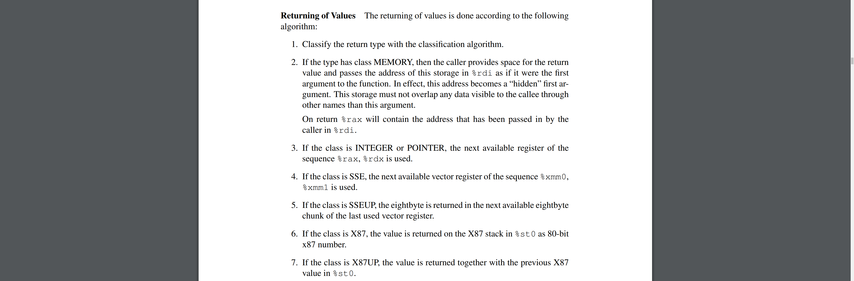
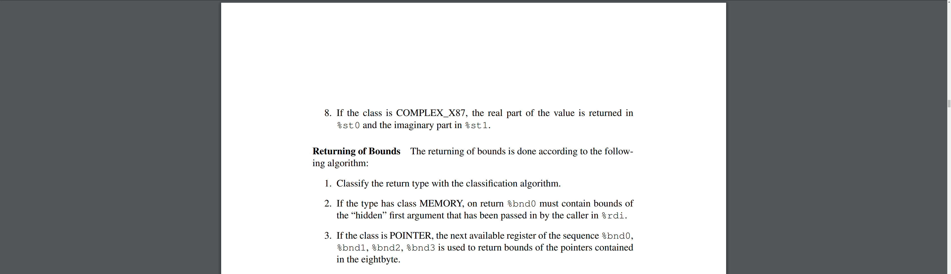
Chapter 3.2.3: Parameter Passing
mpx-linux64-abi.pdf
System V Application
Binary Interface,
AMD64 Architecture
Processor Supplement
Draft Version 0.3
Pages 25–26

Slide 32
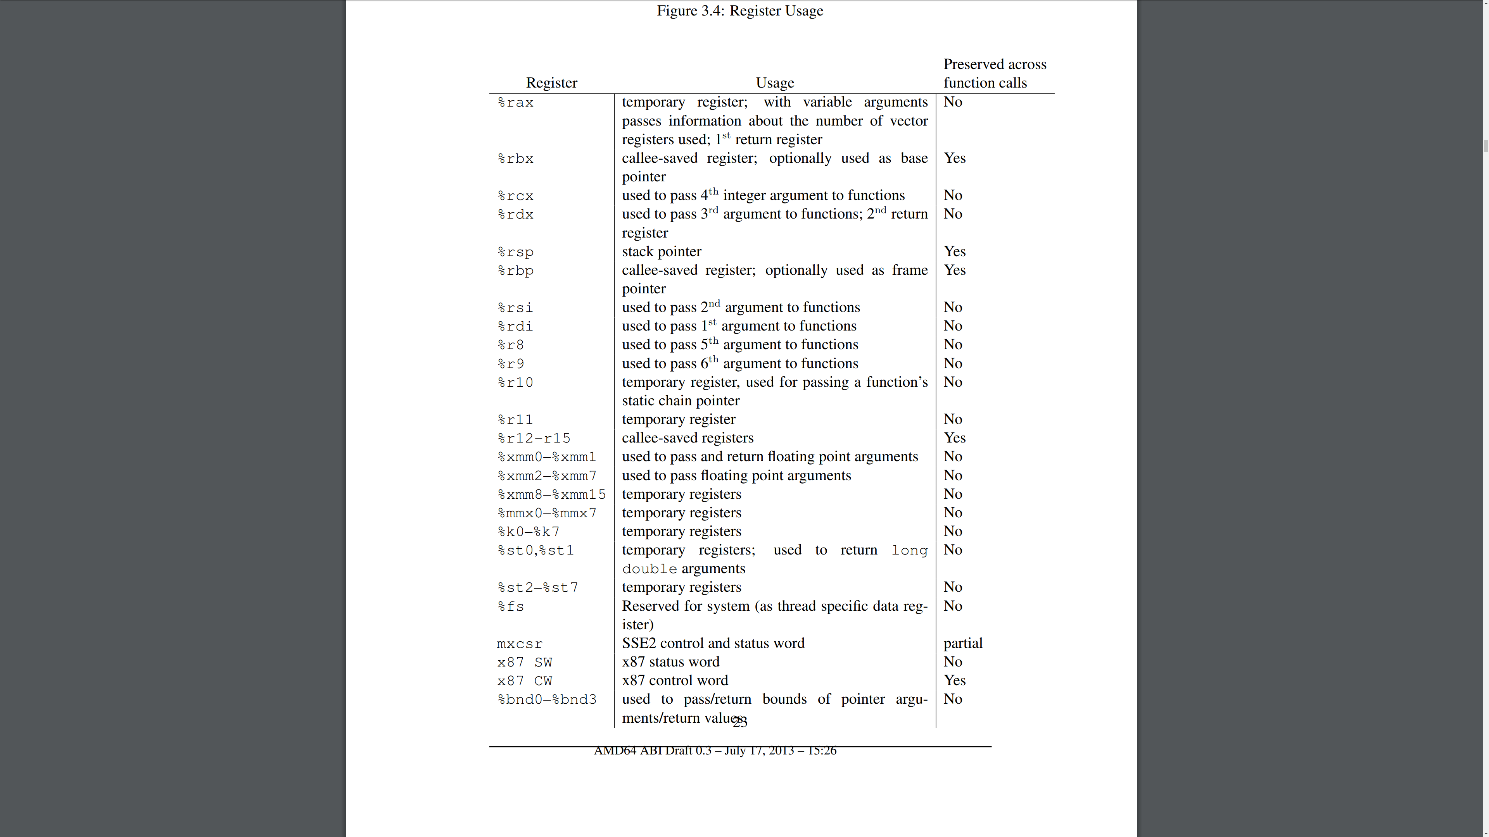
Figure 3.4: Register Usage
CALLER SAVES =
— Use freely as a temporary
variable
— When calling other functions,
must save and restore the
contents around the call,
because the other function
may clobber this register.
— Everything that is not
"callee-saves"; for example RAX
CALLEE SAVES =
— If used as a temporary
variable, must save the register
contents at the entrance
and restore at the exit
— When calling other functions,
don’t need to worry about
the other function clobbering
this register.
— RBX, RBP, R12, R13, R14, R15
mpx-linux64-abi.pdf
System V Application
Binary Interface,
AMD64 Architecture
Processor Supplement
Draft Version 0.3
Page 23

Slide 33
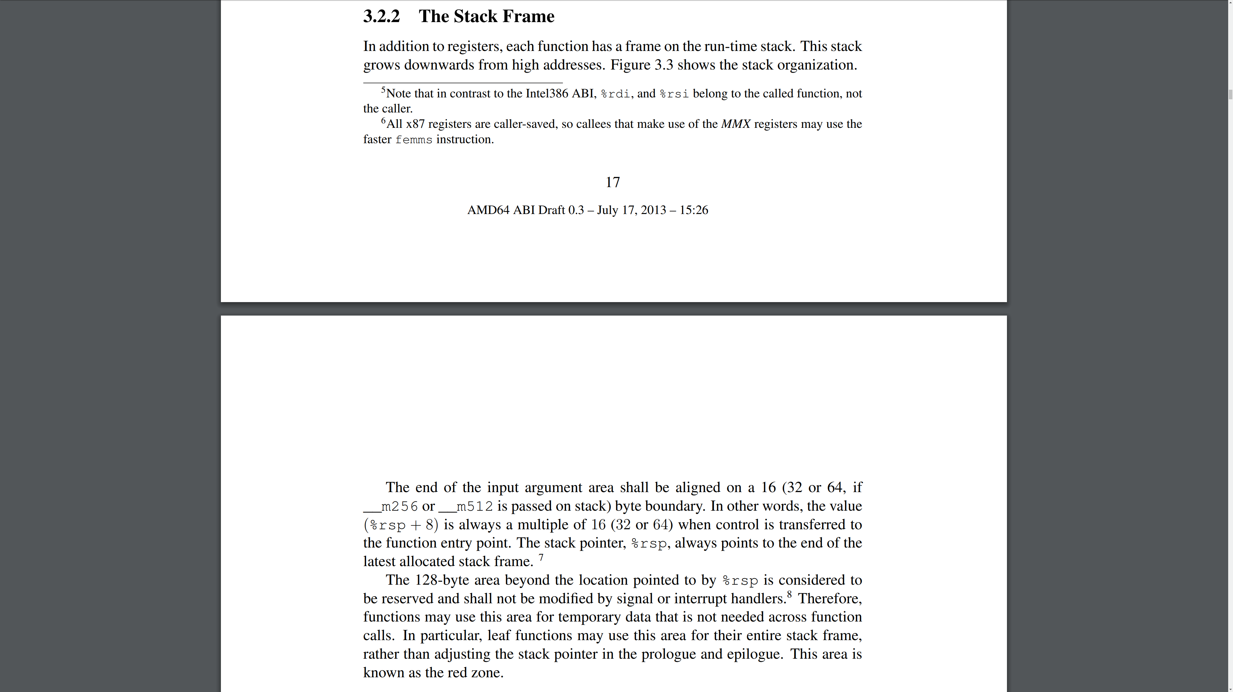
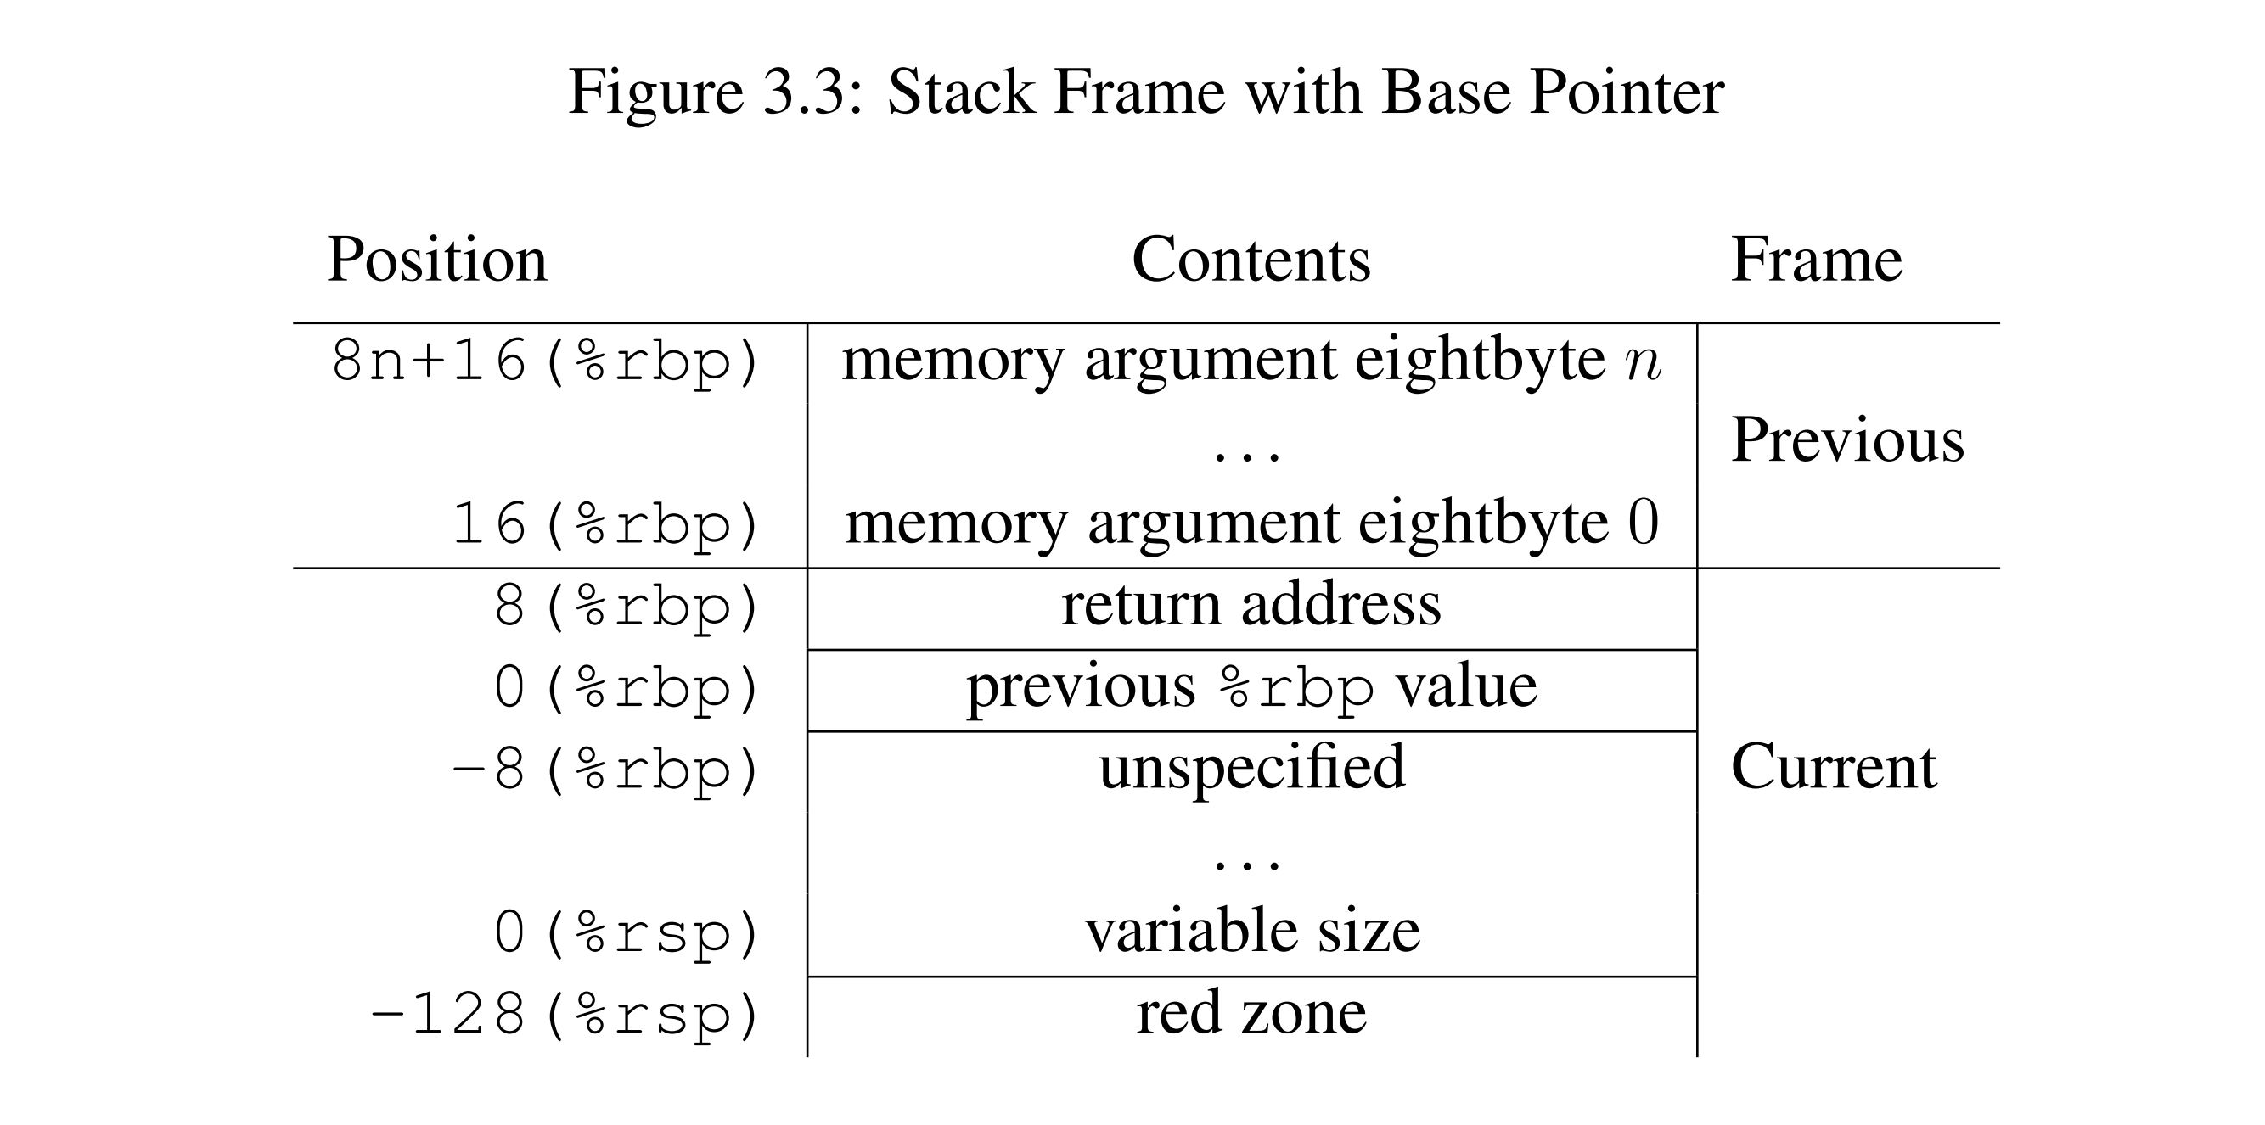
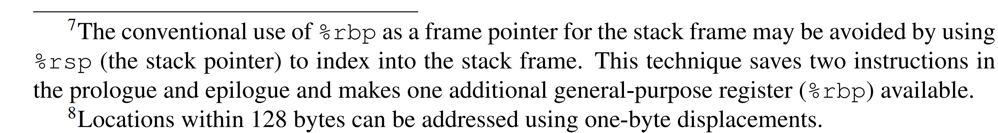
Chapter 3.2: Function Calling Sequence
mpx-linux64-abi.pdf
System V Application Binary Interface,
AMD64 Architecture Processor Supplement
Draft Version 0.3
Pages 17–18

Slide 34
CPU register roles: Summary
x86_64
Register size: 64 bits
Parameter size: 64 bits (8 bytes)
Register parameters: RDI,RSI,RDX,RCX,R8,R9
Function return value: RAX
Callee-saves registers: RBX,RBP,R12,R13,R14,R15
Mandatory stack alignment*: 16 bytes
Redzone†: 128 bytes
*) This requirement only concerns functions that call other functions.
These functions must make sure that the stack frame of the callee will satisfy this alignment.
†) This optional feature only benefits leaf functions, i.e. functions that do not call other functions.

Slide 35
CPU register roles: Summary
x86_64 snes
Register size: 64 bits 16 bits
Parameter size: 64 bits (8 bytes) 16 bits (2 bytes)
Register parameters: RDI,RSI,RDX,RCX,R8,R9 X,Y,A
Function return value: RAX A
Callee-saves registers: RBX,RBP,R12,R13,R14,R15 -
Mandatory stack alignment*: 16 bytes 1 byte
Redzone†: 128 bytes 0 bytes
Caller-saves registers: RAX,RCX,RDX,RSI,RDI, X,Y,A
R8~R11, MM0~MM7, XMM0~XMM15
Other: RSP,RIP,RFLAGS,CS~GS,SS,CR0~CR8,DRx,TRx… S,P,PC,D,DBR,PBR
*) This requirement only concerns functions that call other functions.
These functions must make sure that the stack frame of the callee will satisfy this alignment.
†) This optional feature only benefits leaf functions, i.e. functions that do not call other functions.

Slide 36
CPU register roles: Summary
x86_64 snes
Register size: 64 bits 16 bits
Parameter size: 64 bits (8 bytes) 16 bits (2 bytes)
Register parameters: RDI,RSI,RDX,RCX,R8,R9 X,Y,A
Function return value: RAX A
Callee-saves registers: RBX,RBP,R12,R13,R14,R15 -
Mandatory stack alignment*: 16 bytes 1 byte
Redzone†: 128 bytes 0 bytes
Caller-saves registers: RAX,RCX,RDX,RSI,RDI, X,Y,A
R8~R11, MM0~MM7, XMM0~XMM15
Other: RSP,RIP,RFLAGS,CS~GS,SS,CR0~CR8,DRx,TRx… S,P,PC,D,DBR,PBR
*) This requirement only concerns functions that call other functions.
These functions must make sure that the stack frame of the callee will satisfy this alignment.
†) This optional feature only benefits leaf functions, i.e. functions that do not call other functions.

Slide 37
Stack Layout
On the x86_64, RSP points to the address where the next pop would read.
MOV RAX, [RSP] reads the latest 64-bit thing pushed.
MOV [RSP+8], RAX writes into the thing pushed before that.
MOV [RSP-8], RAX writes into the red-zone.
On the SNES, S points to the address where the next push would write.
LDA 1,S reads the latest 16-bit thing pushed.
STA 3,S writes into the thing pushed before that.

Slide 38
Stack Layout
On the x86_64, RSP points to the address where the next pop would read.
MOV RAX, [RSP] reads the latest 64-bit thing pushed.
MOV [RSP+8], RAX writes into the thing pushed before that.
MOV [RSP-8], RAX writes into the red-zone.
On the SNES, S points to the address where the next push would write.
LDA 1,S reads the latest 16-bit thing pushed.
STA 3,S writes into the thing pushed before that.
There is no red-zone on the SNES. If an interrupt / NMI occurs, it will unconditionally write into the address pointed by S. On the x86_64, interrupts, signal handlers, and threads use a separate stack.
(And, “LDA -1,S” is not even a valid instruction; the offset cannot be negative.)

Slide 39
Stack Layout
x86_64 snes
[RSP+24] Function parameter #9 7,S Function parameter #6
[RSP+16] Function parameter #8 5,S Function parameter #5
[RSP+8] Function parameter #7 3,S Function parameter #4
[RSP] Function return address 1,S Function return address
(Parameters 1—6 were passed in RDI,RSI,RDX,RCX,R8,R9) (Parameters 1—3 were passed in X,Y,A)
Myfunc: Myfunc:
RET ; return RTS ; return

Slide 40
Stack Layout
x86_64 snes
[RSP+40] Function parameter #9 11,S Function parameter #6
[RSP+32] Function parameter #8 9,S Function parameter #5
[RSP+24] Function parameter #7 7,S Function parameter #4
[RSP+16] Function return address 5,S Function return address
[RSP+8] Temporary variable #1 3,S Temporary variable #1
[RSP] Temporary variable #2 1,S Temporary variable #2
Myfunc: Myfunc:
SUB RSP, 16 ; allocate space for 2 locals PHX ; allocate space for 2 locals + 2 outparams
MOV [RSP+8], RAX ; write into temp PHX
ADD RSP, 16 ; release the space STA 1,S ; write into temp
RET ; return PLX ; release the space
PLX
RTS ; return

Slide 41
Stack Layout
x86_64 snes
[RSP+24] Function parameter #9 11,S Function parameter #6
[RSP+16] Function parameter #8 9,S Function parameter #5
[RSP+8] Function parameter #7 7,S Function parameter #4
[RSP] Function return address 5,S Function return address
[RSP-8] Temporary variable #1 in red-zone 3,S Temporary variable #1
[RSP-16] Temporary variable #2 in red-zone 1,S Temporary variable #2
Myfunc: Myfunc:
MOV [RSP-8], RAX ; write into temp PHX ; allocate space for 2 locals + 2 outparams
RET ; return PHX
STA 1,S ; write into temp
PLX ; release the space
PLX
RTS ; return

Slide 42
Stack Layout
x86_64 snes
[RSP+56] Function parameter #9 15,S Function parameter #6
[RSP+48] Function parameter #8 13,S Function parameter #5
[RSP+40] Function parameter #7 11,S Function parameter #4
[RSP+32] Function return address 9,S Function return address
[RSP+24] Temporary variable #1 7,S Temporary variable #1
[RSP+16] Temporary variable #2 5,S Temporary variable #2
[RSP+8] Parameter #8 to child function 3,S Parameter #5 to child function
[RSP] Parameter #7 to child function 1,S Parameter #4 to child function
(Parameters 1—6 are passed in RDI,RSI,RDX,RCX,R8,R9) (Parameters 1—3 are passed in X,Y,A)
Myfunc: Myfunc:
SUB RSP, 32 ; allocate space for 2 locals + 2 outparams PHX ; allocate space for 2 locals + 2 outparams
MOV [RSP+24], RAX ; write into temp PHX
MOV [RSP], RAX ; write param #7 for childfunc PHX
CALL childfunc PHX
ADD RSP, 32 ; release the space STA 5,S ; write into temp
RET ; return STA 1,S ; write param #4 for childfunc
JSR childfunc
PLX ; release the space
PLX
PLX
PLX
RTS ; return

Slide 43
Stack Layout
x86_64 snes
[RSP+72] Function parameter #9 15,S Function parameter #6
[RSP+64] Function parameter #8 13,S Function parameter #5
[RSP+56] Function parameter #7 11,S Function parameter #4
[RSP+48] Function return address 9,S Function return address
[RSP+40] Backup of callee-saves register 7,S Temporary variable #1
[RSP+32] Backup of callee-saves register 5,S Temporary variable #2
[RSP+24] Temporary variable #1 3,S Parameter #5 to child function
[RSP+16] Temporary variable #2 1,S Parameter #4 to child function
[RSP+8] Parameter #8 to child function
[RSP] Parameter #7 to child function
Myfunc: Myfunc:
PUSH RBX ; backup a callee-saves register PHX ; allocate space for 2 locals + 2 outparams
PUSH RBP ; backup a callee-saves register PHX
SUB RSP, 32 ; allocate space for 2 locals + 2 outparams PHX
MOV [RSP+24], RAX ; write into temp PHX
MOV [RSP], RAX ; write param #7 for childfunc STA 5,S ; write into temp
CALL childfunc STA 1,S ; write param #4 for childfunc
ADD RSP, 32 ; release the space JSR childfunc
POP RBP ; restore a callee-saves register PLX ; release the space
POP RBX ; restore a callee-saves register PLX
RET ; return PLX
PLX
RTS ; return

Slide 44
Stack Layout
x86_64 snes
[RSP+72] Function parameter #9 15,S Function parameter #6
[RSP+64] Function parameter #8 13,S Function parameter #5
[RSP+56] Function parameter #7 11,S Function parameter #4
[RSP+48] Function return address 9,S Function return address
[RSP+40] Backup of callee-saves register 7,S Temporary variable #1
[RSP+32] Backup of callee-saves register 5,S Temporary variable #2
[RSP+24] Temporary variable #1 3,S Parameter #5 to child function
[RSP+16] Temporary variable #2 1,S Parameter #4 to child function
[RSP+8] Parameter #8 to child function
[RSP] Parameter #7 to child function
Myfunc: Myfunc:
PUSH RBX ; backup a callee-saves register PHX ; allocate space for 2 locals + 2 outparams
PUSH RBP ; backup a callee-saves register PHX
SUB RSP, 32 ; allocate space for 2 locals + 2 outparams PHX
MOV [RSP+24], RAX ; write into temp PHX
MOV [RSP], RAX ; write param #7 for childfunc STA 5,S ; write into temp
CALL childfunc STA 1,S ; write param #4 for childfunc
ADD RSP, 32 ; release the space JSR childfunc
POP RBP ; restore a callee-saves register PLX ; release the space
POP RBX ; restore a callee-saves register PLX
RET ; return PLX
PLX
RTS ; return

Slide 45
Stack Layout
x86_64 snes
[RSP+72] Function parameter #9 15,S Function parameter #6
[RSP+64] Function parameter #8 13,S Function parameter #5
[RSP+56] Function parameter #7 11,S Function parameter #4
[RSP+48] Function return address 9,S Function return address
[RSP+40] Backup of callee-saves register 7,S Temporary variable #1
[RSP+32] Backup of callee-saves register 5,S Temporary variable #2
[RSP+24] Temporary variable #1 3,S Parameter #5 to child function
[RSP+16] Temporary variable #2 1,S Parameter #4 to child function
[RSP+8] Parameter #8 to child function
[RSP] Parameter #7 to child function
Myfunc: Myfunc:
PUSH RBX ; backup a callee-saves register PHX ; allocate space for 2 locals + 2 outparams
PUSH RBP ; backup a callee-saves register PHX
SUB RSP, 32 ; allocate space for 2 locals + 2 outparams PHX
MOV [RSP+24], RAX ; write into temp PHX
MOV [RSP], RAX ; write param #7 for childfunc STA 5,S ; write into temp
CALL childfunc STA 1,S ; write param #4 for childfunc
ADD RSP, 32 ; release the space JSR childfunc
POP RBP ; restore a callee-saves register PLX ; release the space
POP RBX ; restore a callee-saves register PLX
RET ; return PLX
PLX
RTS ; return
7
Stack
items
[RSP-8] Child function return address

Slide 46
Stack Layout
x86_64 snes
[RSP+80] Function parameter #9 15,S Function parameter #6
[RSP+72] Function parameter #8 13,S Function parameter #5
[RSP+64] Function parameter #7 11,S Function parameter #4
[RSP+56] Function return address 9,S Function return address
[RSP+48] Backup of callee-saves register 7,S Temporary variable #1
[RSP+40] Backup of callee-saves register 5,S Temporary variable #2
[RSP+32] Temporary variable #1 3,S Parameter #5 to child function
[RSP+24] Temporary variable #2 1,S Parameter #4 to child function
[RSP+16] Padding
[RSP+8] Parameter #8 to child function
[RSP] Parameter #7 to child function
Myfunc: Myfunc:
PUSH RBX ; backup a callee-saves register PHX ; allocate space for 2 locals + 2 outparams
PUSH RBP ; backup a callee-saves register PHX
SUB RSP, 40 ; allocate space for 2 locals + 1 padding + 2 outparams PHX
MOV [RSP+32], RAX ; write into temp PHX
MOV [RSP], RAX ; write param #7 for childfunc STA 5,S ; write into temp
CALL childfunc STA 1,S ; write param #4 for childfunc
ADD RSP, 40 ; release the space JSR childfunc
POP RBP ; restore a callee-saves register PLX ; release the space
POP RBX ; restore a callee-saves register PLX
RET ; return PLX
PLX
RTS ; return
8
Stack
items
[RSP-8] Child function return address

Slide 47
Stack Layout
x86_64 snes
[RSP+80] Function parameter #9 15,S Function parameter #6
[RSP+72] Function parameter #8 13,S Function parameter #5
[RSP+64] Function parameter #7 11,S Function parameter #4
[RSP+56] Function return address 9,S Function return address
[RSP+48] Backup of callee-saves register 7,S Temporary variable #1
[RSP+40] Backup of callee-saves register 5,S Temporary variable #2
[RSP+32] Temporary variable #1 3,S Parameter #5 to child function
[RSP+24] Temporary variable #2 1,S Parameter #4 to child function
[RSP+16] Padding
[RSP+8] Parameter #8 to child function
[RSP] Parameter #7 to child function
Myfunc: Myfunc:
PUSH RBX ; backup a callee-saves register PHX ; allocate space for 2 locals + 2 outparams
PUSH RBP ; backup a callee-saves register PHX
SUB RSP, 40 ; allocate space for 2 locals + 1 padding + 2 outparams PHX
MOV [RSP+32], RAX ; write into temp PHX
MOV [RSP], RAX ; write param #7 for childfunc STA 5,S ; write into temp
CALL childfunc STA 1,S ; write param #4 for childfunc
ADD RSP, 40 ; release the space JSR childfunc
POP RBP ; restore a callee-saves register PLX ; release the space
POP RBX ; restore a callee-saves register PLX
RET ; return PLX
PLX
RTS ; return
8
Stack
items
[RSP-8] Child function return address

Slide 48
Stack Management: x86_64
To allocate n units of space:
SUB RSP, n*8
or ADD RSP, n*-8
or LEA RSP, [RSP + n*-8]
(Unit = word size = 64 bits = 8 bytes)

Slide 49
Stack Management: x86_64
To allocate n units of space:
SUB RSP, n*8
or ADD RSP, n*-8
or LEA RSP, [RSP + n*-8]
To release n units of space:
ADD RSP, n*8
(Unit = word size = 64 bits = 8 bytes)

Slide 50
Stack Management: snes
To allocate 1 unit of space:
PHX
(Unit = word size = 16 bits = 2 bytes)

Slide 51
Stack Management: snes
To allocate 2 units of space:
PHX
PHX
(Unit = word size = 16 bits = 2 bytes)

Slide 52
Stack Management: snes
To allocate 3 units of space:
PHX
PHX
PHX
(Unit = word size = 16 bits = 2 bytes)

Slide 53
Stack Management: snes
To allocate 4 units of space:
PHX
PHX
PHX
PHX
(Unit = word size = 16 bits = 2 bytes)

Slide 54
Stack Management: snes
To allocate 5 units of space:
PHX
PHX
PHX
PHX
PHX
(Unit = word size = 16 bits = 2 bytes)

Slide 55
Stack Management: snes
To allocate 6 units of space:
PHX
PHX
PHX
PHX
PHX
PHX
(Unit = word size = 16 bits = 2 bytes)

Slide 56
Stack Management: snes
To allocate 7 units of space:
PHX
PHX
PHX
PHX
PHX
PHX
PHX
(Unit = word size = 16 bits = 2 bytes)

Slide 57
Stack Management: snes
To allocate 8 units of space:
PHX
PHX
PHX
PHX
PHX
PHX
PHX
PHX
(Unit = word size = 16 bits = 2 bytes)

Slide 58
Stack Management: snes
To allocate 9 units of space:
PHX
PHX
PHX
PHX
PHX
PHX
PHX
PHX
PHX
(Unit = word size = 16 bits = 2 bytes)

Slide 59
Stack Management: snes
To allocate 10 units of space:
PHX
PHX
PHX
PHX
PHX
PHX
PHX
PHX
PHX
PHX
(Unit = word size = 16 bits = 2 bytes)

Slide 60
Stack Management: snes
To allocate 11 units of space:
PHX
PHX
PHX
PHX
PHX
PHX
PHX
PHX
PHX
PHX
PHX
(Unit = word size = 16 bits = 2 bytes)

Slide 61
Stack Management: snes
To allocate 12 units of space:
PHX
PHX
PHX
PHX
PHX
PHX
PHX
PHX
PHX
PHX
PHX
PHX
(Unit = word size = 16 bits = 2 bytes)

Slide 62
Stack Management: snes
To allocate 12 units of space: And, to free 12 units:
PHX PLX
PHX PLX
PHX PLX
PHX PLX
PHX PLX
PHX PLX
PHX PLX
PHX PLX
PHX PLX
PHX PLX
PHX PLX
PHX PLX
(Unit = word size = 16 bits = 2 bytes)

Slide 63
Stack Management: snes
To allocate 30 units of space:
TSX
TXA
SEC
SBC #30*2
TAX
TXS
(Unit = word size = 16 bits = 2 bytes)

Slide 64
Stack Management: snes
To allocate 30 units of space:
TSX
TXA
SEC
SBC #30*2
TAX
TXS
(Unit = word size = 16 bits = 2 bytes)
Clobbers X
Clobbers A

Slide 65
Stack Management: snes
To allocate 30 units of space:
TSX PHX
TXA TSX
SEC TXA
SBC #30*2 SEC
TAX SBC #29*2
TXS TAX
TXS
LDA 29*2+1,S
TAX
(Unit = word size = 16 bits = 2 bytes)
Clobbers X
Saves X
Clobbers A
Clobbers A
Restores X

Slide 66
Stack Management: snes
To allocate 30 units of space:
TSX PHX PHA
TXA TSX PHX
SEC TXA TSX
SBC #30*2 SEC TXA
TAX SBC #29*2 SEC
TXS TAX SBC #28*2
TXS TAX
LDA 29*2+1,S TXS
TAX LDA 28*2+1,S
TAX
LDA 29*2+1,S
(Unit = word size = 16 bits = 2 bytes)
Clobbers X
Saves X
Saves A & X
Clobbers A
Clobbers A
Restores X
Restores both

Slide 67
Stack Management: snes
To release 30 units of space:
TSX
PHA
TXA
CLC
ADC #30*2
TAX
PLA
TXS
(Unit = word size = 16 bits = 2 bytes)
Saves A
Clobbers X
Restores A

Slide 68
Stack Management: snes
To release 30 units of space:
TSX PHA
PHA TXA
TXA TSX
CLC STA 30*2+1,X
ADC #30*2 TXA
TAX CLC
PLA ADC #30*2
TXS TAX
PLA
TXS
PLX
(Unit = word size = 16 bits = 2 bytes)
Saves A
Clobbers X
Restores A

Slide 69
Stack Management: snes
To release 30 units of space:
TSX PHA
PHA TXA
TXA TSX
CLC STA 30*2+1,X
ADC #30*2 TXA
TAX CLC
PLA ADC #30*2
TXS TAX
PLA
TXS
PLX
(Unit = word size = 16 bits = 2 bytes)
Saves A
Clobbers X
Restores A

Slide 70
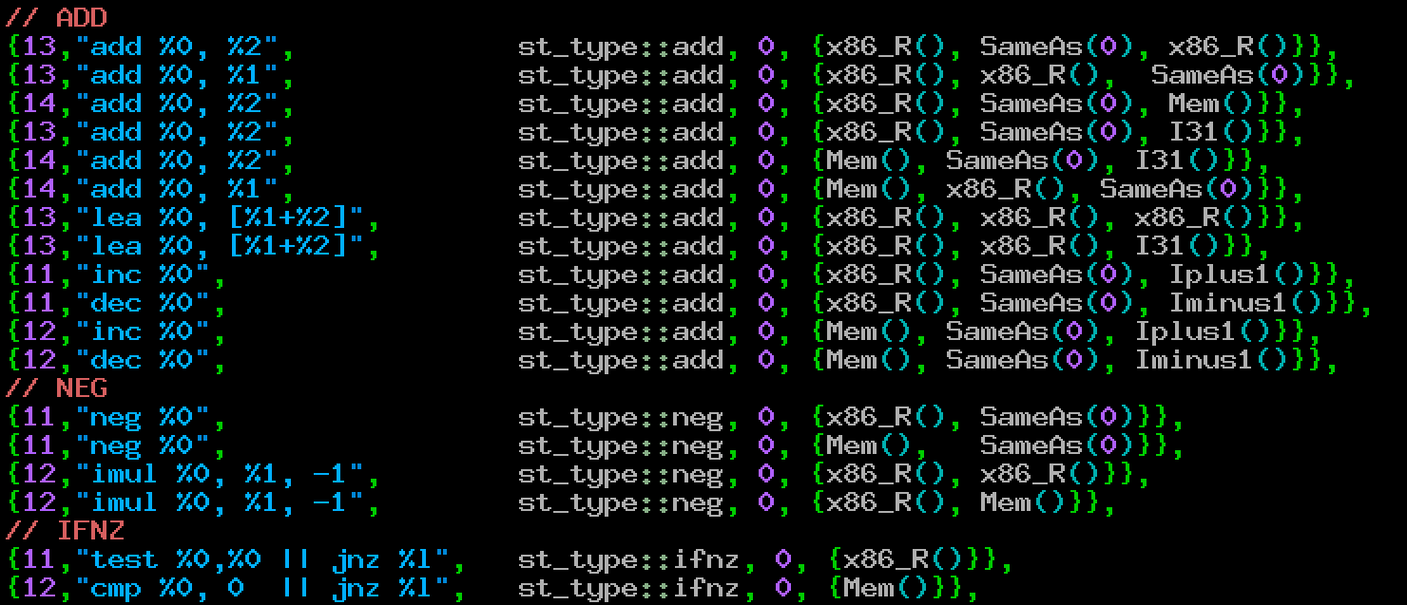
Flashback: Instruction Patterns

Slide 71
Flashback: Instruction Patterns

Slide 72
Flashback: Instruction Patterns

Slide 73
Flashback: Instruction Patterns

Slide 74
Flashback: Instruction Patterns

Slide 75
Flashback: Instruction Patterns
Param0 Param1 Param2 Pattern expansion
R0 R0 R15 “add rdi, [rsp]”
R1 R1 R15 “add rsi, [rsp]”
R2 R2 R15 “add rdx, [rsp]”
R3 R3 R15 “add rcx, [rsp]”
R4 R4 R15 “add r8, [rsp]”
R5 R5 R15 “add r9, [rsp]”
R6 R6 R15 “add rax, [rsp]”
R7 R7 R15 “add r10, [rsp]”
R8 R8 R15 “add r11, [rsp]”
R9 R9 R15 “add r12, [rsp]”
R10 R10 R15 “add r13, [rsp]”
R11 R11 R15 “add r14, [rsp]”
R12 R12 R15 “add r15, [rsp]”
R13 R13 R15 “add rbx, [rsp]”
R14 R14 R15 “add rbp, [rsp]”
For “add %0, %2” with {x86_R(), SameAs(0), Mem()}
Param0 Param1 Param2 Pattern expansion
R0 R0 R16 “add rdi, [rsp+8]”
R1 R1 R16 “add rsi, [rsp+8]”
R2 R2 R16 “add rdx, [rsp+8]”
R3 R3 R16 “add rcx, [rsp+8]”
R4 R4 R16 “add r8, [rsp+8]”
R5 R5 R16 “add r9, [rsp+8]”
R6 R6 R16 “add rax, [rsp+8]”
R7 R7 R16 “add r10, [rsp+8]”
R8 R8 R16 “add r11, [rsp+8]”
R9 R9 R16 “add r12, [rsp+8]”
R10 R10 R16 “add r13, [rsp+8]”
R11 R11 R16 “add r14, [rsp+8]”
R12 R12 R16 “add r15, [rsp+8]”
R13 R13 R16 “add rbx, [rsp+8]”
R14 R14 R16 “add rbp, [rsp+8]”
Param0 Param1 Param2 Pattern expansion
R0 R0 R17 “add rdi, [rsp+16]”
R1 R1 R17 “add rsi, [rsp+16]”
R2 R2 R17 “add rdx, [rsp+16]”
R3 R3 R17 “add rcx, [rsp+16]”
R4 R4 R17 “add r8, [rsp+16]”
R5 R5 R17 “add r9, [rsp+16]”
R6 R6 R17 “add rax, [rsp+16]”
R7 R7 R17 “add r10, [rsp+16]”
R8 R8 R17 “add r11, [rsp+16]”
R9 R9 R17 “add r12, [rsp+16]”
R10 R10 R17 “add r13, [rsp+16]”
R11 R11 R17 “add r14, [rsp+16]”
R12 R12 R17 “add r15, [rsp+16]”
R13 R13 R17 “add rbx, [rsp+16]”
R14 R14 R17 “add rbp, [rsp+16]”

Slide 76
Data Classes
— Actual CPU registers
Not all CPU registers are equal
— Memory variables
On the SNES, there
are INX & INY, but
no INA; there is ADC
that adds to A, but
no equivalents
for X & Y.

Slide 77
Data Classes
— Actual CPU registers
Not all CPU registers are equal
— Memory variables
Global variables?
— Not an option with re-entrant
functions (such as recursion)
— Memory is kept reserved for
these variables even when the
function is not being invoked.

Slide 78
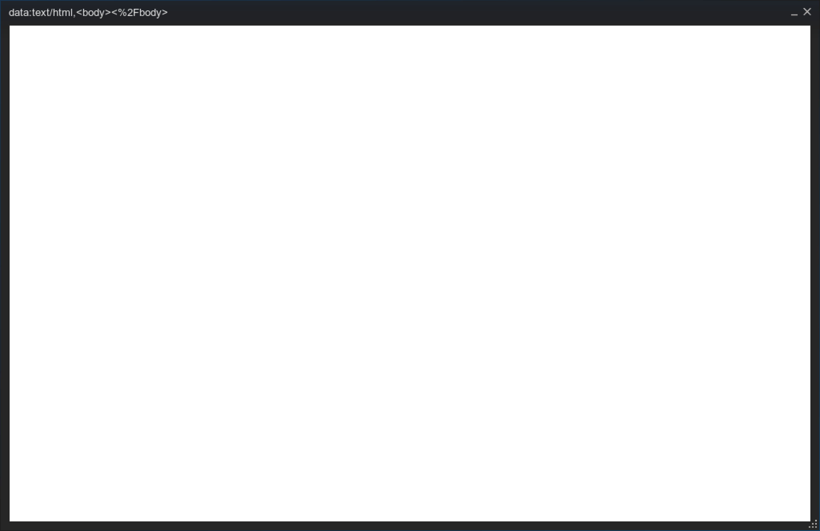
End of Episode 5 part A
Flashback: Instruction Patterns
Param0 Param1 Param2 Pattern expansion
R0 R0 R15 “add rdi, [rsp]”
R1 R1 R15 “add rsi, [rsp]”
R2 R2 R15 “add rdx, [rsp]”
R3 R3 R15 “add rcx, [rsp]”
R4 R4 R15 “add r8, [rsp]”
R5 R5 R15 “add r9, [rsp]”
R6 R6 R15 “add rax, [rsp]”
R7 R7 R15 “add r10, [rsp]”
R8 R8 R15 “add r11, [rsp]”
R9 R9 R15 “add r12, [rsp]”
R10 R10 R15 “add r13, [rsp]”
R11 R11 R15 “add r14, [rsp]”
R12 R12 R15 “add r15, [rsp]”
R13 R13 R15 “add rbx, [rsp]”
R14 R14 R15 “add rbp, [rsp]”
For “add %0, %2” with {x86_R(), SameAs(0), Mem()}
Param0 Param1 Param2 Pattern expansion
R0 R0 R16 “add rdi, [rsp+8]”
R1 R1 R16 “add rsi, [rsp+8]”
R2 R2 R16 “add rdx, [rsp+8]”
R3 R3 R16 “add rcx, [rsp+8]”
R4 R4 R16 “add r8, [rsp+8]”
R5 R5 R16 “add r9, [rsp+8]”
R6 R6 R16 “add rax, [rsp+8]”
R7 R7 R16 “add r10, [rsp+8]”
R8 R8 R16 “add r11, [rsp+8]”
R9 R9 R16 “add r12, [rsp+8]”
R10 R10 R16 “add r13, [rsp+8]”
R11 R11 R16 “add r14, [rsp+8]”
R12 R12 R16 “add r15, [rsp+8]”
R13 R13 R16 “add rbx, [rsp+8]”
R14 R14 R16 “add rbp, [rsp+8]”
Param0 Param1 Param2 Pattern expansion
R0 R0 R17 “add rdi, [rsp+16]”
R1 R1 R17 “add rsi, [rsp+16]”
R2 R2 R17 “add rdx, [rsp+16]”
R3 R3 R17 “add rcx, [rsp+16]”
R4 R4 R17 “add r8, [rsp+16]”
R5 R5 R17 “add r9, [rsp+16]”
R6 R6 R17 “add rax, [rsp+16]”
R7 R7 R17 “add r10, [rsp+16]”
R8 R8 R17 “add r11, [rsp+16]”
R9 R9 R17 “add r12, [rsp+16]”
R10 R10 R17 “add r13, [rsp+16]”
R11 R11 R17 “add r14, [rsp+16]”
R12 R12 R17 “add r15, [rsp+16]”
R13 R13 R17 “add rbx, [rsp+16]”
R14 R14 R17 “add rbp, [rsp+16]”

Slide 79
Begin of Episode 5 part B
Flashback: Instruction Patterns
Param0 Param1 Param2 Pattern expansion
R0 R0 R15 “add rdi, [rsp]”
R1 R1 R15 “add rsi, [rsp]”
R2 R2 R15 “add rdx, [rsp]”
R3 R3 R15 “add rcx, [rsp]”
R4 R4 R15 “add r8, [rsp]”
R5 R5 R15 “add r9, [rsp]”
R6 R6 R15 “add rax, [rsp]”
R7 R7 R15 “add r10, [rsp]”
R8 R8 R15 “add r11, [rsp]”
R9 R9 R15 “add r12, [rsp]”
R10 R10 R15 “add r13, [rsp]”
R11 R11 R15 “add r14, [rsp]”
R12 R12 R15 “add r15, [rsp]”
R13 R13 R15 “add rbx, [rsp]”
R14 R14 R15 “add rbp, [rsp]”
For “add %0, %2” with {x86_R(), SameAs(0), Mem()}
Param0 Param1 Param2 Pattern expansion
R0 R0 R16 “add rdi, [rsp+8]”
R1 R1 R16 “add rsi, [rsp+8]”
R2 R2 R16 “add rdx, [rsp+8]”
R3 R3 R16 “add rcx, [rsp+8]”
R4 R4 R16 “add r8, [rsp+8]”
R5 R5 R16 “add r9, [rsp+8]”
R6 R6 R16 “add rax, [rsp+8]”
R7 R7 R16 “add r10, [rsp+8]”
R8 R8 R16 “add r11, [rsp+8]”
R9 R9 R16 “add r12, [rsp+8]”
R10 R10 R16 “add r13, [rsp+8]”
R11 R11 R16 “add r14, [rsp+8]”
R12 R12 R16 “add r15, [rsp+8]”
R13 R13 R16 “add rbx, [rsp+8]”
R14 R14 R16 “add rbp, [rsp+8]”
Param0 Param1 Param2 Pattern expansion
R0 R0 R17 “add rdi, [rsp+16]”
R1 R1 R17 “add rsi, [rsp+16]”
R2 R2 R17 “add rdx, [rsp+16]”
R3 R3 R17 “add rcx, [rsp+16]”
R4 R4 R17 “add r8, [rsp+16]”
R5 R5 R17 “add r9, [rsp+16]”
R6 R6 R17 “add rax, [rsp+16]”
R7 R7 R17 “add r10, [rsp+16]”
R8 R8 R17 “add r11, [rsp+16]”
R9 R9 R17 “add r12, [rsp+16]”
R10 R10 R17 “add r13, [rsp+16]”
R11 R11 R17 “add r14, [rsp+16]”
R12 R12 R17 “add r15, [rsp+16]”
R13 R13 R17 “add rbx, [rsp+16]”
R14 R14 R17 “add rbp, [rsp+16]”

Slide 80
End of Episode 5 part B
Flashback: Instruction Patterns
Param0 Param1 Param2 Pattern expansion
R0 R0 R15 “add rdi, [rsp]”
R1 R1 R15 “add rsi, [rsp]”
R2 R2 R15 “add rdx, [rsp]”
R3 R3 R15 “add rcx, [rsp]”
R4 R4 R15 “add r8, [rsp]”
R5 R5 R15 “add r9, [rsp]”
R6 R6 R15 “add rax, [rsp]”
R7 R7 R15 “add r10, [rsp]”
R8 R8 R15 “add r11, [rsp]”
R9 R9 R15 “add r12, [rsp]”
R10 R10 R15 “add r13, [rsp]”
R11 R11 R15 “add r14, [rsp]”
R12 R12 R15 “add r15, [rsp]”
R13 R13 R15 “add rbx, [rsp]”
R14 R14 R15 “add rbp, [rsp]”
For “add %0, %2” with {x86_R(), SameAs(0), Mem()}
Param0 Param1 Param2 Pattern expansion
R0 R0 R16 “add rdi, [rsp+8]”
R1 R1 R16 “add rsi, [rsp+8]”
R2 R2 R16 “add rdx, [rsp+8]”
R3 R3 R16 “add rcx, [rsp+8]”
R4 R4 R16 “add r8, [rsp+8]”
R5 R5 R16 “add r9, [rsp+8]”
R6 R6 R16 “add rax, [rsp+8]”
R7 R7 R16 “add r10, [rsp+8]”
R8 R8 R16 “add r11, [rsp+8]”
R9 R9 R16 “add r12, [rsp+8]”
R10 R10 R16 “add r13, [rsp+8]”
R11 R11 R16 “add r14, [rsp+8]”
R12 R12 R16 “add r15, [rsp+8]”
R13 R13 R16 “add rbx, [rsp+8]”
R14 R14 R16 “add rbp, [rsp+8]”
Param0 Param1 Param2 Pattern expansion
R0 R0 R17 “add rdi, [rsp+16]”
R1 R1 R17 “add rsi, [rsp+16]”
R2 R2 R17 “add rdx, [rsp+16]”
R3 R3 R17 “add rcx, [rsp+16]”
R4 R4 R17 “add r8, [rsp+16]”
R5 R5 R17 “add r9, [rsp+16]”
R6 R6 R17 “add rax, [rsp+16]”
R7 R7 R17 “add r10, [rsp+16]”
R8 R8 R17 “add r11, [rsp+16]”
R9 R9 R17 “add r12, [rsp+16]”
R10 R10 R17 “add r13, [rsp+16]”
R11 R11 R17 “add r14, [rsp+16]”
R12 R12 R17 “add r15, [rsp+16]”
R13 R13 R17 “add rbx, [rsp+16]”
R14 R14 R17 “add rbp, [rsp+16]”

