Slide 1
__v16si vector addition on x86_64, 32-bit instructions only
MOV EAX, [VAR1+0] MOV EAX, [VAR1+32]
MOV EBX, [VAR1+4] MOV R9D, [VAR1+36]
MOV ECX, [VAR1+8] MOV R10D, [VAR1+40]
MOV EDX, [VAR1+12] MOV R11D, [VAR1+44]
MOV ESI, [VAR1+16] MOV R12D, [VAR1+48]
MOV EDI, [VAR1+20] MOV R13D, [VAR1+52]
MOV EBP, [VAR1+24] MOV R14D, [VAR1+56]
MOV R8D, [VAR1+28] MOV R15D, [VAR1+60]
ADD [VAR2+0], EAX ADD [VAR2+32], EAX
ADD [VAR2+4], EBX ADD [VAR2+36], R9D
ADD [VAR2+8], ECX ADD [VAR2+40], R10D
ADD [VAR2+12], EDX ADD [VAR2+44], R11D
ADD [VAR2+16], ESI ADD [VAR2+48], R12D
ADD [VAR2+20], EDI ADD [VAR2+52], R13D
ADD [VAR2+24], EBP ADD [VAR2+56], R14D
ADD [VAR2+28], R8D ADD [VAR2+60], R15D

Slide 2
__v16si vector addition, MMX instructions: 64-bit SIMD
MOV EAX, [VAR1+0] MOV EAX, [VAR1+32]
MOV EBX, [VAR1+4] MOV R9D, [VAR1+36]
MOV ECX, [VAR1+8] MOV R10D, [VAR1+40]
MOV EDX, [VAR1+12] MOV R11D, [VAR1+44]
MOV ESI, [VAR1+16] MOV R12D, [VAR1+48]
MOV EDI, [VAR1+20] MOV R13D, [VAR1+52]
MOV EBP, [VAR1+24] MOV R14D, [VAR1+56]
MOV R8D, [VAR1+28] MOV R15D, [VAR1+60]
ADD [VAR2+0], EAX ADD [VAR2+32], EAX
ADD [VAR2+4], EBX ADD [VAR2+36], R9D
ADD [VAR2+8], ECX ADD [VAR2+40], R10D
ADD [VAR2+12], EDX ADD [VAR2+44], R11D
ADD [VAR2+16], ESI ADD [VAR2+48], R12D
ADD [VAR2+20], EDI ADD [VAR2+52], R13D
ADD [VAR2+24], EBP ADD [VAR2+56], R14D
ADD [VAR2+28], R8D ADD [VAR2+60], R15D
MOVQ MM0, [VAR1+0]
MOVQ MM1, [VAR1+8]
MOVQ MM2, [VAR1+16]
MOVQ MM3, [VAR1+24]
MOVQ MM4, [VAR1+32]
MOVQ MM5, [VAR1+40]
MOVQ MM6, [VAR1+48]
MOVQ MM7, [VAR1+56]
PADDD MM0, [VAR2+0]
PADDD MM1, [VAR2+8]
PADDD MM2, [VAR2+16]
PADDD MM3, [VAR2+24]
PADDD MM4, [VAR2+32]
PADDD MM5, [VAR2+40]
PADDD MM6, [VAR2+48]
PADDD MM7, [VAR2+56]
MOVQ [VAR2+0], MM0
MOVQ [VAR2+8], MM1
MOVQ [VAR2+16], MM2
MOVQ [VAR2+24], MM3
MOVQ [VAR2+32], MM4
MOVQ [VAR2+40], MM5
MOVQ [VAR2+48], MM6
MOVQ [VAR2+56], MM7
Available since Intel® Pentium® MMX (1997)

Slide 3
__v16si vector addition, SSE2 instructions: 128-bit SIMD
MOV EAX, [VAR1+0] MOV EAX, [VAR1+32]
MOV EBX, [VAR1+4] MOV R9D, [VAR1+36]
MOV ECX, [VAR1+8] MOV R10D, [VAR1+40]
MOV EDX, [VAR1+12] MOV R11D, [VAR1+44]
MOV ESI, [VAR1+16] MOV R12D, [VAR1+48]
MOV EDI, [VAR1+20] MOV R13D, [VAR1+52]
MOV EBP, [VAR1+24] MOV R14D, [VAR1+56]
MOV R8D, [VAR1+28] MOV R15D, [VAR1+60]
ADD [VAR2+0], EAX ADD [VAR2+32], EAX
ADD [VAR2+4], EBX ADD [VAR2+36], R9D
ADD [VAR2+8], ECX ADD [VAR2+40], R10D
ADD [VAR2+12], EDX ADD [VAR2+44], R11D
ADD [VAR2+16], ESI ADD [VAR2+48], R12D
ADD [VAR2+20], EDI ADD [VAR2+52], R13D
ADD [VAR2+24], EBP ADD [VAR2+56], R14D
ADD [VAR2+28], R8D ADD [VAR2+60], R15D
MOVDQU XMM0, [VAR1+0]
MOVDQU XMM1, [VAR1+16]
MOVDQU XMM2, [VAR1+32]
MOVDQU XMM3, [VAR1+48]
PADDD XMM0, [VAR2+0]
PADDD XMM1, [VAR2+16]
PADDD XMM2, [VAR2+32]
PADDD XMM3, [VAR2+48]
MOVDQU [VAR2+0], XMM0
MOVDQU [VAR2+48], XMM1
MOVDQU [VAR2+16], XMM2
MOVDQU [VAR2+32], XMM3
Available since Intel® Pentium® 4 (2001), standard in all x86_64 processors
128-bit XMM registers first appeared in SSE (Pentium Ⅲ, 1999), but epi32 operations need SSE2.

Slide 4
__v16si vector addition, AVX2 instructions: 256-bit SIMD
MOV EAX, [VAR1+0] MOV EAX, [VAR1+32]
MOV EBX, [VAR1+4] MOV R9D, [VAR1+36]
MOV ECX, [VAR1+8] MOV R10D, [VAR1+40]
MOV EDX, [VAR1+12] MOV R11D, [VAR1+44]
MOV ESI, [VAR1+16] MOV R12D, [VAR1+48]
MOV EDI, [VAR1+20] MOV R13D, [VAR1+52]
MOV EBP, [VAR1+24] MOV R14D, [VAR1+56]
MOV R8D, [VAR1+28] MOV R15D, [VAR1+60]
ADD [VAR2+0], EAX ADD [VAR2+32], EAX
ADD [VAR2+4], EBX ADD [VAR2+36], R9D
ADD [VAR2+8], ECX ADD [VAR2+40], R10D
ADD [VAR2+12], EDX ADD [VAR2+44], R11D
ADD [VAR2+16], ESI ADD [VAR2+48], R12D
ADD [VAR2+20], EDI ADD [VAR2+52], R13D
ADD [VAR2+24], EBP ADD [VAR2+56], R14D
ADD [VAR2+28], R8D ADD [VAR2+60], R15D
VMOVDQU YMM0, [VAR1+0]
VMOVDQU YMM1, [VAR1+32]
VPADDD YMM0, [VAR2+0]
VPADDD YMM1, [VAR2+32]
VMOVDQU [VAR2+0], YMM0
VMOVDQU [VAR2+32], YMM1
Available since Haswell microarchitecture (2013)
256-bit YMM registers first appeared in AVX (Sandy Bridge, 2011), but epi32 operations need AVX2.

Slide 5
__v16si vector addition, AVX-512F instructions: 512-bit SIMD
MOV EAX, [VAR1+0] MOV EAX, [VAR1+32]
MOV EBX, [VAR1+4] MOV R9D, [VAR1+36]
MOV ECX, [VAR1+8] MOV R10D, [VAR1+40]
MOV EDX, [VAR1+12] MOV R11D, [VAR1+44]
MOV ESI, [VAR1+16] MOV R12D, [VAR1+48]
MOV EDI, [VAR1+20] MOV R13D, [VAR1+52]
MOV EBP, [VAR1+24] MOV R14D, [VAR1+56]
MOV R8D, [VAR1+28] MOV R15D, [VAR1+60]
ADD [VAR2+0], EAX ADD [VAR2+32], EAX
ADD [VAR2+4], EBX ADD [VAR2+36], R9D
ADD [VAR2+8], ECX ADD [VAR2+40], R10D
ADD [VAR2+12], EDX ADD [VAR2+44], R11D
ADD [VAR2+16], ESI ADD [VAR2+48], R12D
ADD [VAR2+20], EDI ADD [VAR2+52], R13D
ADD [VAR2+24], EBP ADD [VAR2+56], R14D
ADD [VAR2+28], R8D ADD [VAR2+60], R15D
VMOVDQU ZMM0, [VAR1+0]
VPADDD ZMM0, [VAR2+0]
VMOVDQU [VAR2+0], ZMM0
Available since Intel® Xeon Phi™ x200 (2016) and Cannonlake microarchitecture (2017*)
AVX-512DQ is not needed for these epi32 operations.
*) announced

Slide 6
CUDA processing, single stream (default)
Stream 0:
…
calculation
xfer
calculation
xfer
calculation
xfer
GPU utilization: < 100 %
“Stream” is a queue of operations to be performed with the GPU device.

Slide 7
CUDA processing, single stream (default)
Stream 0:
…
calculation
xfer
calculation
xfer
calculation
xfer
GPU
is
idle
GPU
is
idle
GPU
is
idle
GPU utilization: < 100 %
“Stream” is a queue of operations to be performed with the GPU device.

Slide 8
CUDA processing, single stream (default)
Stream 0:
…
calculation
xfer
calculation
xfer
calculation
xfer
Stream 1:
…
waiting for work
GPU utilization: < 100 %
“Stream” is a queue of operations to be performed with the GPU device.

Slide 9
CUDA processing, multi-stream
Stream 0:
…
calculation
xfer
waiting for
GPU availability
calculation
xfer
wait…
Stream 1:
…
waiting for
GPU availability
calculation
xfer
waiting for
GPU availability
calculation
GPU utilization: 100 %
La oveja es un mamifero de cuatro patas. The sheep is a mammal with a four legs.

Slide 10
CUDA processing, multi-stream
Stream 0:
…
calculation
xfer
waiting for
GPU availability
calculation
xfer
wait…
Stream 1:
…
waiting for
GPU availability
calculation
xfer
waiting for
GPU availability
calculation
GPU utilization: 100 %
“Stream” is a queue of operations to be performed with the GPU device.

Slide 12
#include <cmath>
double mylog2(double x) /* log2(x) for 1 positive double */
{
constexpr int mantissa_bits = 52, exponent_bias = 1022;
const double half = 0.5;
int e = (const std::uint64_t&)(x) >> mantissa_bits;
uint64_t m = (const std::uint64_t&)(x) & ((1ull << mantissa_bits)–1);
m |= (const std::uint64_t&)(half);
x = (const double&)(m);
int lt = (x < 1/std::sqrt(2.)) ? –1 : 0;
double dbl_e = e + lt – exponent_bias;
double z = x – (half + (lt ? 0. : half));
double y = half * (x – (lt ? half : 0.)) + half;
x = z / y;
z = x * x;
double u = z + –3.56722798512324312549E1;
double t = –7.89580278884799154124E–1;
u = u * z + 3.12093766372244180303E2;
t = t * z + 1.63866645699558079767E1;
u = u * z + –7.69691943550460008604E2;
t = t * z + –6.41409952958715622951E1;
y = z * (t/u) + (half+half);
return x * (y * std::log2(std::exp(1.))) + dbl_e;
}

Slide 13
#include <cmath>
double mylog2(double x) /* log2(x) for 1 positive double */
{
constexpr int mantissa_bits = 52, exponent_bias = 1022;
const double half = 0.5;
int e = (const std::uint64_t&)(x) >> mantissa_bits;
uint64_t m = (const std::uint64_t&)(x) & ((1ull << mantissa_bits)–1);
m |= (const std::uint64_t&)(half);
x = (const double&)(m);
int lt = (x < 1/std::sqrt(2.)) ? –1 : 0;
double dbl_e = e + lt – exponent_bias;
double z = x – (half + (lt ? 0. : half));
double y = half * (x – (lt ? half : 0.)) + half;
x = z / y;
z = x * x;
double u = z + –3.56722798512324312549E1;
double t = –7.89580278884799154124E–1;
u = u * z + 3.12093766372244180303E2;
t = t * z + 1.63866645699558079767E1;
u = u * z + –7.69691943550460008604E2;
t = t * z + –6.41409952958715622951E1;
y = z * (t/u) + (half+half);
return x * (y * std::log2(std::exp(1.))) + dbl_e;
}
#include <cmath>
#include <x86intrin.h>
__m512d _mm512_log2_pd(__m512d x) /* log2(x) for eight positive doubles */
{
constexpr int mantissa_bits = 52, exponent_bias = 1022;
__m512d half = _mm512_set1_pd(0.5);
__m512i e = _mm512_srli_epi64(_mm512_castpd_si512(x), mantissa_bits);
__m512i m = _mm512_and_si512(_mm512_castpd_si512(x),
_mm512_set1_epi64((1ull << mantissa_bits)–1));
x = _mm512_or_pd(half, _mm512_castsi512_pd(m));
__mmask8 lt = _mm512_cmp_pd_mask(x, _mm512_set1_pd(1/std::sqrt(2.)), _MM_CMPINT_LT);
__m512d ltid = _mm512_castsi512_pd(_mm512_mask_mov_epi64(
_mm512_set1_epi64(0), lt, _mm512_set1_epi64(–1)));
__m512i lti = _mm512_castpd_si512(ltid);
__m512d dbl_e = _mm512_sub_pd(_mm512_cvtepi64_pd(
_mm512_add_epi64(e, lti)), _mm512_set1_pd(exponent_bias));
__m512d z = _mm512_sub_pd(x, _mm512_add_pd(half, _mm512_andnot_pd(ltid, half)));
__m512d y = _mm512_fmadd_pd(half, _mm512_sub_pd(x, _mm512_and_pd(ltid, half)), half);
x = _mm512_div_pd(z, y);
z = _mm512_mul_pd(x, x);
__m512d u = _mm512_add_pd(z, _mm512_set1_pd(–3.56722798512324312549E1));
__m512d t = _mm512_set1_pd(–7.89580278884799154124E–1);
u = _mm512_fmadd_pd(u, z, _mm512_set1_pd(3.12093766372244180303E2));
t = _mm512_fmadd_pd(t, z, _mm512_set1_pd(1.63866645699558079767E1));
u = _mm512_fmadd_pd(u, z, _mm512_set1_pd(–7.69691943550460008604E2));
t = _mm512_fmadd_pd(t, z, _mm512_set1_pd(–6.41409952958715622951E1));
y = _mm512_fmadd_pd(z, _mm512_div_pd(t, u), _mm512_add_pd(half,half));
return _mm512_fmadd_pd(x, _mm512_mul_pd(y, _mm512_set1_pd(std::log2(std::exp(1.)))), dbl_e);
}

Slide 14
#include <cmath>
#include <x86intrin.h>
__m512d _mm512_log2_pd(__m512d x) /* log2(x) for eight positive doubles */
{
constexpr int mantissa_bits = 52, exponent_bias = 1022;
__m512d half = _mm512_set1_pd(0.5);
__m512i e = _mm512_srli_epi64(_mm512_castpd_si512(x), mantissa_bits);
__m512i m = _mm512_and_si512(_mm512_castpd_si512(x),
_mm512_set1_epi64((1ull << mantissa_bits)–1));
x = _mm512_or_pd(half, _mm512_castsi512_pd(m));
__mmask8 lt = _mm512_cmp_pd_mask(x, _mm512_set1_pd(1/std::sqrt(2.)), _MM_CMPINT_LT);
__m512d ltid = _mm512_castsi512_pd(_mm512_mask_mov_epi64(
_mm512_set1_epi64(0), lt, _mm512_set1_epi64(–1)));
__m512i lti = _mm512_castpd_si512(ltid);
__m512d dbl_e = _mm512_sub_pd(_mm512_cvtepi64_pd(
_mm512_add_epi64(e, lti)), _mm512_set1_pd(exponent_bias));
__m512d z = _mm512_sub_pd(x, _mm512_add_pd(half, _mm512_andnot_pd(ltid, half)));
__m512d y = _mm512_fmadd_pd(half, _mm512_sub_pd(x, _mm512_and_pd(ltid, half)), half);
x = _mm512_div_pd(z, y);
z = _mm512_mul_pd(x, x);
__m512d u = _mm512_add_pd(z, _mm512_set1_pd(-3.56722798512324312549E1));
__m512d t = _mm512_set1_pd(-7.89580278884799154124E-1);
u = _mm512_fmadd_pd(u, z, _mm512_set1_pd(3.12093766372244180303E2));
t = _mm512_fmadd_pd(t, z, _mm512_set1_pd(1.63866645699558079767E1));
u = _mm512_fmadd_pd(u, z, _mm512_set1_pd(-7.69691943550460008604E2));
t = _mm512_fmadd_pd(t, z, _mm512_set1_pd(-6.41409952958715622951E1));
y = _mm512_fmadd_pd(z, _mm512_div_pd(t, u), _mm512_add_pd(half,half));
return _mm512_fmadd_pd(x, _mm512_mul_pd(y, _mm512_set1_pd(std::log2(std::exp(1.)))), dbl_e);
}

Slide 15
Fundamental SIMD principles
▧◎⊡
☆□▽
▽▧◎
▧◎⊡
☆□▽
▽▧⊞
☆⊡⊞
☆▧⊞

Slide 16
Fundamental SIMD principles
“Single Instruction — Multiple Data
Different instructions cannot be combined
▧◎⊡
☆□▽
▽▧⊞
☆⊡⊞
☆▧⊞
▧◎⊡
☆□▽
▽▧◎

Slide 17
Fundamental SIMD principles
“Single Instruction — Multiple Data
Different instructions cannot be combined
▧◎⊡
☆□▽
▽▧⊞
☆⊡⊞
☆▧⊞
▧◎⊡
☆□▽
▽▧◎

Slide 18
Fundamental SIMD principles
“Single Instruction — Multiple Data
Same operation is applied to all data
☆▧⊞
☆□▽
☆▧⊞
☆□▽
☆▧⊞
☆□▽
☆□▽
☆▧⊞

Slide 19
Fundamental SIMD principles
✓
✓
“Single Instruction — Multiple Data
Same operation is applied to all data
☆▧⊞
☆□▽
☆▧⊞
☆□▽
☆▧⊞
☆□▽
☆□▽
☆▧⊞

Slide 20
Fundamental SIMD principles
2 3 2 1 1 4 2 5 2 4 3 1 2 1 2 1 5 3 4 1 4 3 1 2 1 1 1 4 2 2 4 2
Total: 76 loops

Slide 21
Fundamental SIMD principles
2 3 2 1 1 4 2 5 2 4 3 1 2 1 2 1 5 3 4 1 4 3 1 2 1 1 1 4 2 2 4 2
Total: 76 ÷ 4 = 19 loops…? (4× speedup)

Slide 22
Fundamental SIMD principles
2 3 2 1 1 4 2 5 2 4 3 1 2 1 2 1 5 3 4 1 4 3 1 2 1 1 1 4 2 2 4 2
Total: 76 ÷ 4 = 19 loops…? (4× speedup)

Slide 23
Fundamental SIMD principles
3 5 4 2 5 4 4 4
Total: 31 loops (~2.45× speedup)

Slide 24
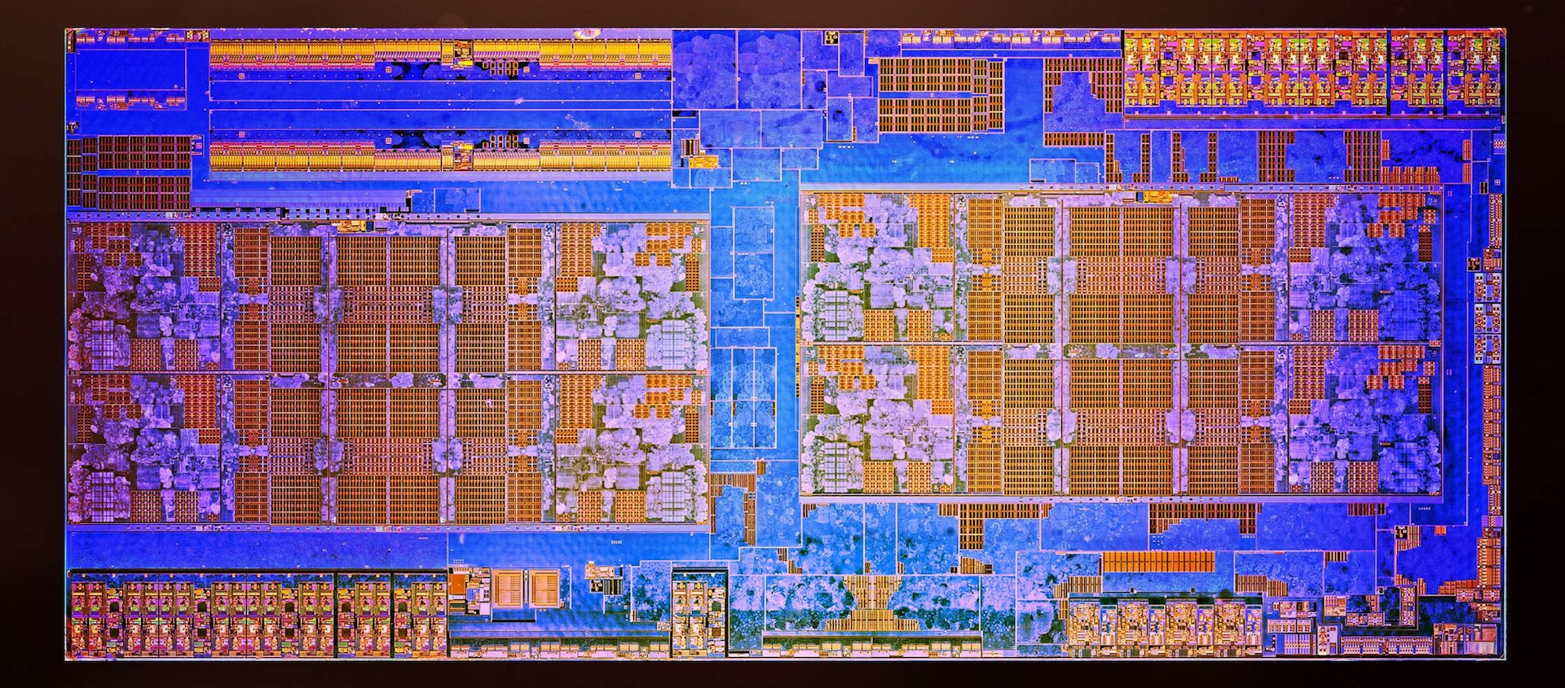
Multi-core CPUs

Slide 25
Multi-core CPUs
Pronounced /raɪzən/. I’m just frolicking.

Slide 26
Multi-core CPUs
Core 5
Core 7
Core 1
Core 3
Core 6
Core 8
Core 2
Core 4

Slide 27
Multi-core CPUs
RAM I/O 2
Core 5
Core 7
Core 1
Core 3
L3 Cache
L3 Cache
Core 6
Core 8
Core 2
Core 4
RAM I/O 1

Slide 28
Multi-core CPUs
Core 1

Slide 29
Multi-core CPUs

Slide 30
Single core layout (AMD Ryzen™ 7)
Branch
predictor
Ins. cache
Ins. decoder
Scheduler
Load
& store
ALU
L2 Cache
FPU
Data cache

Slide 31
OpenMP loop in Mandelbrot fractal renderer
unsigned n_inside = 0;
for(unsigned y = 0; y < Yres; ++y)
{
/* things */
n_inside += something;
/* more things */
}

Slide 32
OpenMP loop in Mandelbrot fractal renderer
unsigned n_inside = 0;
#pragma omp parallel for schedule(dynamic) reduction(+:n_inside)
for(unsigned y = 0; y < Yres; ++y)
{
/* things */
n_inside += something;
/* more things */
}

Slide 33
OpenMP loop in Mandelbrot fractal renderer
unsigned n_inside = 0;
#pragma omp parallel for schedule(dynamic) reduction(+:n_inside)
for(unsigned y = 0; y < Yres; ++y)
{
/* things */
n_inside += something;
/* more things */
}

Slide 34
OpenMP loop in Mandelbrot fractal renderer
unsigned n_inside = 0;
#pragma omp parallel for schedule(dynamic) reduction(+:n_inside)
for(unsigned y = 0; y < Yres; ++y)
{
/* things */
n_inside += something;
/* more things */
}

Slide 35
OpenMP loop in Mandelbrot fractal renderer
unsigned n_inside = 0;
#pragma omp parallel for schedule(dynamic) reduction(+:n_inside)
for(unsigned y = 0; y < Yres; ++y)
{
/* things */
n_inside += something;
/* more things */
}

Slide 36
OpenMP loop in Mandelbrot fractal renderer
unsigned n_inside = 0;
#pragma omp parallel for schedule(dynamic) reduction(+:n_inside)
for(unsigned y = 0; y < Yres; ++y)
{
/* things */
n_inside += something;
/* more things */
}

Slide 37
OpenMP loop in Mandelbrot fractal renderer
unsigned n_inside = 0;
#pragma omp parallel for schedule(dynamic) reduction(+:n_inside)
for(unsigned y = 0; y < Yres; ++y)
{
/* things */
n_inside += something;
/* more things */
}

Slide 38
OpenMP loop in Mandelbrot fractal renderer
unsigned n_inside = 0;
#pragma omp parallel for schedule(dynamic) reduction(+:n_inside)
for(unsigned y = 0; y < Yres; ++y)
{
/* things */
n_inside += something;
/* more things */
}

Slide 39
List of compilers that support OpenMP (C, C++ or Fortran)
– GCC (since 4.2; OpenMP 4.0 supported since 4.9.0)
– LLVM/Clang (since 3.7)
– Visual C++ 2005, 2008, 2010, 2012, 2013 (OpenMP 2.0 only)
– Intel Fortran and C/C++ versions 11.0 and 11.1 compilers, Intel C/C++ and Fortran Composer XE 2011 and Intel Parallel Studio
– IBM XL C/C++ compiler
– Sun Studio 12 update 1
– Oracle Solaris Studio
– Portland Group Fortran, C and C++ compilers
– Mercurium compiler

Slide 40
Intel® Cilk™ Plus keywords
_Cilk_spawn
Runs functions asynchronously with the caller, e.g.:
int x = _Cilk_spawn slow_function();
Value of x will be available only after the function completes.
_Cilk_sync
Forces the caller to wait until all called functions return.
E.g.: _Cilk_sync;
_Cilk_for
Drop-in replacement for the for statement, adds threads
(pretty much the same way as #pragma omp parallel for)

Slide 41
OpenMP loop in Mandelbrot fractal renderer
unsigned n_inside = 0;
#pragma omp parallel for schedule(dynamic) reduction(+:n_inside)
for(unsigned y = 0; y < Yres; ++y)
{
/* things */
n_inside += something;
/* more things */
}

Slide 42
OpenMP CilkPlus loop in Mandelbrot fractal renderer
unsigned n_inside = 0;
for(unsigned y = 0; y < Yres; ++y)
{
/* things */
n_inside += something;
/* more things */
}

Slide 43
CilkPlus loop in Mandelbrot fractal renderer
unsigned n_inside = 0;
_Cilk_for(unsigned y = 0; y < Yres; ++y)
{
/* things */
n_inside += something;
/* more things */
}

Slide 44
CilkPlus loop in Mandelbrot fractal renderer
unsigned n_inside = 0;
//#pragma omp parallel for schedule(dynamic) reduction(+:n_inside)
_Cilk_for(unsigned y = 0; y < Yres; ++y)
{
/* things */
n_inside += something;
/* more things */
}

Slide 45
CilkPlus loop in Mandelbrot fractal renderer
#include <cilk/reducer_opadd.h>
cilk::reducer<cilk::op_add<unsigned>> n_inside(0);
_Cilk_for(unsigned y = 0; y < Yres; ++y)
{
/* things */
*n_inside += something;
/* more things */
}

Slide 46
CilkPlus loop in Mandelbrot fractal renderer
#include <cilk/reducer_opadd.h>
cilk::reducer<cilk::op_add<unsigned>> n_inside(0);
_Cilk_for(unsigned y = 0; y < Yres; ++y)
{
/* things */
*n_inside += something;
/* more things */
}
something = n_inside.get_value();

Slide 47
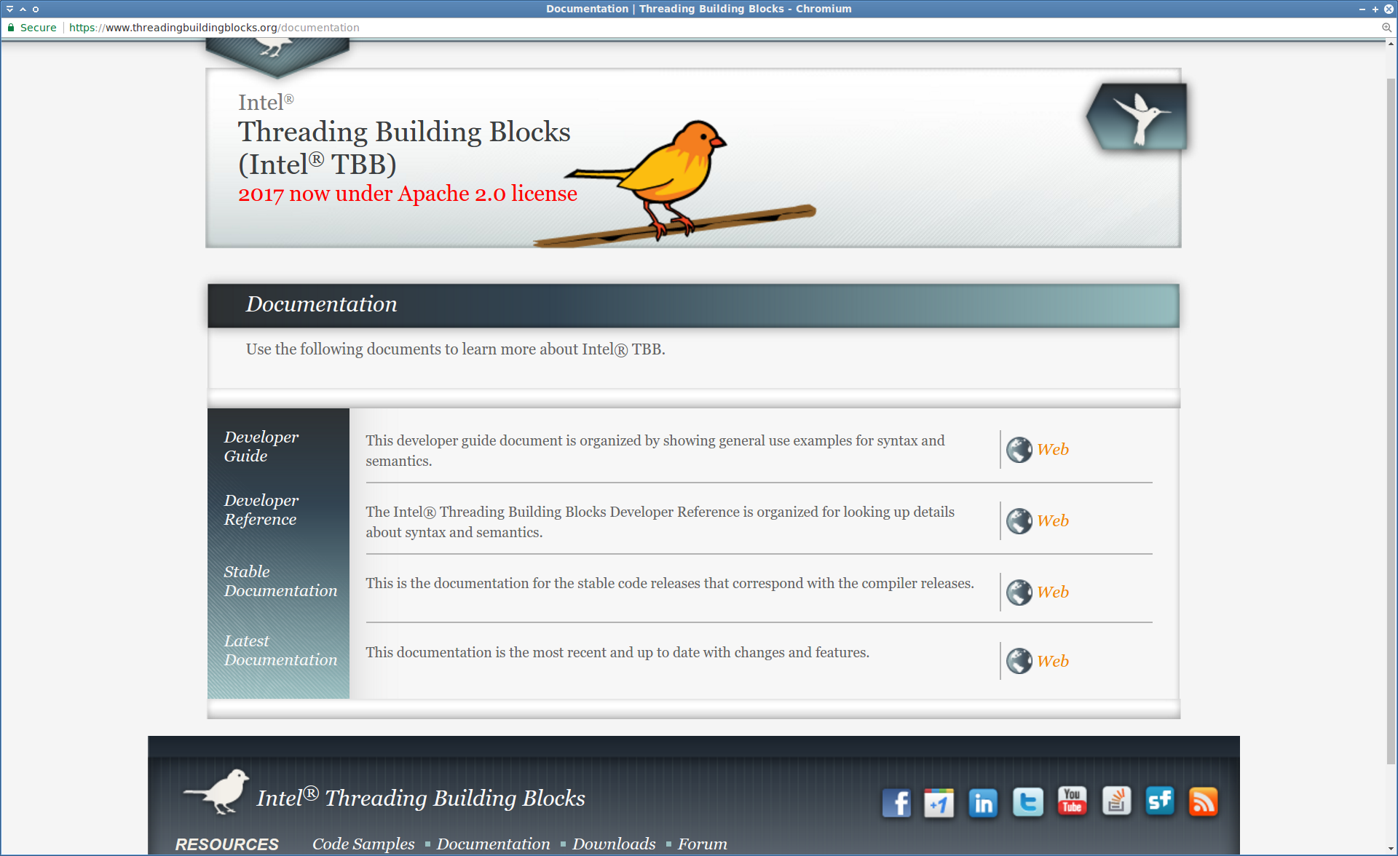

Slide 48
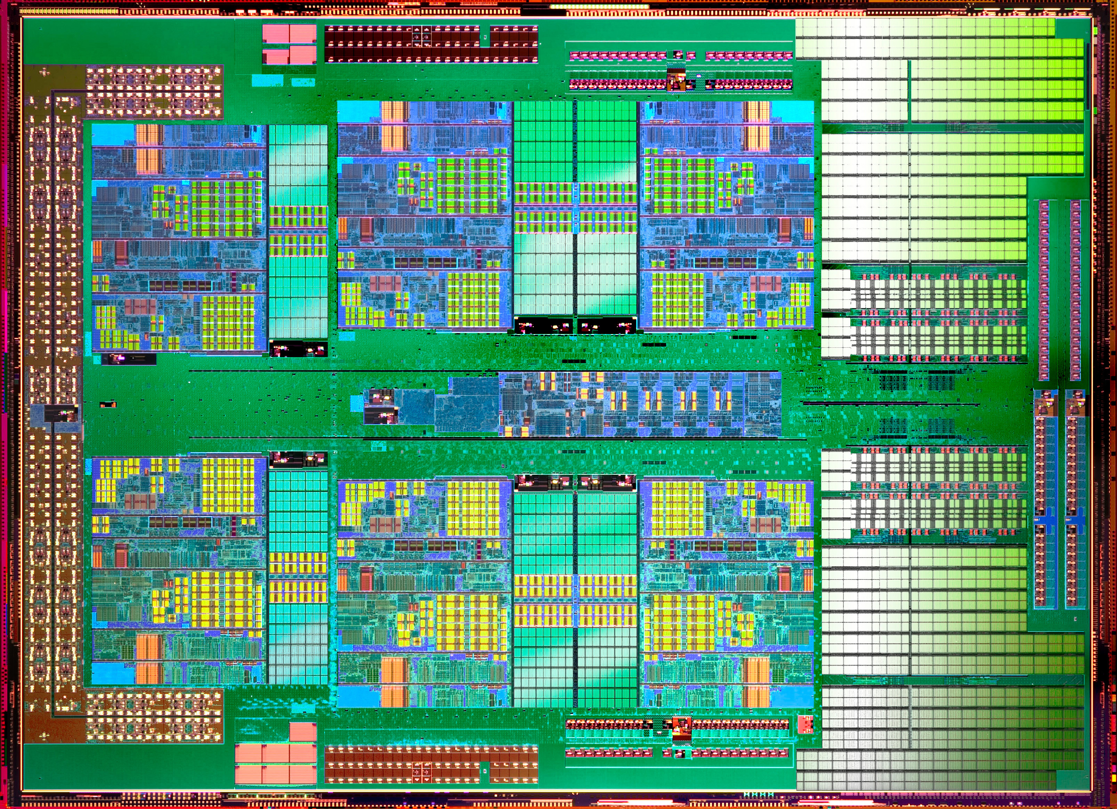

Slide 49
✓

Slide 50
✓
✓
✓
✓
✓
✓

Slide 51
✓ × 6
✓ × 6
?
✓ × 6
✓ × 6

Slide 52
Already done!
Already done!
✓ × 6
✓ × 6
✓ × 6
✓ × 6

Slide 53
Already done!
Already done!
✓ × 6
✓ × 6
✓ × 6
✓ × 6

Slide 54


Slide 55
(Clustering)

Slide 56


Slide 58
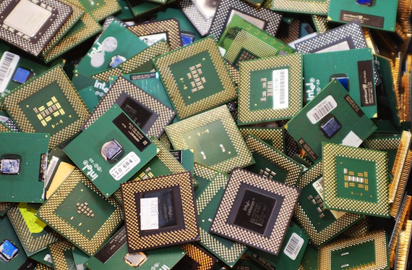

Slide 59
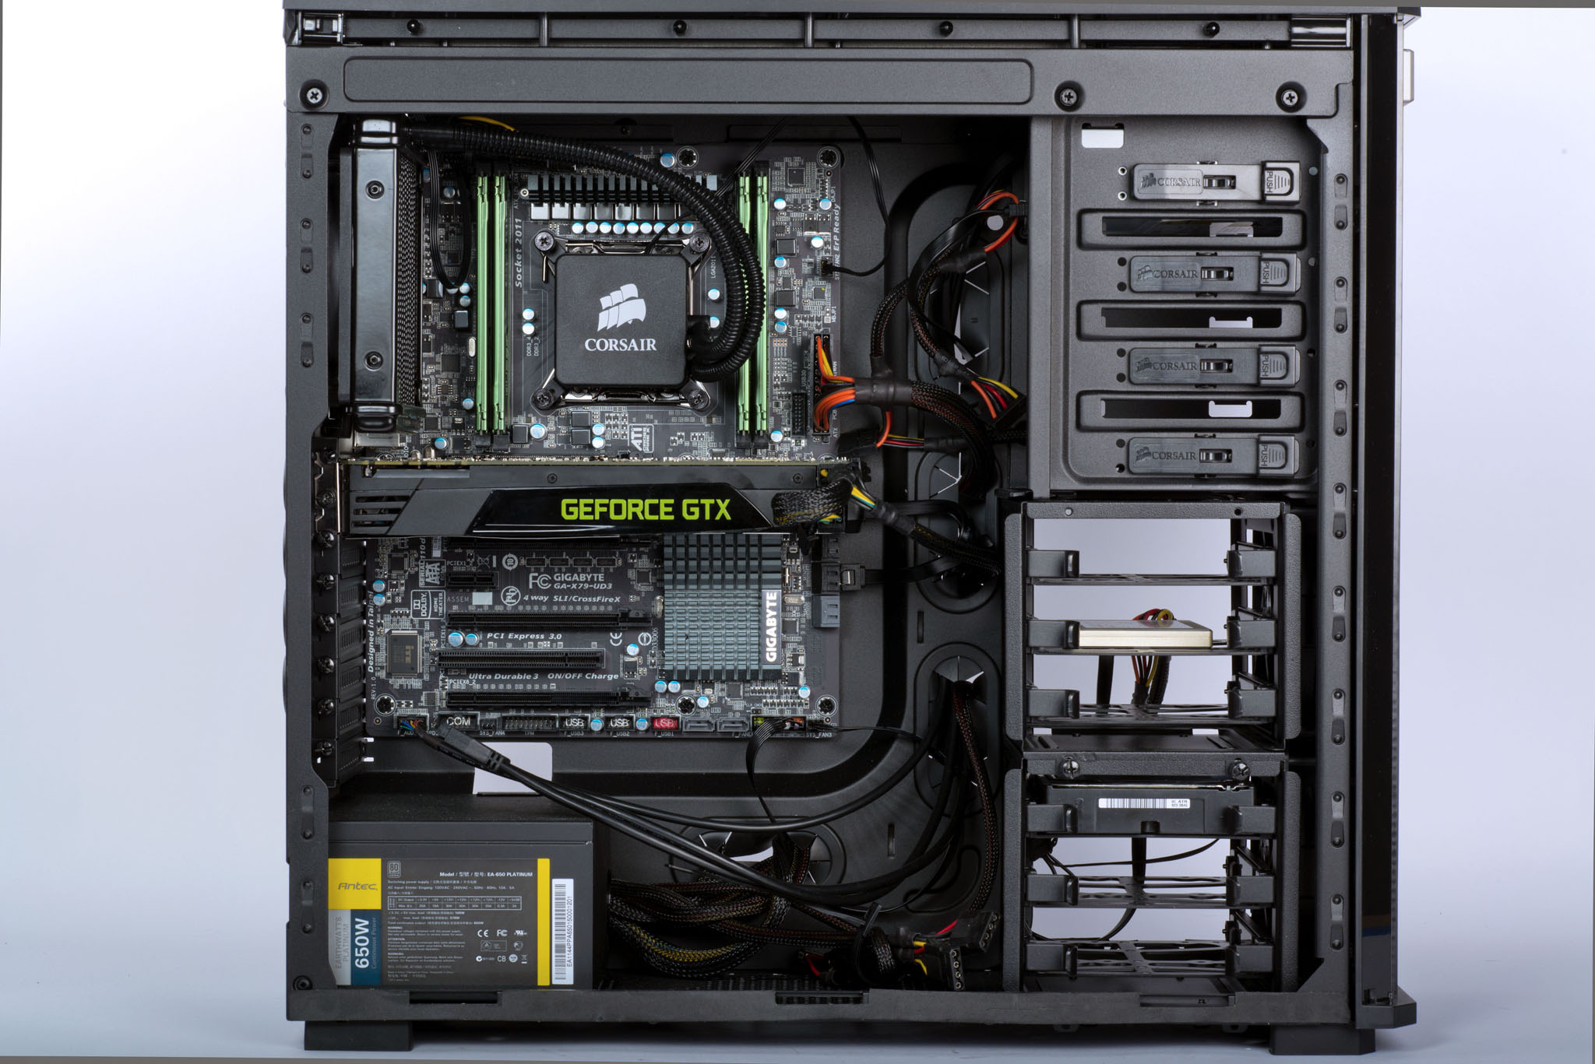

Slide 61
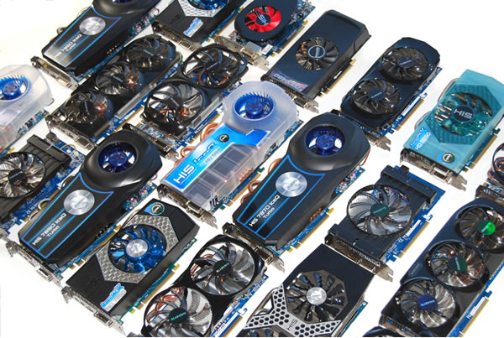

Slide 62
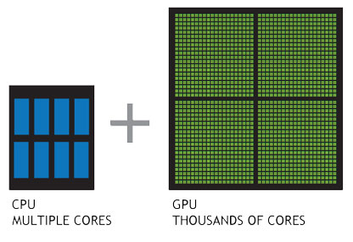

Slide 63
Offloading targets in GCC
• NVidia PTX enabled graphics cards
• HSA accelerators
• Intel® Many Integrated Core architecture (MIC)

Slide 64
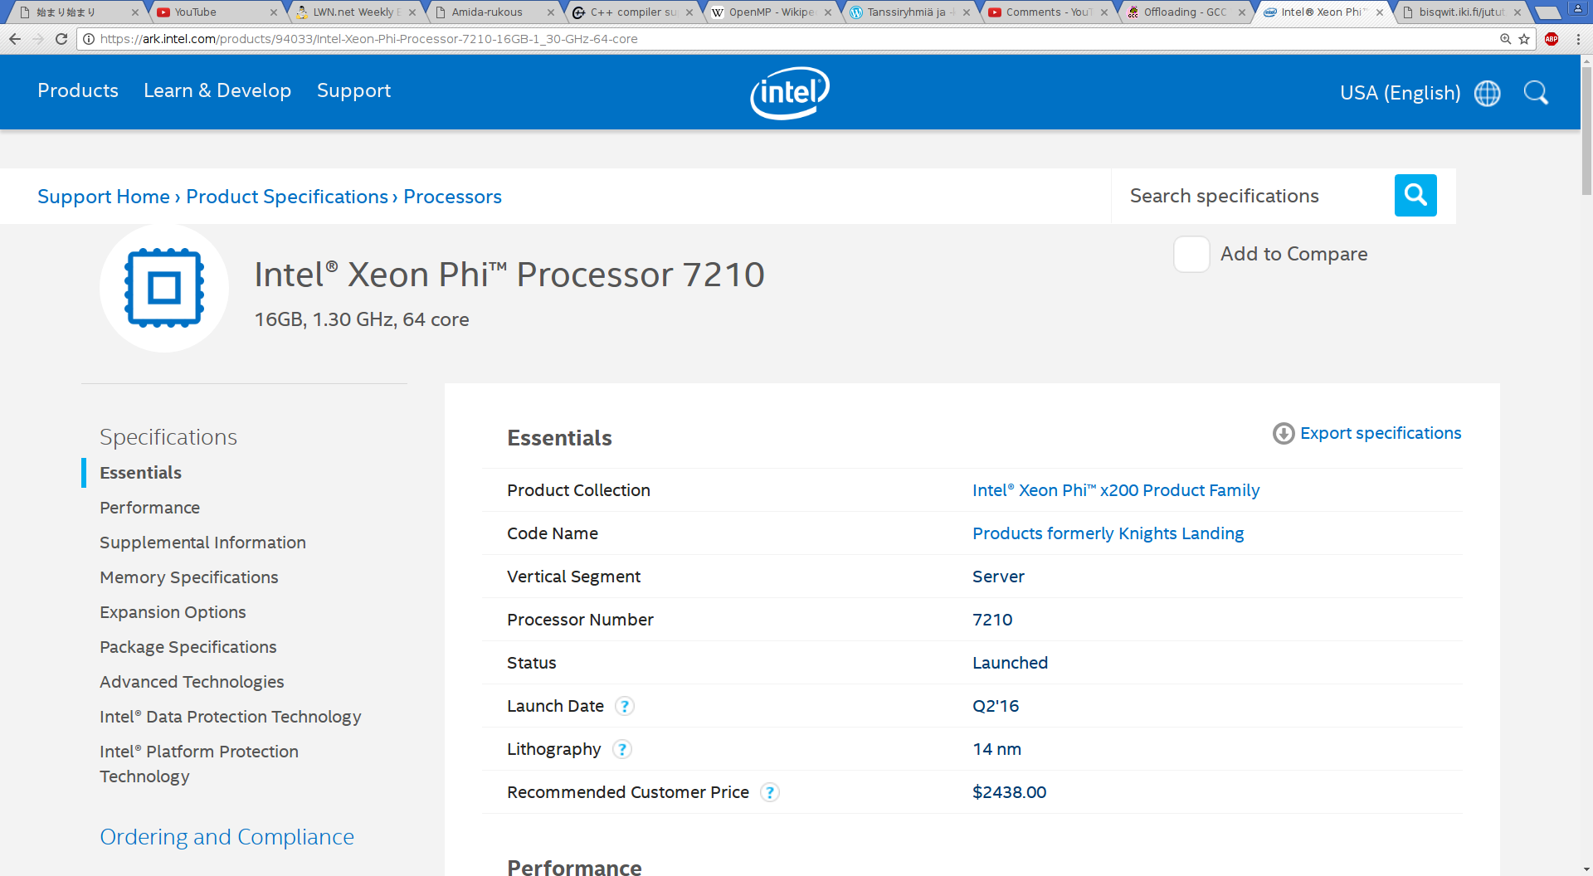

Slide 65
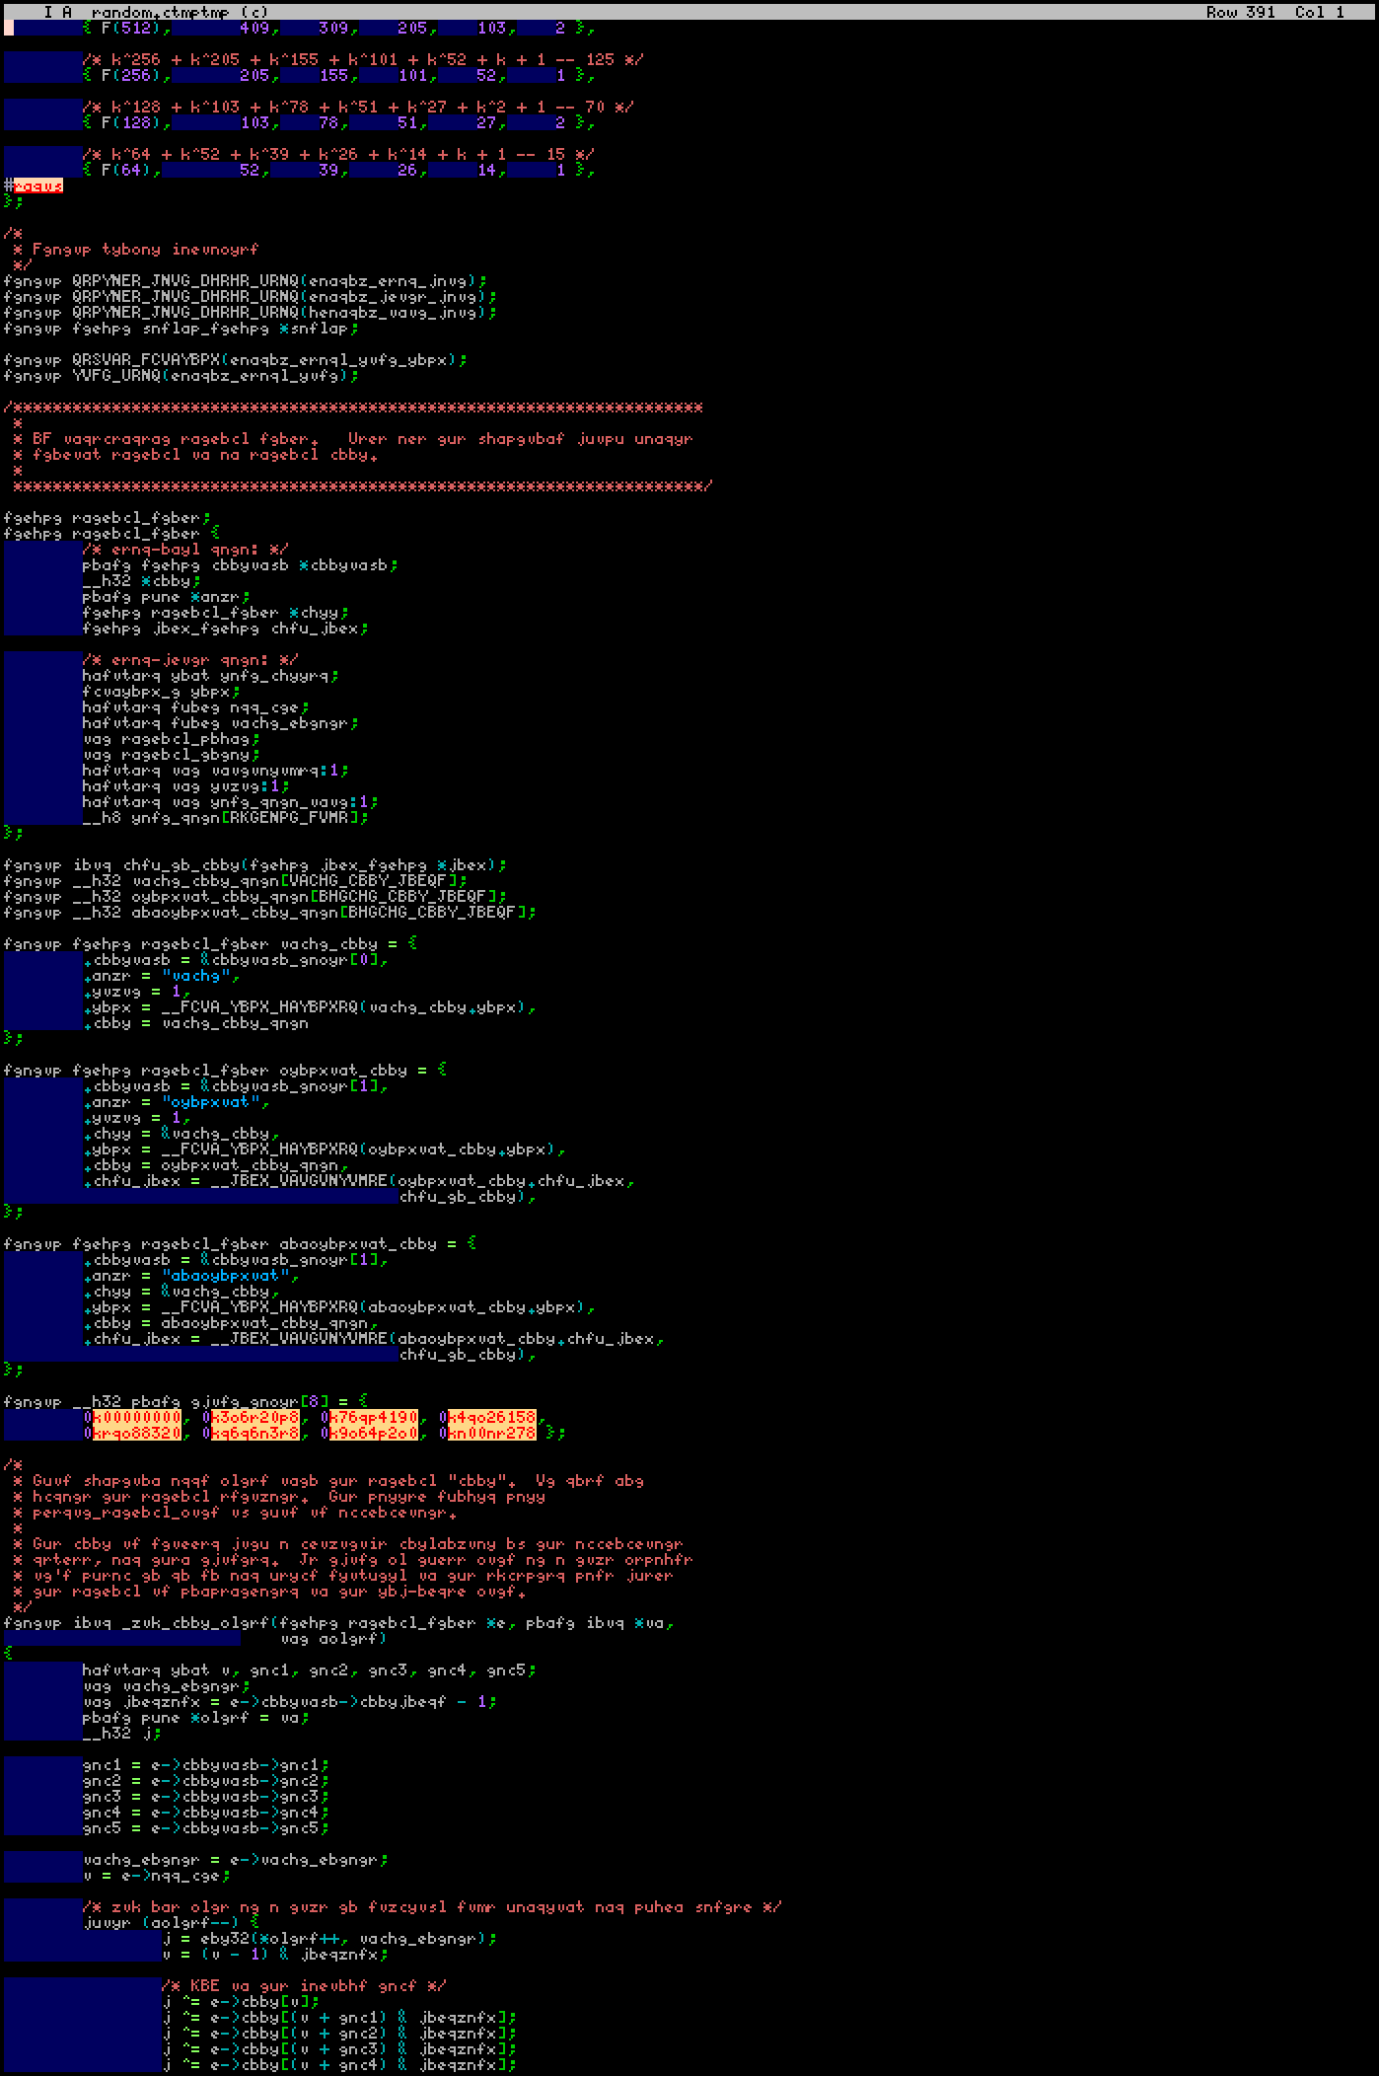
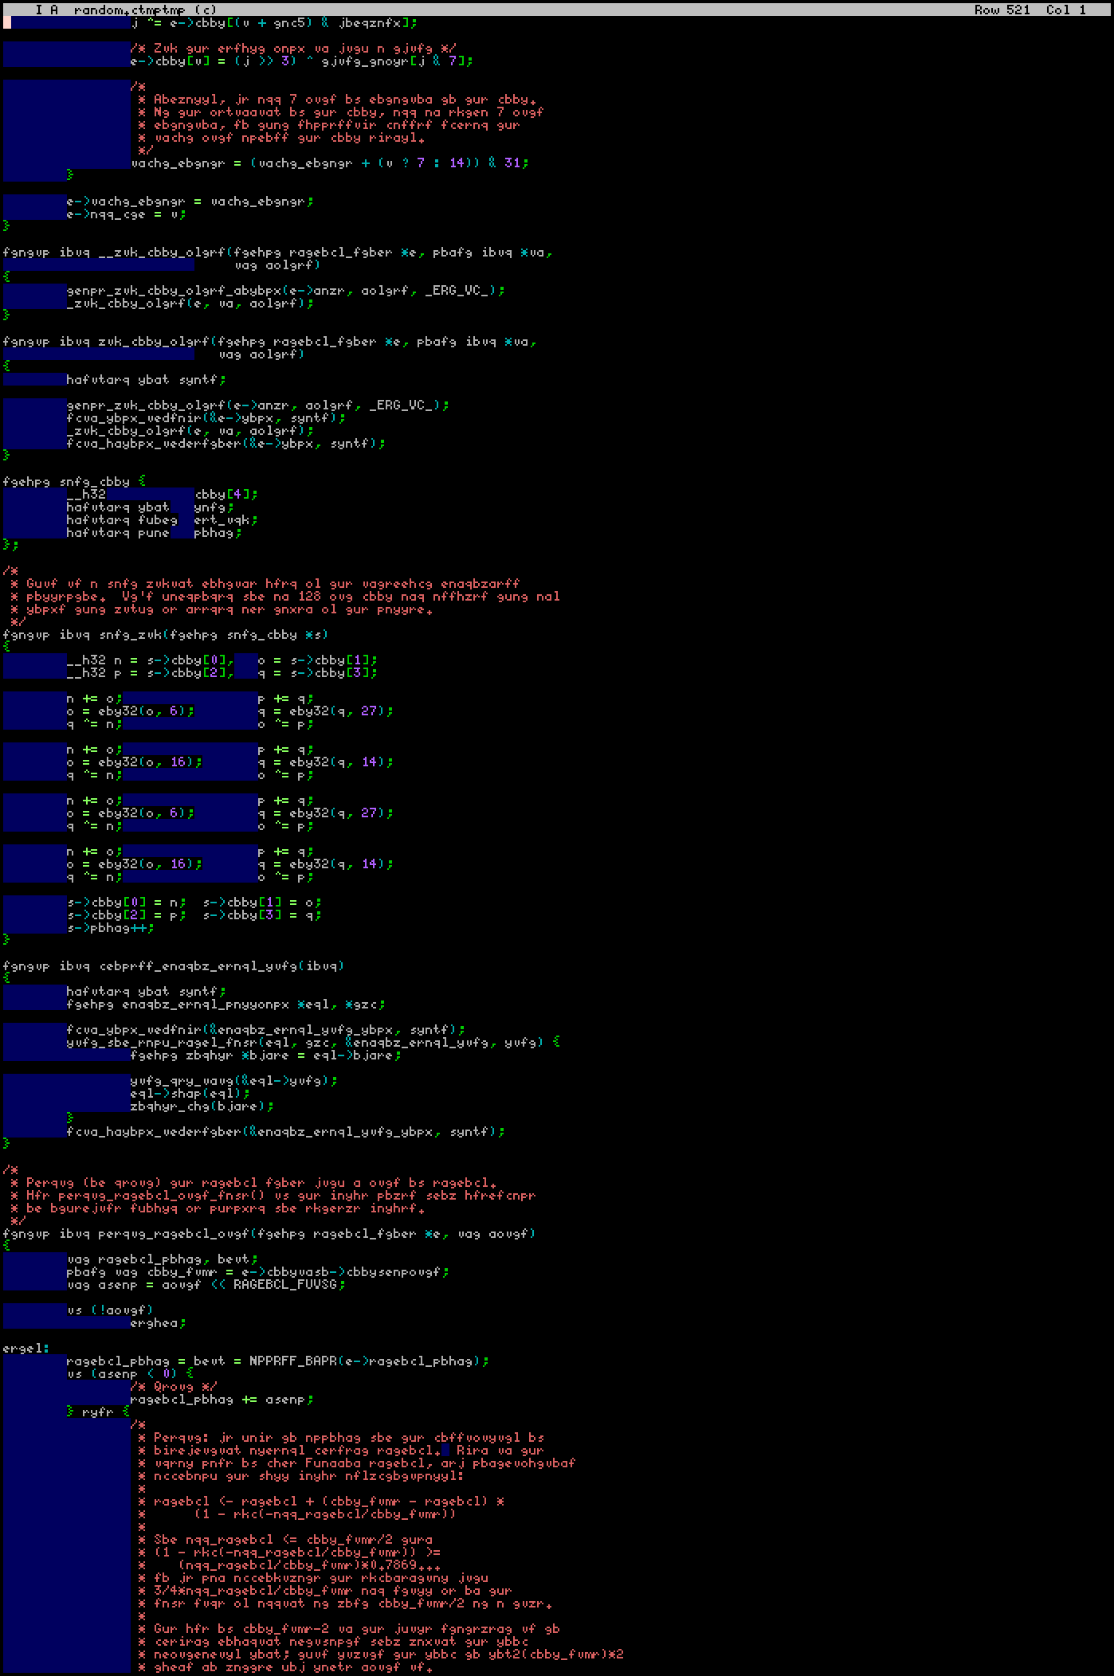
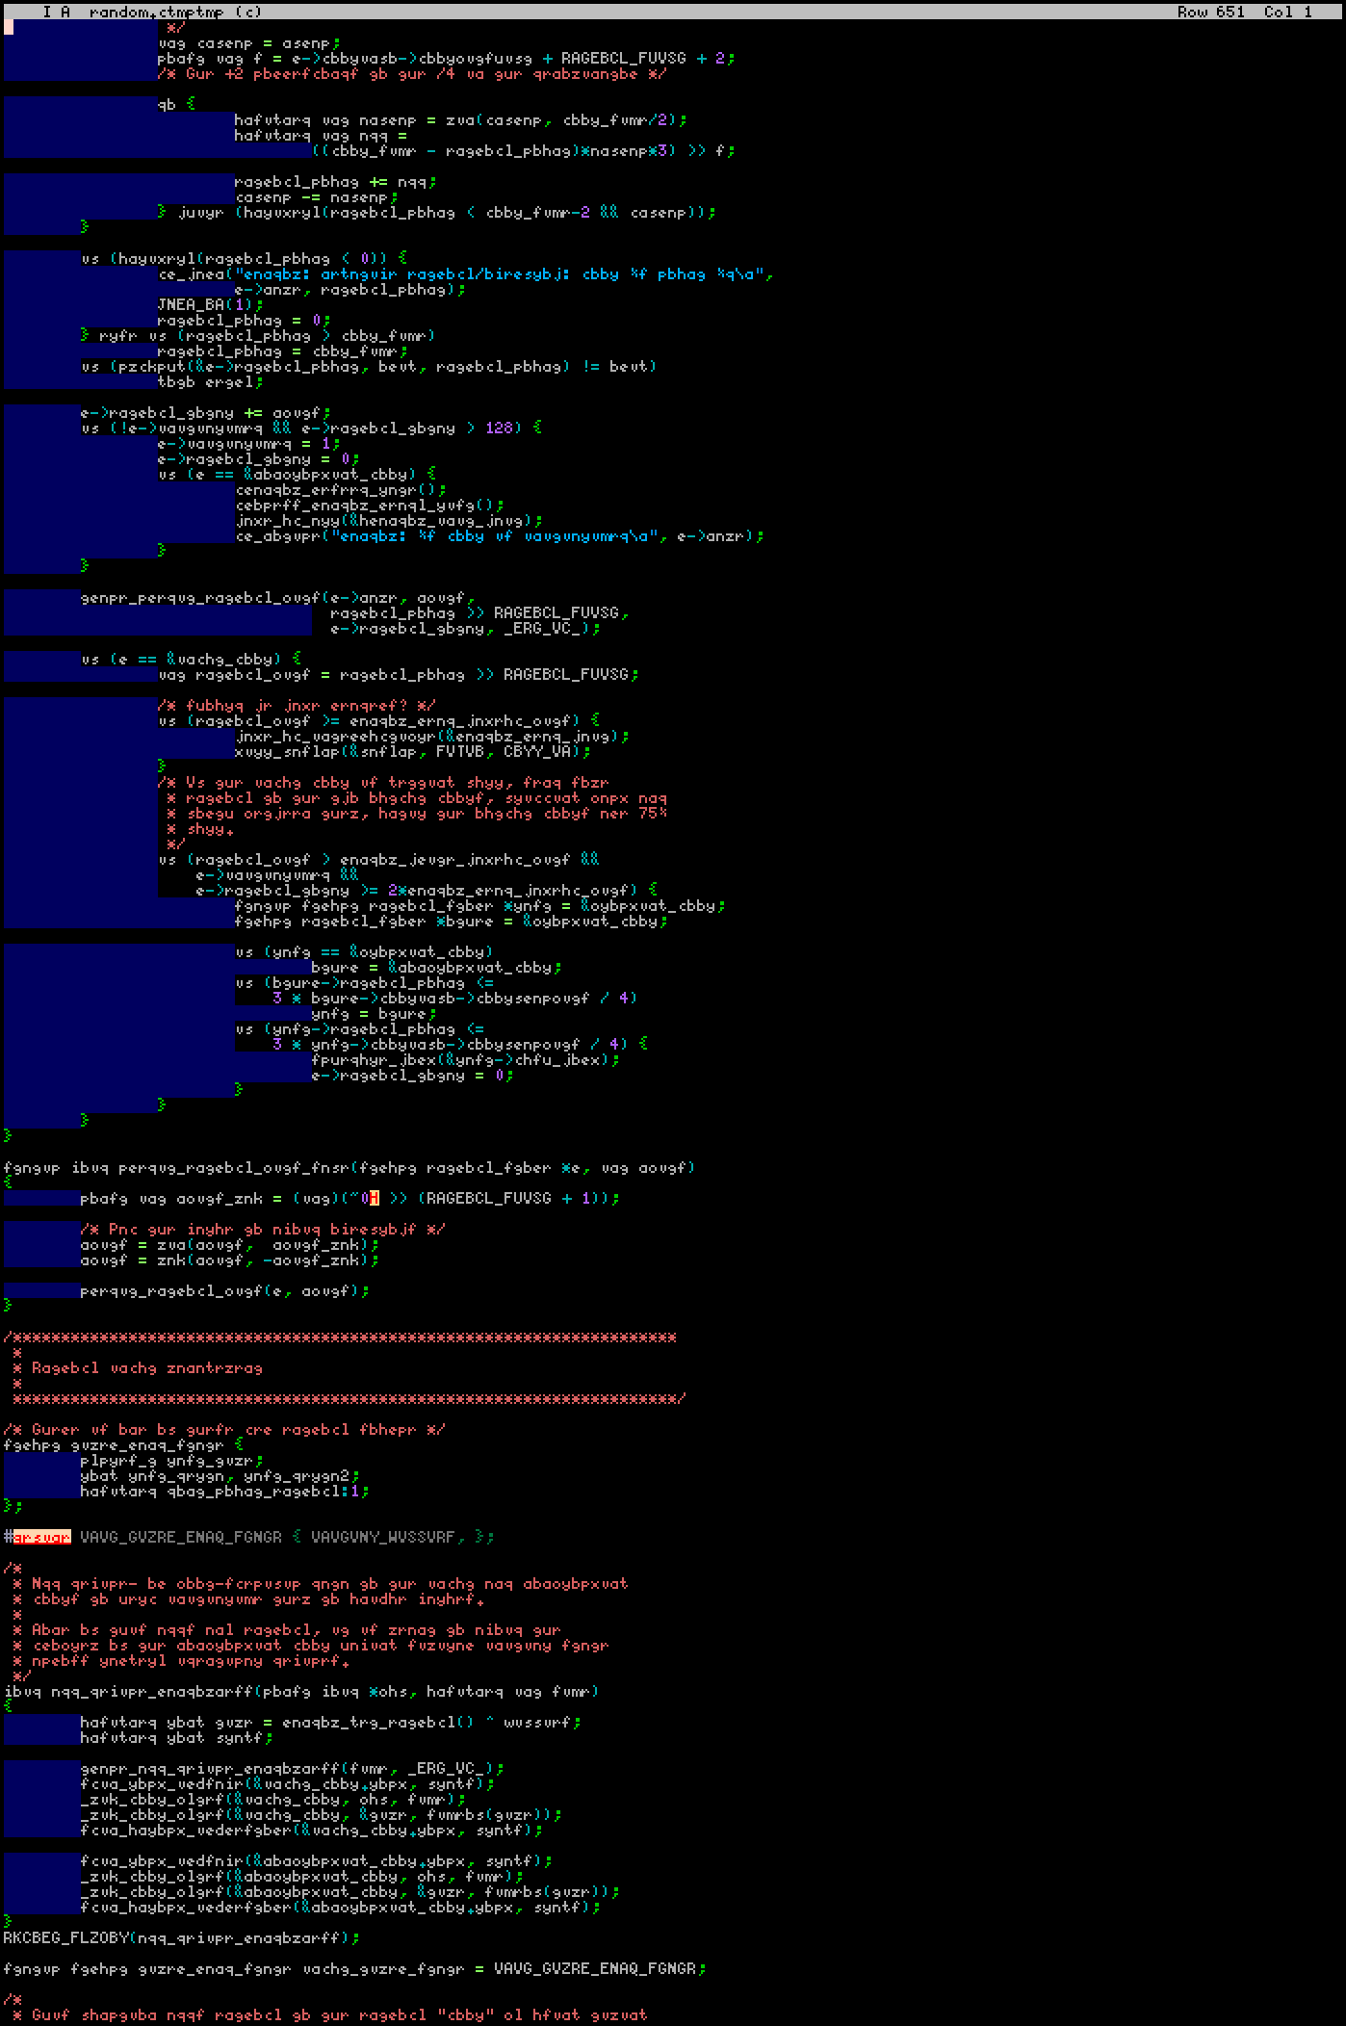
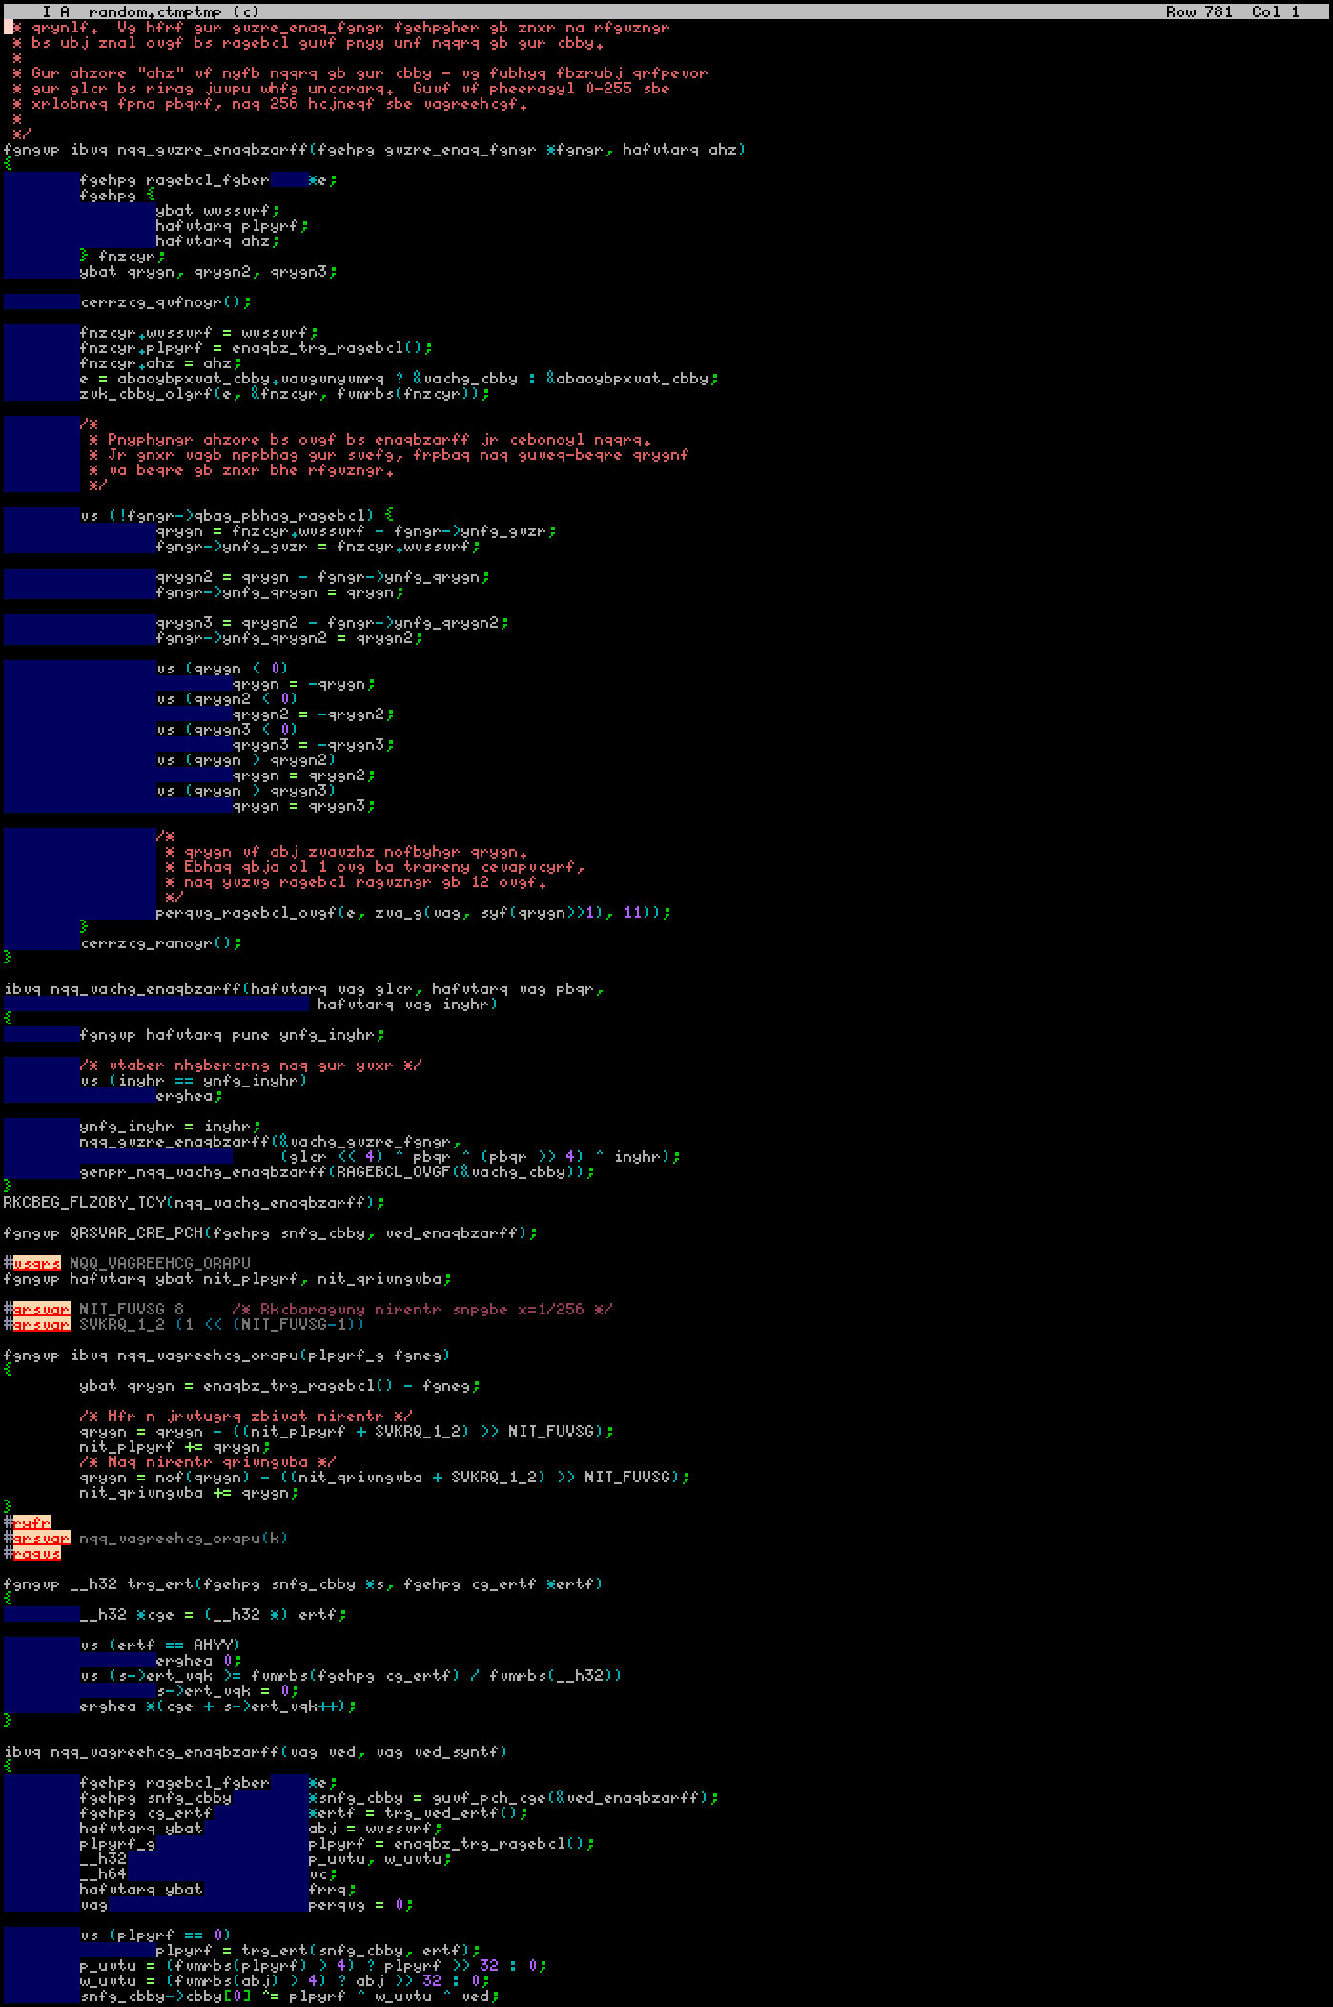

Slide 69
Offloading in GCC
nvptx hsa intelmic host
OpenACC Yes Yes† no? Yes
OpenMP Yes‡ maybe† Yes Yes
Target:
With:
‡) Since GCC 7
Disclaimer: Documentation about these features in GCC was incoherent at worst and
outdated at best. My information may be incorrect. Sorry.
.
†) In my experiments, offloading programs compiled with HSA-enabled GCC crashed unconditionally at start unless you have the HSA/ROCm kernel module installed… And the module is impossible to install without rebooting. So I forfeited the test.

Slide 70
OpenMP offloading pragma
#pragma omp target teams distribute parallel for collapse(2) \
map(to:zr,zi,xscale,yscale) map(from:results[0:npixels])
for(unsigned y=0; y<Yres; ++y)
for(unsigned x=0; x<Xres; ++x)
results[y*Xres+x] = Iterate<true>( zr+xscale*int(x–Xres/2),
zi+yscale*int(y–Yres/2) );

Slide 71
OpenMP offloading pragma
#pragma omp target teams distribute parallel for collapse(2) \
map(to:zr,zi,xscale,yscale) map(from:results[0:npixels])
for(unsigned y=0; y<Yres; ++y)
for(unsigned x=0; x<Xres; ++x)
results[y*Xres+x] = Iterate<true>( zr+xscale*int(x–Xres/2),
zi+yscale*int(y–Yres/2) );

Slide 72
OpenMP offloading pragma
#pragma omp target teams distribute parallel for collapse(2) \
map(to:zr,zi,xscale,yscale) map(from:results[0:npixels])
for(unsigned y=0; y<Yres; ++y)
for(unsigned x=0; x<Xres; ++x)
results[y*Xres+x] = Iterate<true>( zr+xscale*int(x–Xres/2),
zi+yscale*int(y–Yres/2) );

Slide 73
OpenMP offloading pragma
#pragma omp target teams distribute parallel for collapse(2) \
map(to:zr,zi,xscale,yscale) map(from:results[0:npixels])
for(unsigned y=0; y<Yres; ++y)
for(unsigned x=0; x<Xres; ++x)
results[y*Xres+x] = Iterate<true>( zr+xscale*int(x–Xres/2),
zi+yscale*int(y–Yres/2) );

Slide 74
OpenMP offloading pragma
#pragma omp target teams distribute parallel for collapse(2) \
map(to:zr,zi,xscale,yscale) map(from:results[0:npixels])
for(unsigned y=0; y<Yres; ++y)
for(unsigned x=0; x<Xres; ++x)
results[y*Xres+x] = Iterate<true>( zr+xscale*int(x–Xres/2),
zi+yscale*int(y–Yres/2) );

Slide 75
OpenMP offloading pragma
#pragma omp target teams distribute parallel for collapse(2) \
map(to:zr,zi,xscale,yscale) map(from:results[0:npixels])
for(unsigned y=0; y<Yres; ++y)
for(unsigned x=0; x<Xres; ++x)
results[y*Xres+x] = Iterate<true>( zr+xscale*int(x–Xres/2),
zi+yscale*int(y–Yres/2) );

Slide 76
OpenMP offloading pragma
#pragma omp target teams distribute parallel for collapse(2) \
map(to:zr,zi,xscale,yscale) map(from:results[0:npixels])
for(unsigned y=0; y<Yres; ++y)
for(unsigned x=0; x<Xres; ++x)
results[y*Xres+x] = Iterate<true>( zr+xscale*int(x–Xres/2),
zi+yscale*int(y–Yres/2) );

Slide 77
OpenMP offloading pragma
#pragma omp target teams distribute parallel for collapse(2) \
map(to:zr,zi,xscale,yscale) map(from:results[0:npixels])
for(unsigned y=0; y<Yres; ++y)
for(unsigned x=0; x<Xres; ++x)
results[y*Xres+x] = Iterate<true>( zr+xscale*int(x–Xres/2),
zi+yscale*int(y–Yres/2) );

Slide 78
Running an OpenMP offloading program
GlaDOS 5.0 #1 SMP Tue Aug 09 16:23:50 CST 2005 ft128
You are a horrible person.
You have new mail.
Last login: Thu Apr 26 12:52:08 2012 from 104.75.57.87
glados:~$ ls -l mandelbrot-openmp-loop
-rwxr-xr-x 1 susan staff 43080 Jun 14 23:32 mandelbrot-openmp-loop
glados:~$ OMP_DEFAULT_DEVICE= ./mandelbrot-openmp-loop

Slide 79
Running an OpenMP offloading program
GlaDOS 5.0 #1 SMP Tue Aug 09 16:23:50 CST 2005 ft128
You are a horrible person.
You have new mail.
Last login: Thu Apr 26 12:52:08 2012 from 104.75.57.87
glados:~$ ls -l mandelbrot-openmp-loop
-rwxr-xr-x 1 susan staff 43080 Jun 14 23:32 mandelbrot-openmp-loop
glados:~$ OMP_DEFAULT_DEVICE= ./mandelbrot-openmp-loop

Slide 80
Running an OpenMP offloading program
GlaDOS 5.0 #1 SMP Tue Aug 09 16:23:50 CST 2005 ft128
You are a horrible person.
You have new mail.
Last login: Thu Apr 26 12:52:08 2012 from 104.75.57.87
glados:~$ ls -l mandelbrot-openmp-loop
-rwxr-xr-x 1 susan staff 43080 Jun 14 23:32 mandelbrot-openmp-loop
glados:~$ OMP_DEFAULT_DEVICE=1 ./mandelbrot-openmp-loop
Frame 0: 1810.100776 ms
Frame 1: 1664.933525 ms

Slide 81


Slide 82
Parallelism terminology relationships
OpenMP OpenACC NVidia CPU
league · · ·
team gang block ·
thread worker thread thread
simd vector warp simd/vec
Kindly post a correction please, if I have misunderstood something.

Slide 83
Running an OpenMP offloading program
Frame 570: 7348.88917299986133 ms
[2276848.682460] NVRM: os_schedule: Attempted to yield the CPU whi
le in atomic or interrupt context
[2276848.772610] NMI watchdog: BUG: soft lockup - CPU#7 stuck for
22s! [swapper/7:0]
libgomp: cuStreamSynchronize error: the launch timed out and was t
erminated
libgomp: cuMemFreeHost error: the launch timed out and was termina
ted
libgomp: device finalization failed
glados:~$

Slide 84
CUDA: C++ with extensions
CUDA
IS
C++

Slide 85
CUDA: C++ with extensions
Extra attributes that can be used in variable declarations
Attribute Access Shared between Lifetime
__constant__ read-only all GPU threads program
__device__ read-write all GPU threads program
__shared__ read-write all GPU threads current block
(none, global) depends host only program
(none, local) depends current thread scope

Slide 86
CUDA: C++ with extensions
Extra attributes that can be used in function and method declarations
Attribute Compiled for Called from
__device__ GPU GPU
__host__ host host
__device__ __host__ both same
__global__ GPU host (!)
(none) host* host*
*) I think they may be available for GPU too, if inlined; don’t quote me on this

Slide 87
Running a CUDA “kernel”
int __device__ foo(double x) // GPU-only function that is called from GPU code only
{
return x * 5;
}
void __global__ sum() // GPU function that is called from host. Called “kernel”
{
dim3 dim = blockDim; // {20,1,1} (number of blocks, from function call)
dim3 blk = blockIdx; // {n,0,0} where n = 0—19 (up to number specified in call)
dim3 thr = threadIdx; // {m,0,0} where m = 0—49 (up to number specified in call)
int w = warpSize; // architecture-dependent constant, typically 32
unsigned index = blk.x + dim.x * thr.x; // Identify this particular call (0—999)
foo(2.5); // can run other GPU functions from here
}
int main()
{
sum<<<20, 50>>> (); // 20*50 instances of sum() will be called, some or all simultaneously
// Calling foo(); here would be invalid, it only exists on GPU
}

Slide 88
Blocks, threads, and warps
1 warp
1 warp
1 warp
1 warp
上上上上上上上上 人人人人人人人人 仁仁仁仁仁仁仁仁 于于于于于于于于
乜乜乜乜乜乜乜乜 下下下下下下下下 万万万万万万万万 今今今今今今今今
力力力力力力力力 占占占占占占占占 厶厶厶厶厶厶厶厶 天天天天天天天天
Block
(32 threads)
1 warp
1 warp
1 warp
1 warp
Block
(32 threads)
1 warp
1 warp
1 warp
1 warp
Block
(32 threads)

Slide 89
Convenience “vector” datatypes in CUDA
char1, char2, char3, char4 uchar1, uchar2, uchar3, uchar4
short1, short2, short3, short4 ushort1, ushort2, ushort3, ushort4
int1, int2, int3, int4 uint1, uint2, uint3, uint4
long1, long2, long3, long4 ulong1, ulong2, ulong3, ulong4
float1, float2, float3, float4 double1, double2
longlong1, longlong2 ulonglong1, ulonglong2
These are all defined in CUDA library, for example float4 is:
struct float4 { float x, y, z, w; };
__device_builtin__ __builtin_align__(16)
And of course, dim3, which is identical to uint3, but is a distinct type rather than a typedef.

Slide 90
CUDA runtime library
glados:~/usr/include$ grep -lr NVIDIA\ Corp .|xargs c_count|tail -n10
560 ./cublasXt.h
173 ./cublas_v2.h
2090 ./cublas_api.h
386 ./cublas.h
134 ./common_functions.h
224 ./channel_descriptor.h
9 ./builtin_types.h
71 ./__cudaFatFormat.h
Total:
147752
glados:~/usr/include$
The sloc for Linux kernel 4.4.3 is 193202, according to c_count (*.[ch] files only)

Slide 91
Combination Of All The Best Features So Far
­CUDA version with two streams
and
Eight native CPU threads
each simultaneously rendering
a different picture
with SIMD using Intel intrinsics

