Slide 1

TEAM INFINITE TUPLES
http://www.cs.rit.edu/~bdi8241/adhoc/
Jacob Hays
Brad Israel
Notes:
Quick introduction of ourselves

Slide 2
TEAM INFINITE TUPLES
Overview
Paper 1: Wireless Grids
Paper 2: Ad-hoc grid enviroment
Paper 3: Collaborative Problem-Solving Framework for Mobile Devices
Our design

Slide 3
TEAM INFINITE TUPLES
Wireless Grids
Goal:
Allow mobile devices to share their resources and create a wireless grid environment
Problem:
What type of infrastructure is best suited for allowing a variety of mobile devices to share their resources. The part of the infrastructure that we are studying is the enabling middleware

Slide 4
TEAM INFINITE TUPLES
Wireless Grids (cont.)
Solution:
Combine existing software to solve the following problems of resource description, resource discovery, coordination systems, trust establishment, and clearing mechanisms

Slide 5
TEAM INFINITE TUPLES
Ad-hoc Grid Environment
Goal:
Allow every computer and device in a network to form a dynamic ad-hoc grid
Problem:
How to rapidly deploy applications on an ad-hoc grid, where the topology is not static

Slide 6
TEAM INFINITE TUPLES
Ad-hoc Grid Environment (cont.)
Solution:
Create a service-oriented middleware which will allow the application level to be developed seperately from the service components.
I.E nodes on a grid network

Slide 7
TEAM INFINITE TUPLES
Collaborative Problem-Solving Framework for Mobile Devices
Goals:
As mobile devices become more and more common, so does their ability to be used in collaborative grid applications
Problems:
The nature of mobile wireless networks is that they are unreliable. How to distribute work load among nodes that may enter/leave the network at any moment.

Slide 8
TEAM INFINITE TUPLES
Collaborative Problem-Solving Framework for Mobile Devices (cont)
Their Solution:
Create a framework for a wireless grid. 4 parts.
Initiator: Wireless device that initials a task
Subordinate: Device that helps solve a task.
Keep Alive Server: Wireless devices advertise themselves to this. Keeps track of available devices.
Brokering Service: Distributes workload across the available nodes. Redistributes work as nodes enter/leave network

Slide 9
TEAM INFINITE TUPLES
Collaborative Problem-Solving Framework for Mobile Devices (cont)
How we are using this:
- All the problems mentioned we will have to deal with.
- Their solution proposes a more centralized version with servers. We will design it pure ad-hoc
- The user experience will be similar. Any node in the network can initiate problems, and all others will help work with it.

Slide 10
TEAM INFINITE TUPLES
Product Design:
A application that runs on multiple computers, that communicate together with Tupleboard.
Problem Creator: Create new fractal problems to solve
Problem Viewer: View completed and in progress problems. View performance statistics.
Control Panel: Set number of problems to work on, statistics, etc.
Problem Solver: Decides what problems and what chunks to work on. Will create threads to work on individual chunks of problems.

Slide 11
TEAM INFINITE TUPLES
Product Design:
Communication through 2 tuple types
Problem Tuple: Contains formula, parameters, Name, poster, number of chunks.
Chunk tuple: Contains copy of Problem tuple, Chunk number and parameters, Data (Empty or complete), metric.
The Chunk tuples act as the state of the problem. They are initially empty, but will be updated as more chunks of the problem are completed.

Slide 12
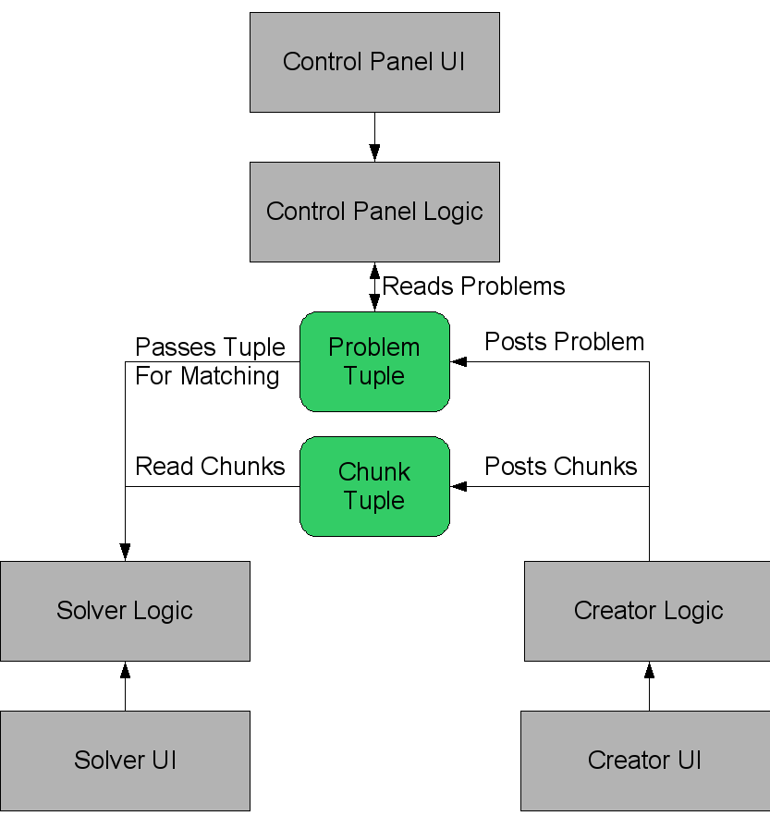

Slide 13
Questions?
http://www.cs.rit.edu/~bdi8241/adhoc/
Notes:
Quick introduction of ourselves

