Slide 1

TEAM INFINITE TUPLES
http://www.cs.rit.edu/~bdi8241/adhoc/
Jacob Hays
Brad Israel
Notes:
Quick introduction of ourselves

Slide 2
TEAM INFINITE TUPLES
Agenda
Project Overview
Review of design
GUI
Problem loading and solving logic
Questions

Slide 3
TEAM INFINITE TUPLES
Project Overview
Adhoc collaborative problem solving framework.
Focus is on fractals.
Allow users to create fractal problems and distribute workload to other users within the adhoc network

Slide 4
TEAM INFINITE TUPLES
Product Design Review:
A application that runs on multiple computers, that communicate together with Tupleboard.
Problem Creator: Load compiled java classes that implement a fractal problem. User sets parameters.
Problem Viewer: View completed and in progress problems. View performance statistics.
Control Panel: Set which problems to work on, display statistics, etc.
Problem Solver: Decides what chunks of problems to work on. Will create threads to work on individual chunks of problems.

Slide 5
TEAM INFINITE TUPLES
Product Design Review:
Communication through 2 tuple types
Problem Tuple: Contains formula, parameters, Name, poster, number of chunks.
Chunk tuple: Contains copy of Problem tuple, Chunk number and parameters, Data (Empty or complete), metric.
The Chunk tuples act as the state of the problem. They are initially empty, but will be updated as more chunks of the problem are completed.

Slide 6
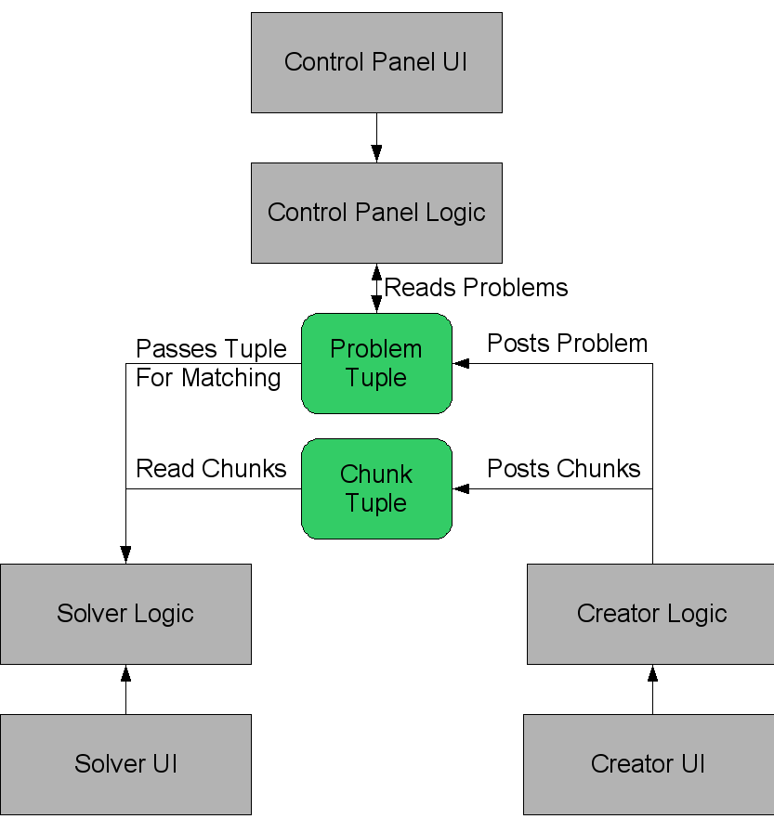

Slide 7
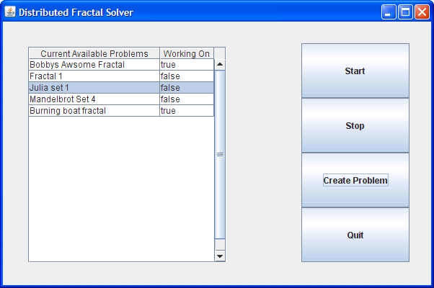
TEAM INFINITE TUPLES
GUI:

Slide 8
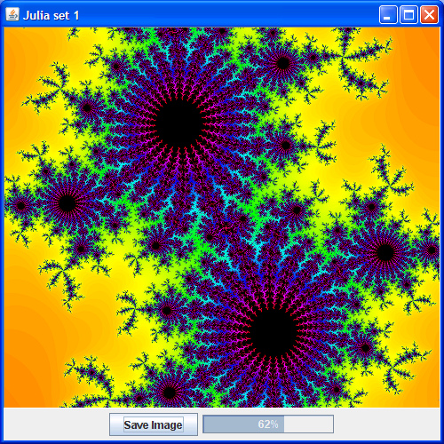
TEAM INFINITE TUPLES
GUI:

Slide 9
TEAM INFINITE TUPLES
GUI:

Slide 10
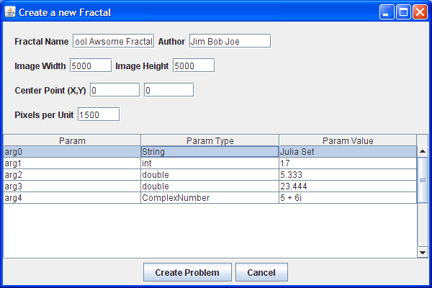
TEAM INFINITE TUPLES
GUI:

Slide 11
TEAM INFINITE TUPLES
Problem Creation:
Implement and compile the fractalImplementation interface
Load the class file using a ClassLoader
Use Java Reflections to find the constructor and allow the user to enter in any constructor arguments
Enter picture parameters, such as height, width, resolution, etc
Create the needed tuples

Slide 12
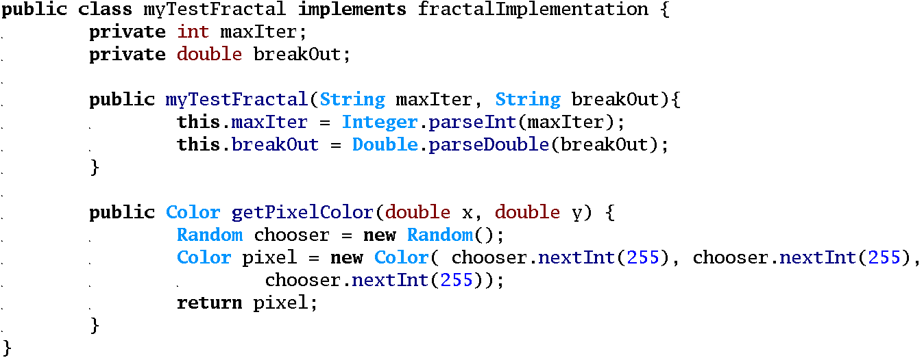
TEAM INFINITE TUPLES
Problem Example:

Slide 13
TEAM INFINITE TUPLES
Problem Solving:
Get the class and constructor arguments from the Problem tuple
Load the class using a ClassLoader
Use Java Reflections to initialize the class using the constructor with arguments
Loop through every pixel in the image and use reflections to invoke the getPixelColor method
Output the computed pixel data

Slide 14
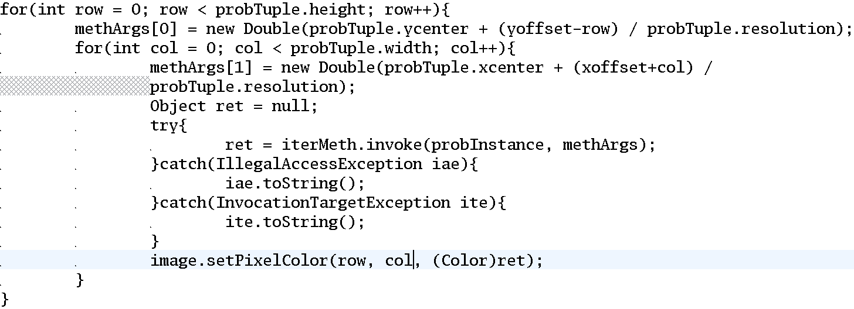
TEAM INFINITE TUPLES
Solve Example:

Slide 15

TEAM INFINITE TUPLES
Output:

Slide 16
Questions?
http://www.cs.rit.edu/~bdi8241/adhoc/
Notes:
Quick introduction of ourselves

