Slide 1

TEAM INFINITE TUPLES
http://www.cs.rit.edu/~bdi8241/adhoc/
Jacob Hays
Brad Israel
Notes:
Quick introduction of ourselves

Slide 2
TEAM INFINITE TUPLES
Agenda
Project Overview
Design
Demo
Results
Future Work
What we learned

Slide 3
TEAM INFINITE TUPLES
Project Overview
Adhoc collaborative problem solving framework.
Focus is on fractals.
Allow users to create fractal problems and distribute workload to other users within the adhoc network

Slide 4
TEAM INFINITE TUPLES
Design
ProblemTuple – Holds problem name and fractal image paramters. Contains the Class file that generates the fractal and the specified arguments.
ChunkTuple – Specifies a part of the problem to solve. Contains the data which is initially empty, but updated later with competed chunk.

Slide 5
TEAM INFINITE TUPLES
Design
ControlPanelLogic – Sets up Tupleboard and manages the current Problems on the Network. User input starts working on problems, or creates new ones.
CreateProblem – Reads the problem class file, gets user input parameters, and posts a new ProblemTuple with its ChunkTuples.
SolverLogic – Keeps track of the Chunks and the state changes of them for a problem. Creates a dispay GUI to show fractal and statistics.

Slide 6
TEAM INFINITE TUPLES
Design
SolverThread – Thread created to solve a chunk of a problem. Runs the class file to solve for the chunk that it is given.
ChunkSelector – A thread started up for each problem the program is working on. It chooses what chunks to work on and creates solver threads for each one.
ChunkCollection – A storage object for the chunk tuples, whose methods are synchronized to work with threads.
FractalImplemetation – An Interface with a single method used to create a fractal. A class implements this interface when creating a new fractal.

Slide 7
TEAM INFINITE TUPLES
Demo

Slide 8
TEAM INFINITE TUPLES
Results: Mandelbrot Fractal Test
Image size : 2500x2500
Center point : (-0.75, 0)
Pixels Per unit (Resolution) : 6000
Number of Iterations: 1000
Break out Value: 4.0

Slide 9
TEAM INFINITE TUPLES
Test 1:
Baseline – A completely sequential version of the program, without Java Reflections or Tupleboard.
Total Time: 105836ms (~105.8sec)
Computational Time: 105339ms (~105.3sec)

Slide 10
TEAM INFINITE TUPLES
Test 2:
Baseline with Java Refections – To see how much slowdown is the result of Java Reflections, a sequential version of Mandelbrot run with Java Reflections.
Total Time: 43988ms (~43.9sec)
Computational Time: 43744ms (~43.7)

Slide 11
TEAM INFINITE TUPLES
Test 3:
Baseline with Java Reflections and Tupleboard – To test the slow down of Tupleboard, run Mandelbrot through our program, but only one process works on it.
Total Time: 90858ms (~90 sec)
Computational Time: 53461ms (~53sec)
Average Time per Chunk: 106ms

Slide 12
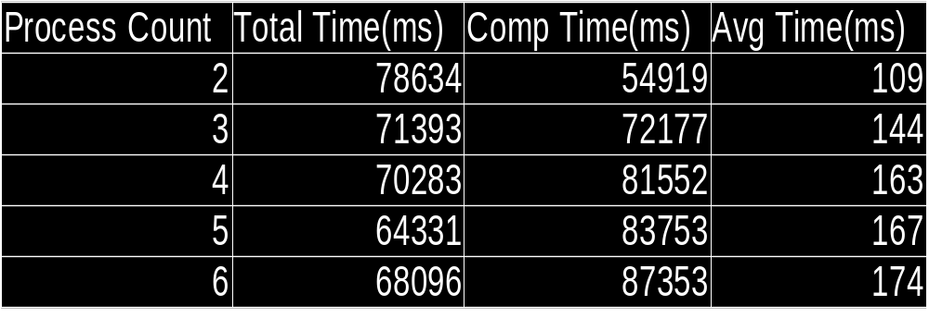
TEAM INFINITE TUPLES
Test 3:
Multiple Adhoc Processes

Slide 13
TEAM INFINITE TUPLES
Future Work:
Give the user control in how to split up the problem.
Implement various chunking methods, including methods that can split up chunks after the problem has started.
Allow user to specify how many problems to automatically work on as soon as they are posted.
Allow the user to set the number of solving threads for each problem that they are working on.
Implement the middleware for a broader use. E.x. Image processing or use with Matlab.

Slide 14
TEAM INFINITE TUPLES
What we learned
It is possible to share resources with others in an ad-hoc network.
Requires less set up and infrastructure.
Because of the lack of infrastructure, there is a lot more overhead and error checking that must be done.

Slide 15
Questions?
http://www.cs.rit.edu/~bdi8241/adhoc/
Notes:
Quick introduction of ourselves

