Slide 1


Justin Field
Brad Israel
Eric Lutley
Eric Miedlar
Ian Paterson

Slide 2
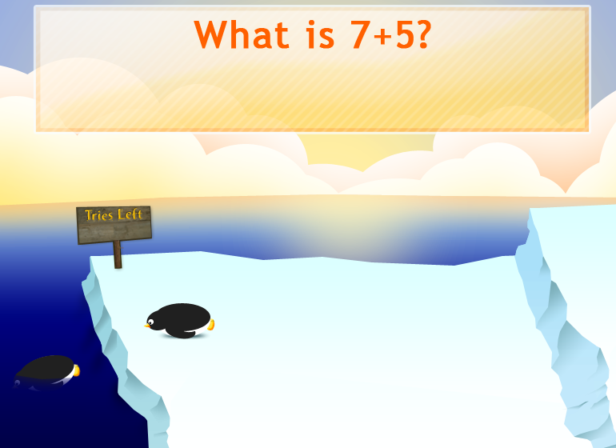
Fancy Unfulfilled Features

Slide 3
User Testing
We had one second-grader test our game. Her feedback prompted the following changes:
  Decreased the difficulty of the multiplication and division problems.
  Changed game instructions to use more visuals and less words.

Slide 4
R3 Acceptance Test Results
Test No. | Feature (User Story) covered | Preconditions | Test actions | Expected Outcome | R3 Outcome
1 | Whack Correct Mole | A new round has started. | Click on the mole with the correct answer. | Correct overlay is shown, and the score is 3.
2 | Whack Correct Mole | A new round has started. | Click on a mole with an incorrect answer. | Incorrect overlay appears, and the number of tries reduces to 2.
 |  |  | Click on the mole with the correct answer. | Correct overlay is show, and two is added to the score.
3 | Whack Correct Mole | A new round has started. | Click on a mole with an incorrect answer. | Incorrect overlay appears, and the number of tries reduces to 2.
 |  |  | Click on a mole with an incorrect answer. | Incorrect overlay appears, and the number of tries reduces to 1.
 |  |  | Click on the mole with the correct answer. | Correct overlay is show, and the score is 1.
4 | Lose Round | A new round has started. | Let the round timer run out without clicking on any of the moles. | Incorrect overlay with correct answer.
5 | Present Problem | Player has gone to game screen. | Player clicks to start the game. | A problem is displayed at the top of the screen.
 |  |  | Player completes the round. | A problem is displayed at the top of the screen, and the timer resets.
6 | Three chances | A new round has started. | Player whacks the wrong mole. | Incorrect flashes. Incorrect Sound effect occurs. Try counter decreases to two.
 |  |  | Whack the wrong mole again. | Same as above except counter decreases to one.
 |  |  | Whack the wrong mole again. | Counter decreases to zero. Incorrect overlay displays with correct answer.

Slide 5
R3 Acceptance Test Results
7 | Whack animals | A new round has started. | Click on mole with cursor. | All moles go down. Overlay appears.
8 | Sound effects | A new round has started. | Answer question incorrectly. | The "incorrect" sound effect occurs.
 |  |  | Answer question correctly. | The correct sound effect occurs. It is some stock cartoon sound effect.
9 | Student Report | Player has been playing a game. | Player selects quit, or plays twenty rounds and then completes the bonus round.. | A report that will display the student’s name, score, percent correct, number of questions correct on first try, the number of questions answered correctly, and the total number of questions.
10 | Multiplication Problem | User the presses the x/division sign button. | Play the game until you get a multiplication problem. | A multiplication problem appears within 100 rounds.
 |  | User presses the mix button. | Play the game until you get a multiplication problem. | A multiplication problem appears within 100 rounds.
11 | Division Problems | User presses the x/division sign button. | Play the game until you get a division problem. | A division problem appears within 100 rounds.
 |  | User presses the mix button. | Play the game until you get a division problem. | A division problem appears within 100 rounds.
12 | User add. | User is in administration mode and current teacher is set as the default class. | "Add user" button is selected. | The new user dialog appears.
 |  |  | Dialog is filled out. OK is pressed. | Student name appears in registry.
 |  |  | User presses the Save button and returns to the login screen. | Student name appears in the login screen.
13 | User delete | User is in administration mode. | Student name is selected | Student name no longer appears in the login screen.
 |  |  | “Delete” button is pressed
 |  |  | User presses the Save button and returns to the login screen.
14 | Class Progress Report | User is in administration mode and under the student tab. | User clicks a students name. | A report appears displaying the players statistics for all games.

Slide 6
R3 Acceptance Test Results
15 | Database storage | User plays game. | User enters administration mode. User clicks the students name in the list. | The last played game can be found under the user's name.
16 | Difficulty Level | User creates a new user and then gets 60 points in two rounds. | User starts a new game of the same type as the last two. | Moles increase in speed. Onscreen indicator reads level 2.
17 | Add Problem | User is under the "Questions" tab in administration mode. No problems have been entered. | User clicks the "Add New Question" button. | Popup screen appears.
 |  |  | User enters data and presses "Save Question. | Problem appears in list.
 |  |  | User starts a new game of the appriate type. | The problem appears on the screen.
18 | Teacher Login | Program is started. User is at login screen. | Teacher presses the "Teacher Login" button. | A enter popup password appears.
 |  |  | Teacher enters password. | Teacher enters administration mode.
19 | User login | Program is started. User is at login screen. | Student runs mouse over there name. | Select game image appears.
 |  |  | User selects a game type. | User is brought to the selected game type.
20 | Teacher Login | Program is started. User is at login screen. | Teacher enters incorrect password. | A popup appears detailing the error.
21 | Teacher Password change | User is under the MiscOptionTab in administrator mode. | Teacher Enters new password in both the "Enter New Password" and "Confirm New Password" fields. | Fields display asteriks.
 |  |  | Teacher presses the "Change Password" button. | A popup appears stating password was successfully changed.
 |  |  | Teacher logs out. | Program returns to log-in screen.
 |  |  | Teacher clicks name. | Enter password popup appears.
 |  |  | Teacher enters new password. | Teacher can login.

Slide 7
R3 Acceptance Test Results
22 | School Board Login | User has logged on to their computer. | User launches the school board statistic program and enters the IP Address of a server running the system . | User is given access to the School Board Screen.
23 | Bonus Round | Tester starts a new game. | Tester answers twenty questions.. | The user enters the bonus round.
24 | Add/Delete Teacher from database. | Tester is logged in as a Teacher and at the "Teachers" tab . | Tester clicks "Add New Teacher" button. | An input box appears.
 |  |  | User enters a teacher's name and presses "OK". | Teacher's name appears in the list.
 |  |  | User clicks the "Save" button. | Information is saved to the database.
 |  |  | User logs out. | User is returned to the login screen.
 |  |  | User logs in to the database using new teacher data. | User successuflly logs in.
 |  |  | User logs out and logs in as Admin. | User is brought to Admin screen.
 |  |  | User clicks the "Teachers' tab. | User is brought to the teacher's option menu.
 |  |  | User selects the Previously created teacher and presses the "Delete Teacher" button | Teacher's name is removed from the list.
 |  |  | User Presses the "Save" button. | Information is saved to the database.
 |  |  | User logs out. | User is taken to the login screen.
 |  |  | User attempts to login using the recently removed teacher data. | User cannot login.
25 | Admin mode. | Tester is at the login screen. | Tester presses the login button and enters the username "Admin" and the password "Admin". | The user logs in as the "Admin"
26 | Default Teacher Password | Tester is logged in as a Teacher and at the "Teacher" tab | Tester presses the "Add New Teacher" button. | An Input Box appears.
 |  |  | Tester enters new teacher's name and presses "OK". | User name appears in the list of teachers.
 |  |  | Tester presses the save button. | Information is saved to the database.
 |  |  | User logs out of admin mode. | User is brought back to the login screen
 |  |  | User attempts to login using the recently created teacher user name and the password username. | User successuflly logs in.

Slide 8
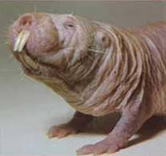
And Now For The Demo…

