Slide 1
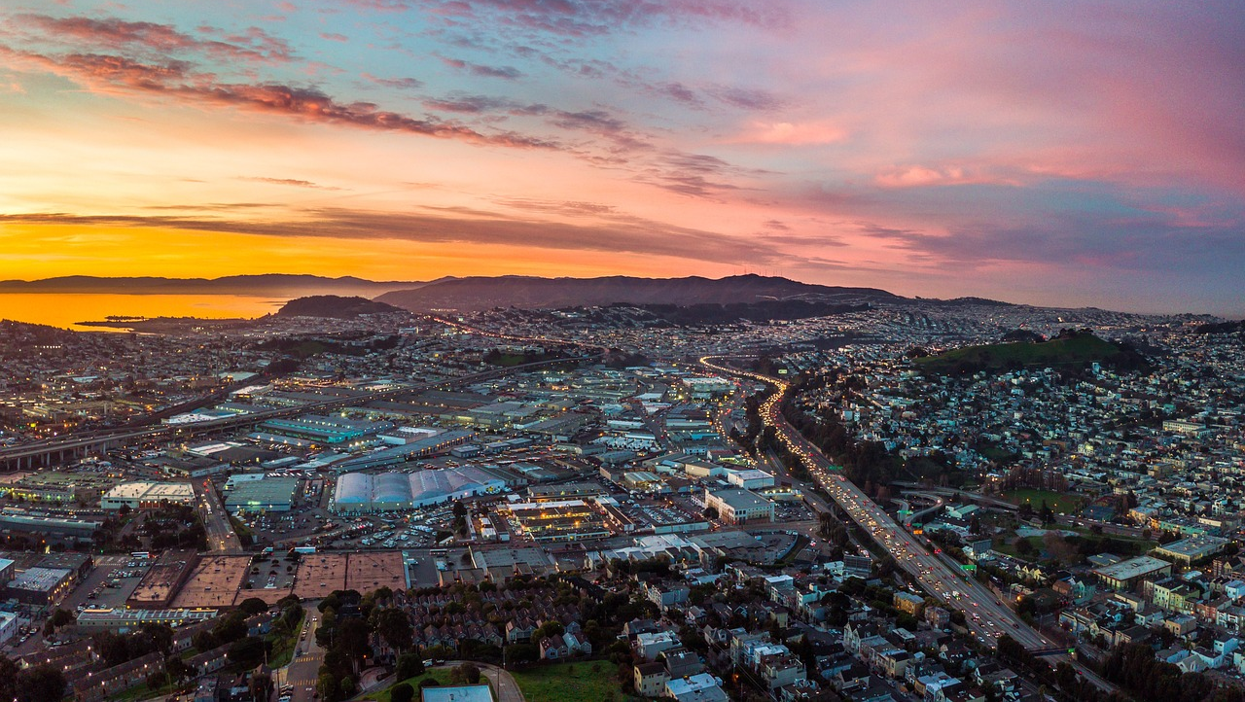
California House Sale Prices
Renee Agnor, Stephanie Bissell, Rebekah Higley, and Chris Howell

Slide 2
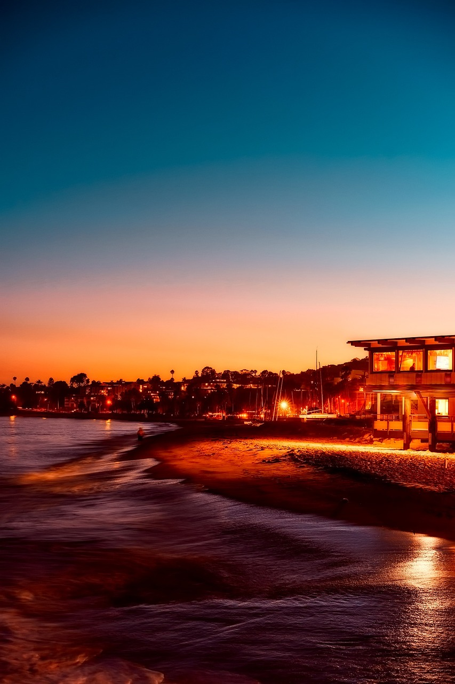
Project Description and Goal:
Create a model to estimate the median house value within a block of California based on the criteria in the dataset
Create a dashboard to display the information on a map
Research Questions to Answer:
What is the median house values within a block given the following information about a home:
Longitude
Latitude
Housing Median Age (within a block)
Total Rooms (within a block)
Total Bedrooms (within a block)
Population (within a block)
Households (within a block)
Medium Income (within a block)
Ocean Proximity

Slide 3
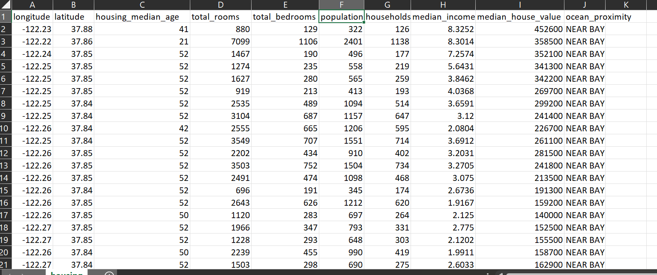
The Data:
We found this data on Kaggle
It has 10 columns and 20641 rows

Slide 4
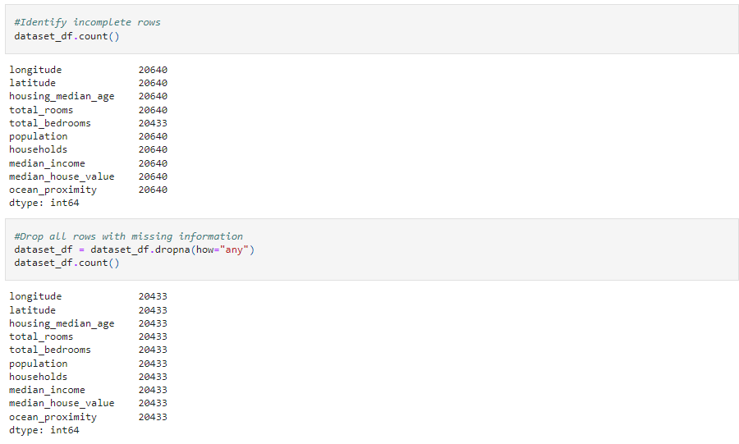
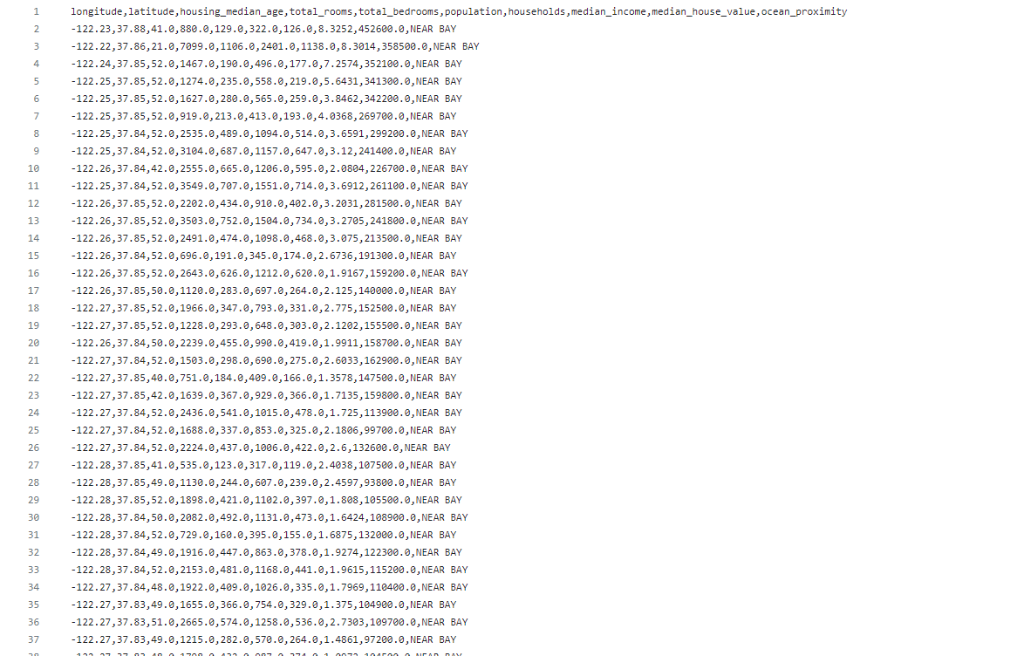
Looking at the rows
Dropping rows with missing info
Cleaned data ->

Slide 5
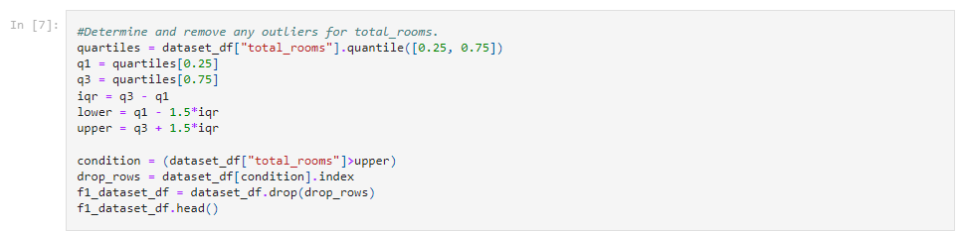
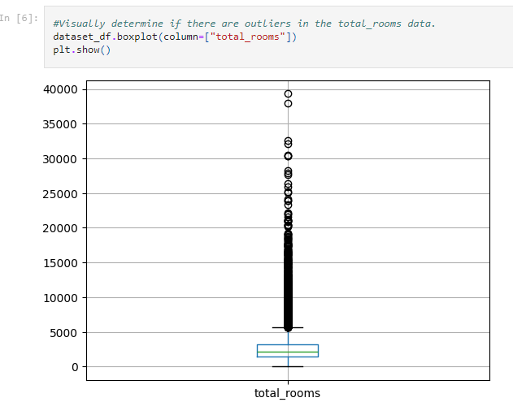
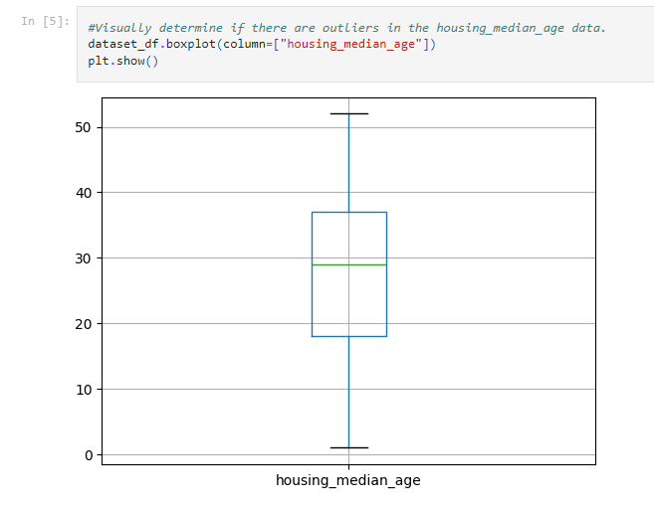
Checking for outliers
Removing outliers

Slide 6
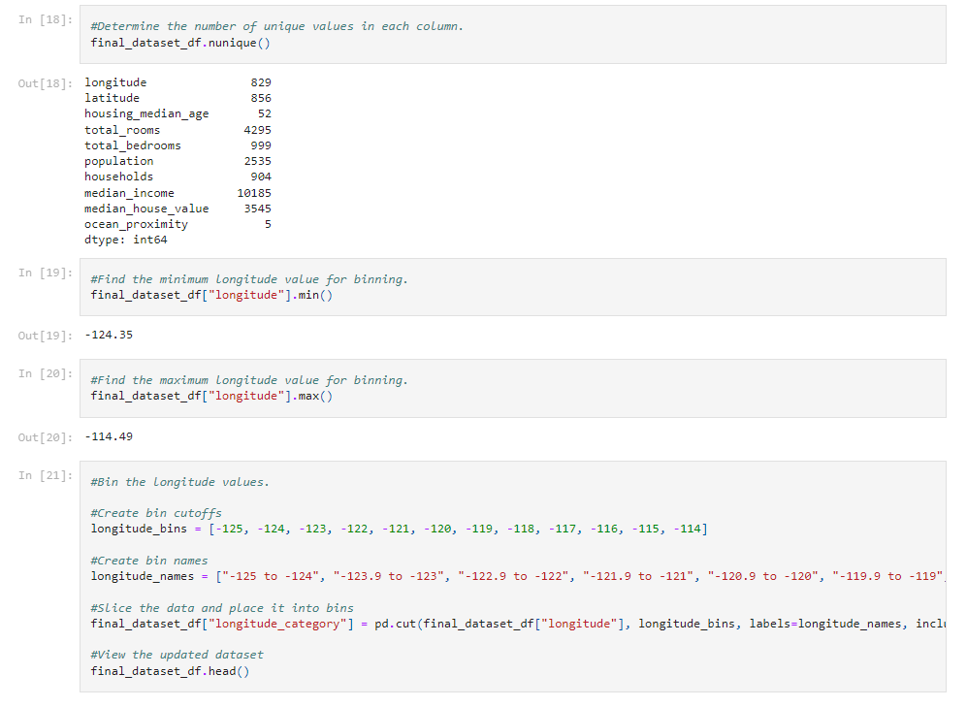
Binning for all the columns
List of Columns:
Longitude
Latitude
Housing Median Age (within a block)
Total Rooms (within a block)
Total Bedrooms (within a block)
Population (within a block)
Households (within a block)
Medium Income (within a block)
Ocean Proximity

Slide 7
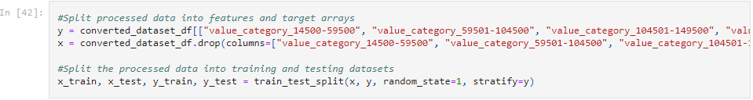
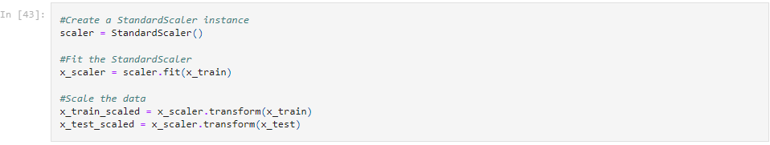
Split Data
and
Scale Data

Slide 8
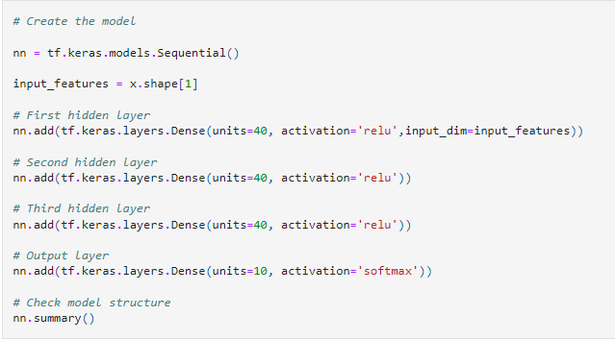
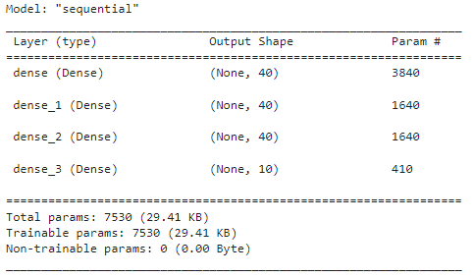
Training the Data

Slide 9
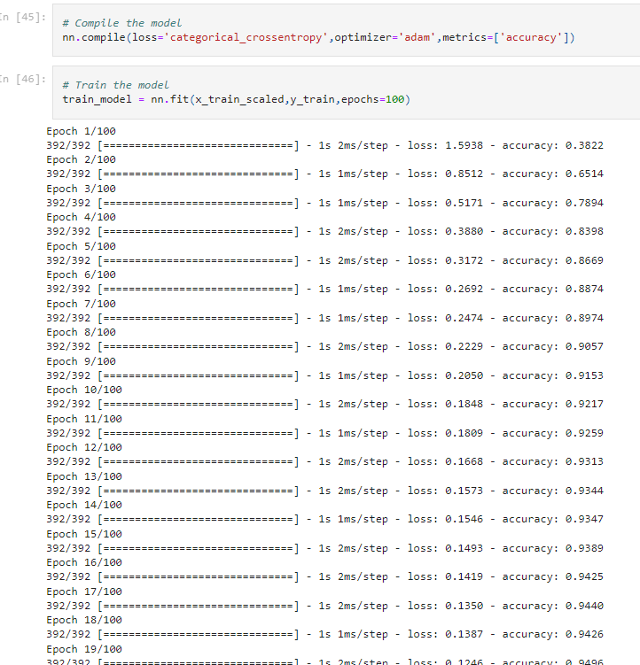
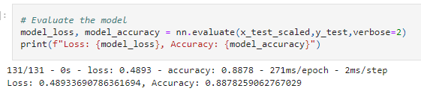
Compiling the Model
Training the Model
Evaluate the Model

Slide 10
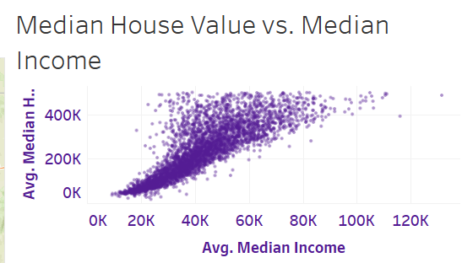
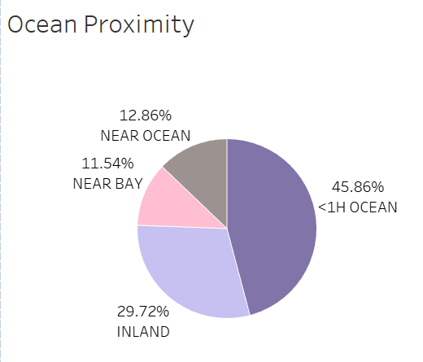
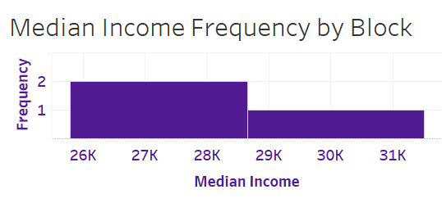
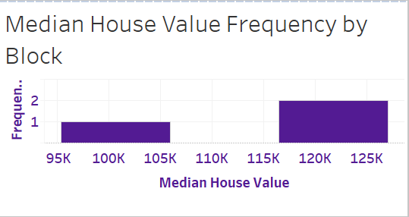
Creating the Tableau graph
Combining them into a Dashboard

Slide 11
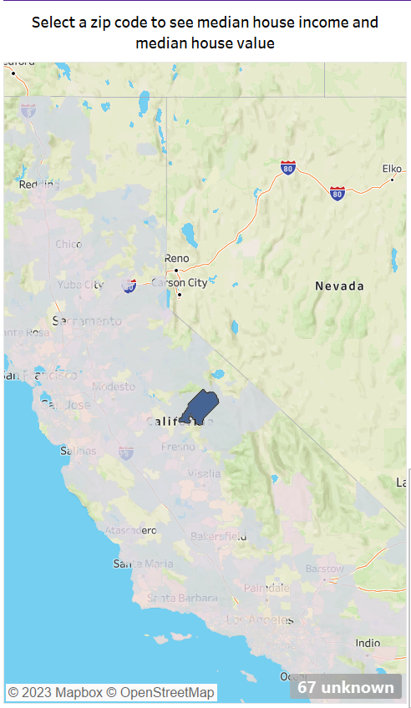
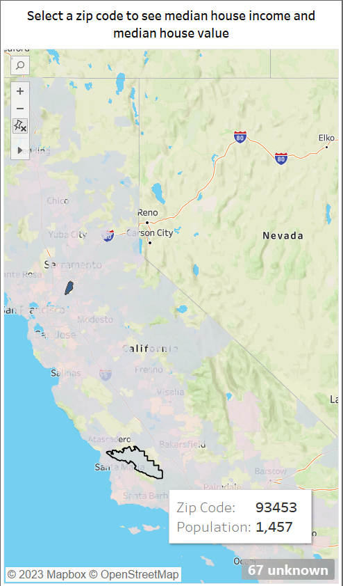
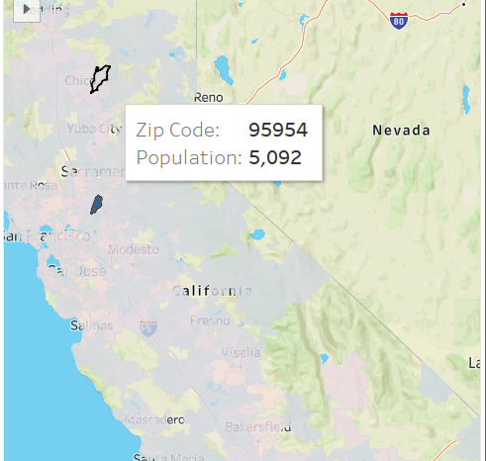
Include a map that has all the zip codes and when you hover over a section of the map it shows the zip code and population

Slide 12
Link to Tableau Dashboard:
https://public.tableau.com/app/profile/renee.agnor/viz/Project_4_16983605975100/CaliforniaHousingDashboard?publish=yes
Citations
Derwiki. (2018, June 24). Sunrise, City, Water. Pixabay. https://pixabay.com/photos/sunrise-city-water-san-francisco-3495775/
12019. (2017, July 22). Santa Barbara, California, House image. Free for use. Pixabay. https://pixabay.com/photos/santa-barbara-california-house-home-2532138/

