Slide 1
Week 8 SpendSense
Viktoria Todorova

Slide 2
TABLE OF CONTENTS
01
02
03
04
Context and Description
Planned
Architecture
Value Of Work
For Next Sprint

Slide 3
DESCRIPTION
Financial management system designed to help businesses and individuals track, manage, and analyze their finances.
Expense Tracking
Budget Creation and Management
Reports and Dashboards
SpendSence helps make managing finances easier in today's complicated financial world.

Slide 4
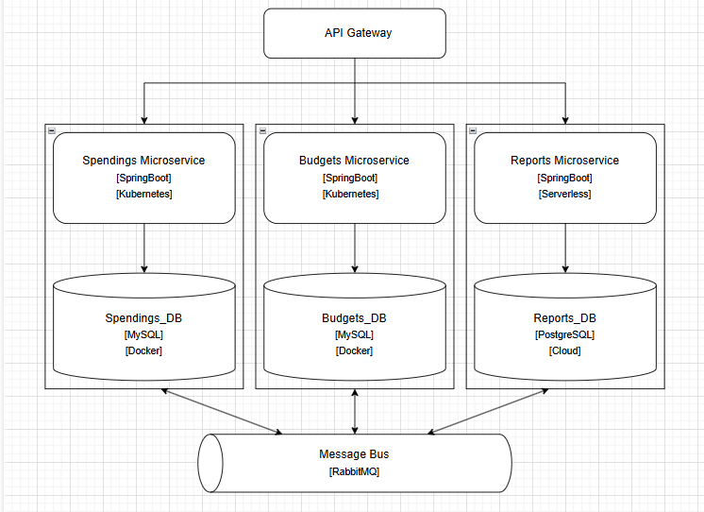
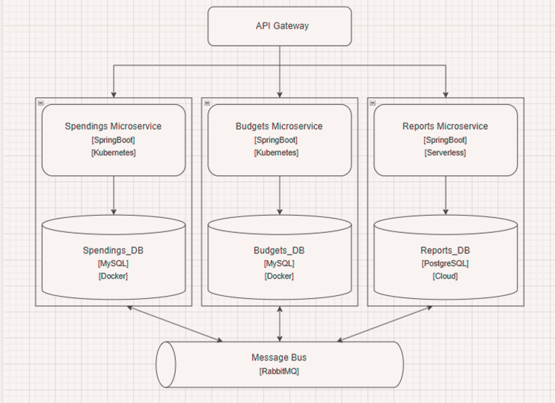
ARCHITECTURE
Traefik - Routes requests to the correct MS and provides a unified API layer, optimized for K8s
Runs only when needed, AWS Lambda works well with PostgreSQL
Always on, frequent API calls and need for stable DB connection
PostgreSQL for its advanced SQL features (complex queries, windows functions, etc.)
AWS RDS – handles scaling, backups and fault tolerance
Reliable transactions of messages, instead of broadcasting data – short-lived, simpler to set up,

Slide 5
VALUE OF WORK
FINANCIAL LITERACY
BUSINESS POTENTIAL
The application gives insights into its users’ financial habits and promotes responsibility
Can expand to an application that predicts financial habits and detects fraud
RELIABLE
EFFICIENT
It ensures users' financial data is safe and structured while providing seemless UX
Ensures smooth operation during high traffic; only starts some fragments when needed

Slide 6
PPEVIOUS SPRINT
API GATEWAY
TESTS
CI/CD PIPELINES
Secures and manages all service requests
Ensures components work correctly
Automates testing, building, and future deployments

Slide 7
NEXT SPRINT
DEPLOYMENT
SECURITY
CI/CD PIPELINES
At this stage, locally in Minikube
Log in for users and TLS FOR Rabbit MQ
Automates testing, building, and future deployments

Slide 8
QUESTIONS & ANSWERS

Slide 9
THANKS!
If you have any further questions, don’t hesitate to contact me at
v.todorova@fontysict.nl

