Slide 1
Laptop price prediction using different machine learning algorithms
Anjala Bhatta (23118/076)
Prapanna Bista (23173/076)
Mahesh Chandra Regmi (23153/076)
3/31/2024

Slide 2
Table of content
Introduction
Problem Statement
Objective
Literature Review
Methodology
Result and Discussion
Conclusion

Slide 3
Introduction
This project aim is to analyze price of laptop using different machine learning algorithms.
Algorithms used are Linear Regression, Decision Tree and SVM.
Web application that predict price in which user input different specification of the laptop.
Output shows graphical visualization of three algorithms and decide which is best among all.

Slide 4

Problem Statement
The laptop price varies in different store so price need to be determined.
Different algorithms give different results so better one need to be selected.
This Photo by Unknown Author is licensed under CC BY-NC

Slide 5

Objective
Develop a GUI to predict laptop price on the basis of different features entered by user.
Develop a predicted price visualizer on the basis of different algorithm’s evaluation metrices.

Slide 6
Literature review
V. Surjuse, S. Lohakare, A. Barapatre, and A. Chapke, “Laptop Price Prediction using Machine Learning,” International Journal of Computer Science and Mobile Computing, vol. 11, no. 1, pp. 164–168, Jan. 2022, doi: https://doi.org/10.47760/ijcsmc.2022.v11i01.021.
A. D. Siburian et al., “Laptop Price Prediction with Machine Learning Using Regression Algorithm,” Jurnal Sistem Informasi dan Ilmu Komputer Prima(JUSIKOM PRIMA), vol. 6, no. 1, pp. 87–91, Sep. 2022, doi: https://doi.org/10.34012/jurnalsisteminformasidanilmukomputer.v6i1.2850.
V. Sarala, P. Sai, and P. Kumar, “Laptop Price Prediction.” Available: https://ijesat.com/ijesat/files/V23I9047_1694756701.pdf
“Laptop Price Estimation Using Machine Learning | International Journal of Research in Engineering, Science and Management,” journal.ijresm.com, Mar. 2024, Accessed: Mar. 28, 2024. [Online]. Available: https://journal.ijresm.com/index.php/ijresm/article/view/2961
L. Akkouh, "Machine Learning-Based Price Prediction for Laptops," Article, Jan. 2024. [Online]. Available: https://www.researchgate.net/publication/377721653.

Slide 7
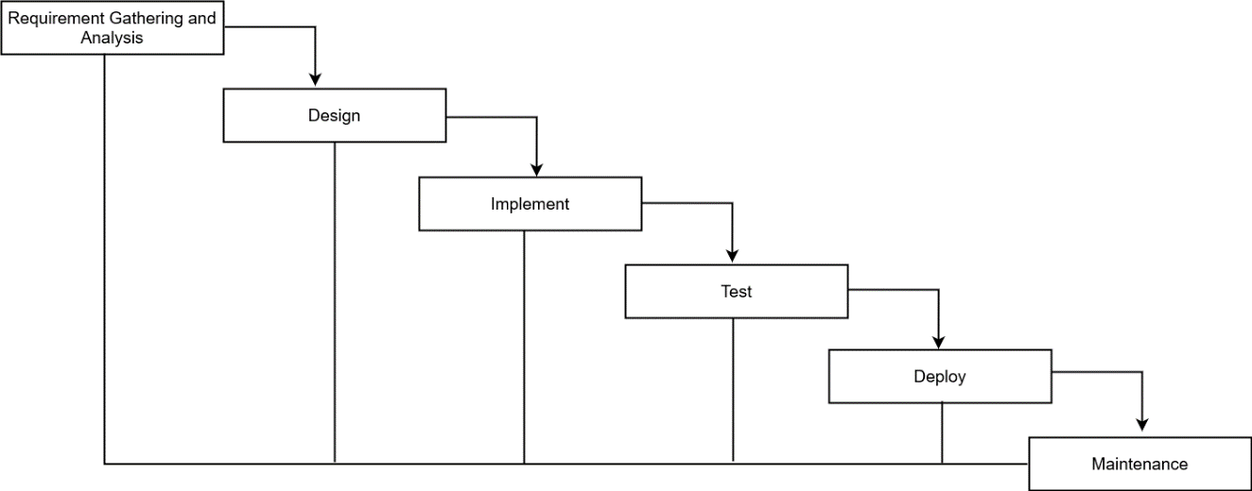
Methodology used
Waterfall model

Slide 8
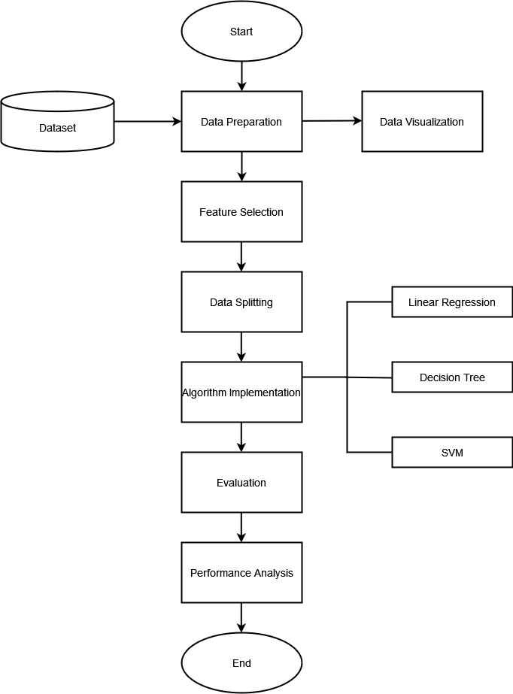
System Design
System Flowchart

Slide 9

Tools Used

Slide 10
Algorithm used
Linear Regression
Decision Tree
Support Vector Machine (SVM)

Slide 11
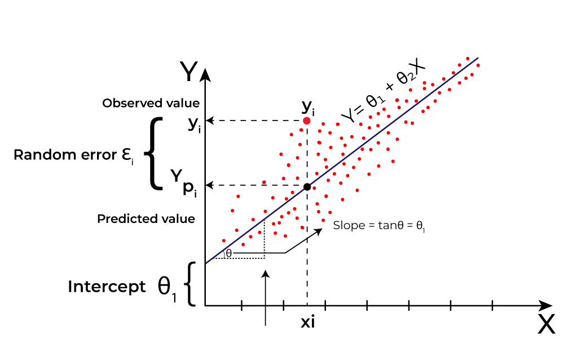
Linear regression

Slide 12
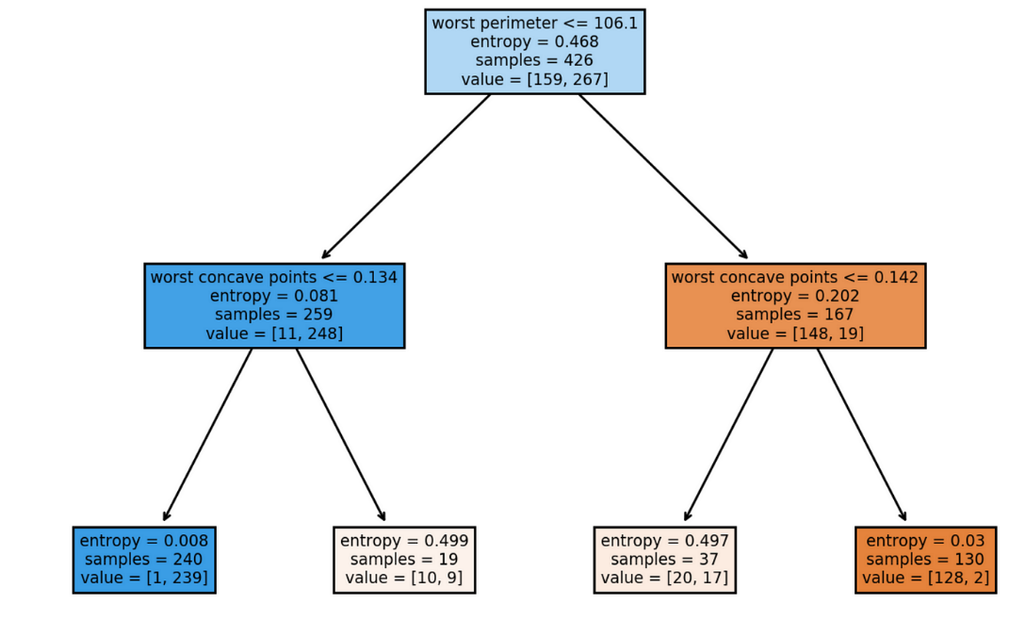
Decision tree

Slide 13
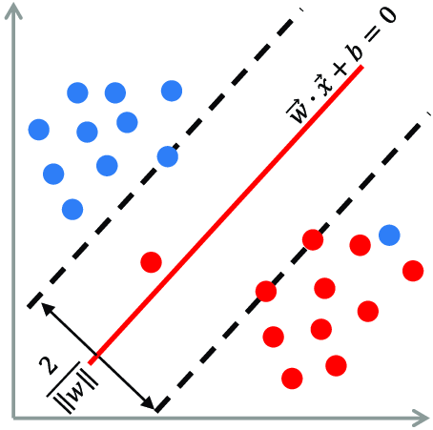
Support Vector machine (SVM)

Slide 14

Dataset
12 columns
Training data – 80%
Testing data – 20%
1304 rows
Kaggle dataset
CSV Format

Slide 15
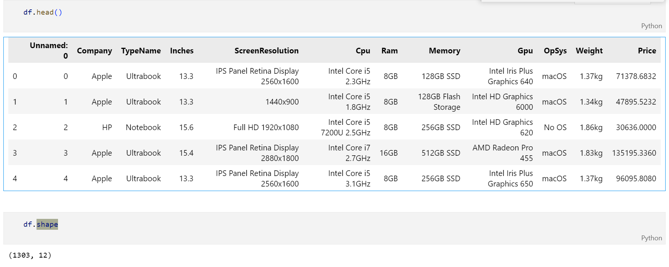
Overview of dataset

Slide 16
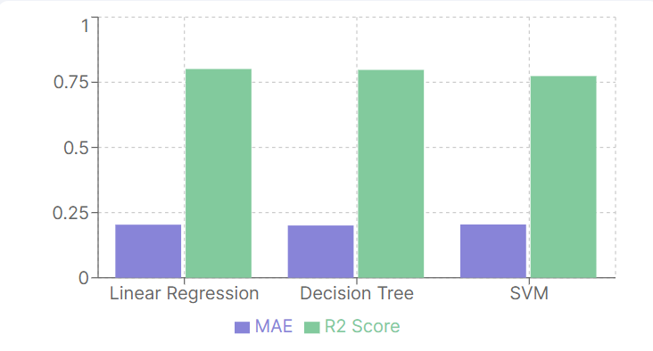
Result analysis
Result Analysis of Different Algorithms
S.N. | Methods | MAE | R^{­2} Score
1 | Linear Regression | 0.203573 | 0.801030
2 | Decision Tree | 0.201348 | 0.802387
3 | SVM | 0.204373 | 0.773879
A lower MAE indicates better accuracy of the model
A higher R2 score indicates that the model fits the data better.

Slide 17



Result analysis
Description of metrices
n = number of samples in the dataset.
yi​ is the actual value of the target variable for the ith sample.
​ $\hat{y_{i}}$is the predicted value of the target variable for the ith sample.
$\overline{y}$is the mean of the observed values.

Slide 18
Limitations
Model could have been trained with a much larger dataset.
Prediction failed with mac price prediction, as we have considered only intel and AMD processor during feature extraction.
It is difficult to address all available factor.

Slide 19
Conclusion
Hence, this project aims to correctly predict price of laptop with the help of different machine learning algorithms.
It can be explored further and implement with larger and relevant datset.
It can be integrated with ecommerce store like daraz, ITTI, neostore etc.

Slide 20
Project Demo

Slide 21
Thank you

