Slide 1

API Training – Day 3
BISTEC GLOBAL SERVICES (PVT) LTD
Chandima Ranaweera

Slide 2

Hearts Academy
Help our Hearts to improve their skills

Slide 3
Overview
WEB Request/Response Structure
BDD
Specflow
Demo – Api Testing Framework

Slide 4
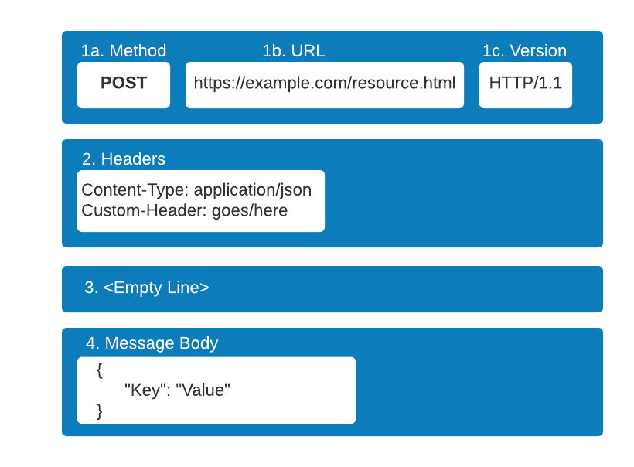
WEB Request/Response Structure

Slide 5
BDD – Given/When/Then
Scenario: Get list of Employees
Given A new admin is created with username and password
When Get Employee list api is called
Then Status code should be 200

Slide 6
Specflow
BDD Framework for .Net
Support Feature files
Support xUnit Test runner
Live Documentation Plugin

Slide 7
Hands On

Slide 8
Questions ?

Slide 9

Contact us
Australia
BISTEC Global Pty Ltd.
Level 2/11 York St, Sydney NSW 2000
(+61) 02 9052 4700
Sri Lanka
BISTEC Global Services Pvt Ltd.
No. 14, Sir Baron Jayathilake Mawatha, Colombo 00100.
(+94) 77 768 1014
hello@bistecglobal.com

