Slide 1
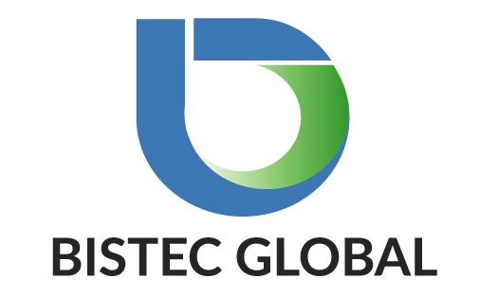
Introduction to Azure DevOps Pipelines
BISTEC GLOBAL SERVICES (PVT) LTD
Chandima Ranaweera

Slide 2
Bistec Quality Circle
Deliver high-quality software to the customer via smooth QA
Collaborative vision between Dev and QA

Slide 3
Overview
Why DevOps
GitOps
Classic pipelines vs YAML pipelines
Hands on Demo

Slide 4
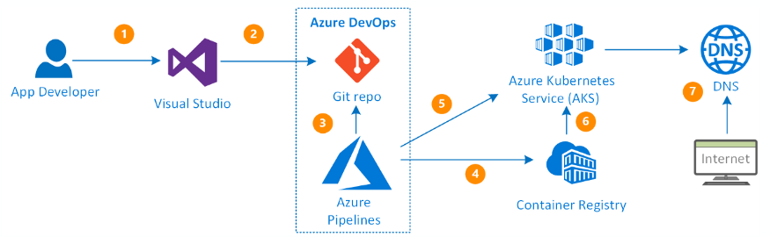
Why devops
Continuous delivery of software
Better collaboration between teams
Easy deployment
Better efficiency and scalability
Errors are fixed at the initial stage
More security
Less manual intervention (which means fewer chances of error)

Slide 5
What can be automated
Build
Unit Tests
UI Tests
Static code analysis (SonarQube)
Deployments
Etc..

Slide 6
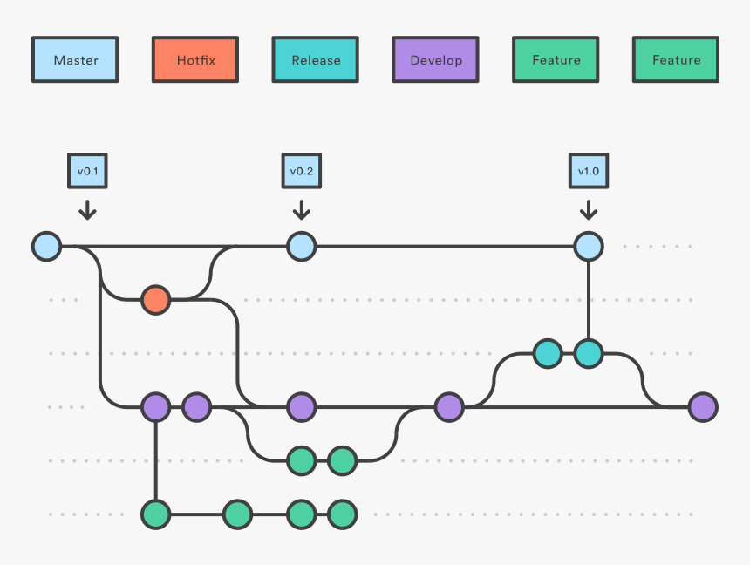
Gitops / CI-CD
Built around GIT version control system
Each software feature is isolated into git branch (Git Flow)
Pull requests to continuously integrate features to system
Continues deliveries managed by YAML pipelines

Slide 7
Azure Devops pipelines
Classic Pipelines
YAML Pipelines
Created in Azure DevOps Portal by dragging and dropping elements.
Separated into Build and Release pipelines.
Created as a YAML text and committed to git repository.
Multistage pipelines within the same job
Future of the DevOps

Slide 8
Hands On

Slide 9
Questions ?

Slide 10

Contact us
Australia
BISTEC Global Pty Ltd.
Level 2/11 York St, Sydney NSW 2000
(+61) 02 9052 4700
Sri Lanka
BISTEC Global Services Pvt Ltd.
No. 14, Sir Baron Jayathilake Mawatha, Colombo 00100.
(+94) 77 768 1014
hello@bistecglobal.com

