Slide 1

Advanced TDD with .net
BISTEC GLOBAL SERVICES (PVT) LTD
Chandima Ranaweera

Slide 2
Bistec Quality Circle
Deliver high-quality software to the customer via smooth QA
Collaborative vision between Dev and QA
TDD workshop 2

Slide 3
Top 10 software bugs in history
The Explosion of the Ariane 5.
PayPal accidentally credits man $92 quadrillion.
Windows Calculator Bug.
The Metric System and NASA’s Mars Climate Orbiter.
The $475 Pentium FDIV bug.
Y2K Bug (1999).
The year 2038 problem.
Patriot Missile Failure (1991).
Gangnam Style music video ‘broke’ YouTube.
BSOD during the Windows 98 presentation.

Slide 4
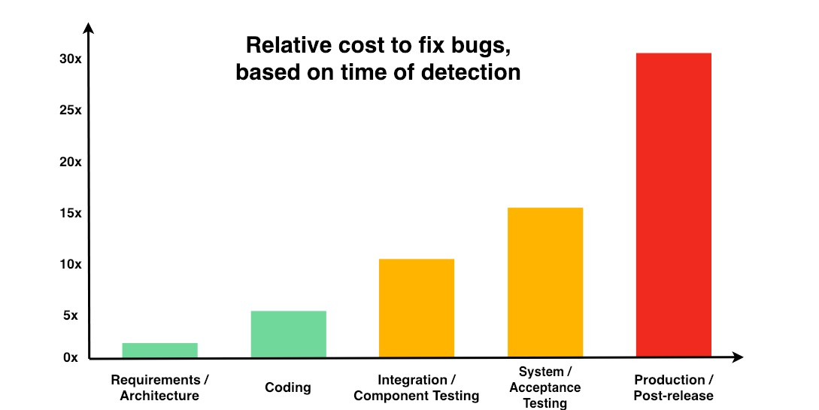
Cost of Fixing Defects
Each phase increases cost of fixing a defect by 5x times.

Slide 5

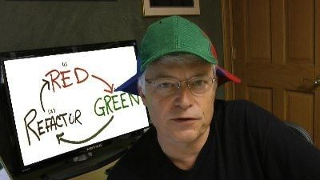
Thinking in TDD

Slide 6
Hands On

Slide 7
Questions ?

Slide 8

Contact us
Australia
BISTEC Global Pty Ltd.
Level 2/11 York St, Sydney NSW 2000
(+61) 02 9052 4700
Sri Lanka
BISTEC Global Services Pvt Ltd.
No. 14, Sir Baron Jayathilake Mawatha, Colombo 00100.
(+94) 77 768 1014
hello@bistecglobal.com

