Slide 1
Normalization

Slide 2
Normalization is the process of structuring and handling the relationship between data to minimize redundancy in the relational table and avoid the unnecessary anomalies properties from the database like insertion, update and delete. It helps to divide large database tables into smaller tables and make a relationship between them. It can remove the redundant data and ease to add, manipulate or delete table fields.
A normalization defines rules for the relational table as to whether it satisfies the normal form. A normal form is a process that evaluates each relation against defined criteria and removes the multivalued, joins, functional and trivial dependency from a relation. If any data is updated, deleted or inserted, it does not cause any problem for database tables and help to improve the relational table' integrity and efficiency.

Slide 3
Objective of Normalization
It is used to remove the duplicate data and database anomalies from the relational table.
Normalization helps to reduce redundancy and complexity by examining new data types used in the table.
It is helpful to divide the large database table into smaller tables and link them using relationship.
It avoids duplicate data or no repeating groups into a table.
It reduces the chances for anomalies to occur in a database.

Slide 4


Slide 5

Types of Anomalies
1. Data redundancy occurs in a relational database when two or more rows or columns have the same value or repetitive value leading to unnecessary utilization of the memory.
There are two students in the above table, 'James' and 'Ritchie Rich', whose records are repetitive when we enter a new CourseID. Hence it repeats the studRegistration, StudName and address attributes.

Slide 6
2. Insert Anomaly: An insert anomaly occurs in the relational database when some attributes or data items are to be inserted into the database without existence of other attributes.
For example, In the Student table, if we want to insert a new courseID, we need to wait until the student enrolled in a course. In this way, it is difficult to insert new record in the table. Hence, it is called insertion anomalies.

Slide 7
3. Update Anomalies: The anomaly occurs when duplicate data is updated only in one place and not in all instances. Hence, it makes our data or table inconsistent state.
For example, suppose there is a student 'James' who belongs to Student table. If we want to update the course in the Student, we need to update the same in the course table; otherwise, the data can be inconsistent. And it reflects the changes in a table with updated values where some of them will not.

Slide 8
4. Delete Anomalies: An anomaly occurs in a database table when some records are lost or deleted from the database table due to the deletion of other records.
For example, if we want to remove Trent Bolt from the Student table, it also removes his address, course and other details from the Student table. Therefore, we can say that deleting some attributes can remove other attributes of the database table.

Slide 9
So, we need to avoid these types of anomalies from the tables and maintain the integrity, accuracy of the database table. Therefore, we use the normalization concept in the database management system.

Slide 10
Types of Normalization
First Normal Form (1NF)
Second Normal Form (2NF)
Third Normal Form (3NF)
Boyce and Codd Normal Form (BCNF)
Fourth Normal Form (4NF)
Fifth Normal Form (5NF)

Slide 11
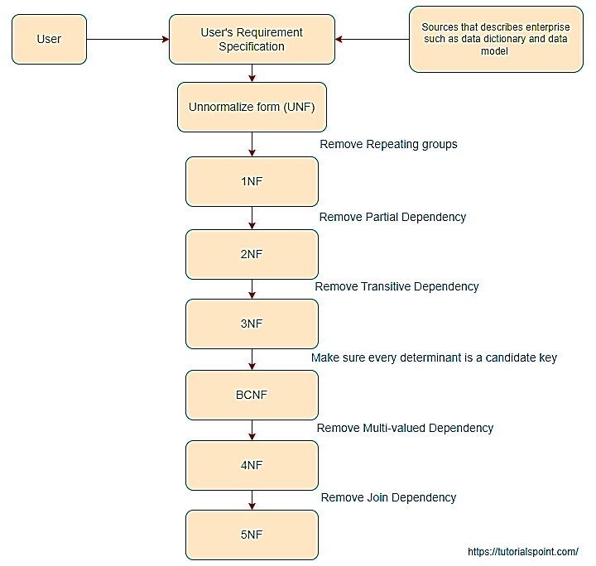
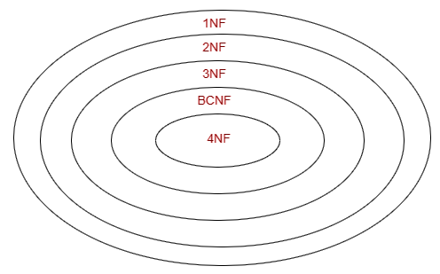

Slide 12
First Normal Form (1NF):
The table will be in First Normal Form (1NF) if all the attributes of the table contain only atomic values. We can also say that if a table holds the multivalued data items in attributes or composite values, the relation cannot be in the first normal form. So, we need to make it first normal form by making the entries of the table atomic.

Slide 13
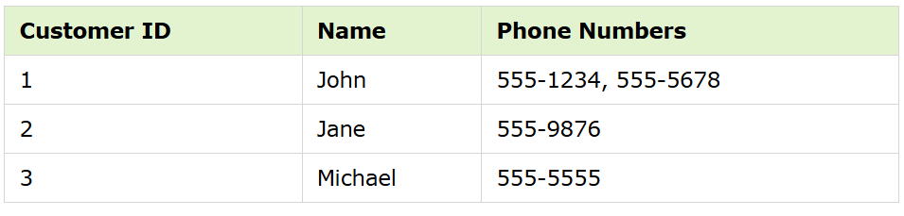
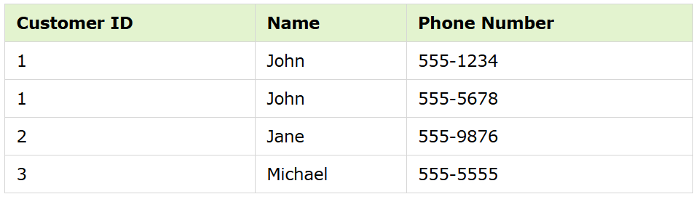
Example
A table is in 1NF if each column contains atomic values and each row is uniquely identified. For example, a table that lists customers and their phone numbers −
This violates 1NF because the Phone Numbers column contains repeating groups.
To normalize this table to 1NF, we can split the Phone Numbers column into separate rows and add a separate primary key column −

Slide 14
Functional dependency
Functional dependencies are the constraints that are derived from the meaning and interrelationship of the data. Let F is a set of all functional dependencies. The set of all dependencies that include F as well as all dependencies that can be inferred from F is called CLOSURE of F denoted by F⁺.

Slide 15
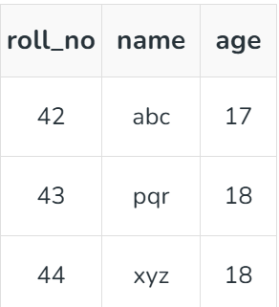
1. Trivial Functional Dependency
In Trivial Functional Dependency, a dependent is always a subset of the determinant. i.e. If X → Y and Y is the subset of X, then it is called trivial functional dependency.
Symbolically: A→B is trivial functional dependency if B is a subset of A.
Here, {roll_no, name} → name is a trivial functional dependency, since the dependent name is a subset of determinant set {roll_no, name}. Similarly, roll_no → roll_no is also an example of trivial functional dependency.

Slide 16
2. Non-trivial Functional Dependency
In Non-trivial functional dependency, the dependent is strictly not a subset of the determinant. i.e. If X → Y and Y is not a subset of X, then it is called Non-trivial functional dependency.
Example 1 : Id -> Name , Name -> DOB
Here, roll_no → name is a non-trivial functional dependency, since the dependent name is not a subset of determinant roll_no. Similarly, {roll_no, name} → age is also a non-trivial functional dependency, since age is not a subset of {roll_no, name}

Slide 17
Rules of functional dependencies
There are six inference rules which are as follows −
Reflexivity: X->X // An attribute(s) determines itself
Augmentation: if X->Y then XZ->YZ
Transitivity: if X->Y & Y->Z then X->Z
Additivity or Union : if X->Y & X->Z then X->YZ
Projectivity or Decomposition: If X->YZ then X-> Y & X->Z
Pseudo-Transitivity: If X->Y, YZ->W then XZ->W

Slide 18
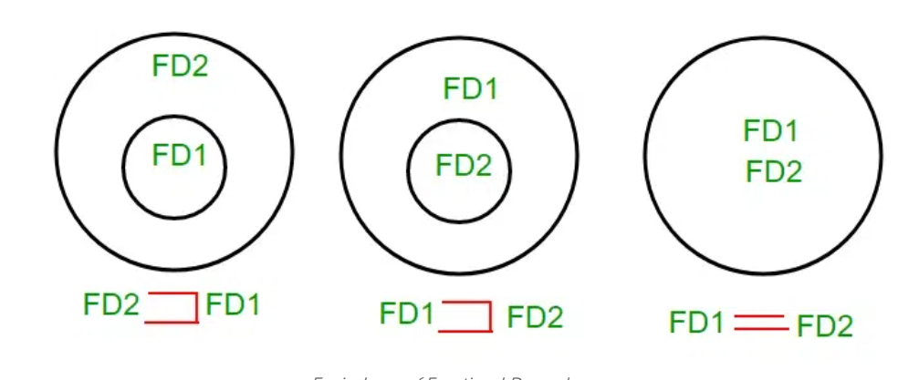
Equivalence of Functional Dependencies
How To Find the Relationship Between Two Functional Dependency Sets?
Let FD1 and FD2 be two FD sets for a relation R.
If all FDs of FD1 can be derived from FDs present in FD2, we can say that FD2 ⊃ FD1.
If all FDs of FD2 can be derived from FDs present in FD1, we can say that FD1 ⊃ FD2.
If 1 and 2 both are true, FD1=FD2.

Slide 20
Canonical Cover of Functional Dependencies in DBMS
A canonical cover is a set of functional dependencies that is equivalent to a given set of functional dependencies but is minimal in terms of the number of dependencies. Canonical Cover of functional dependency is also called minimal set of functional dependency or irreducible form of functional dependency.

Slide 21
Step 1: Combine Functional Dependencies with the Same Left-Hand Side
If two or more functional dependencies in F have the same left-hand side, combine them into a single functional dependency by taking the union of their right-hand sides.
Example:
A→B and A→C become A→BC.

Slide 22
Step 2: Decompose Functional Dependencies
If the right-hand side of a functional dependency has multiple attributes (e.g., X→AB), decompose it into multiple functional dependencies, each with a single attribute on the right-hand side.
Example:
X→AB becomes X→A and X→B.

Slide 23
Step 3: Check for Redundant Dependencies
A functional dependency FD in F is redundant if it can be removed without changing the closure of F.
To check:
Temporarily remove FD from F.
Compute the closure of the remaining set.
If the closure is the same as the closure of the original set, FD is redundant and can be removed.

Slide 24
Step 4: Eliminate Extraneous Attributes
An attribute is extraneous if removing it does not change the closure of the functional dependency set. There are two scenarios:
Extraneous Attributes on the Left-Hand Side:
For X→Y, check if any attribute in X can be removed without affecting the closure.
To check:
Remove an attribute A from X to form X′.
Compute the closure of F with X′→Y instead of X→YX .
If the closure remains unchanged, A is extraneous.
Extraneous Attributes on the Right-Hand Side:
For X→Y, check if any attribute in Y can be removed without affecting the closure.
To check:
Remove an attribute B from Y.
Compute the closure of F with X→Y′, where Y′ is Y without B.
If the closure remains unchanged, B is extraneous.

Slide 25
Step 5: Verify the Final Canonical Cover
Ensure that each functional dependency is in its simplest form:
The left-hand side has no extraneous attributes.
The right-hand side contains only one attribute.
Check that the closure of the canonical cover is the same as the closure of the original set F.

Slide 26
Second Normal Form (2NF):
A Relation will be in 2NF if it follows the following condition:
The table or relation should be in 1NF or First Normal Form.
All the non-prime attributes should be fully functionally dependent on the candidate key.
The table should not contain any partial dependency.

Slide 28

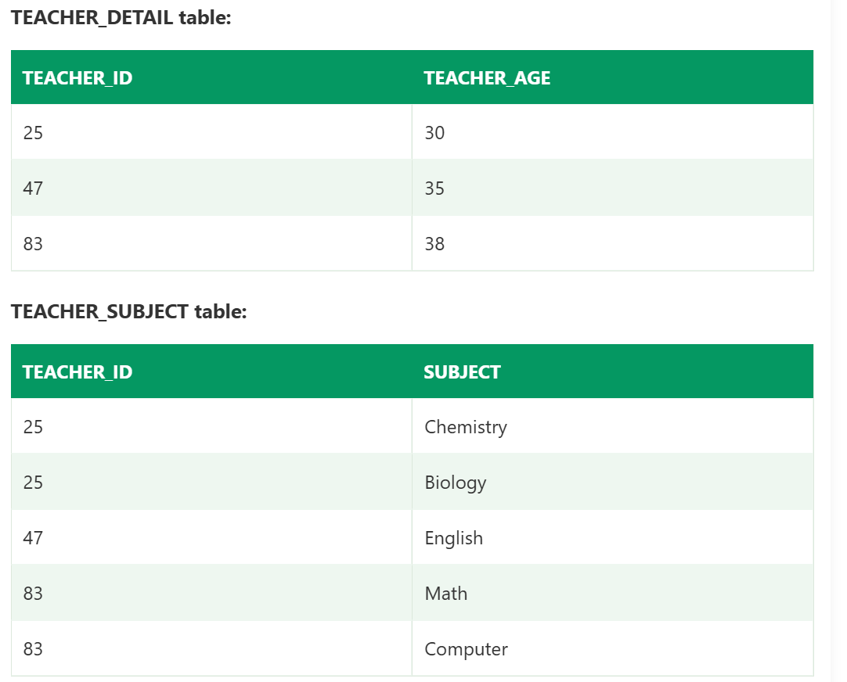
In the given table, non-prime attribute TEACHER_AGE is dependent on TEACHER_ID which is a proper subset of a candidate key. That's why it violates the rule for 2NF.
To convert the given table into 2NF, we decompose it into two tables:

Slide 29
Third Normal Form
A relation is in Third Normal Form (3NF) if it is already in Second Normal Form (2NF) and does not have transitive dependencies for non-prime attributes.
X is a super key.
or
Y is a prime attribute (each element of Y is part of some candidate key).

Slide 30
Fourth normal form (4NF)
A relation will be in 4NF if it is in Boyce Codd normal form and has no multi-valued dependency.
For a dependency A → B, if for a single value of A, multiple values of B exists, then the relation will be a multi-valued dependency.

Slide 31
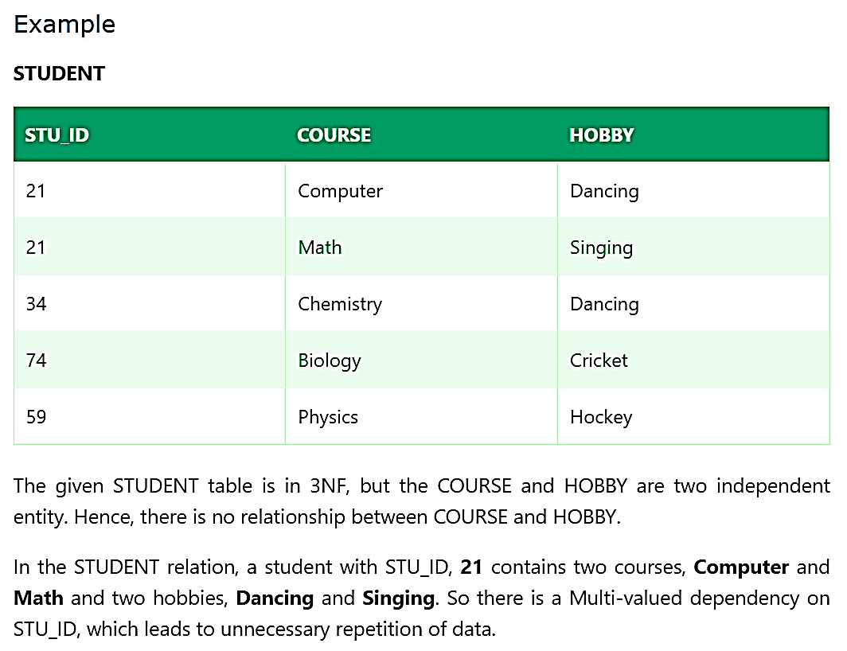

Slide 32



Slide 33
Fifth normal form (5NF)
A relation is in 5NF if it is in 4NF and not contains any join dependency and joining should be lossless.
5NF is satisfied when all the tables are broken into as many tables as possible in order to avoid redundancy.
5NF is also known as Project-join normal form (PJ/NF).

Slide 34
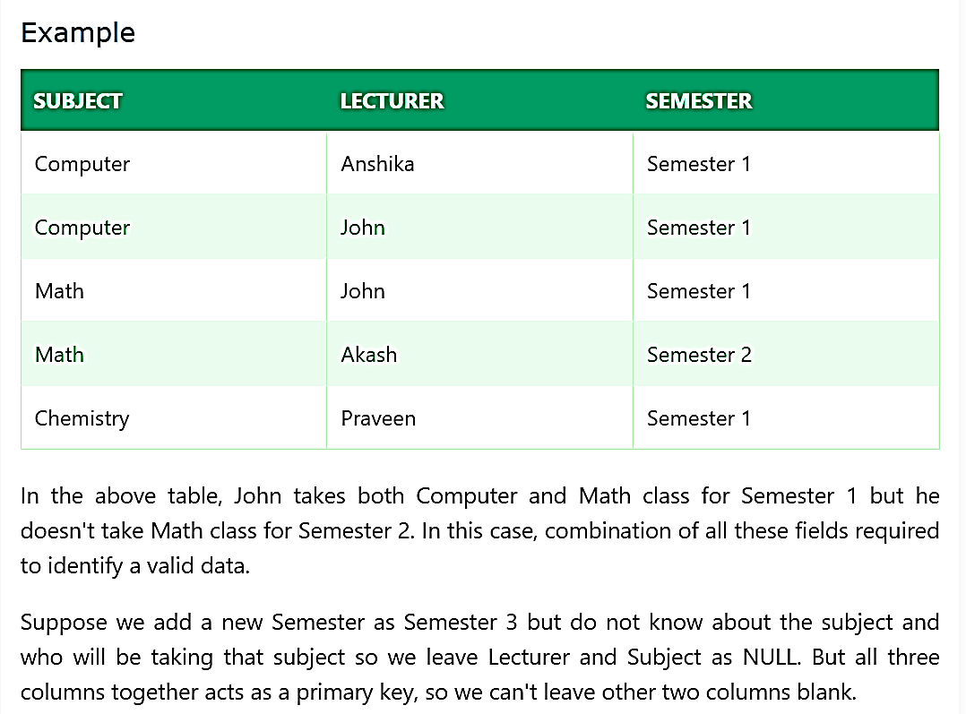

Slide 35




