Slide 1
Degree of Relationship
In DBMS, a degree of relationship represents the number of entity types that are associated with a relationship.
Types of degree
Now, based on the number of linked entity types, we have 4 types of degrees of relationships.
Unary
Binary
Ternary
N-ary

Slide 2
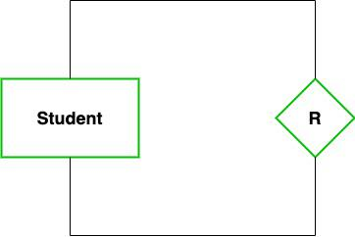
Unary (Degree 1)
In this type of relationship, both the associating entity types are the same. So, we can say that unary relationships exist when both entity types are the same and we call them the degree of relationship is 1. In other words, in a relation only one entity set is participating then such type of relationship is known as a unary relationship.
Example: In a particular class, we have many students, there are monitors too. So, here class monitors are also students. Thus, we can say that only students are participating here. So the degree of such type of relationship is 1.

Slide 3

Binary (Degree 2)
In a Binary relationship, there are two types of entity associates. So, we can say that a Binary relationship exists when there are two types of entity and we call them a degree of relationship is 2. Or in other words, in a relation when two entity sets are participating then such type of relationship is known as a binary relationship. This is the most used relationship and one can easily be converted into a relational table.
Example: We have two entity types ‘Student’ and ‘ID’ where each ‘Student’ has his ‘ID’. So, here two entity types are associating we can say it is a binary relationship. Also, one ‘Father’ can have many ‘daughters’ but each ‘daughter’ should belong to only one ‘father. We can say that it is a one-to-many binary relationship.

Slide 4
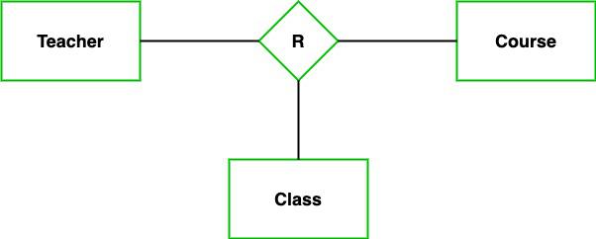
Ternary (Degree 3)
In the Ternary relationship, there are three types of entity associates. So, we can say that a Ternary relationship exists when there are three types of entity and we call them a degree of relationship is 3. Since the number of entities increases due to this, it becomes very complex to turn E-R into a relational table. Now let’s understand with the examples.
Example: We have three entity types ‘Teacher’, ‘Course’, and ‘Class’. The relationship between these entities is defined as the teacher teaching a particular course, also the teacher teaches a particular class. So, here three entity types are associating we can say it is a ternary relationship.

Slide 5
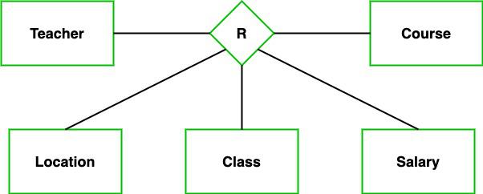
N-ary (n Degree)
In the N-ary relationship, there are n types of entity that associates. So, we can say that an N-ary relationship exists when there are n types of entities. There is one limitation of the N-ary relationship, as there are many entities so it is very hard to convert into an entity, rational table. So, this is very uncommon, unlike binary which is very much popular.
Example: We have 5 entities Teacher, Class, Location, Salary, Course. So, here five entity types are associating we can say an n-ary relationship is 5.

Slide 6
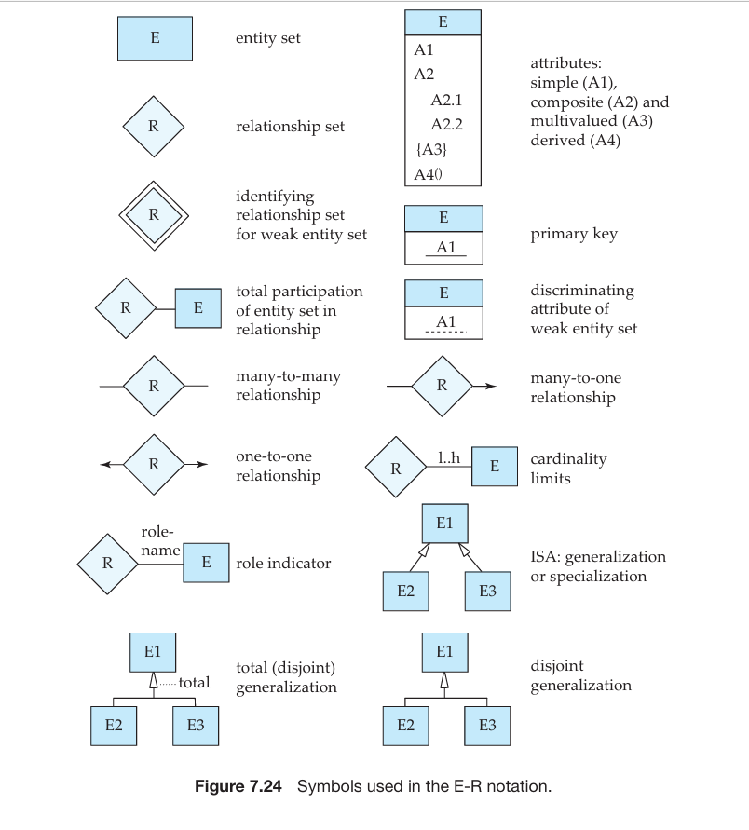

Slide 7
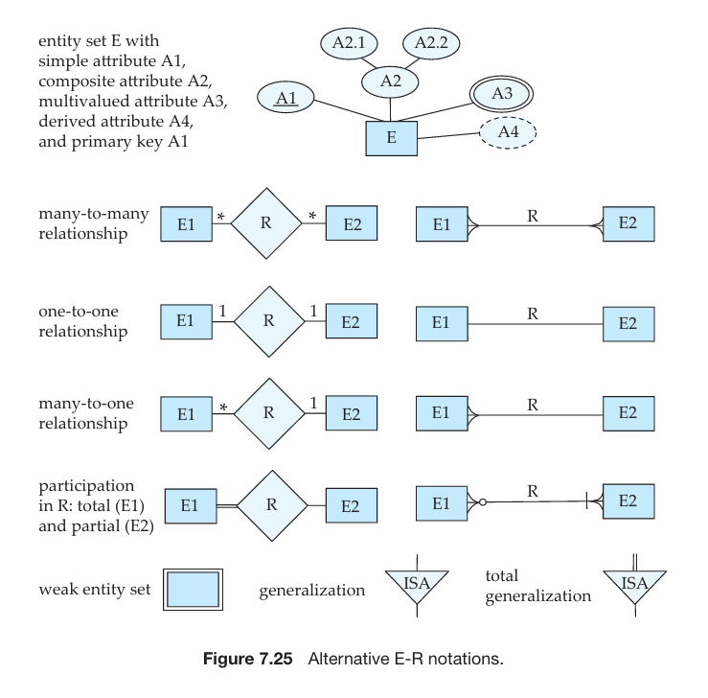

Slide 8
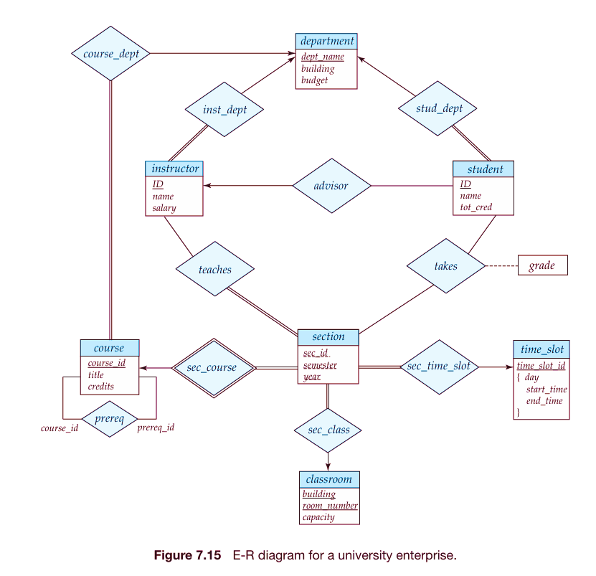

Slide 9
Entities and Their Attributes
Department (Strong Entity)
Attributes: dept_name, building, budget
Represents different departments in the university.
Instructor (Strong Entity)
Attributes: ID, name, salary
Represents faculty members teaching courses.
Student (Strong Entity)
Attributes: ID, name, tot_cred
Represents students enrolled in courses.
Course (Strong Entity)
Attributes: course_id, title, credits
Represents academic courses offered.
Section (Strong Entity)
Attributes: sec_id, semester, year
Represents different sections of a course in a particular semester.
Classroom (Strong Entity)
Attributes: building, room_number, capacity
Represents physical classrooms where lectures take place.
Time Slot (Strong Entity)
Attributes: time_slot_id, day, start_time, end_time
Represents different time slots for scheduling classes.

Slide 10
Relationships Between Entities
course_dept (One-to-Many)
A department offers multiple courses.
inst_dept (Many-to-One)
Each instructor belongs to one department.
stud_dept (Many-to-One)
Each student is associated with one department.
advisor (One-to-One)
Each student has one instructor as an advisor.
teaches (Many-to-Many)
An instructor can teach multiple sections, and a section can be taught by multiple instructors.
takes (Many-to-Many)
A student can take multiple sections, and each section can have multiple students.
The relationship has an attribute: grade (indicating the student's performance in a section).
sec_course (Many-to-One)
A section belongs to a single course.
sec_time_slot (Many-to-One)
A section is assigned to one time_slot.
sec_class (Many-to-One)
A section is conducted in one classroom.
prereq (One-to-Many)
A course can have prerequisite courses.

Slide 11
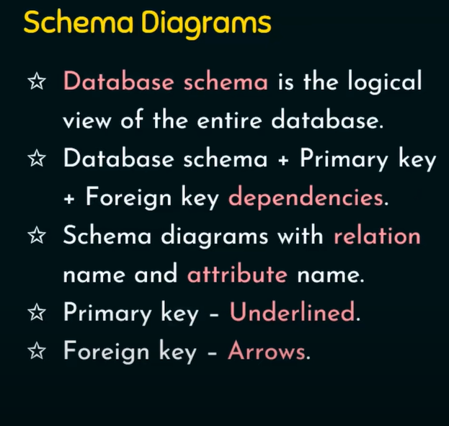

Slide 12
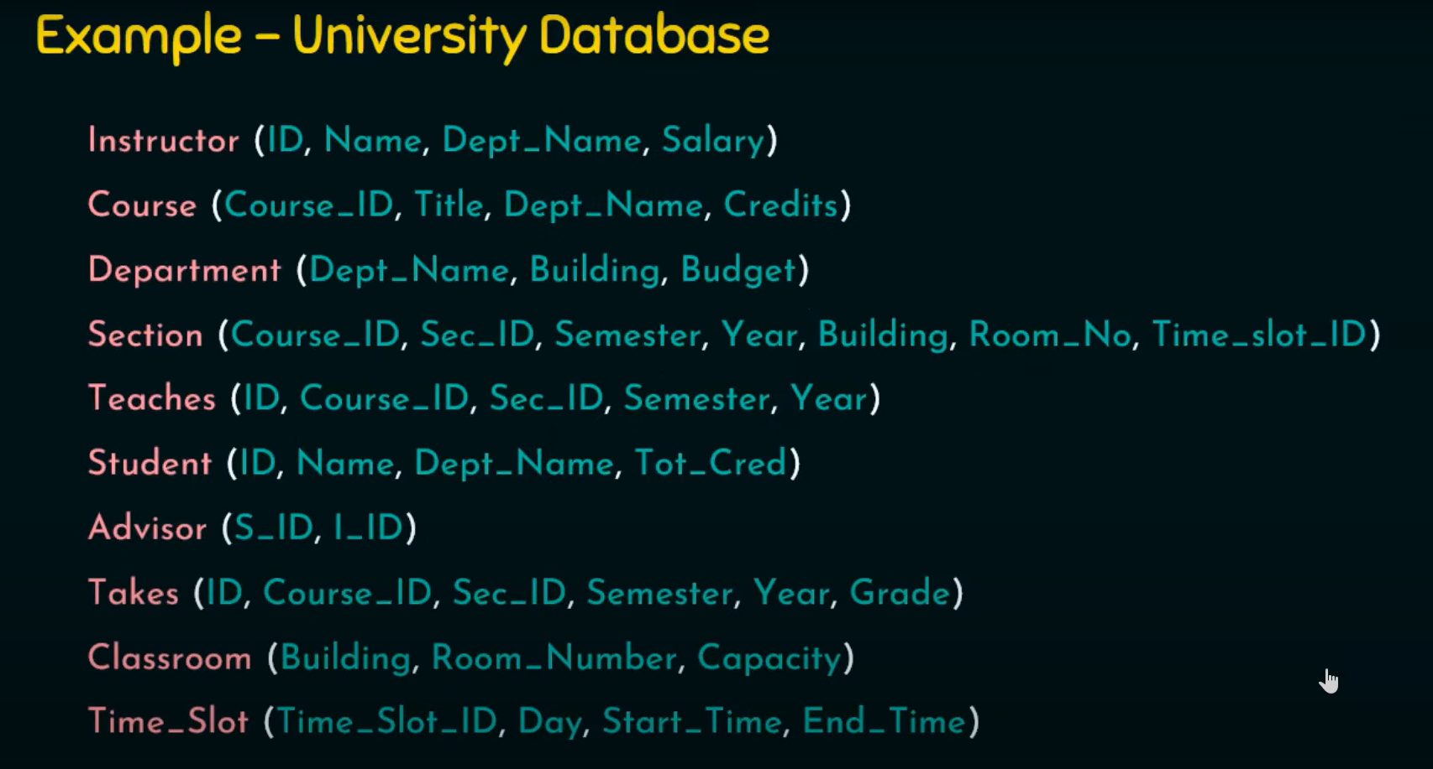

Slide 13
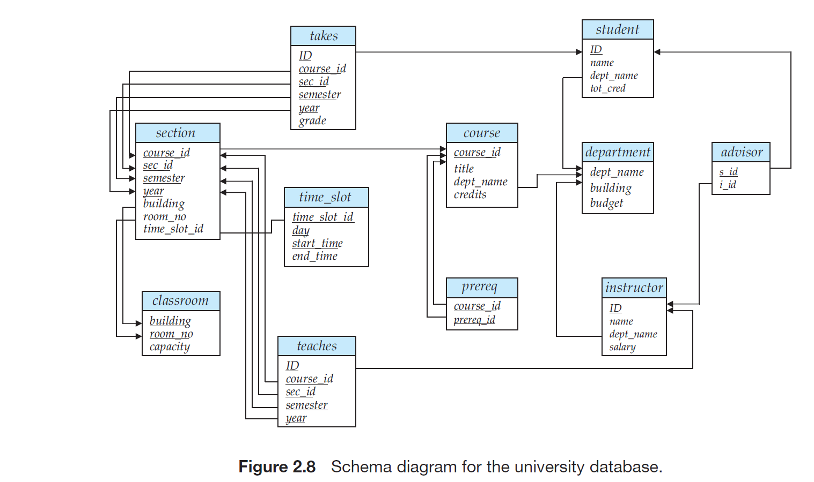

Slide 14
Explanation of Relationship Types
One-to-One (1:1): Each entity in one set is related to only one entity in another set.
Example: advisor (Each student has one instructor as an advisor.)
One-to-Many (1:M): One entity is related to multiple entities in another set.
Example: inst_dept (One department has multiple instructors.)
Many-to-Many (M:N): Multiple entities in one set can be related to multiple entities in another set.
Example: takes (A student can take multiple sections, and each section can have multiple students.)

