Slide 1
CoCo Quest 2026 | Theme 1: Agentic Data Quality Guardian
GuardianAI
DATA TRUST SCORE
62 → ~100
Autonomous Data Steward for Snowflake
Overall, across 5 related tables
Turns messy, growing data into trusted data: autonomously, continuously and safely. A live data trust score recovers the moment a human approves a fix.
9
agents
27
quality checks
5
related tables
Biswajit Jena
Solo entry
Notes:
Hi, I'm Biswajit Jena, and this is my solo entry for CoCo Quest 2026, Theme 1: Agentic Data Quality Guardian. GuardianAI is an autonomous data steward that runs entirely inside Snowflake. It detects, explains, fixes and validates data quality issues across five related tables. It only stops to ask a human before applying a risky fix. The number to remember is on the right: the overall data trust score goes from 62 to about 100 once fixes are approved. In the next few minutes I'll show how it works, why it's agentic, and how it stays safe.

Slide 2
THE PROBLEM
Bad data silently breaks business decisions
Duplicate customers
Orphan orders & payments
Invalid emails
Negative prices
Inflate customer counts and every report built on them.
Corrupt revenue attribution across related tables.
Waste marketing spend on customers you can't reach.
Distort margin and product profitability.
Traditional tools detect issues, then stop.
Investigate root cause
›
Judge business impact
›
Write the fix
›
Prove it worked
...are all left to a human. That doesn't scale, and it doesn't run continuously.
GuardianAI | CoCo Quest 2026 | Biswajit Jena
2 / 12
Notes:
Bad data rarely fails loudly. Duplicate customers inflate reports. Orphan orders and payments corrupt revenue attribution. Invalid emails waste marketing spend, and negative prices distort margins. Most data quality tools detect these issues and stop there. A person still has to find the root cause, judge the business impact, write the fix and prove it worked. That manual loop doesn't scale as data grows, and it doesn't run continuously. That's the gap GuardianAI closes.

Slide 3
THE SOLUTION
An agentic loop that owns the full data-quality lifecycle
Detect
Score
Rebuild Plan
Explain
Impact
Approve
Remediate
Validate
Govern
Human gate
Why it's agentic, not just automation
1
2
3
4
Distinct roles
Self-verifying
Self-healing
Knows when to stop
Each agent has one job and reasons over the previous agent's output.
The Validation Agent independently re-checks the Remediation Agent's work.
The pipeline rebuilds its own fix plan when new issues appear.
It decides its next step, including when to pause and ask a human.
GuardianAI | CoCo Quest 2026 | Biswajit Jena
3 / 12
Notes:
GuardianAI is a chain of specialised agents, orchestrated by native Snowflake Tasks, that runs the whole loop: detect, score, rebuild the plan, explain, assess impact, approve, remediate, validate and govern. The amber step is the only place a human is needed. What makes it agentic rather than a script: each agent has a distinct role and reasons over the previous agent's output. The Validation Agent independently re-checks the remediation. The pipeline rebuilds its own fix plan when new issues appear. And the system decides its own next step, including when to stop and ask a human.

Slide 4
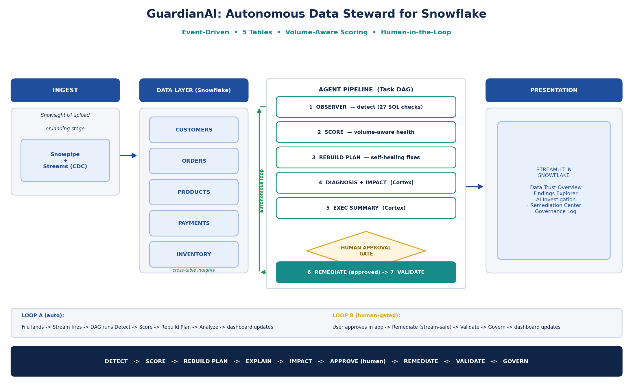
HOW IT FITS TOGETHER
Architecture: 100% native Snowflake
Ingest
Snowsight upload or landing stage; Streams capture new rows (CDC).
Data layer
CUSTOMERS, ORDERS, PRODUCTS, PAYMENTS, INVENTORY, with cross-table checks.
Agent pipeline
Task DAG: Observer → Score → Rebuild Plan → Diagnosis + Impact → Exec Summary.
Human gate
Approve → Remediate → Validate → Govern.
Presentation
Streamlit in Snowflake, 5 pages.
GuardianAI | CoCo Quest 2026 | Biswajit Jena
4 / 12
Notes:
Everything runs natively in Snowflake, with no external services. Data arrives through a Snowsight upload or a landing stage, and Streams capture the new rows. Five related retail tables form the data layer. A Task DAG runs the agent pipeline: Observer, Health Scorer, Plan Builder, then the Cortex-powered Diagnosis, Impact and Executive Summary agents. After that comes the human approval gate, then Remediate, Validate and Govern. A five-page Streamlit-in-Snowflake app is the window into all of it.

Slide 5
THE AGENTS
Nine specialised agents
# | Agent | Tech | Responsibility
1 | Data Observer | Deterministic SQL | 27 checks across 5 tables (incl. cross-table) → DQ_ISSUES
2 | Health Scorer | SQL (volume-aware) | Severity × % rows affected → per-table + overall score
3 | Plan Builder | SQL | Self-healing: rebuilds the fix plan for current issues
4 | Diagnosis | Snowflake Cortex | Plain-English root cause per issue
5 | Business Impact | Snowflake Cortex | Executive-language business impact
6 | Exec Summary | Snowflake Cortex | One CDO-style headline paragraph
7 | Remediation | SQL + Cortex | Fix SQL + confidence + risk + approval flag; AI narrates
8 | Validation | Deterministic SQL | Re-detect + re-score, prove before → after
9 | Governance Recorder | SQL | Immutable audit trail of every action + approval
Design principle: SQL detects and executes (auditable). AI only reasons, explains and narrates. A human approves anything risky.
GuardianAI | CoCo Quest 2026 | Biswajit Jena
5 / 12
Notes:
Here are the nine agents. The blue rows use Snowflake Cortex, with mistral-large2 through CORTEX.COMPLETE, for the work that needs language and reasoning: root cause, business impact and an executive summary. The Remediation Agent pairs deterministic fix SQL with Cortex narration, and attaches a confidence score, a risk level and an approval flag to every fix. Detection, scoring, validation and governance are deterministic SQL. That's the design principle on the banner: SQL detects and executes so everything is auditable. AI only reasons and explains, and a human approves anything risky.

Slide 6
THE INTELLIGENCE UPGRADE
Volume-aware scoring: severity and spread
THE FORMULA
Severity | PRESENCE | VOLUME_MULT / 1% rows
CRITICAL | 8 | 1.5
HIGH | 4 | 1.0
MEDIUM | 2 | 0.7
LOW | 1 | 0.3
penalty = PRESENCE(sev)
+ VOLUME_MULT(sev) × pct_rows
table = GREATEST(0, 100 − Σ penalty)
overall = AVG(table scores)
Why it matters
Worked example
■ A large, mostly-clean table is correctly rewarded.
■ A structural breach (orphan / duplicate key) still hurts, even at low volume.
■ This is how a real CDO reasons about trust.
A CRITICAL issue touching 2% of rows:
8 + 1.5 × 2 = 11-point penalty
A LOW issue touching 2% of rows:
1 + 0.3 × 2 = 1.6-point penalty
GuardianAI | CoCo Quest 2026 | Biswajit Jena
6 / 12
Notes:
A naive score subtracts a flat penalty per issue type, so a ten-row table and a million-row table look the same. GuardianAI's Health Scorer is volume-aware. Each issue costs a fixed presence penalty by severity, plus a volume multiplier times the percentage of rows affected. Table health is 100 minus the total penalty, floored at zero, and the overall score is the average across the five tables. In practice, a critical issue on 2% of rows costs 11 points, while a low issue on the same rows costs 1.6. Big, mostly-clean tables are rewarded, but a structural breach like an orphan key still hurts even at low volume.

Slide 7
BEYOND SINGLE-TABLE CHECKS
Cross-table integrity: the differentiator
Checks impossible from one table alone
ORPHAN_ORDER
An order whose customer doesn't exist.
CUSTOMERS
ORDERS
PAYMENTS
ORPHAN_PAYMENT
ORPHAN_ORDER
ORPHAN_PAYMENT
AMOUNT_MISMATCH
A payment whose order doesn't exist.
PAYMENT_AMOUNT_MISMATCH
ORPHAN_INVENTORY
Payment amount ≠ the matching order's amount.
PRODUCTS
INVENTORY
ORPHAN_INVENTORY
Stock for a product that doesn't exist.
Arrows point from child to parent table
GuardianAI | CoCo Quest 2026 | Biswajit Jena
7 / 12
Notes:
This is what I think sets GuardianAI apart. Most data quality checks look at one table at a time. GuardianAI also checks relationships across the five tables. Orphan orders have a customer that doesn't exist. Orphan payments point to an order that doesn't exist. Payment amount mismatches are payments that don't equal the order they belong to. Orphan inventory is stock for a product that doesn't exist. These are exactly the issues that silently break revenue reporting, and you can't see them from a single table.

Slide 8
STREAMS + TASK DAG
Event-driven orchestration: two loops
Loop A: Ingest → Detect
Fully automatic
File lands
Stream fires
Detect
Score
Rebuild Plan
Analyze
Dashboard updates
Loop B: Human action → Re-clean
Human-gated: never self-fires
User clicks Approve
Remediate (stream-safe)
Validate
Govern
Dashboard updates
6
7
18
SYSTEM$STREAM_HAS_DATA
Streams
Tasks
Stored procedures
gating: a cheap no-op when idle
GuardianAI | CoCo Quest 2026 | Biswajit Jena
8 / 12
Notes:
Orchestration is event-driven and uses only native Snowflake: six Streams, seven Tasks and eighteen stored procedures. Loop A is fully automatic. When a file lands, a Stream captures the new rows and the Task DAG runs detect, score, rebuild plan and analyse, and the dashboard updates. Loop B is human-gated and never fires on its own. Only when a user clicks Approve does it remediate, validate and write to the governance log. Tasks are gated on SYSTEM$STREAM_HAS_DATA, so when nothing has changed they're a cheap no-op, which protects credits.

Slide 9
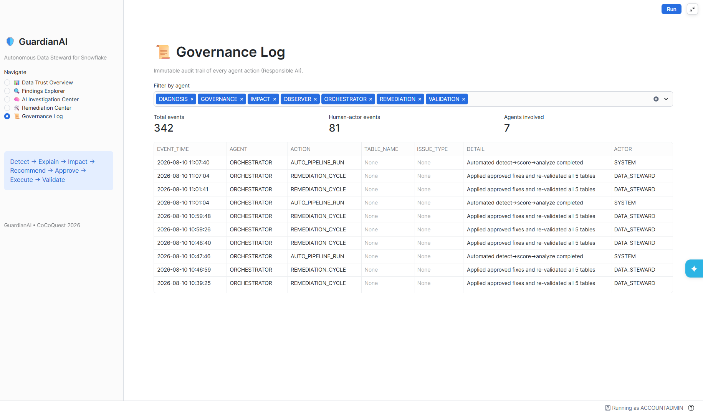
SAFE AUTONOMY
Responsible AI, by design
✓
Human-in-the-loop
Every high-risk fix needs explicit approval.
✓
Quarantine, never delete
Bad rows are preserved for review.
✓
Deterministic fix SQL
No AI-generated code executes blindly.
✓
Stream-safe remediation
Dedup uses TRUNCATE + INSERT, never drops tables.
Governance Log: an immutable audit trail of every agent action and approval
✓
Full governance log
Every agent action is recorded with an actor.
GuardianAI | CoCo Quest 2026 | Biswajit Jena
9 / 12
Notes:
Autonomy is only useful if it's safe, so Responsible AI is built into the architecture, not added on. Every high-risk fix needs explicit human approval. Bad rows are quarantined, never deleted. The fix SQL is deterministic and reviewable, so no AI-generated code runs blindly. Remediation is stream-safe: deduplication uses truncate-and-insert rather than dropping tables. Every action, by an agent or a human, is written to the governance log on the right, with an actor and a timestamp.

Slide 10
IMPACT
Results: every table moves from HIGH risk to LOW
OVERALL TRUST SCORE
62 → ~100
after one human approval
5 / 5
tables HIGH → LOW risk
0
rows deleted: deduped or quarantined
100%
of actions in the audit log
GuardianAI | CoCo Quest 2026 | Biswajit Jena
10 / 12
Notes:
Here are the results on the full dataset: about 1,000 customers, 5,000 orders, 500 products, 4,500 payments and 500 inventory rows, with a known set of injected issues so the run is reproducible. Before remediation, scores ranged from 51 for CUSTOMERS to 72 for ORDERS, for an overall score of 62. After one approval, every table recovers to 100 and the overall score reaches about 100. All five tables move from high to low business risk. No row is deleted: each one is either deduplicated or quarantined, and every step is in the audit log.

Slide 11
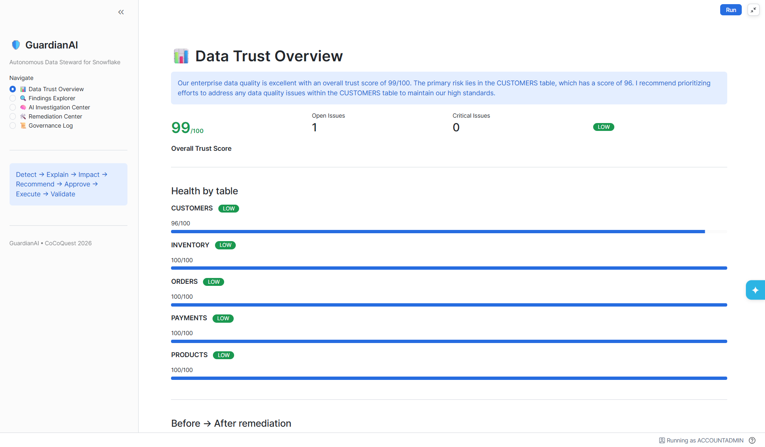
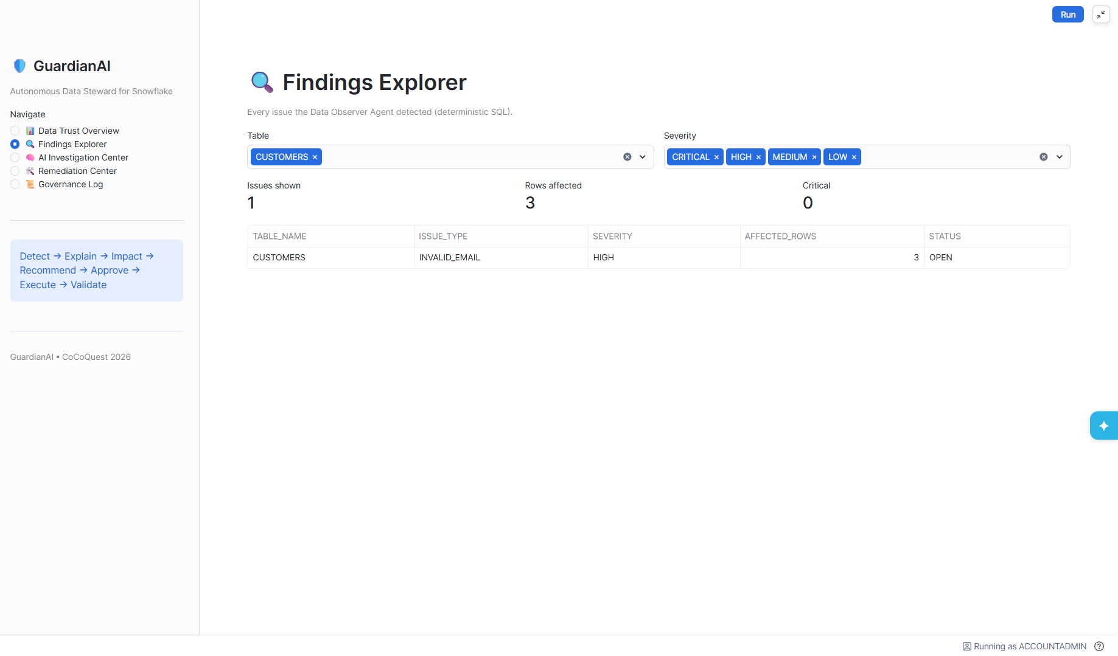
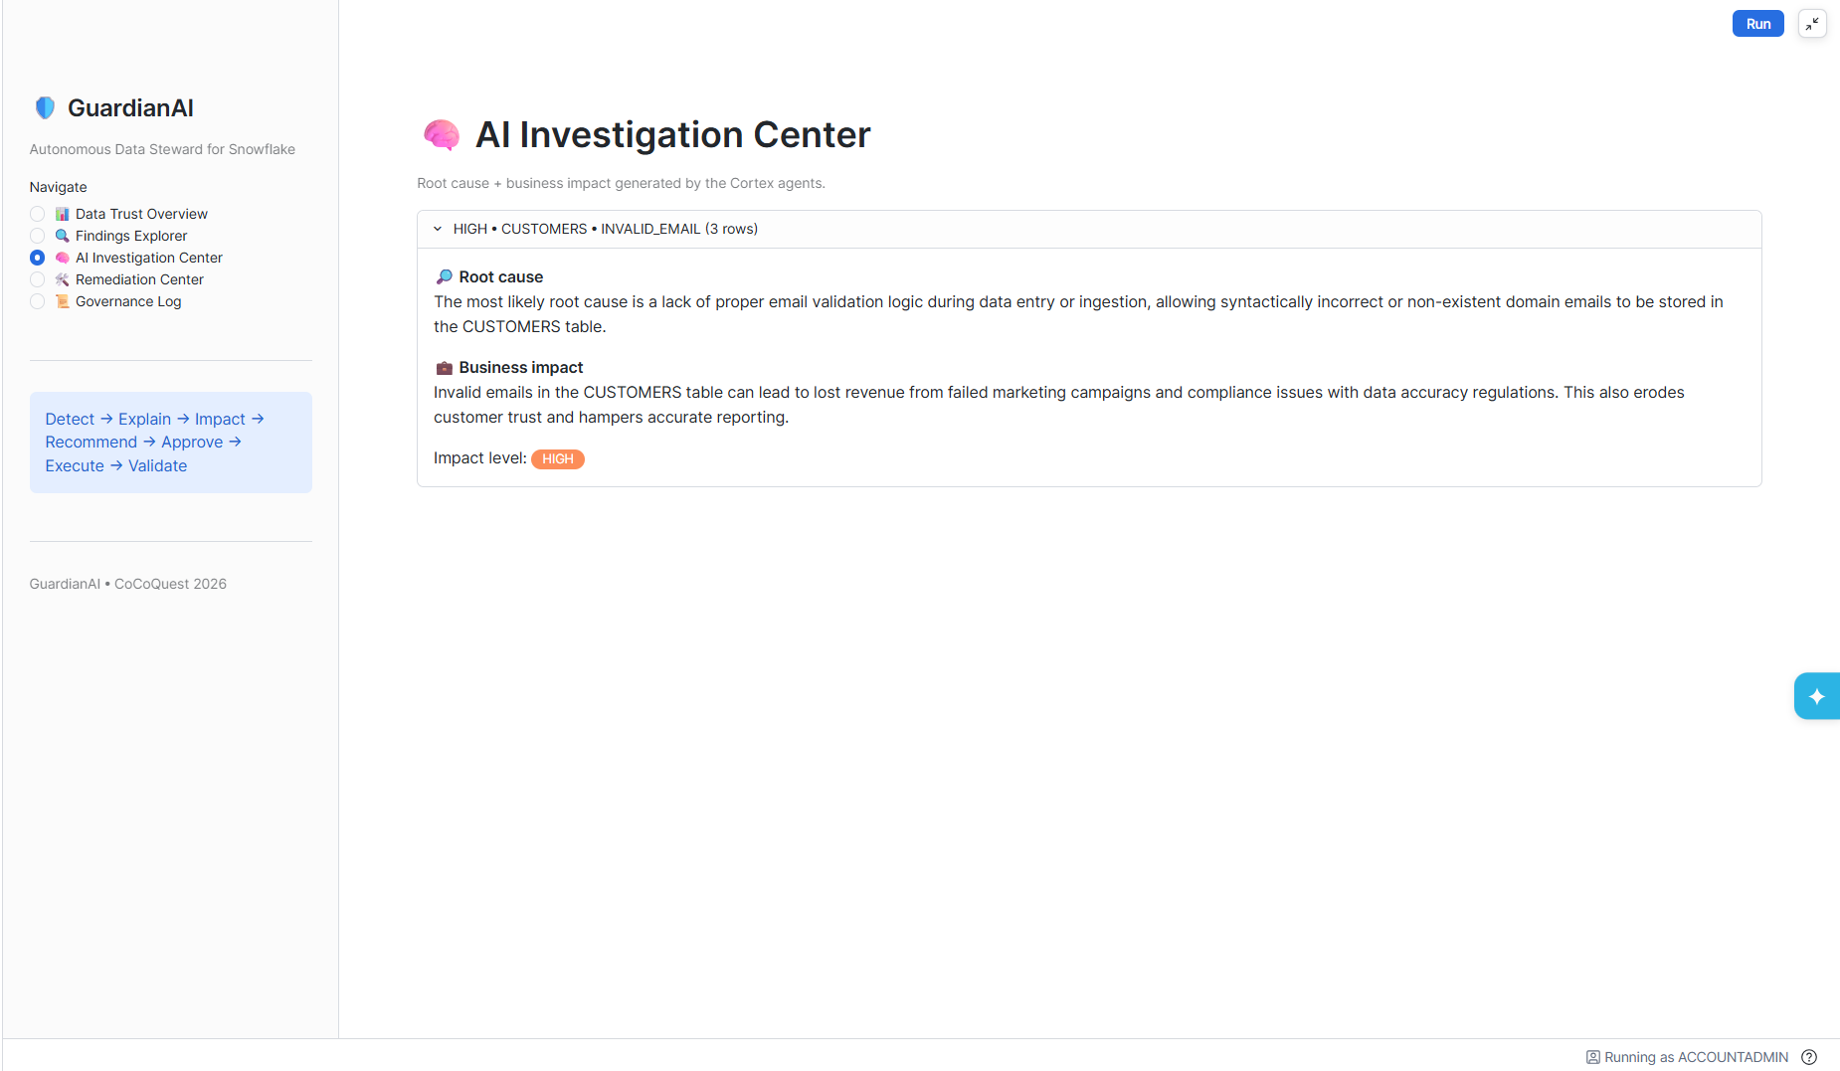
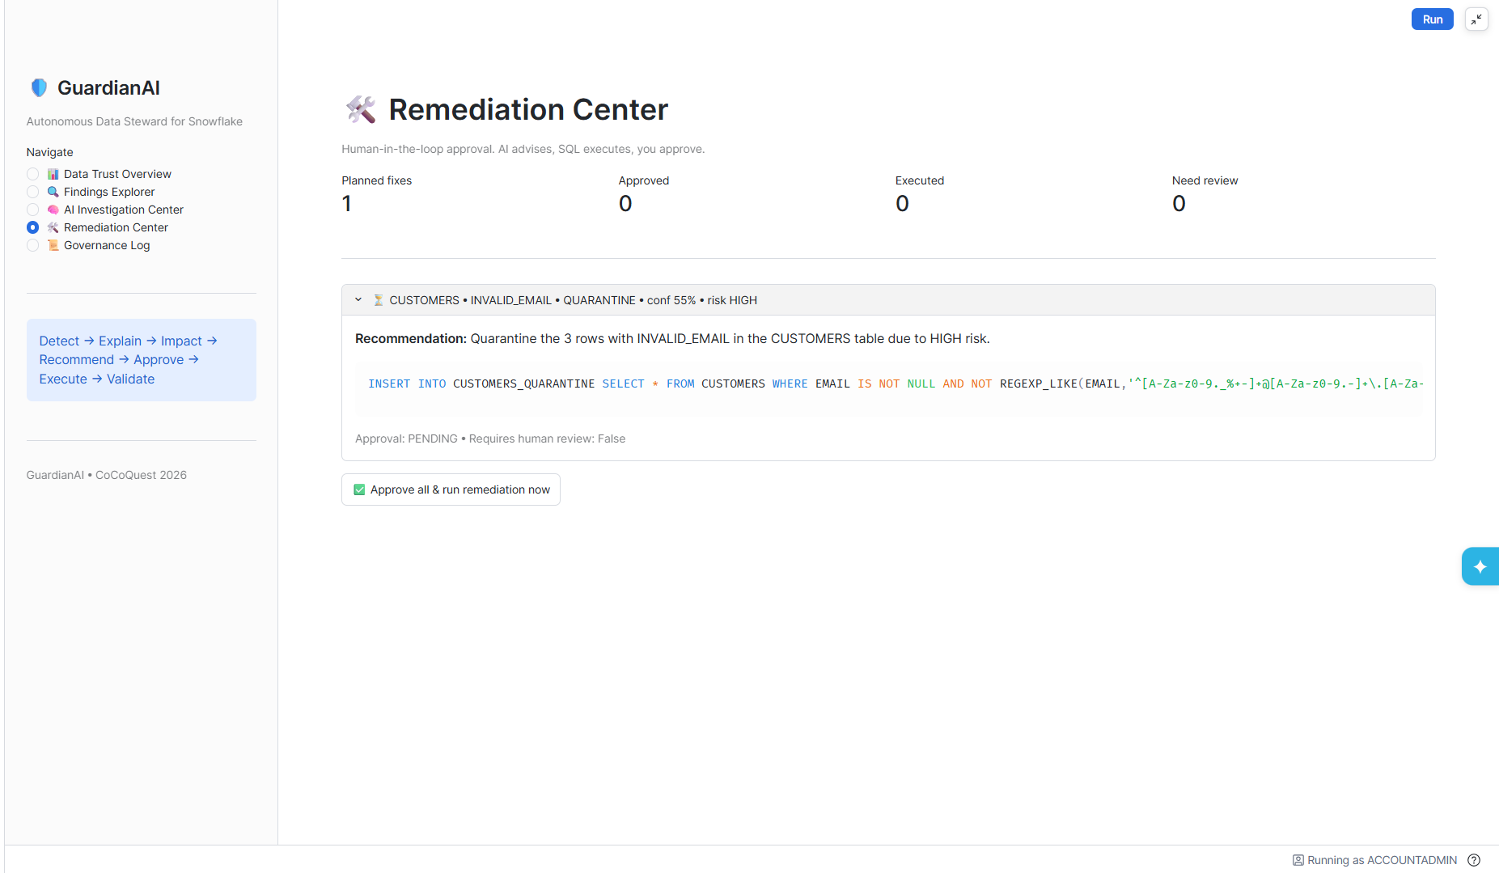
LIVE DEMO SURFACE
The GuardianAI app: Streamlit in Snowflake
1
Data Trust Overview
Live trust score, per-table risk, before → after.
2
Findings Explorer
Every issue, filterable by severity and table.
3
AI Investigation
Cortex root cause + business impact per issue.
Data Trust Overview
Findings Explorer
4
Remediation Center
Fix, confidence, risk and the approval gate.
5
Governance Log
Full audit trail of agent and human actions.
AI Investigation Center
Remediation Center
GuardianAI | CoCo Quest 2026 | Biswajit Jena
11 / 12
Notes:
The whole system is visible through a five-page Streamlit-in-Snowflake app. The Overview shows the live trust score and per-table risk, including the before-and-after view. Findings Explorer lists every issue, filterable by severity and table. AI Investigation shows the Cortex-generated root cause and business impact for each issue. Remediation Center is where the proposed fix, its confidence and its risk are shown, and where a human approves it. The Governance Log, which we saw earlier, is the audit trail. One click on Approve all and run remediation, and the overall score climbs to about 100.

Slide 12
STACK, ROADMAP & THANKS
Built on Snowflake, built to grow
Snowflake features used
Roadmap
Snowflake Cortex
CORTEX.COMPLETE (mistral-large2)
1
Scheduled autonomous scans
Streams
change data capture on new rows
with Slack / Teams alerts on new criticals
Tasks / DAG
event-driven Loop A + Loop B
2
Learned severity weighting
Stored procedures
agents as callable SQL units
tuned from historical approvals
Streamlit in Snowflake
5-page data trust app
3
Data contracts
+ upstream prevention, not just repair
Stages + Snowsight
ingest and landing
Thank you
GuardianAI turns messy data into trusted data, safely.
Biswajit Jena
CoCo Quest 2026 | Theme 1
GuardianAI | CoCo Quest 2026 | Biswajit Jena
12 / 12
Notes:
GuardianAI is built entirely on native Snowflake. Cortex handles reasoning, Streams and Tasks handle event-driven orchestration, stored procedures implement the agents, and Streamlit in Snowflake is the front end. Nothing leaves the platform. Next on the roadmap: scheduled autonomous scans with Slack or Teams alerts on new critical issues, severity weights learned from historical approvals, and data contracts that prevent bad data upstream instead of only repairing it. Thank you. I'm Biswajit Jena, and I'm happy to take questions or walk through a live demo.

