Slide 1

KHARAGPUR DATA SCIENCE HACKATHON
Team: data smashers
Hirakjyoti Medhi
Roshan Jha
Biswajit Bera
Rakesh Kumar

Slide 2
OBJECTIVE
This presentation will cover the following aspects of the project:-
Algorithm code: This part explains the algorithm used to train and fit the model.
Back-testing Result: Historical data is used for back-testing.
Risk Management Plan: Assessing and exploring risk management factors for a good trading strategy.
Summary of the model: A concise explanation of the model’s working.

Slide 3
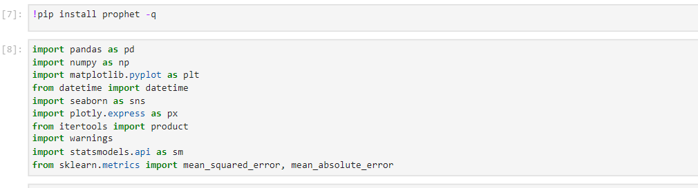
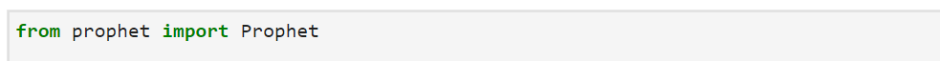
Algorithm Code
We used the FB Prophet algorithm to fit the trading model because it can handle time series data with various patterns and seasonality.
Importing relevant libraries
Importing the FB Prophet model

Slide 4
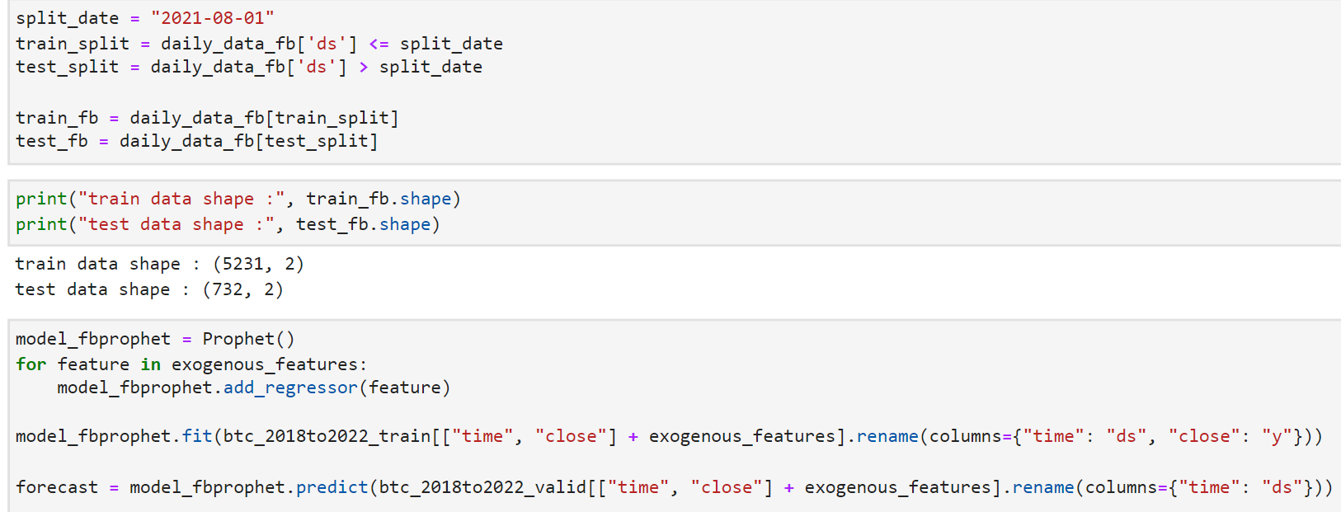
Splitting train and test data
Fitting the FB Prophet Model

Slide 5
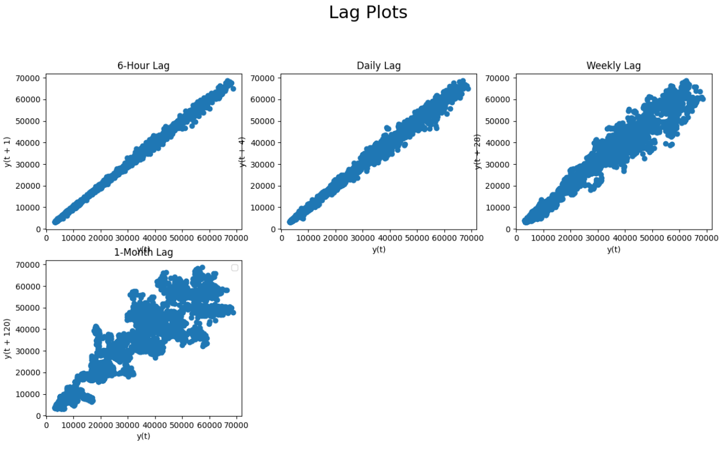
Lag Plots: why are we using 6-hour data?
There is a positive correlation for 6 hours, daily, and weekly lag plots. But we can see that there is no correlation for monthly lag plot. Also, our data at the 6-hour level preserves the auto-correlation the most. So, we will use 6 hour frequency data. , our data at the 6-hour level preserves the autocorrelation6-hour

Slide 6
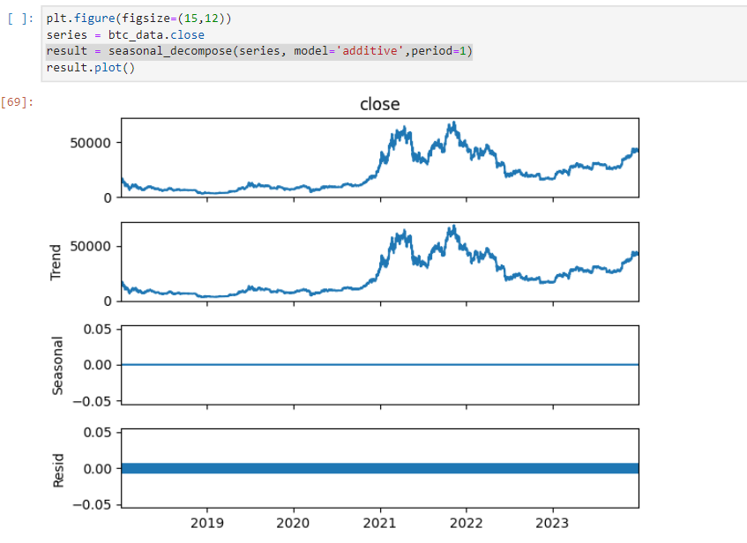
Seasonality, Trend, and Residual of closing prices
The seasonal_decompose function typically returns an object that contains the decomposed components, allowing you to access and analyze the trend, seasonal, and residual components of the time series separately. Looking at the images, we see that there's no seasonality. There is no constant mean, covariance, or variance. Hence, this looks like nonstationary.

Slide 7
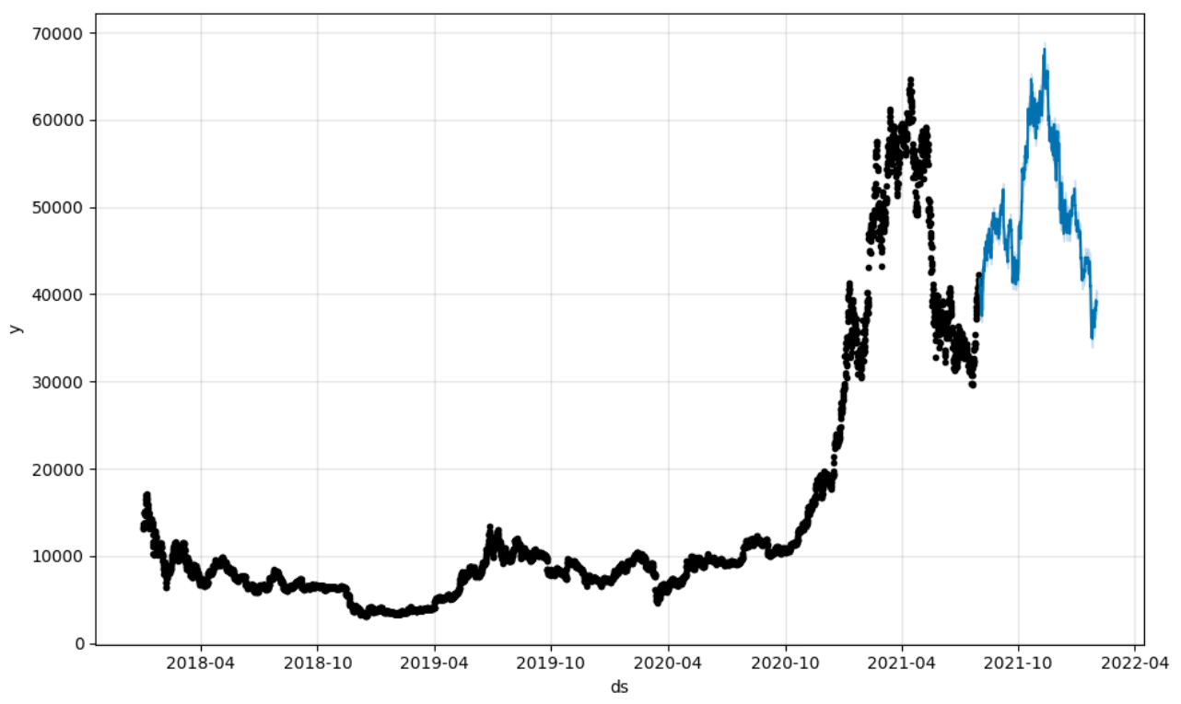
Original and forecasted prices of BTC
The black data points represent the original values from 2018-01-01 to 2021-07-31, and the blue data points represent the forecasted values from 2021-08-01 to 2022-01-31.

Slide 8
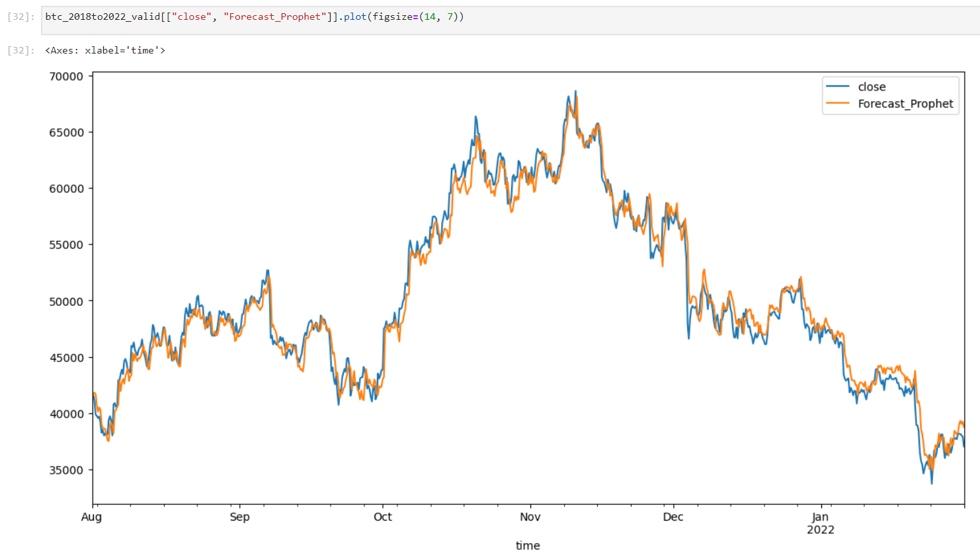
Predicted v/s original BTC values
As you can see, the model did a pretty good job predicting the closing price of BTC. The blue line represents the known prices whereas the orange line represents the predicted prices.

Slide 9
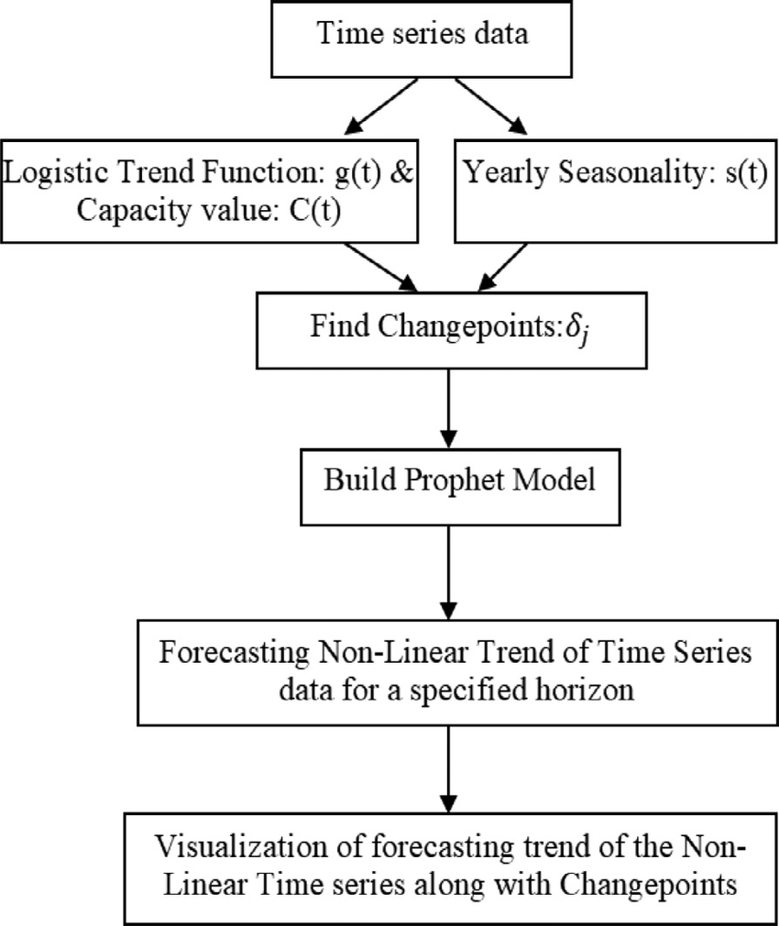
More about FB Prophet Algorithm
FB Prophet Core Idea:
Models time series data as a combination of trend, seasonality, and noise components.
Trend represented by a piecewise linear regression model.
Seasonality captured using Fourier series.
Noise accounts for random fluctuations.
Mathematics Behind FB Prophet:
Trend modeling with a piecewise linear regression model.
Seasonality modeling using Fourier series.
Bayesian inference using a Markov Chain Monte Carlo algorithm.
Incorporates additional regressors (e.g., holidays, weather patterns).

Slide 10
Practical Implementation in Python:
Demonstrates time series forecasting for daily temperature in Delhi, India.
Covers data visualization, model fitting, and future date prediction.
Visualizes forecasted values and prediction intervals.
Showcases inclusion of additional regressors (humidity, wind speed) for improved accuracy.
FB Prophet Highlights:
Powerful and customizable time series forecasting tool.
Capable of capturing complex patterns.
Utilizes Bayesian framework for estimating posterior distributions.
Provides probabilistic forecasts with uncertainty measures.
Article Goal:
Equip readers with a comprehensive understanding of FB Prophet's logic, mathematics, and practical implementation.
Emphasizes its effectiveness in capturing complex time series patterns.

Slide 11
The mathematical equation behind the Prophet model is defined as
y(t) = g(t) + s(t) + h(t) + e(t)
with, g(t) representing the trend.
Prophet uses a piecewise linear model for trend forecasting.
-s(t) represents periodic changes (weekly, monthly, yearly).
-h(t) represents the effects of holidays (recall: Holidays impact businesses).
-e(t) is the error term.
The Prophet model fitting procedure is usually very fast (even for thousands of observations), and it does not require any data pre-processing. It also deals with missing data and outliers.

Slide 12
Back-testing Results
The back-testing strategy aims to assess the performance of a trading strategy over historical data. It involves buying and selling decisions based on specified conditions related to consecutive periods of price increase or decrease.
The provided strategies focus on variations in the number of periods required for triggering buy and sell actions.
The code allows users to test different strategies by modifying the provided strategies or adding new ones.
Back-testing is performed on historical data to calculate each strategy's percentage return on investment.
The results are visualized to compare the performance of different strategies.
The code uses the Yahoo Finance library to retrieve historical stock prices for the specified symbol.
Additional data processing includes calculating day-to-day price differences.

Slide 13
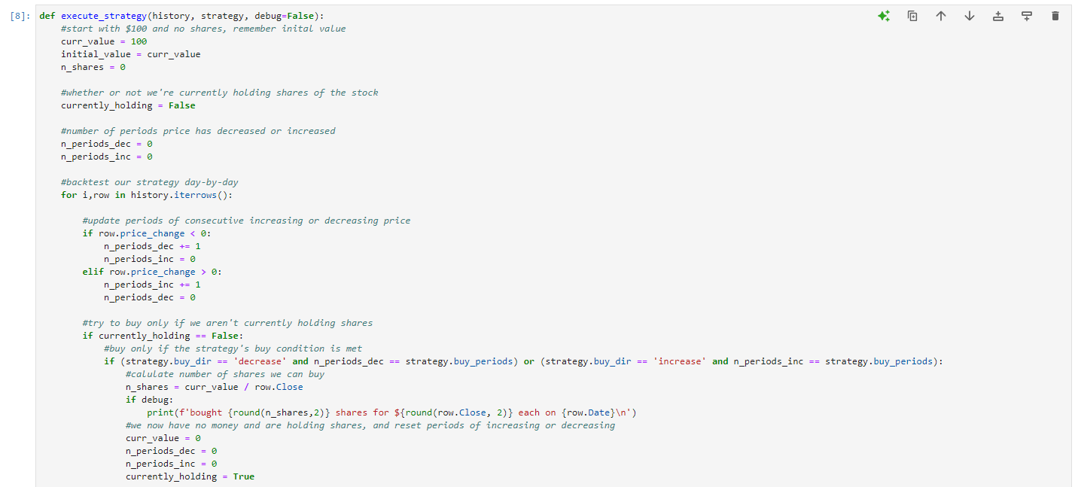
Back-testing Function
The execute_strategy function conducts the back-testing of a given strategy.
It iterates through historical data, updating consecutive periods of increasing or decreasing prices.

Slide 14
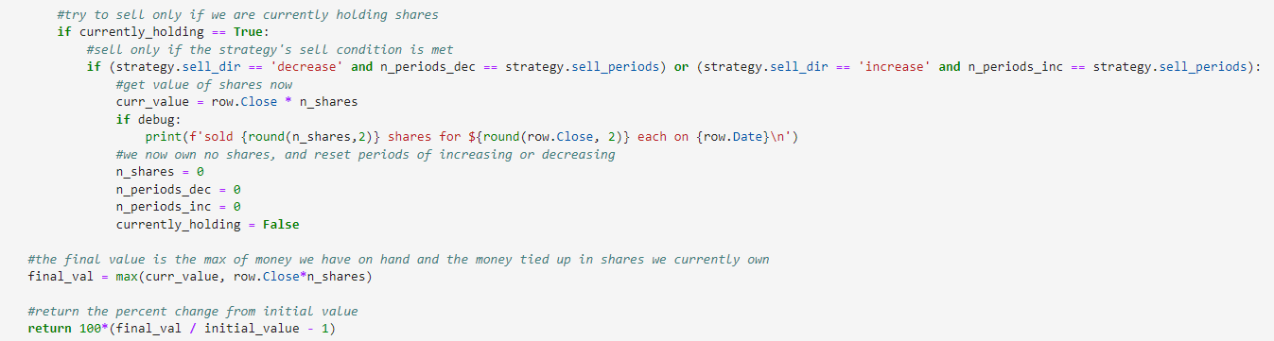
The strategy's buy and sell conditions are checked, and actions (buying or selling) are taken accordingly.
The final value is calculated as the maximum of money on hand or the value tied up in owned shares.

Slide 15
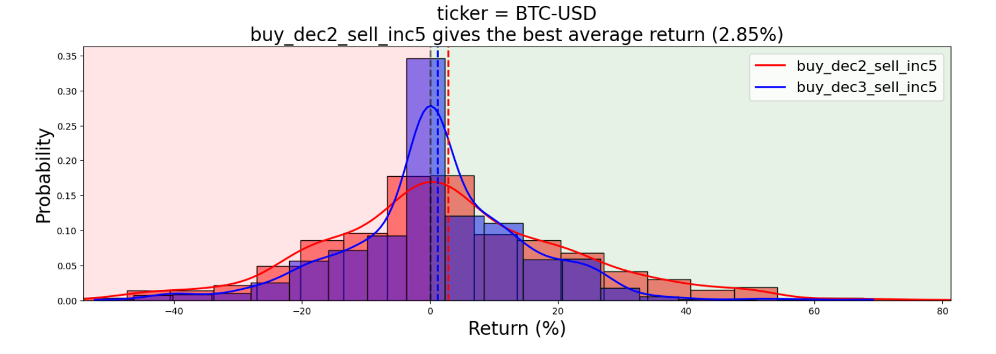
buy_dec2_sell_inc2: Buy if the price decreases for 2 periods, sell if it increases for 2 periods.
buy_dec5_sell_inc5: Buy if price decreases for 5 periods, sell if it increases for 5 periods.

Slide 16
Risk Management Factors
Risk/Reward Ratio:
Analyze the amount of money at risk and the expected positive outcome before opening a trade.
A higher risk/reward ratio can lead to profitability even with a low win rate.
Illustrative example shows profitability with a 20% success rate and a 1:5 risk/reward ratio.
Finding the right balance between risk, profits, and losses is crucial for effective risk management.
Risk-Reward Ratio=Potential Loss/Potential Profit​
Stop Loss/Take Profit Orders:
Stop Loss and Take Profit orders function differently based on trader type and asset.
It is crucial not to deviate from the strategy, avoiding changes to stop loss or take profit based on market movements.
Consider using exit partials, trailing stops, and sticking to the original strategy for effective risk management.
Stop-Loss Price = Current Price - (Current Price * Stop-Loss Percentage)

Slide 17
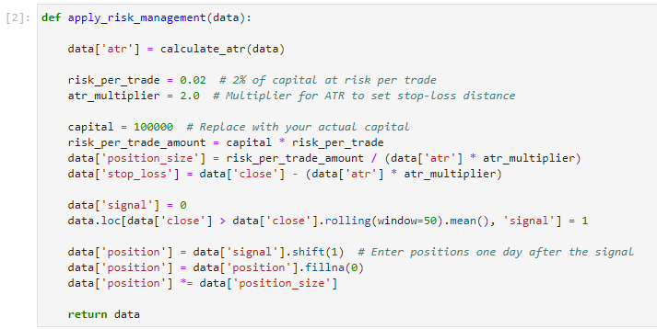
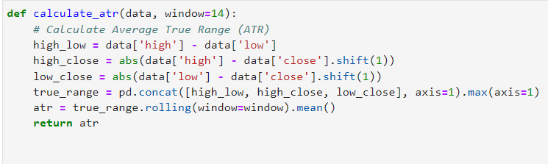
Applying Risk Management through a Python code
These lines define a function calculate_atr that calculates the Average True Range (ATR) based on high, low, and close prices. The ATR is calculated as the rolling mean of the True Range over a specified window
The function calculates the ATR, determines the position size based on a fixed percentage of capital at risk per trade, sets the stop-loss level based on the ATR, and defines a simple trading signal (buy when the close price is above the 50-day moving average). The position size is adjusted based on the calculated position size and risk management rules.

Slide 18
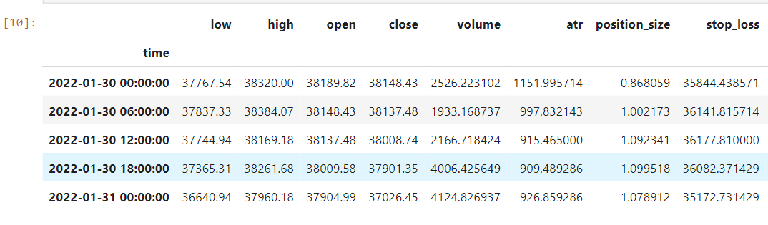
Three extra columns containing ATR, position size, and stop loss can be seen here in the snippet.

Slide 19
Summary
Historical Bitcoin data (01 Jan 2018 to 31 Jan 2022) was loaded using the historic_crypto library and CoinBase API, analyzed at 6-hour intervals for autocorrelation. Rolling mean and standard deviation were computed for price attributes with varying windows (3, 7, 30 days).
The FB Prophet algorithm modeled non-stationary data, with training (2018-01-01 to 2021-08-01) and testing (2021-08-01 to 2022-01-31). FB Prophet exhibited a Mean Absolute Error of 954.50 and Root Mean Square Error of 1253.94.
Back-testing identified a strategy yielding around 2.85% by buying during 2-period price decreases and selling during 5-period increases over a month, with associated risk.
Risk management, including Risk to Reward ratio and stop-loss mechanisms, was integrated, calculated using ATR. The framework and results were presented in a notebook.

