Slide 1

A machine learning (ML) model that utilizes a 32-channel electroencephalography (EEG) machine to monitor the electrical brain activity of human beings for the prediction of stress (in percentage).

Slide 2
INTRODUCTION
Stress is a common problem in today’s fast-paced lifestyle leading to various health related issues. Detecting stress is important for timely intervention and prevention of serious health issues.
Working memory is a cognitive system that is responsible for temporarily holding and manipulating information needed for complex cognitive tasks, such as problem-solving, reasoning, and language comprehension. It allows us to keep important information in our mind and work with it, without being distracted by irrelevant information.
The goal of the project is to provide a non-invasive, accurate, and cost effective way to measure the stress and to see how the effective working memory is being affected due to the stress by using the web application which we have specifically designed for this purpose.

Slide 3
PARAMETERS TAKEN INTO CONSIDERATION
Attention
Meditation
Complex cognitive tasks
Problem Solving
Language comprehension.
Reasoning

Slide 4
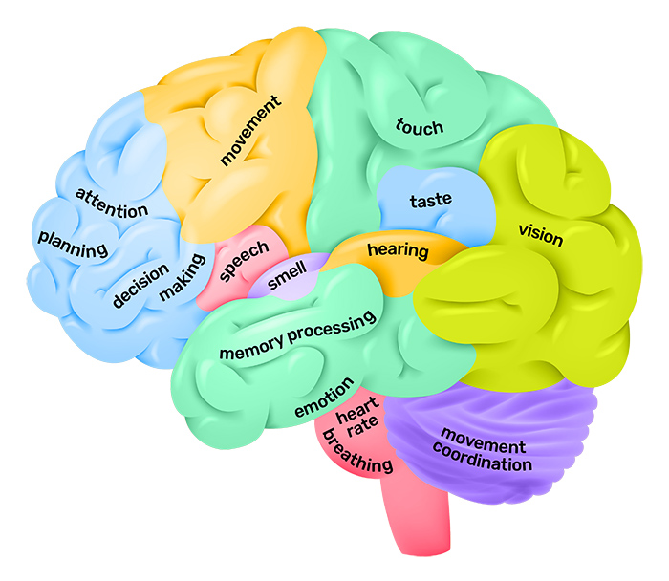
COLLECTION OF DATA
The user attaches the 32 channel EEG machine to his/her head at some specific points
and the machine records the brain activity such as attention and
meditation.
The following points are considered
according to the functional area of the
brain:

Slide 5
The points of the EEG machine which are used to collect data for our model are:
1. T4-T6: It measures the activity in the temporal lobe of the brain and measures the information related to attention in the human being wearing it.
2. P3-O1: It measures the activity in the parieto-occipetal lobe of the brain and measures the information related to meditation in the human being wearing it.
3. F7-T3: The F7 electrode is positioned on the left side of the forehead, while the T3 electrode is positioned above the left ear. The F7-T3 point in EEG recording typically measures activity in the left frontal lobe of the brain and can capture information related to language processing, working memory, and attentional processes
4. F8-T4: F8 is typically placed on the right side of the forehead, just above the eyebrow, and measures activity in the right prefrontal cortex. T4 is typically placed on the right side of the scalp, towards the back of the head, and measures activity in the right temporal lobe.The combination of F8-T4 is often used in EEG studies to monitor activity in these specific regions of the brain, as they are thought to be involved in various cognitive processes such as attention, emotion, and memory.

Slide 6
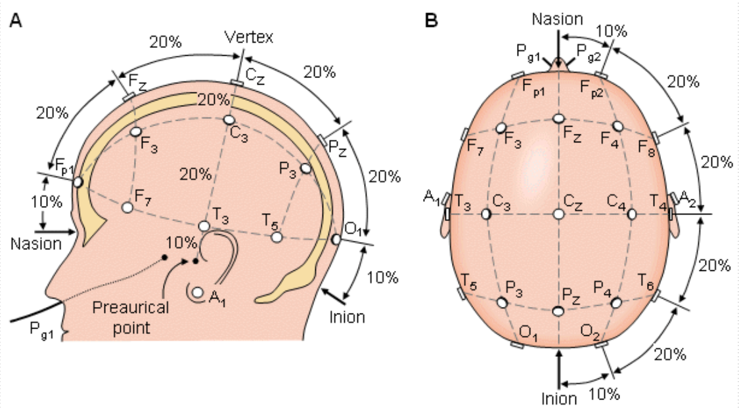

Slide 7
APPLICATION
Our model can be used to detect various stress and memory related impairments such as
Mild Cognitive Impairments
Alzheimer’s disease
Short Term Memory Loss
Long Term Memory Loss
Fronto-Temporal Dementia

Slide 8
FUTURE WORK
Temporary memory loss is a common problem that affects individuals who experience chronic stress. We only now focused on how the effective working memory varies with respect to the change in value of stress. Our future work includes detecting the variation of the values of effective working memory(in percentage) due to stress by analyzing the points F7-T3 and F8-T4. We plan to collect EEG data from individuals who experience temporary memory loss due to stress and use machine learning algorithms to analyze the data and improve the web-application so as to allow it to work as the EEG monitoring software.

Slide 9
THANK YOu
Sl. No. | Name | Roll No. | Regd. No.
1. | Adarsh Ranjan Tripathy | 397001 | 2001105164
2. | Biswabijay Dhal | 397008 | 2001105223
3. | Shalini Senapati | 397038 | 2001105201
4. | Subhashish Swain | 397048 | 2001105211
5. | Subhransu Kumar Mishra | 397050 | 2001105213

