Slide 1
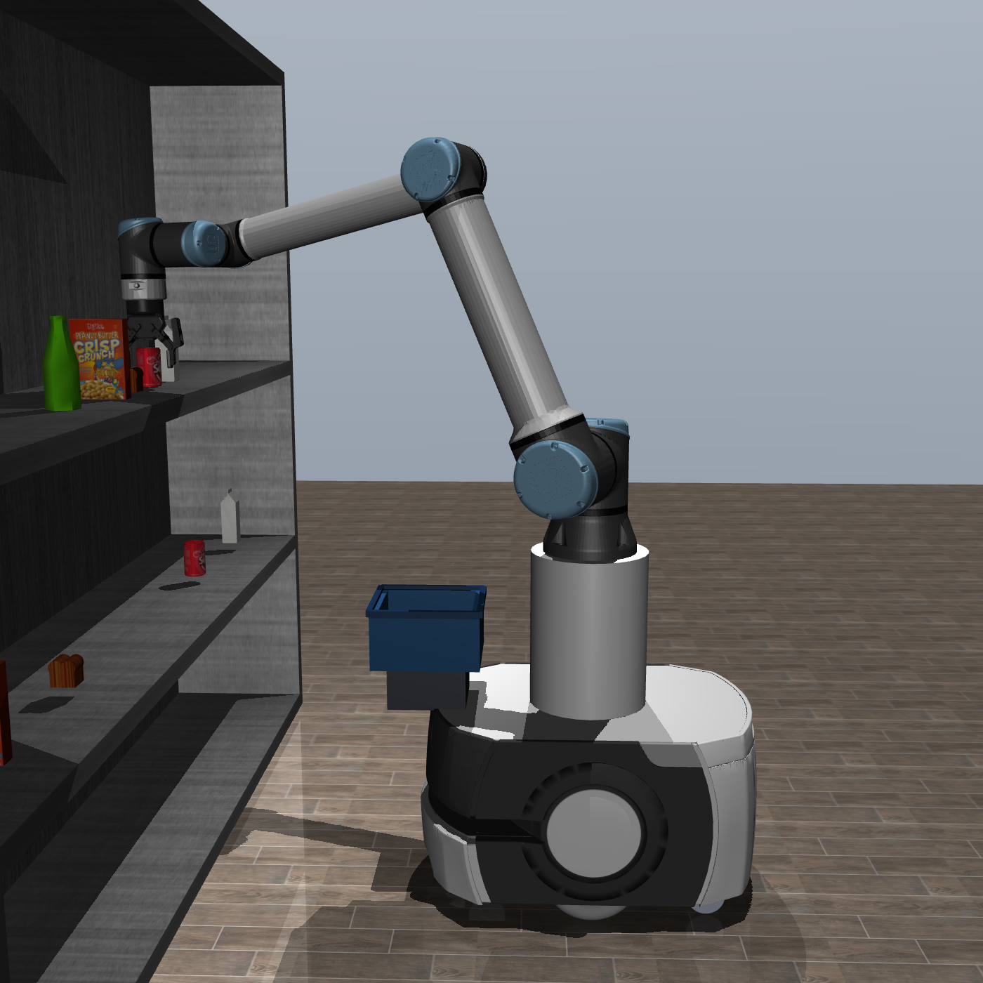
Mobile Manipulator Grasping of Everyday Objects Using Vision–Language–Action (VLA) Models
by Biswajeet Panda
Supervisors: Dr Gilbert Tang · Prof Phil Webb
Notes:
Title slide.

Slide 2
Contents
1
Motivation & the 12 GB question
2
What is a VLA? (SmolVLA)
3
The road here: RoboCasa → UR10e → Supermarket
4
System, data & training
5
Results & rigorous evaluation
6
Seeing the model “think” + shopping-list demo
7
Limitations & next steps
2

Slide 3
The Problem
Picking items from a shopping list means solving three hard problems — at the same time:
PERCEPTION
LANGUAGE
MANIPULATION
See and identify the right item on a cluttered shelf.
Understand which item the request is actually asking for.
Grasp it and place it cleanly in the basket.
Vision-Language-Action (VLA) models promise all three in one network — but they're large.
3
Notes:
The task is three hard problems at once; VLAs promise all three in one model, but they're large — which sets up the hardware constraint.

Slide 4
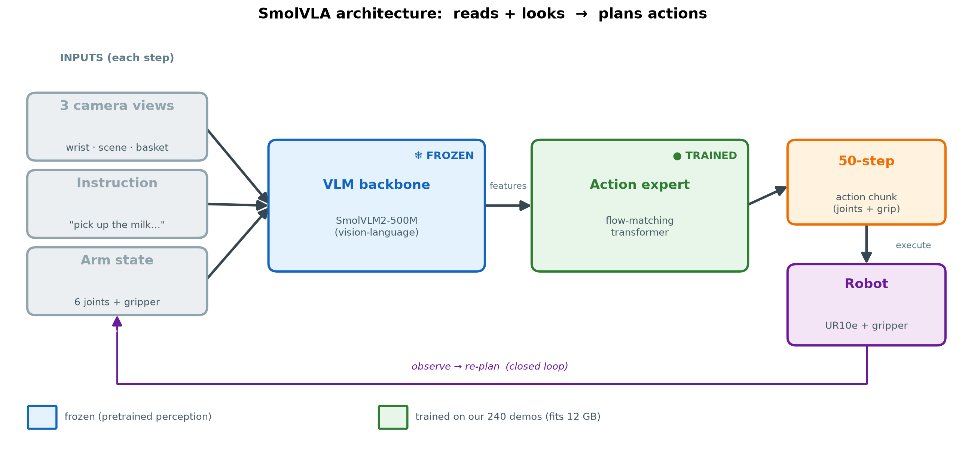
What is a VLA? And what is SmolVLA?
▪ VLA = one neural network: images + a language instruction in, robot actions out — no hand-coded perception/planning/control stack.
▪ SmolVLA: a compact (~450M-param) open VLA (Hugging Face LeRobot), built for modest hardware — the reason it fits 12 GB.
▪ Architecture — two parts:
– VLM backbone (SmolVLM2-500M): encodes images + instruction into features — WE FREEZE THIS.
– Action expert (flow-matching): features + arm state → a 50-step action chunk — WE TRAIN ONLY THIS.
▪ Runs closed-loop: observe → encode → predict 50-step plan → execute → re-plan.
4
Notes:
“It reads and looks, then acts.” Freeze backbone, train only the action expert.

Slide 5
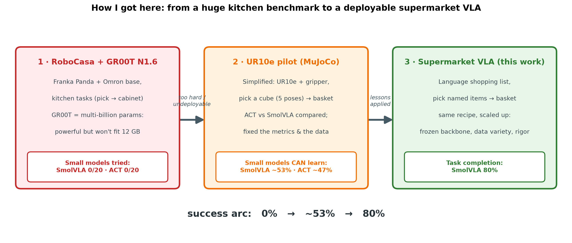
The Road Here: from a Kitchen Benchmark to This Project
▪ Started with RoboCasa — a Franka Panda + Omron mobile robot doing kitchen tasks (pick → cabinet) in MuJoCo.
▪ RoboCasa's benchmark model is NVIDIA GR00T N1.6 — multi-billion params: strong (54% zero-shot) but far too large for 12 GB.
▪ Deployable small models on the same tasks — SmolVLA, ACT, Pi0 — couldn't do it: SmolVLA 0/20, ACT 0/20.
▪ Decision: step back to a simpler, controlled task — then scale the lessons up.
5
Notes:
Why the supermarket project exists: huge model works but won't deploy; small models fail on the hard benchmark.

Slide 6
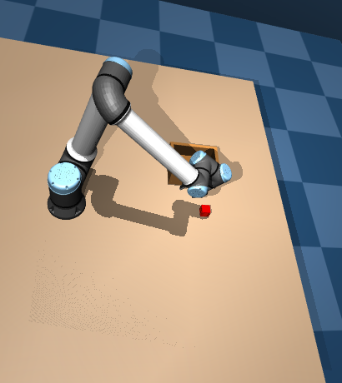
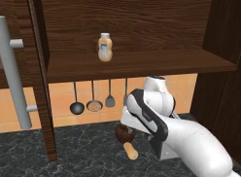
Three Robots, One Progression
too big to deploy
lessons applied
RoboCasa · GR00T N1.6
small models: 0/20
UR10e pilot (MuJoCo)
SmolVLA ~53%
Supermarket VLA · this work
SmolVLA 80%
6
Notes:
The same VLA recipe across three robots: the huge model on RoboCasa (undeployable), the UR10e pilot where small models finally worked, and the supermarket VLA it led to.

Slide 7
The UR10e Pilot: What It Taught Me
▪ Simplified to a MuJoCo UR10e + Robotiq gripper: pick a cube from 5 positions → basket. ACT vs SmolVLA.
▪ Small models CAN learn a controlled task: ACT ~47% placed, SmolVLA ~53% placed.
▪ Three lessons — carried straight into the supermarket VLA:
– Fix the success metric — a bug inflated 80% → a real 40%; measure actual release.
– Data variety > volume — duplicated demos taught nothing.
– Freeze the backbone — fully unfreezing vision blew the 12 GB budget.
▪ These lessons → applied in the supermarket VLA → 80%.
7
Notes:
Methodology over model: fixing metrics and data drove the biggest gains.

Slide 8
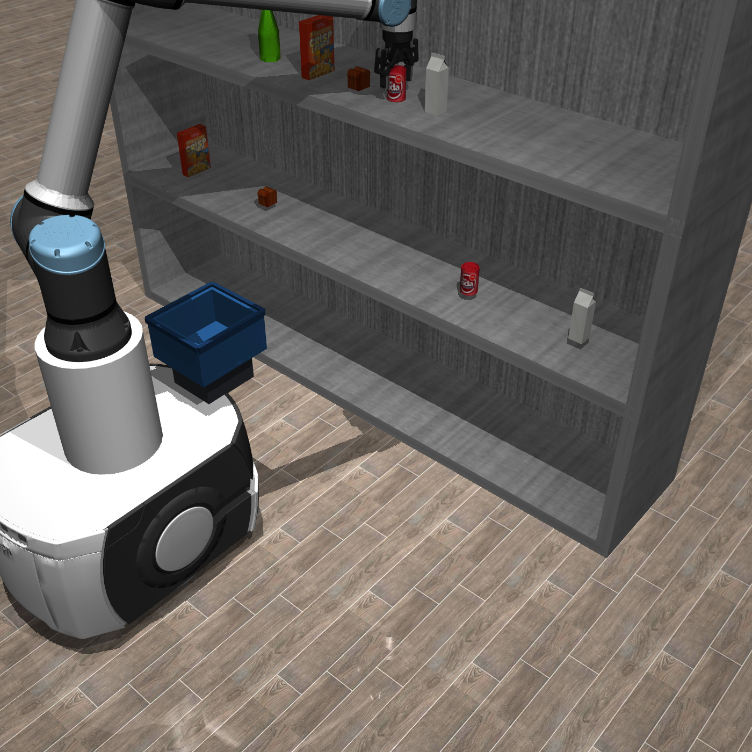
The System
▪ Simulator: MuJoCo (headless GPU rendering)
▪ Robot: Omron LD-60 mobile base + UR10e arm + Robotiq 2-finger gripper
▪ Products: real textured grocery meshes (milk, cola, bread, water bottle)
▪ 3 cameras: wrist (eye-in-hand) · scene (shelf-facing) · basket (drop target)
8
Notes:
Custom-built store scene. The 3-camera setup matters later.

Slide 9
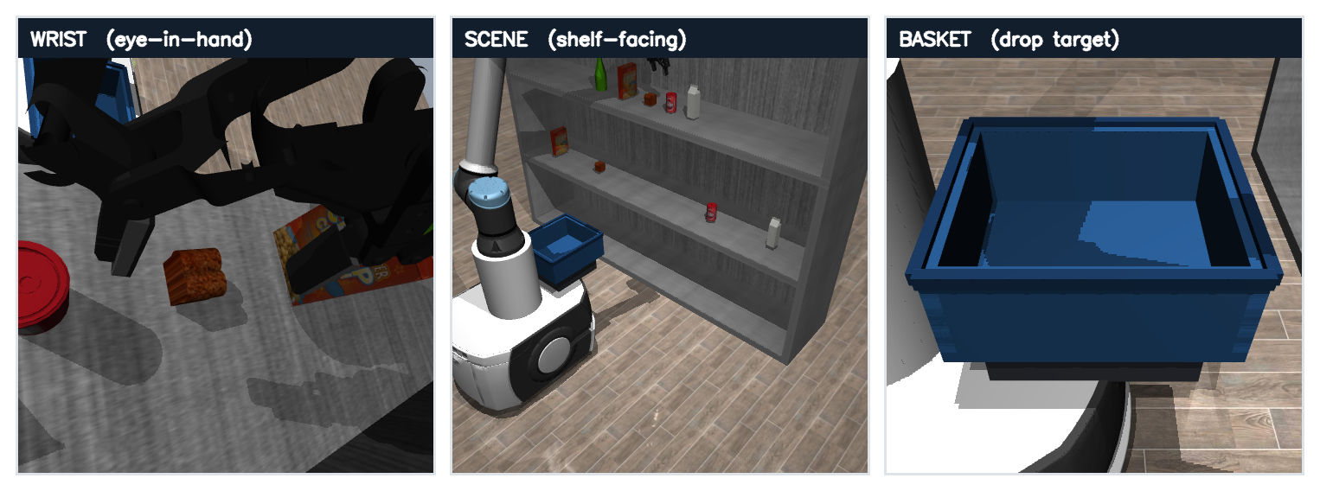
What the Robot Sees — Three Camera Views
▪ The policy acts from three synchronized views every step — plus the instruction:
– Wrist (eye-in-hand): close-up of the gripper and the item being grasped.
– Scene (shelf-facing): the whole aisle — which items are where.
– Basket (drop target): added so it can see exactly where to drop.
9
Notes:
These three images + the text instruction are the ENTIRE input to SmolVLA.

Slide 10
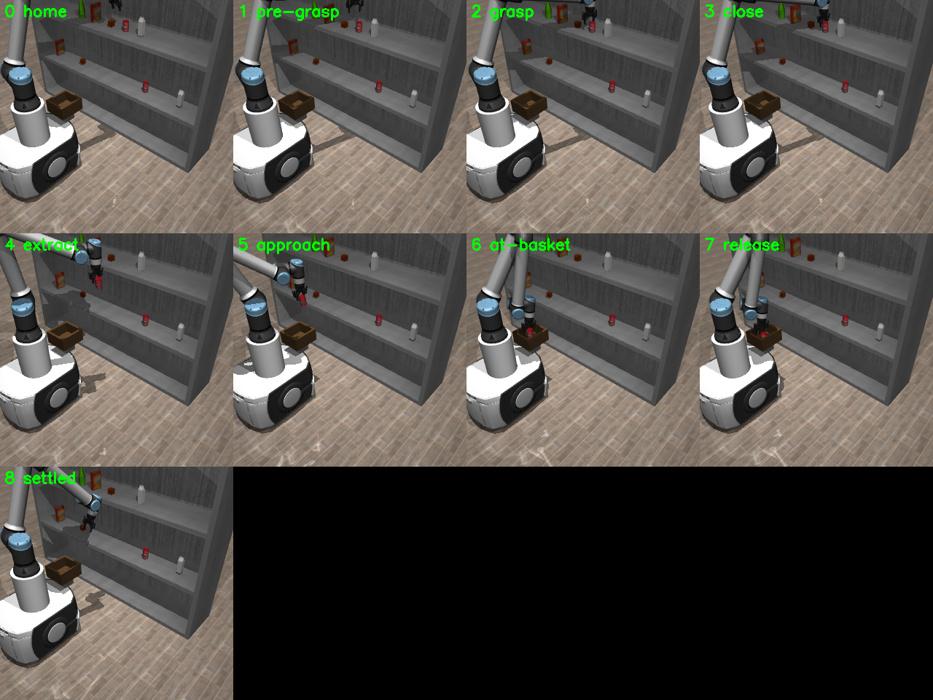
Approach: the Pipeline
▪ Scripted expert → demos → fine-tune SmolVLA → closed-loop evaluation
▪ Scripted expert = a hand-coded “teacher” using inverse kinematics; generates clean pick-place demos.
▪ SmolVLA learns to imitate — but conditioned on language + vision.
10
Notes:
The expert only teaches; at run time the neural net drives.

Slide 11
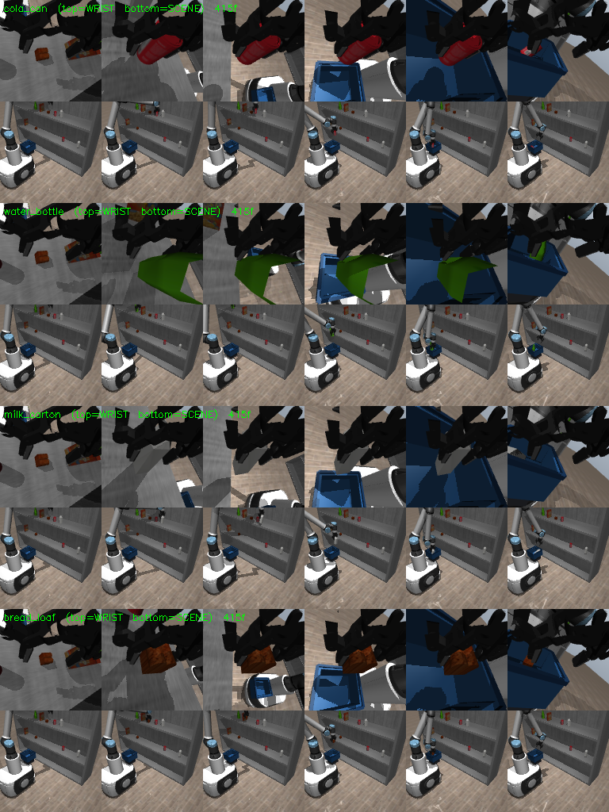
Data Collection
▪ 240 demonstrations (60 per item × 4 items), only successful episodes kept.
▪ Each frame: 3 camera images + arm state + action + a language instruction.
▪ ~20 instruction paraphrases so it keys off meaning, not one sentence.
▪ Per-episode position jitter for variety.
11
Notes:
Highlight the language variety — that's what makes it language-conditioned.

Slide 12
Training on 12 GB
▪ Fine-tuned from smolvla_base (pretrained on community robot data).
▪ Froze the vision-language backbone, trained only the action head → fits in ~3 GB, no overfitting.
▪ Why it works: the backbone already sees and reads; we only teach how this robot acts.
▪ Batch 8 · 20k steps · ~4 h · RTX A2000 12 GB.
12
Notes:
A VLA fits 12 GB by freezing perception.

Slide 13
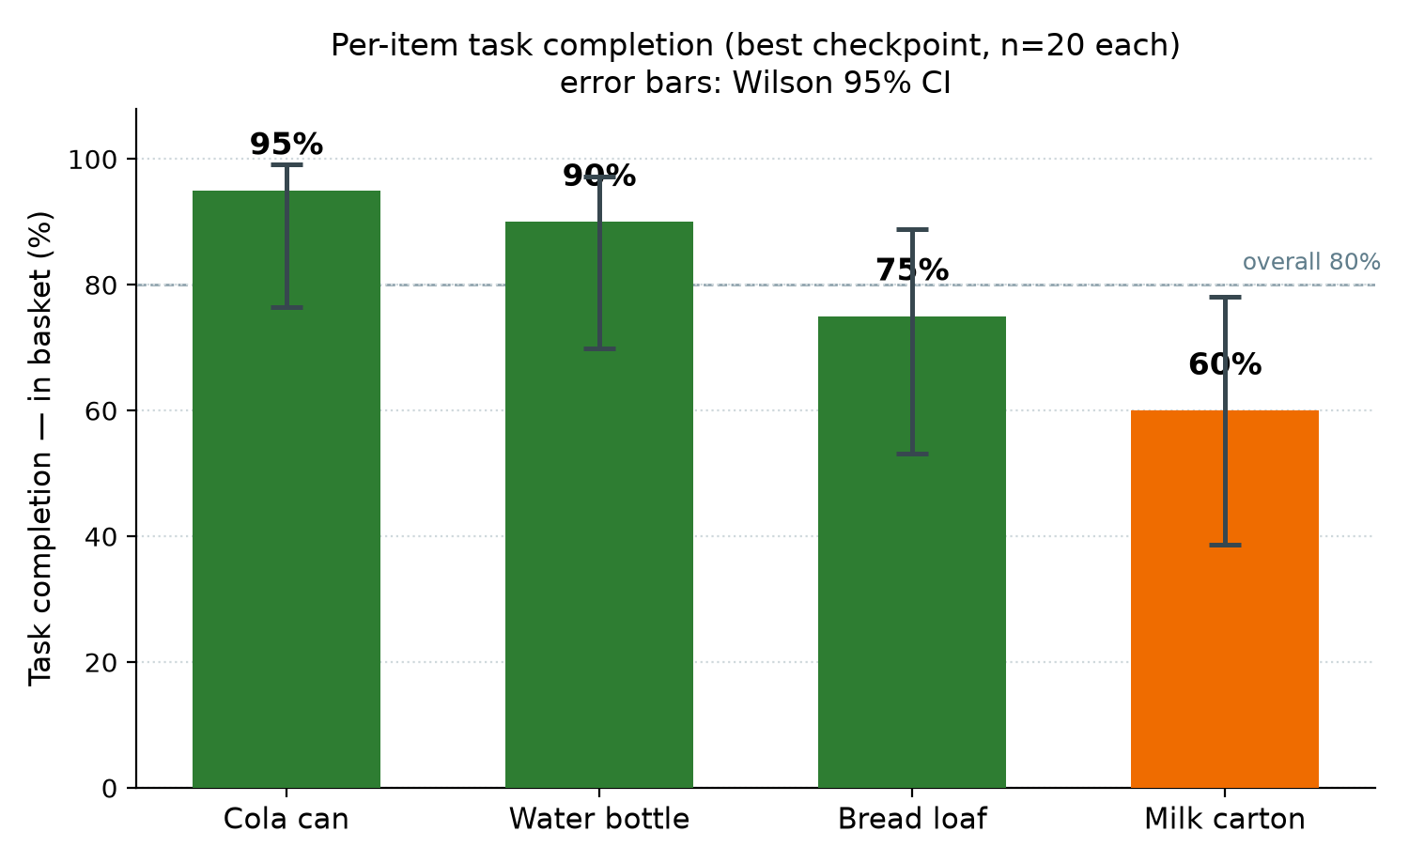
Headline Result
▪ 80% task-completion rate — reads instruction → picks the named item → lands it in the basket.
▪ 95% confidence interval: 70–87% (Wilson) · grasp success 92.5%.
▪ Measured over 320 closed-loop trials — not a lucky demo.
– Confidence interval = the range the true rate very likely sits in.
13
Notes:
THE slide. Say 80%, then show it's rigorously measured.

Slide 14
Results per Item (best checkpoint)
▪ Three of four items complete ≥75%; two at ≥90%. Milk is the weak point.
▪ All with Wilson 95% CIs, 20 trials each.
Item | Grasp | In basket
Cola can | 100% | 95%
Water bottle | 100% | 90%
Loaf of bread | 100% | 75%
Milk carton | 70% | 60%
14
Notes:
Be honest about milk — acknowledging the weak spot builds credibility.

Slide 15
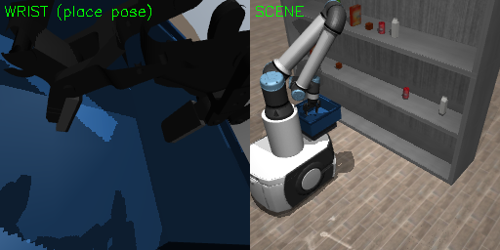
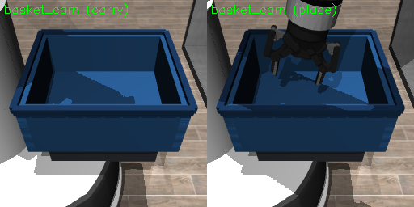
From 0% to 80%: Failure Analysis
▪ First policy: 0% placement — but it grasped, carried, and lowered items to within ~2 cm of the basket.
▪ Diagnosis: near-misses, not broken understanding — dropped ~10 cm short + didn't cleanly stop.
▪ Three targeted fixes: clean episode boundaries, a dedicated basket camera, a wider tote.
▪ Result: 0% → 80%.
15
Notes:
A strong narrative arc — diagnosed rather than blindly retrained.

Slide 16
It Genuinely Understands Language
▪ Same scene, change only the instruction → the arm reaches the named item.
▪ “milk” → left · “bread” → center · “water bottle” → right (matches each item's position).
▪ Not “grab the nearest” — it's reading the words.
16
Notes:
This proves language grounding.

Slide 17
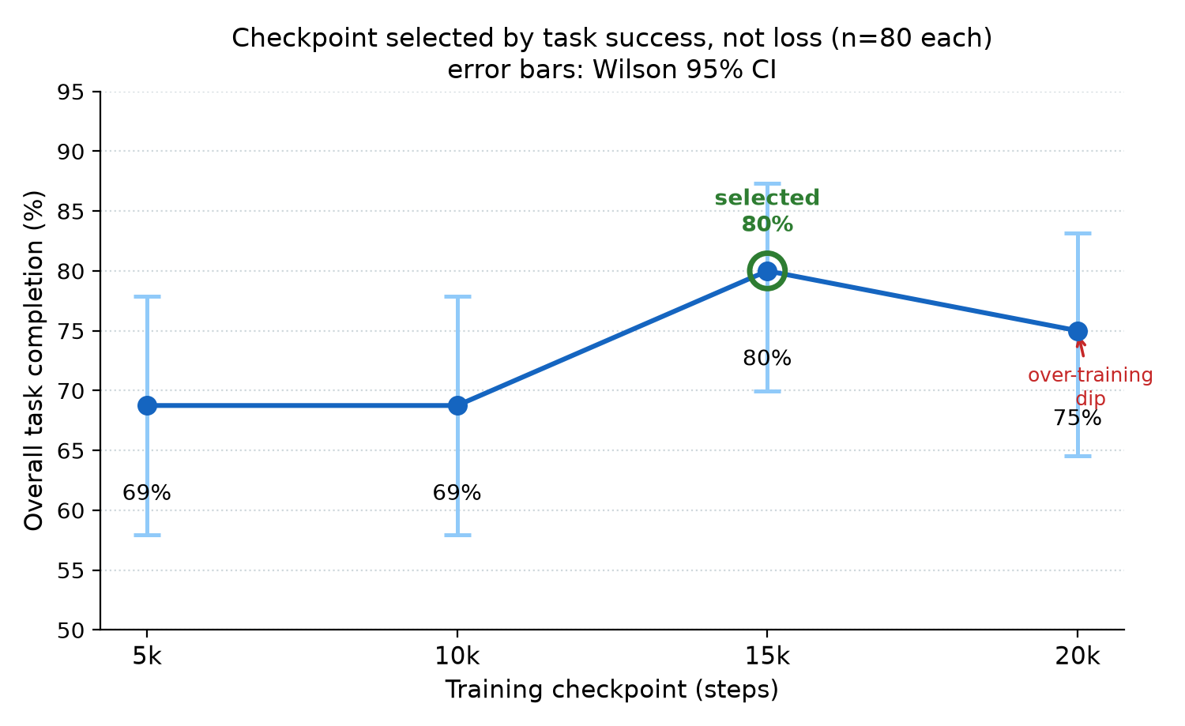
Which Model Do We Keep? (checkpoint selection)
▪ A “checkpoint” = a saved snapshot during training. 20k steps, saved every 5k → 4 versions (5k/10k/15k/20k), like save-points.
▪ We can only deploy one, so we had to choose which snapshot to keep.
▪ How we chose: ran the robot with each of the 4 and measured actual task success — NOT the loss curve.
▪ 15k was best (80%); the final 20k was worse (75%) — it over-trained.
▪ So we selected 15k. Picking by loss would have shipped the worse robot.
17
Notes:
Define checkpoint first, then the choice. Select by what the robot does, not the loss.

Slide 18
Seeing the VLA “Think”
▪ SmolVLA plans 50 steps ahead — we surface its own predicted action plan live.
▪ At the first frame it has already decided to close the gripper at +16 steps — it plans the grasp before reaching the item.
▪ Honest interpretability: the plan is the model's real output, not a heuristic.
grip plan : ················██████████████████
intent : CLOSE -> grasp at +16
(· = open █ = closed)
the model's own 50-step plan at frame 0
18
Notes:
The “wow” slide. The sparkline is the network's intention.

Slide 19
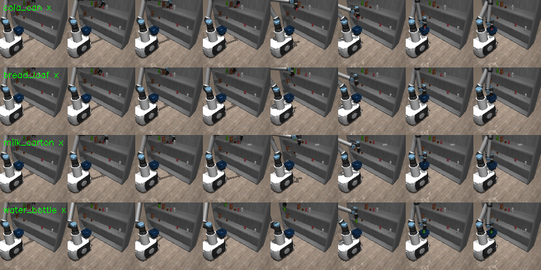
Following a Shopping List
▪ Type a list from a menu → robot collects each item in order, basket accumulates.
▪ Deterministic menu (numbers or names) — reliable, no brittle text guessing.
▪ Retry-on-miss re-attempts a dropped item.
19
Notes:
The end-to-end product. A short screen recording works well here if presenting live.

Slide 20
Closed-Loop Rollout — the Policy Collecting Items
20
Notes:
Enlarged closed-loop rollout filmstrip: SmolVLA reaching to grasp and place each item.

Slide 21
Honest Limitations
▪ Milk is the weakest item (60%) — recoverable with milk-specific tuning / more data.
▪ Multi-item lists are less reliable than single picks: a full basket is a view the policy never saw in training. First item is always solid.
▪ Cereal excluded — grip slips on the wide box.
21
Notes:
Volunteering limits builds credibility.

Slide 22
Next Steps
▪ Stage 2 — Navigation VLA: drive the base between shelves in a store with moving, colliding shoppers.
▪ Orchestrator: loop the full list — navigate → pick → place → deliver.
▪ Optional: small retrain with non-empty baskets to make multi-item lists fully reliable.
22
Notes:
The roadmap — this is Part A of a two-VLA system.

Slide 23
Takeaways
▪ A capable VLA fine-tuned and run on a single 12 GB GPU — proven possible on modest hardware.
▪ 80% task completion, rigorously measured (320 trials, Wilson CIs, success-based selection).
▪ Genuine language grounding + a window into the model's plan.
▪ End-to-end: language → shopping list → collected.
23
Notes:
Circle back to the opening question and the headline number.

