Slide 1

Rising Childcare Cost Crisis
Biswajit Sharma
DSC640

Slide 2
Increasing Childcare Prices is a Threat to People and Society
The childcare prices have been rising very aggressively, which can have detrimental impact on both people and the economy. The increased childcare cost causes financial burden on families and reduces their capability to spend on essential areas like healthcare, nutrition, and education. High childcare cost hinders individuals, particularly women from participating in the workforce, that causes reduction in household income and quality of life. Reduction in workforce and household income also has a detrimental effect on the economy as this results in reduced consumer spending, more dependence, and utilization of social welfare programs.
The government must intervene to address this issue by bringing policies and reforms such as providing subsidiaries, higher tax credits for child and dependent care, and expansion of publicly funded childcare programs, essentially making it more affordable for all families and individuals.

Slide 3
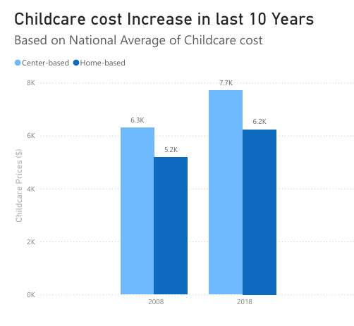
Childcare Cost in Last 10 Years
National average of childcare cost increased by 22% in last 10 years for center-based care.
National average of child care cost increased by 19% in last 10 years for home-based care.

Slide 4
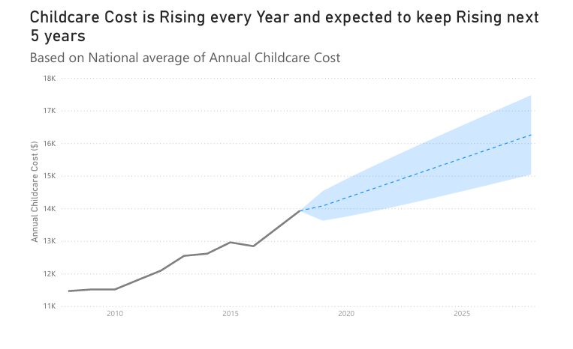
Where Childcare Cost is Heading in Next 5 years?
Childcare cost has been increasing every year and forecast shows that it is expected to keep rising if no action is taken.

Slide 5
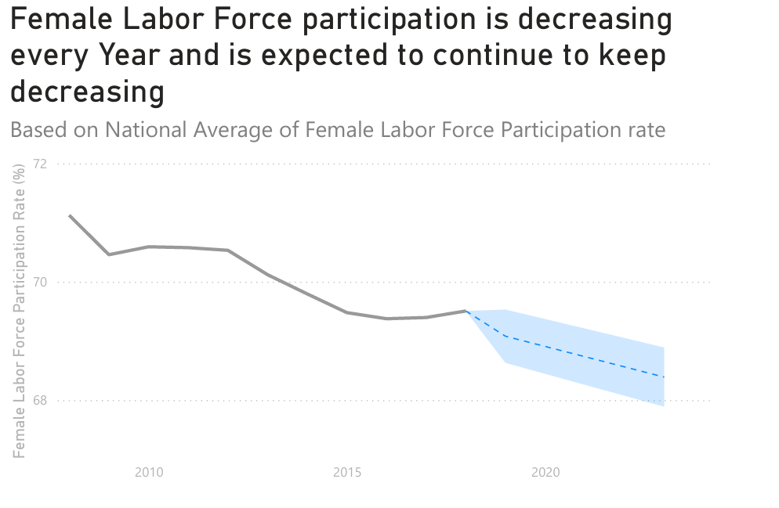
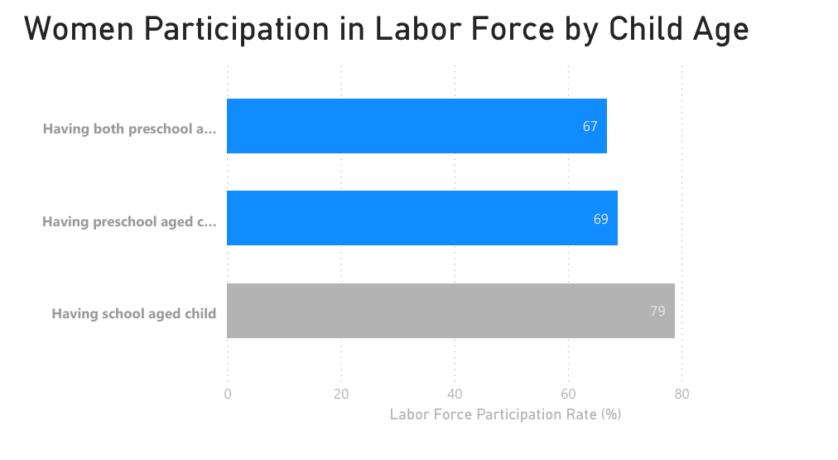
Women’s Participation in Workforce is reducing due to Increasing Childcare Cost
Women’s participation in workforce has been decreasing in last 10 years because women are staying home or working less hours as families are not able afford the rising cost of childcare
Participation in workforce among Women with childcare needs (having preschool aged child/ren) is considerably lower than Women who do not need childcare (having only school aged child/ren)

Slide 6
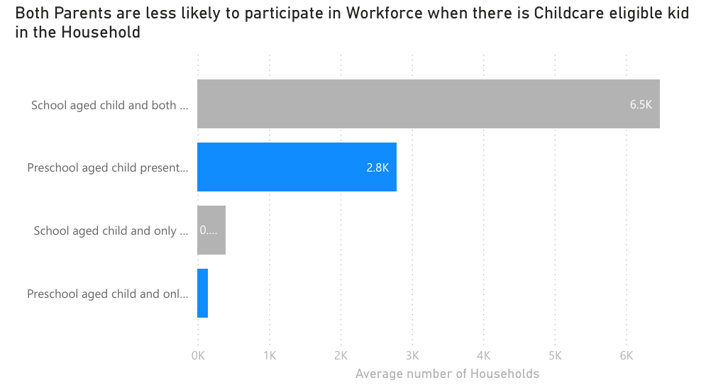
Household Income is reduced when both Parent do not participate in work to provide childcare needs
132% less chances that both parents are working in a household if there is any childcare eligible kid (preschooler).

Slide 7
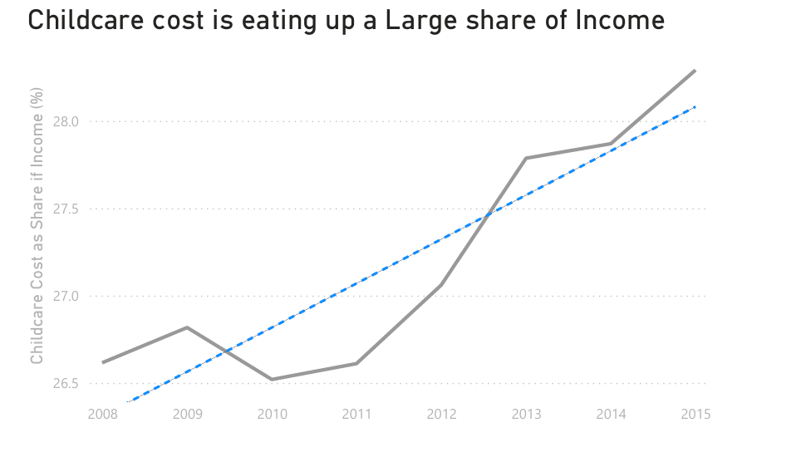
High Childcare cost is taking a toll in general Well Being of the People
The rising childcare cost is also eating up a larger share of the income and families are forced to compromise on good education, comprehensive healthcare, and better quality of life.

Slide 8
If not Now then When?
The concern of rising child care cost has direct impact of the on economy and general welfare of the people. The government and lawmakers must act to address this issue by bringing policies and reforms such as providing subsidiaries, higher tax credits for child care, and expansion of publicly funded childcare programs, essentially making it more affordable for all families and individuals.
It is crucial acknowledge the concern right now and formulate appropriate policies and reforms to make childcare more affordable and easily available before its too late.

