Slide 1
Using a Morlet function based kernel in Kernel PCA to de-noise images
Presented By,
Biswajit Rana
MSc Big Data Analytics (B2330026)
And
Uddalak Mukherjee
MSc Big Data Analytics (B2330042)

Slide 2
Introduction :
What :
Noise can be caused by various factors, such as poor lighting conditions, low-quality cameras, or compression artifacts.
The objective of our project is to Denoise Corrupted or Noisy Images .
Why :
We will recover those images and get better clarity on them.
Aim to restore an image to its original quality by reducing or removing the noise, while preserving the important features of the image.

Slide 3




How :
The idea will be to learn the KPCA basis on noisy images and then use these models to reconstruct and denoise these images .
The Morlet wavelet kernel based on the Morlet wavelet function $ψ\left(x\right)=\cos\left(5x\right)exp⁡(−\frac{x^{2}}{2}$) as follows:
$$\prod_{k=1}^{d}{cos⁡\left(\frac{5\left(x_{k }− y_{k}\right)}{a}\right)} exp⁡\left(−\frac{{(x_{k} −y_{k})}^{2}}{2a^{2}}\right)$$
$$k\left(x,y\right) =$$
where $x, y ε ℝ^{d}$

Slide 4


The paper produced a proof to validate their claim that this is indeed a positive definite kernel using a number of integral transformations. However we have taken a different approach that involves the direct use of Mercer Conditions to prove the same.
$$f_{χ}\left(x\right)=C\cos\left(5x\right)\exp\left(− \frac{x^{2}}{2}\right) , −2.5≤x≤2.5$$
where $C$ $≈$ $−118.2$
To generate samples from this distribution to be added as noise to our images, we can use rejection sampling or Metropolis Hastings with normal proposal distribution.

Slide 5
Figure 1: Morlet Wavelet Function

Slide 6
Work plan and Time line :
Data Collection – 1week
Literature Review -1week
Validating Mathematical Foundation – 1 weeks
Testing existing models – 3 days
Implementing our proposed algorithm in Python – 2weeks
Comparing Results – 2 days
Interpretation - 1 week

Slide 7
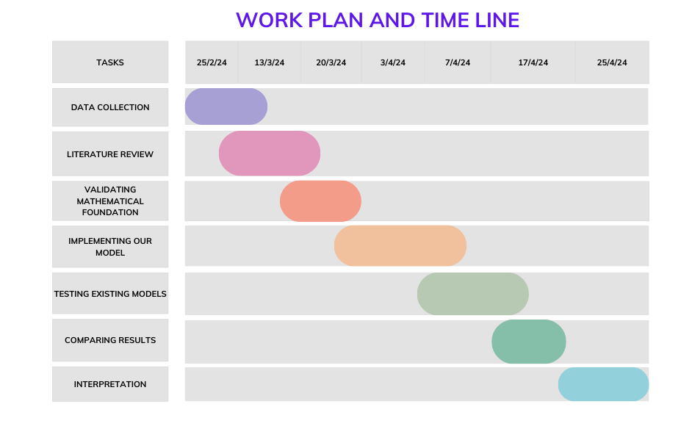

Slide 8
Work plan division in our group:
Data Collection : Uddalak Mukherjee
Literature Review : Both
Validating Mathematical Foundations : Uddalak Mukherjee
Implementation in Python : Biswajit Rana
Comparison with other models : Biswajit Rana
Interpretation of Results : Both

Slide 9
Thank You

