Slide 2
Dimensionality Reduction and Image Processing
PRESENTED BY
UDDALAK MUKHERJEE
Supervisor: Dr. Kuntal Ghosh (ISI-Kolkata)

Slide 3
Content:
Introduction to Dimensionality Reduction
Objective of Dimensionality Reduction
Different algorithms for Dimensionality Reduction
Principal Component Analysis
Mathematical Formulation
Implementation on practical dataset
Kernel Principal Component Analysis
Mathematical Formulation
Implementation on practical dataset
Comparative study of PCA and KPCA using k-NN classification
Image Compression using PCA and KPCA

Slide 4
Introduction to Dimensionality Reduction:
Dimensionality Reduction in Machine Learning is a technique of transforming a data consisting of a large number of features to a data consisting of significantly lower number of features that covers the maximum information belonging to the original data. In mathematical terms, it is the process of transforming a high dimensional vector space to a lower dimensional vector space.
Objective of Dimensionality Reduction:
Dimensionality reduction finds its application in data visualization as it is impossible to visualize data consisting of more than 3 dimensions.

Slide 5
Different Algorithms for Dimensionality Reduction:
Principal Component Analysis (PCA)
Kernel Principal Component Analysis (KPCA)
Locally Linear Embeddings (LLE)
Laplacian Eigenmaps (LE)
Metric Dimensionality Scaling (MDS)
Semi-Definite Embeddings (SDE)
Linear Discriminant Analysis (LDA)

Slide 6
Principal Component Analysis (PCA):
Principal components analysis (PCA) is a very popular technique for dimensionality reduction. Given a set of data of n-dimensions, PCA aims to find a linear subspace of dimension d lower than n such that the data points lie mainly on this linear subspace. The linear subspace can be specified by d orthogonal vectors that form a new coordinate system, called the ‘Principal components’. There are two approaches solving the PCA problem , viz., Variance-Covariance Approach and Singular Value Decomposition Approach. We will be discussing both of them briefly.

Slide 7

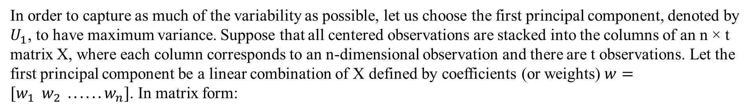

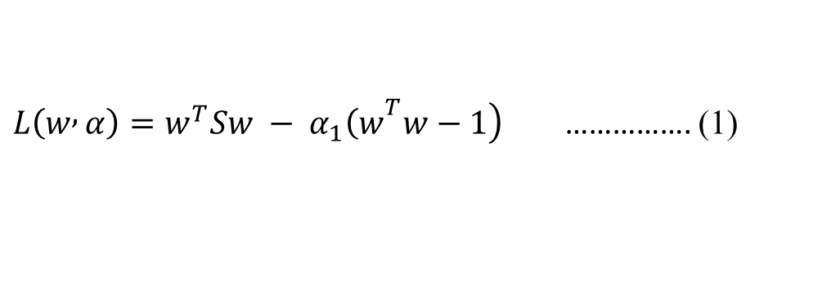
Mathematical formulation behind PCA (Variance-Covariance Approach):
In order to capture as much of the variability as possible, let us choose the first principal component, denoted by $U_{1}$, to have maximum variance. Suppose that all centered observations are stacked into the columns of an n × t matrix X, where each column corresponds to an n-dimensional observation and there are t observations. Let the first principal component be a linear combination of X defined by coefficients (or weights) $w=[w_{1} w_{2} ...... w_{n}]$. In matrix form:
$$U_{1}=w^{T}X$$
$$Var\left(U_{1}\right) = var\left(w^{T}X\right) = var\left(w^{T}Sw\right)$$
where S is the n × n sample covariance matrix of X.
Clearly $Var\left(U_{1}\right)$ can be made arbitrarily large by increasing the magnitude of w. Therefore, we choose w to maximize $w^{T}Sw$ while constraining w to have unit length.
$$max w^{T}Sw$$
$$subject to w^{T}w=1$$
To solve this optimization problem a Lagrange multiplier $α_{1}$ is introduced
$\left.L\left(w , α\right)=w^{T}Sw − α_{1}{\left(w\right.}^{T}w−1\right)$ ……………. (1)

Slide 8

Differentiating with respect to w gives n equations,
$$Sw=α_{1}w$$
Pre-multiplying both sides by $w^{T}$ we have:
$$w^{T}Sw =α_{1}w^{T}w =α_{1}$$
$Var(U_{1})$ is maximized if $α_{1}$ is the largest eigenvalue of S.
Clearly $α_{1}$and w are an eigenvalue and an eigenvector of S. Differentiating (1) with respect to the Lagrange multiplier $α_{1}$gives us back the constraint:
$$w^{T}w=1$$
This shows that the first principal component is given by the normalized eigenvector with the largest associated eigenvalue of the sample covariance matrix S. A similar argument can show that the d dominant eigenvectors of covariance matrix S determine the first d principal components.

Slide 9
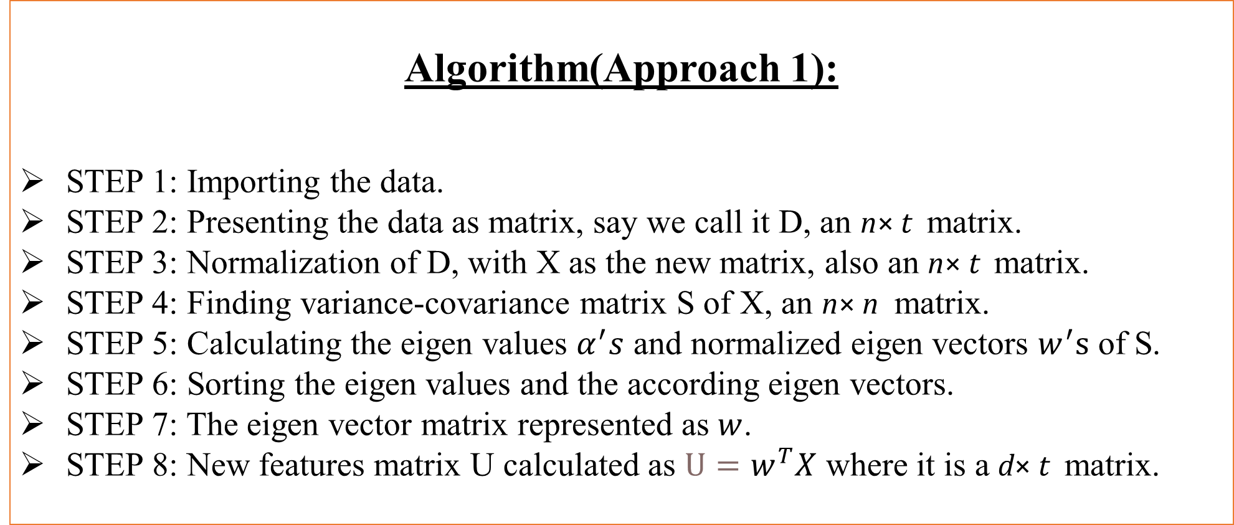
Algorithm(Approach 1):
STEP 1: Importing the data.
STEP 2: Presenting the data as matrix, say we call it D, an n× t matrix.
STEP 3: Normalization of D, with X as the new matrix, also an n× t matrix.
STEP 4: Finding variance-covariance matrix S of X, an n× n matrix.
STEP 5: Calculating the eigen values $α^{′}s$ and normalized eigen vectors $w^{′}s$ of S.
STEP 6: Sorting the eigen values and the according eigen vectors.
STEP 7: The eigen vector matrix represented as $w$.
STEP 8: New features matrix U calculated as $U=w^{T}X$ where it is a d× t matrix.

Slide 10

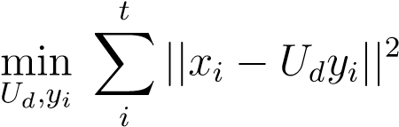
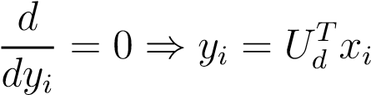
Mathematical formulation behind PCA (SVD Approach):
Another nice property of PCA, is that the projection onto the principal subspace minimizes the squared reconstruction error,
In other words, the principal components of a set of data in < n provide a sequence of best linear approximations to that data, for all ranks d ≤ n. Consider the rank-d linear approximation model as :
f(y) =$\overline{x}$+ U_{d}y
This is the parametric representation of a hyperplane of rank d.
For convenience, suppose $\overline{x}$=0, (otherwise the observations can be simply replaced by their centered versions $\tilde{x}=x_{i}−\overline{x}$
Under this assumption the rank d linear model would be f(y) = U_{d}y, where U_{d} is a n × d matrix with d orthogonal unit vectors as columns and y is a vector of parameters. Fitting this model to the data by least squares leaves us to minimize the reconstruction error:
By partial optimization for y_{i} we obtain:

Slide 11
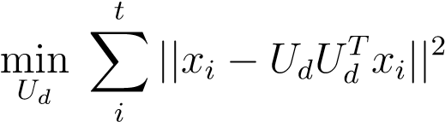

Now we need to find the orthogonal matrix U_{d}:
Define is a n×n matrix which acts as a projection matrix and projects each data point x_{i} onto its rank d reconstruction. In other words, H_{d}x_{i} is the orthogonal projection of x_{i} onto the subspace spanned by the columns of U_{d}. A unique solution U can be obtained by finding the singular value decomposition of X . For each rank d, U_{d} consists of the first d columns of U.
Clearly the solution for U can be expressed as singular value decomposition (SVD) of X.
X = UΣV ^{T}
Since the columns of U in the SVD contain the eigenvectors of XX^{T} .
This approach can be preferred over the former one as it gives better results for data reconstruction.

Slide 12
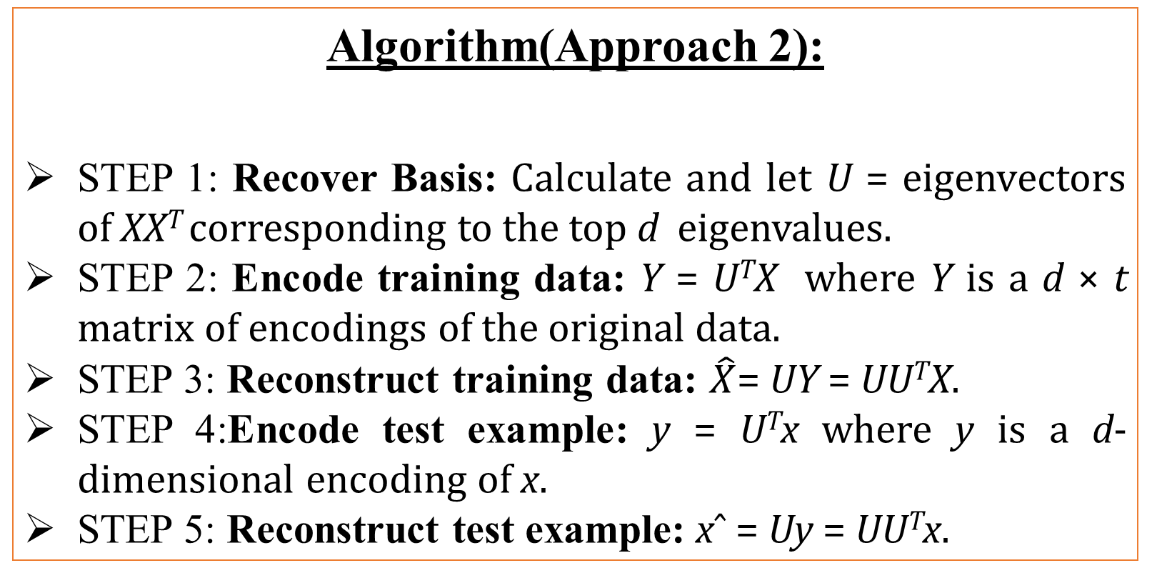
Algorithm(Approach 2):
STEP 1: Recover Basis: Calculate and let U = eigenvectors of XX^{T} corresponding to the top d eigenvalues.
STEP 2: Encode training data: Y = U^{T}X where Y is a d × t matrix of encodings of the original data.
STEP 3: Reconstruct training data: $\hat{X}$= UY = UU^{T}X.
STEP 4:Encode test example: y = U^{T}x where y is a d-dimensional encoding of x.
STEP 5: Reconstruct test example: xˆ = Uy = UU^{T}x.

Slide 13
Implementation on practical dataset
We firstly try to implement this algorithm in practical use as originally discussed. We use the Iris dataset for our implementation with the preferred language for this implementation being R. In this dataset our features are petal length, sepal length, petal width and sepal width.
But first we try to get some useful insights on our data before we begin with our PCA algorithm.

Slide 14
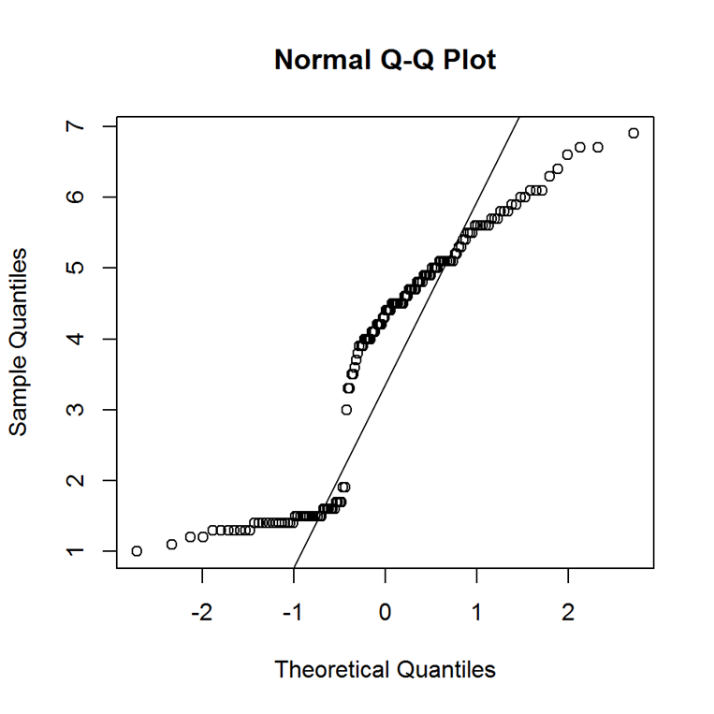
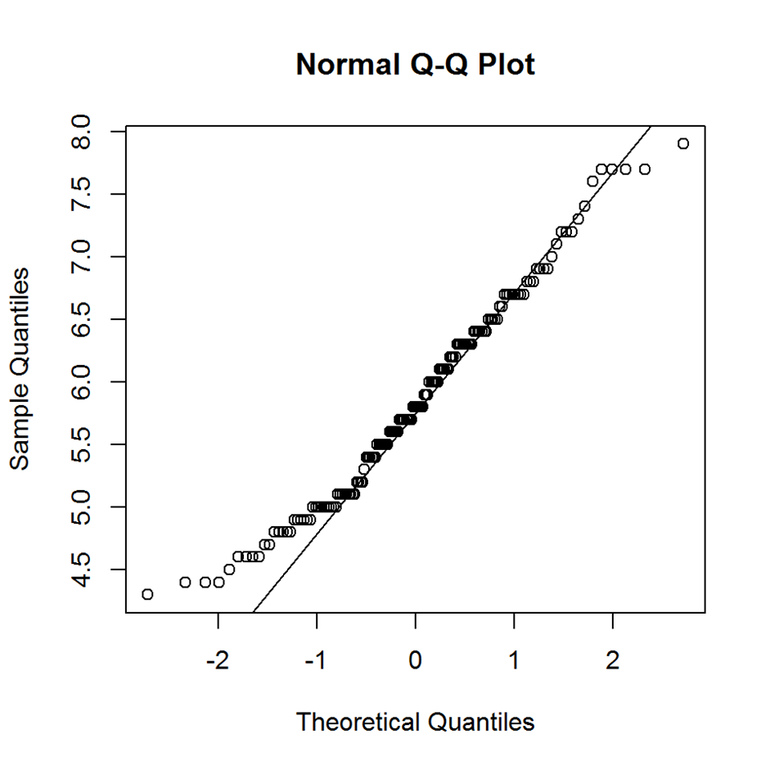
QQ Plots for all the Features
Petal Length
Sepal Length

Slide 15
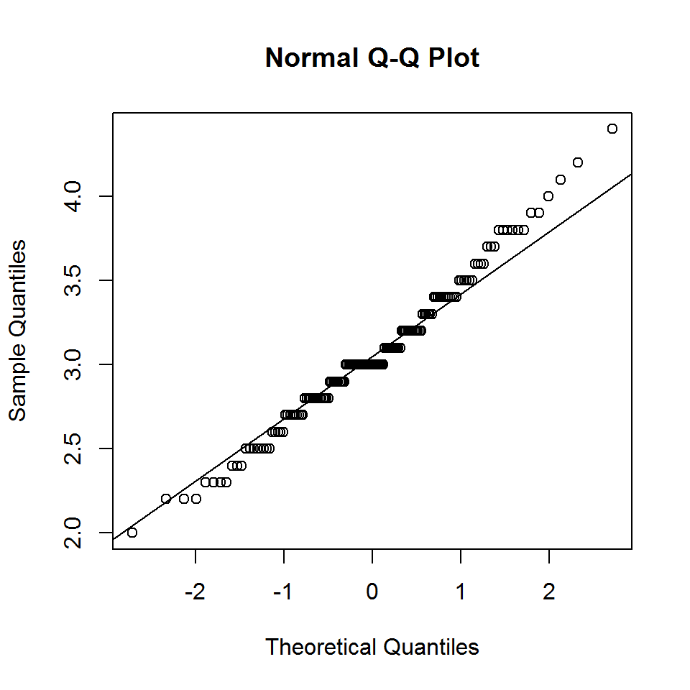
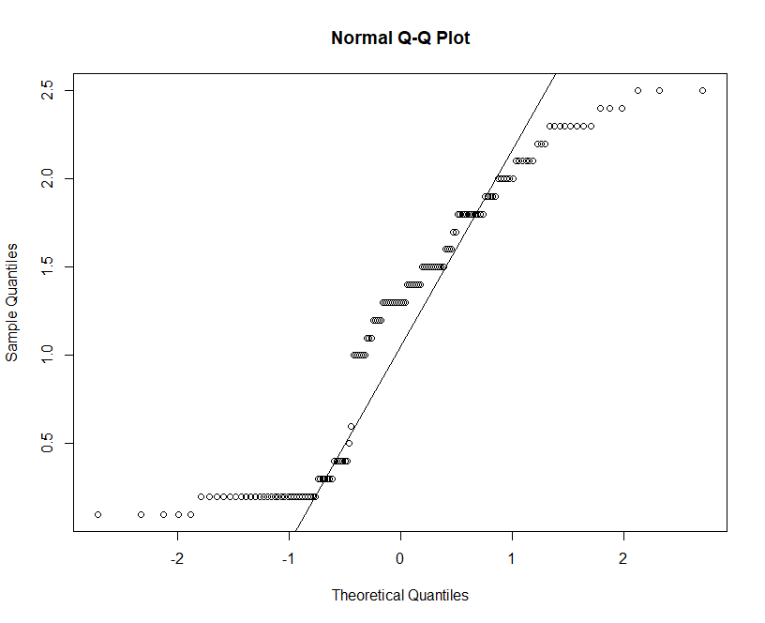
Petal Width
Sepal width

Slide 16
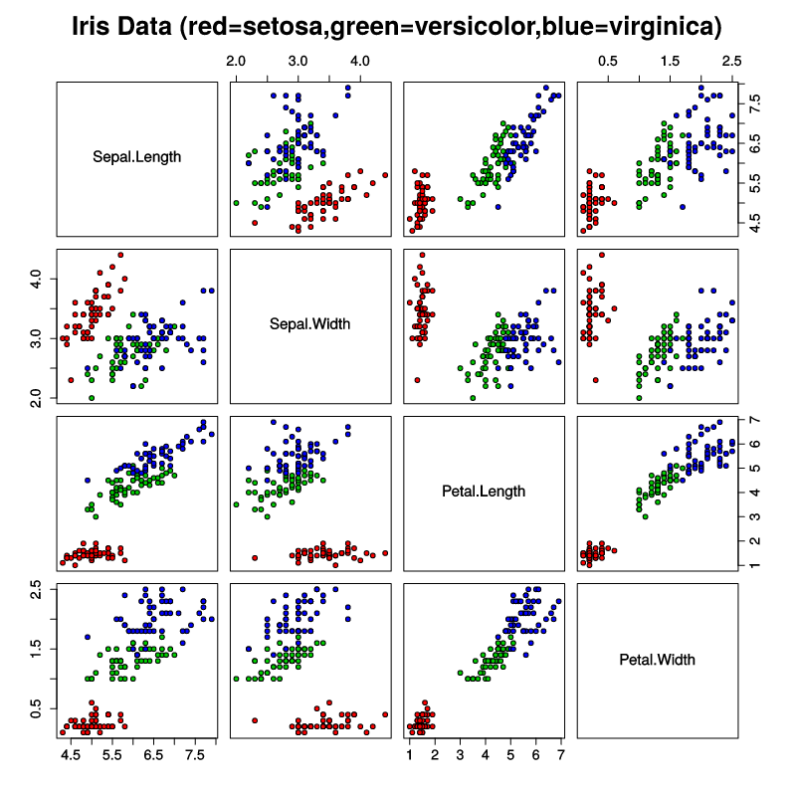
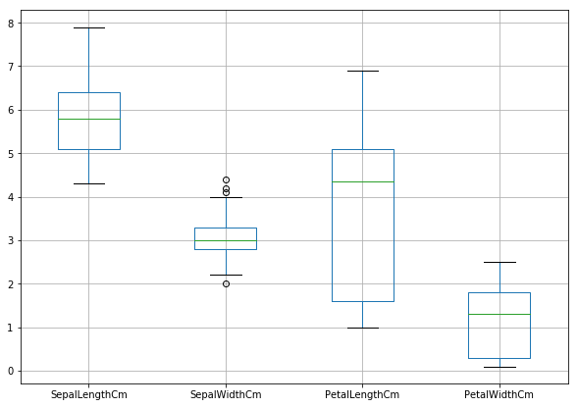
Scatter Plots and Box Plots for all the Features
Scatter Plot
Box Plot

Slide 17
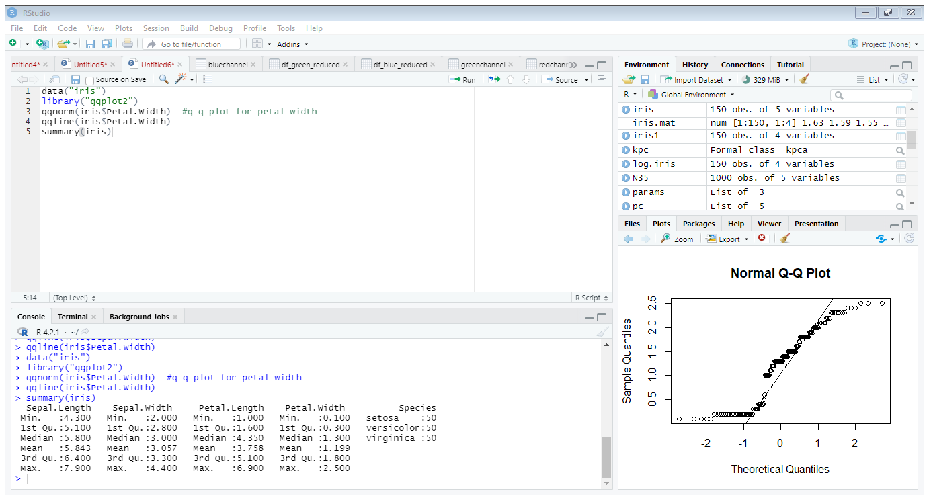
Summary Statistics for all the features

Slide 18
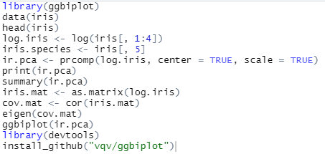
R-Code for PCA on Iris Dataset

Slide 19
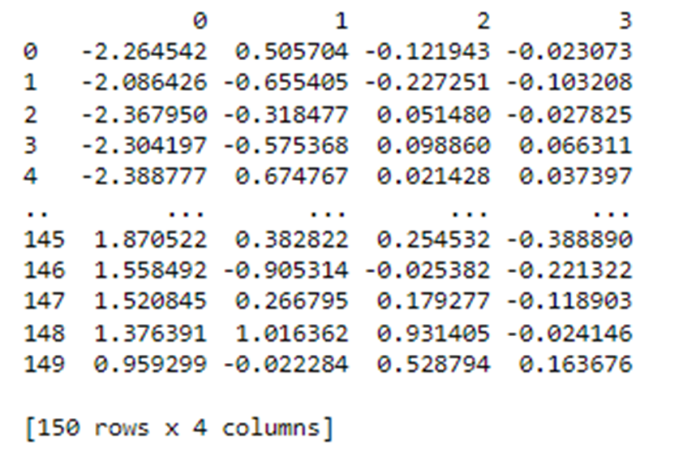
The Original Principal Components
First and final few observations of the Principal Components

Slide 20
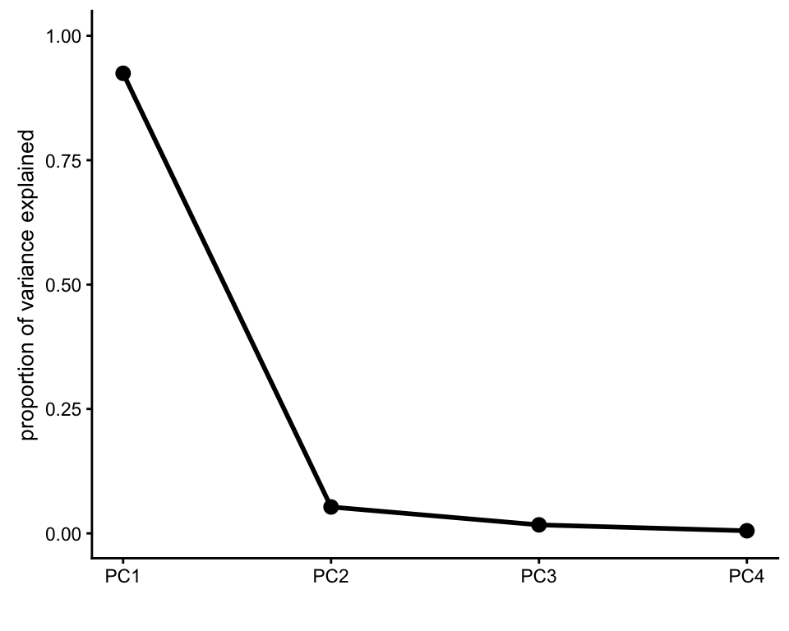
Elbow method for finding optimum number of Principal Components
We find an elbow at PC2 so 2 principal components will be the best for representing the data
Scree Plot of Principal Components

Slide 21
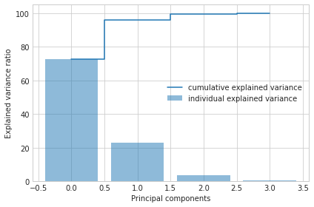
Cumulative Variation Explained by the Principal Components
Proportion of Variation Explained: PC1(73.3%), PC2(22.7%), PC3(3.6%), PC4(0.4%)
The first two Principal Components explain 96% of the variation so the rest do not contribute greatly to the total variation of the data

Slide 22
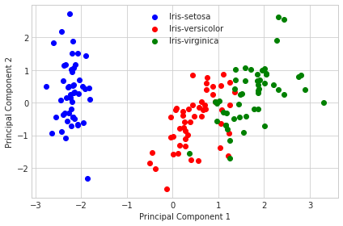
Original Data Rotated on the Principal Components
Original Data Rotated on the Principal Components

Slide 23
Kernel Principal Component Analysis (KPCA)
PCA is designed to model linear variabilities in high-dimensional data. However, many high dimensional data sets have a nonlinear nature. In these cases the high-dimensional data lie on or near a nonlinear manifold (not a linear subspace) and therefore PCA can not model the variability of the data correctly. One of the algorithms designed to address the problem of nonlinear dimensionality reduction is Kernel PCA. In Kernel PCA, through the use of kernels, Principal components can be computed efficiently in high-dimensional feature spaces that are related to the input space by some nonlinear mapping. Kernel PCA finds Principal components which are nonlinearly related to the input space by performing PCA in the space produced by the nonlinear mapping, where the low-dimensional latent structure is, hopefully, easier to discover.

Slide 24
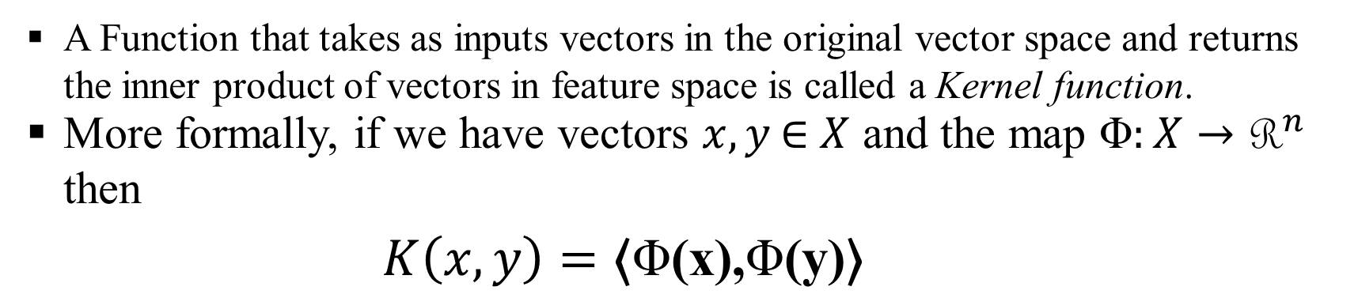
Mathematical formulation behind Kernel PCA:
Before diving into the mathematical interpretation of the Kernel PCA algorithm, we will take a look at the different terms involved in its study
Kernel Function: Definition
A Function that takes as inputs vectors in the original vector space and returns the inner product of vectors in feature space is called a Kernel function.
More formally, if we have vectors $x, y \text{∈} X$ and the map $\text{Φ}:X→{\text{R}}^{n}$ then
$$K\left(x,y\right)=\text{⟨}\text{Φ}\text{(}\text{x}\text{),}\text{Φ}\text{(}\text{y}\text{)⟩}$$

Slide 25
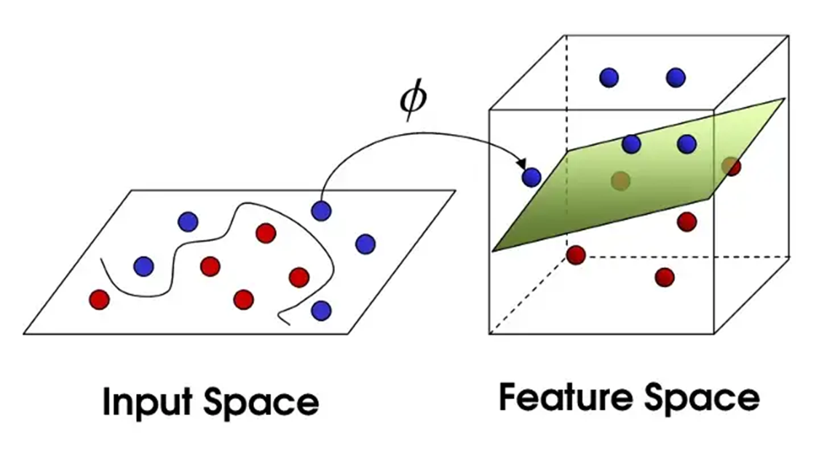
Kernel Function: Objective and Visual Representation
In Support Vector Machines, Kernel Functions are used for converting data which are not linearly separable to linearly separable data through a projection on a higher dimensional vector space. In Dimensionality Reduction, specifically PCA, we also project the data points on lower dimensional hyperplanes, which is why we try to fit an hyperplane between the data points and then rotate it until the maximum variance is captured. Hence, in KPCA we use the Kernel function for a similar purpose.
Visual Representation of the working of a Kernel Function

Slide 26

Kernel Function: Examples
Polynomial Kernel : It is popular for image processing. Equation is:
Gaussian Kernel: It is a general-purpose kernel; used when there is no prior knowledge about the data. Equation is:
Gaussian Radial Basis Function: It is also a general-purpose kernel; used when there is no prior knowledge about the data. However, it is more sophisticated than general Gaussian Kernel. Equation is:
,
There are lots of other Kernels for other uses however we will be using these kernels for our study

Slide 27
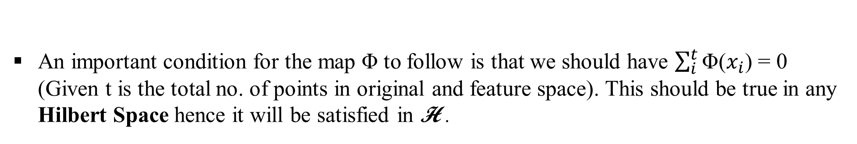
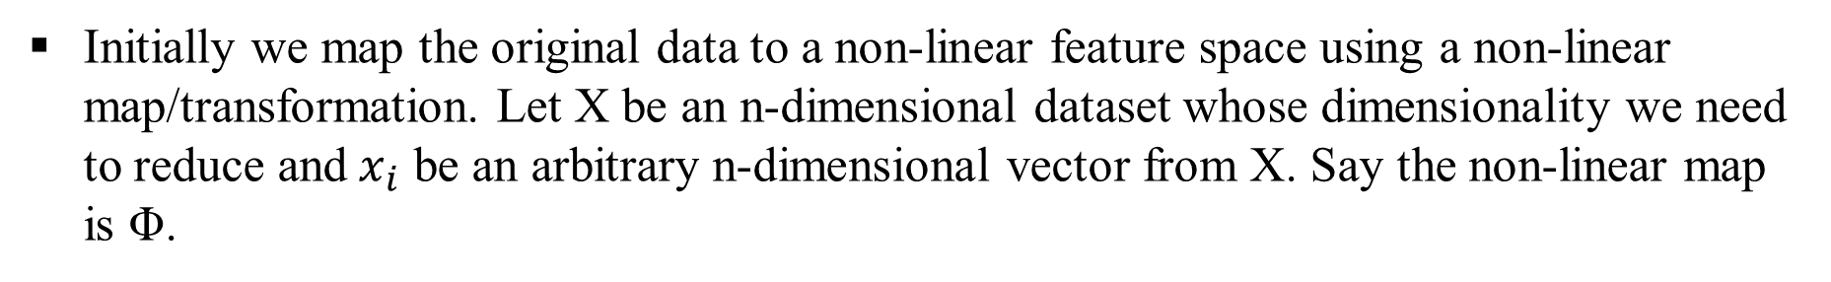
A Step-Wise Look at the mathematical formulation and entire working of Kernel PCA:
Initially we map the original data to a non-linear feature space using a non-linear map/transformation. Let X be an n-dimensional dataset whose dimensionality we need to reduce and${ x}_{i}$ be an arbitrary n-dimensional vector from X. Say the non-linear map is Φ.
Accordingly we define the map Φ as Φ : x →H. And hence, x ↦ Φ(x). H denotes a Hilbert space. Basically our feature space H. will have a orthogonal basis called Hilbert basis for which any Cauchy sequence picked from the vector space will be convergent to a point inside the space itself.
An important condition for the map Φ to follow is that we should have $\sum_{i}^{t}{\text{Φ}\text{(}x_{i}\text{) = 0}}$ (Given t is the total no. of points in original and feature space). This should be true in any Hilbert Space hence it will be satisfied in H .

Slide 28
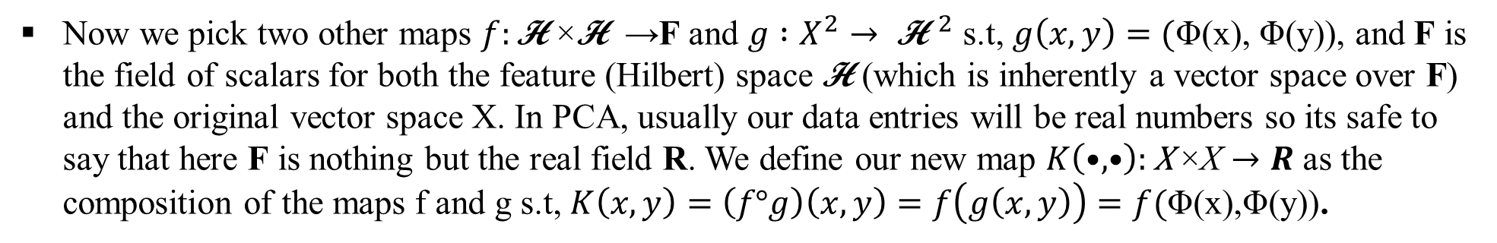
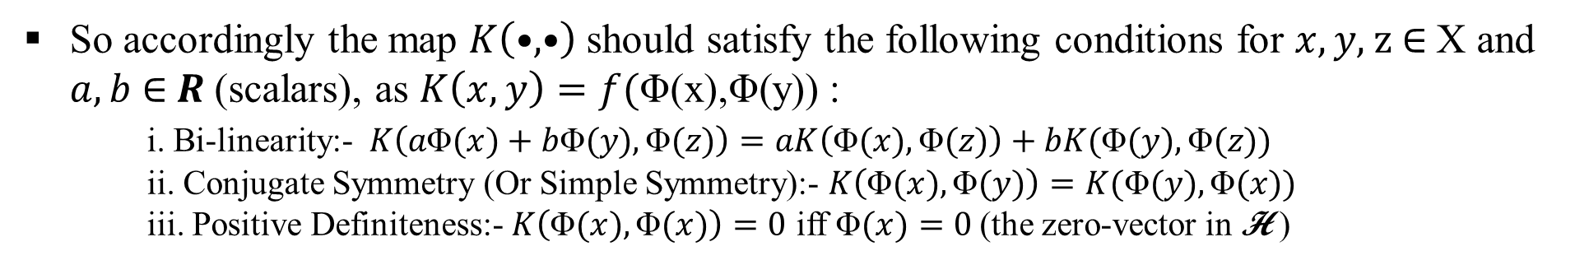
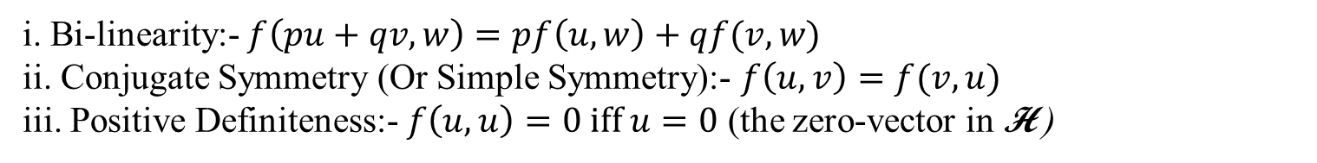
Now we pick two other maps $f:\text{H} \text{×}\text{H} \text{→}\text{F}$ and $g :X^{2}→ {\text{H}}^{ 2}$ s.t, $g\left(x,y\right)=($Φ(x), Φ(y)), and F is the field of scalars for both the feature (Hilbert) space $\text{H}$ (which is inherently a vector space over F) and the original vector space X. In PCA, usually our data entries will be real numbers so its safe to say that here F is nothing but the real field R. We define our new map $K\left(•,•\right):\text{X} \text{×}\text{X}→R$ as the composition of the maps f and g s.t, $K\left(x,y\right)=\left(f°g\right)\left(x,y\right)=f\left(g\left(x,y\right)\right)=f(\text{Φ}\text{(}\text{x}\text{)}\text{,}\text{Φ}\text{(}\text{y}\text{)}\text{)}$.
We define the map f in such a way that it satisfies the following conditions for $u,v,w \text{∈}\text{H}$ and $p,q \text{∈} \text{R}$ (scalars):
i. Bi-linearity:- $f\left(pu+qv,w\right)=pf\left(u,w\right)+qf(v,w)$
ii. Conjugate Symmetry (Or Simple Symmetry):- $f\left(u,v\right)=f(v,u)$
iii. Positive Definiteness:- $f\left(u,u\right)=0 iff u=0$ (the zero-vector in H )
So accordingly the map $K\left(•,•\right)$should satisfy the following conditions for $x,y\text{, }\text{z} \text{∈}$ X and $a,b$ $\text{∈} R$(scalars), as $K\left(x,y\right)=f(\text{Φ}\text{(}\text{x}\text{)}\text{,}\text{Φ}\text{(}\text{y}\text{)}\text{)}$:
i. Bi-linearity:- $K\left(a\text{Φ}(x)+b\text{Φ}(y),\text{Φ}(z)\right)=aK\left(\text{Φ}(x),\text{Φ}(z)\right)+bK(\text{Φ}(y),\text{Φ}(z))$
ii. Conjugate Symmetry (Or Simple Symmetry):- $K\left(\text{Φ}(x),\text{Φ}(y)\right)=K(\text{Φ}(y),\text{Φ}(x))$
iii. Positive Definiteness:- $K\left(\text{Φ}(x),\text{Φ}(x)\right)=0$ iff Φ$(x)=0$(the zero-vector in H )
P.S- Since $\text{Φ}$ is not a linear map so we don’t always necessarily have $\text{Φ}\text{(}ax\text{)=}a\text{Φ}(x)$

Slide 29
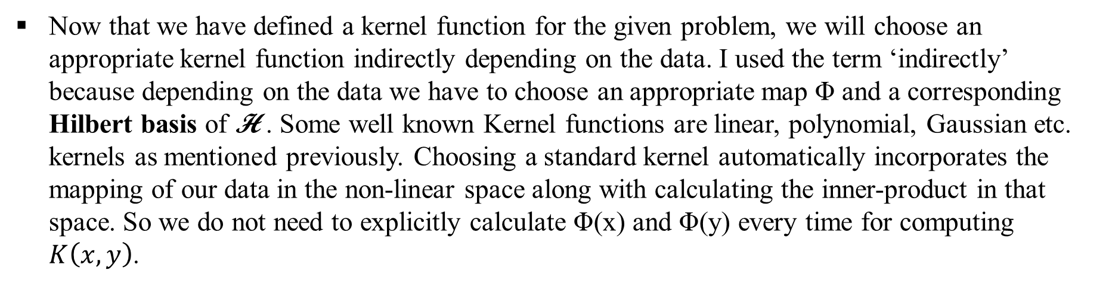
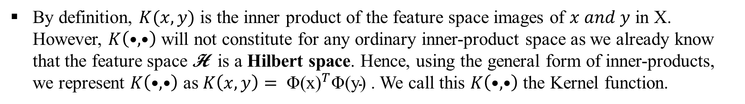
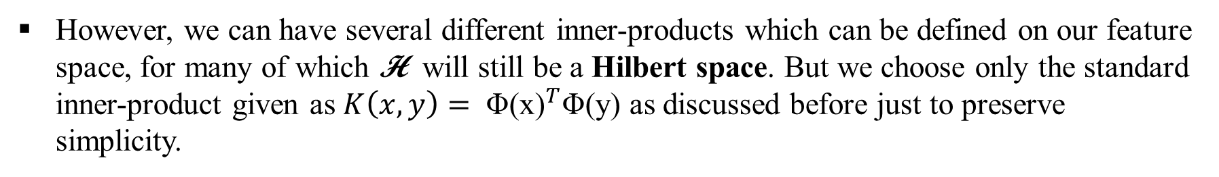
By definition, $K(x,y)$ is the inner product of the feature space images of $x and y$ in X. However, $K\left(•,•\right)$ will not constitute for any ordinary inner-product space as we already know that the feature space H is a Hilbert space. Hence, using the general form of inner-products, we represent $K\left(•,•\right)$ as $K\left(x,y\right)= {\text{Φ}\text{(}\text{x}\text{)}}^{T}\text{Φ}\text{(}\text{y}\text{)}$. We call this $K\left(•,•\right)$ the Kernel function.
Now that we have defined a kernel function for the given problem, we will choose an appropriate kernel function indirectly depending on the data. I used the term ‘indirectly’ because depending on the data we have to choose an appropriate map $\text{Φ}$ and a corresponding Hilbert basis of H . Some well known Kernel functions are linear, polynomial, Gaussian etc. kernels as mentioned previously. Choosing a standard kernel automatically incorporates the mapping of our data in the non-linear space along with calculating the inner-product in that space. So we do not need to explicitly calculate $\text{Φ}\text{(}\text{x}\text{)} \text{and} \text{Φ}\text{(}\text{y}\text{)}$ every time for computing $K\left(x,y\right)$.
However, we can have several different inner-products which can be defined on our feature space, for many of which H will still be a Hilbert space. But we choose only the standard inner-product given as $K\left(x,y\right)= {\text{Φ}\text{(}\text{x}\text{)}}^{T}\text{Φ}\text{(}\text{y}\text{)}$ as discussed before just to preserve simplicity.

Slide 30
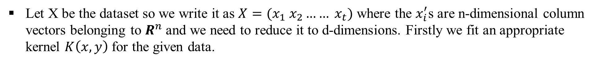
Now that we have defined what a kernel function is, we can now move on to the proper Kernel PCA algorithm :
Let X be the dataset so we write it as $X=(x_{1} x_{2}…… x_{t})$ where the $x_{i}^{′}$s are n-dimensional column vectors belonging to $R^{n}$ and we need to reduce it to d-dimensions. Firstly we fit an appropriate kernel $K\left(x,y\right)$ for the given data.
Centralization is an important aspect of PCA, so the centralized kernel $\tilde{K}$ is given as:
$$\tilde{K}\left(x,y\right)=K\left(x,y\right)−E_{x}\left[K\left(x,y\right)\right] −E_{y}\left[K\left(x,y\right)\right]+E_{x}\left[E_{y}[K\left(x,y\right)]\right]$$
Since these Kernels have some underlying distributions they follow so the marginal expectation of these Kernels can be easily calculated w.r.t both x and y as its often functions of the parameters of the distribution with the involvement of only one variable in each of these expectation forms.
Now we declare a matrix $K_{t\text{×}t}$ with entries $K_{ij}=\tilde{K}(x_{i},x_{j})$. We call this matrix the Kernel Matrix.

Slide 31
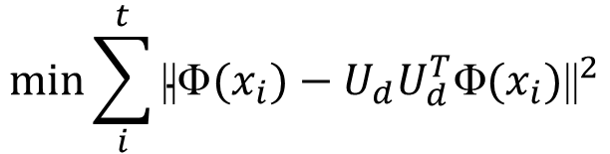
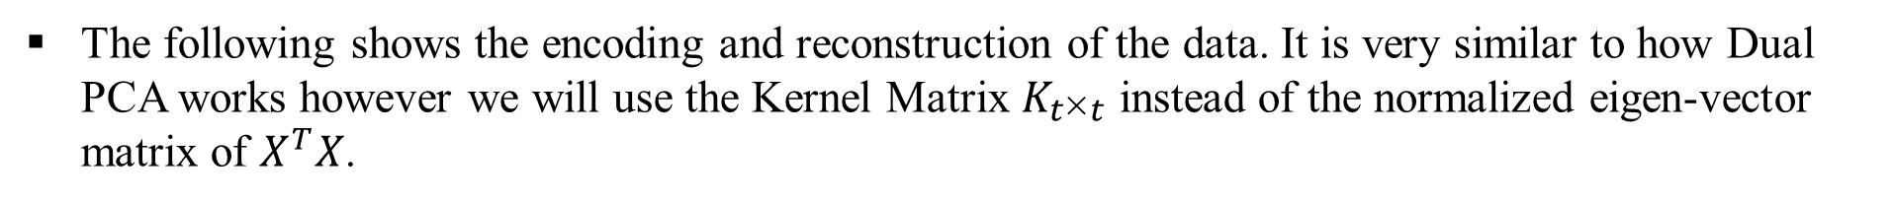
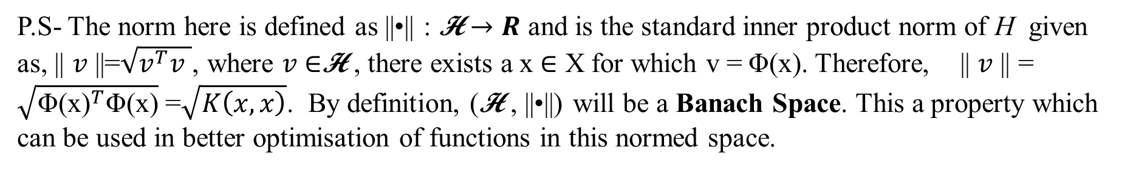
We attempt to minimize the squared reconstruction error using the model $f\left(y\right)=\overline{x}+U_{d}$y ($f\left(y\right)=U_{d}$y after centralization) , i.e,
$$\min{\sum_{i}^{t}{{\text{||}\text{Φ}(x_{i})−U_{d}U_{d}^{T}\text{Φ}(x_{i})\text{||}}^{2}}}$$
By performing partial optimization and L.S.E on this, we get an expression for encoded data.
P.S- The norm here is defined as ||•|| : H $→R$ and is the standard inner product norm of H given as, || $v$||=$\sqrt{v^{T}v }$, where $v$ $\text{∈}\text{H}$ , there exists a x $\text{∈} \text{X}$ for which v = $\text{Φ}\text{(}\text{x}\text{)}$. Therefore, || $v$|| = $\sqrt{{\text{Φ}\text{(}\text{x}\text{)}}^{T}\text{Φ}\text{(}\text{x}\text{)}}$ =$\sqrt{K\left(x,x\right)}$. By definition, (H , ||•||) will be a Banach Space. This a property which can be used in better optimisation of functions in this normed space.
The following shows the encoding and reconstruction of the data. It is very similar to how Dual PCA works however we will use the Kernel Matrix $K_{t\text{×}t}$ instead of the normalized eigen-vector matrix of $X^{T}X$.

Slide 32

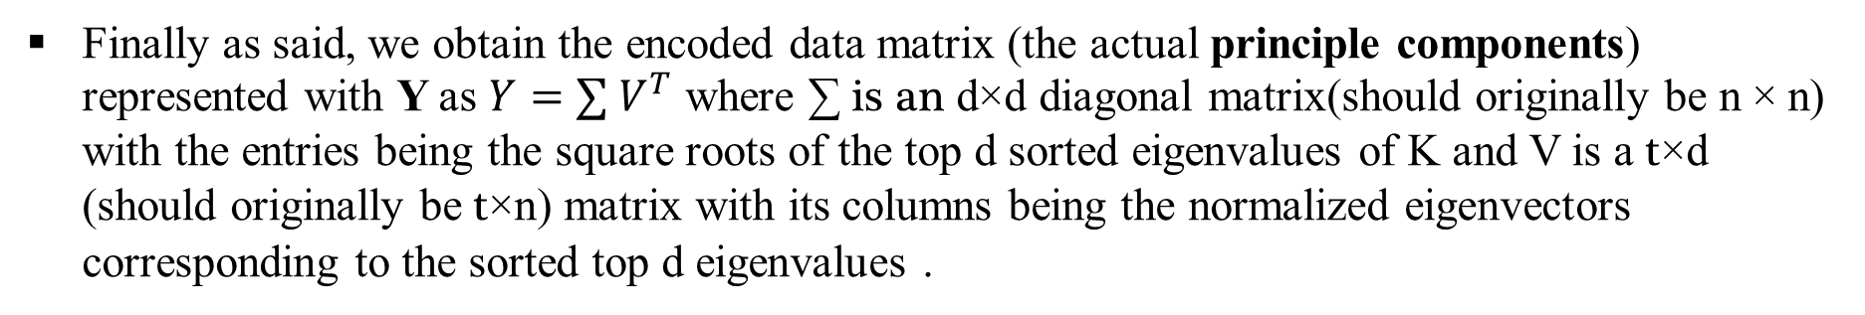
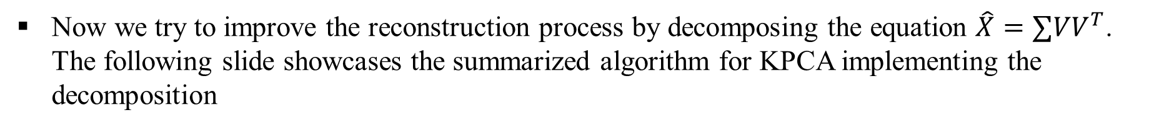
Finally as said, we obtain the encoded data matrix (the actual principle components) represented with Y as $Y=∑{ V}^{T}$ where ∑ is an d$\text{×}\text{d}$ diagonal matrix(should originally be n $\text{×}$n) with the entries being the square roots of the top d sorted eigenvalues of K and V is a t$\text{×}$d (should originally be t$\text{×}\text{n}$) matrix with its columns being the normalized eigenvectors corresponding to the sorted top d eigenvalues .
We can reconstruct the data accordingly as $\hat{X}=∑VV^{T}$ with minimum reconstruction error. However, the reconstruction process in Kernel PCA may be trickier than Ordinary PCA because of the inverse of the non-linear map $\text{Φ}$
Now we try to improve the reconstruction process by decomposing the equation $\hat{X}=∑VV^{T}$. The following slide showcases the summarized algorithm for KPCA implementing the decomposition
More mathematical insight on kernel functions have been provided in the report.

Slide 33
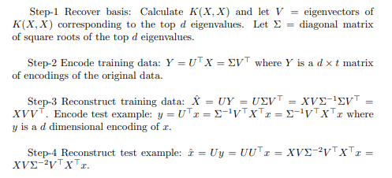
Algorithm(Summarized):

Slide 34
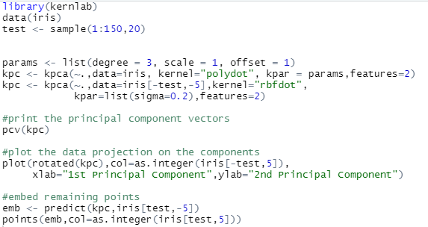
Implementation on practical dataset
We again use the Iris dataset and the help of R programming language to implement Kernel PCA on the dataset and study the new principal components. We will be using the Gaussian and Polynomial Kernels for our study.
R-Code for Implementation

Slide 35
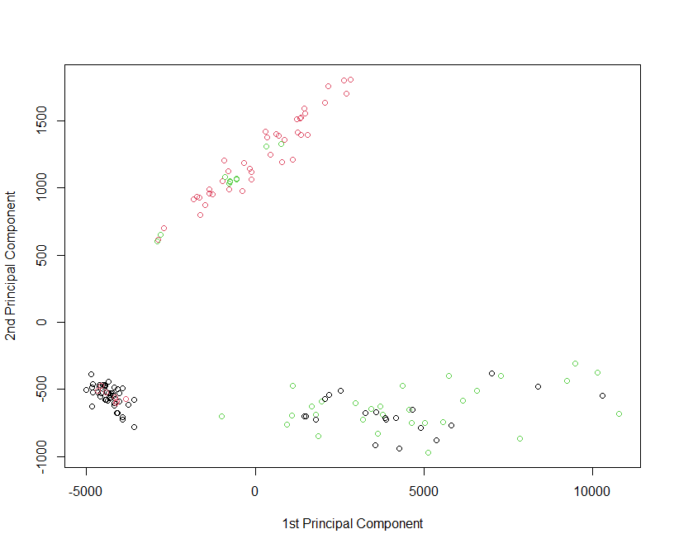
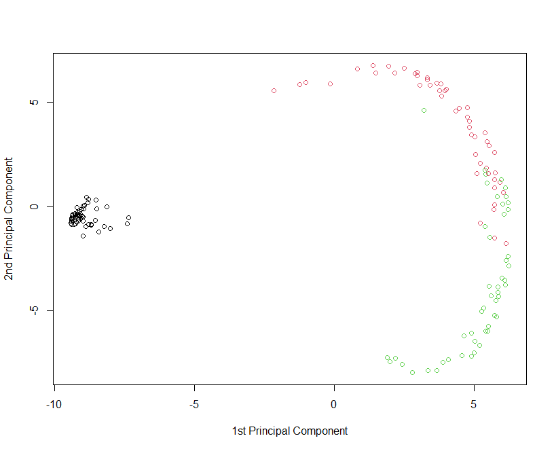
Original data rotated on Principal Components
Polynomial Kernel
Gaussian RBF Kernel

Slide 36
Comparative study of PCA and KPCA using k-NN classification:
Before we begin our comparative study, here is a brief summary of the k-nearest neighbourhood classification algorithm:
The KNN Algorithm:
1. Load the data
2. Initialize K to the chosen number of neighbors
3. For each example in the data:
3.1. Calculate the distance between the query example and the current example from the data.
3.2. Add the distance and the index of the example to an ordered collection.
4. Sort the ordered collection of distances and indices from smallest to largest (in ascending order) by the distances
5. Pick the first K entries from the sorted collection
6. Get the labels of the selected K entries
7. If regression, return the mean of the K labels
8. If classification, return the mode of the K labels

Slide 37
Summary of the comparative study:
Ordinary k-Nearest Neighborhood classification of Iris Data – High Computational Complexity
Recorded Time: 0.11 seconds , Recorded Accuracy: 90 - 96.67 % (taken at k=7, the optimum for this dataset) for classification.
PCA performed to reduce dimensionality of Iris Data.
kNN algorithm on new data is less complex computationally but also less accurate.
Recorded Time: 0.6 seconds, Recorded Accuracy: 81.6 - 94.7 % (also at k=7).
KPCA performed on Iris Data to reduce its dimensionality.
kNN algorithm on new data is less complex computationally and also almost as accurate as ordinary kNN.
Recorded Time: 0.6 seconds, Recorded Accuracy: 91.9 - 94.6 % (at k=7).
We infer from here that Kernel PCA is almost as accurate as ordinary kNN algorithm on practical data-sets like the Iris data-set while having almost the same execution time as PCA with kNN classification.
P.S – The entire implementation was performed in the R programming language and the associated code is attached in the report.

Slide 38
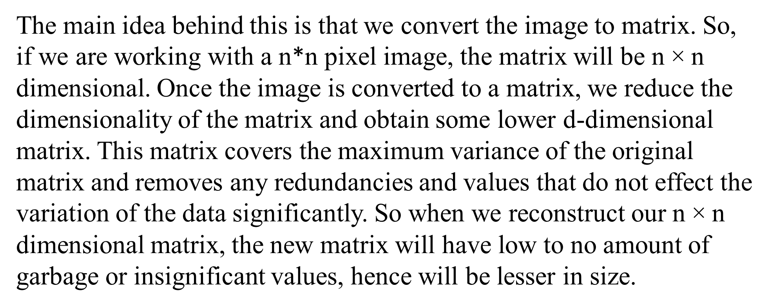
Image Compression using Dimensionality Reduction
The main idea behind this is that we convert the image to matrix. So, if we are working with a n*n pixel image, the matrix will be n $\text{×}$n dimensional. Once the image is converted to a matrix, we reduce the dimensionality of the matrix and obtain some lower d-dimensional matrix. This matrix covers the maximum variance of the original matrix and removes any redundancies and values that do not effect the variation of the data significantly. So when we reconstruct our n $\text{×}$n dimensional matrix, the new matrix will have low to no amount of garbage or insignificant values, hence will be lesser in size.

Slide 39

The original picture of size 9.7kB we are looking to compress

Slide 40
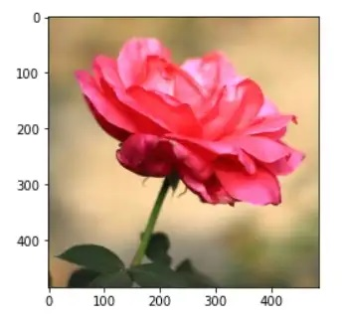
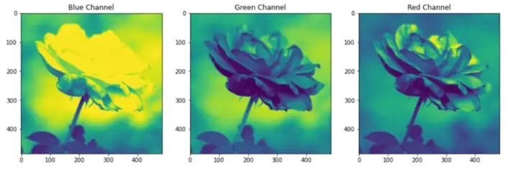
The original picture with calibration
The picture divided in RGB channels

Slide 41
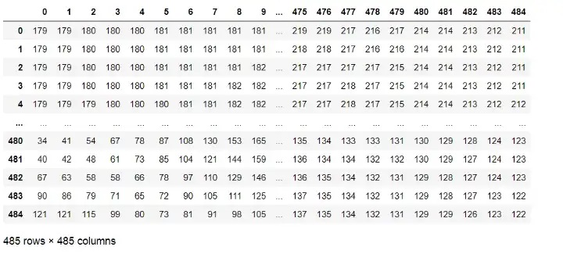
The matrix corresponding to the blue channel

Slide 42
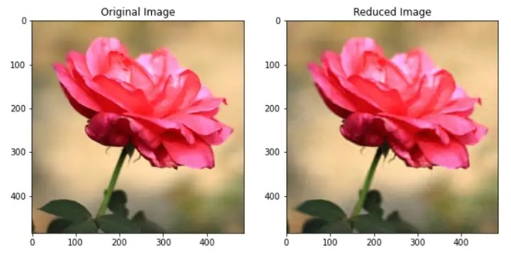
Original vs Reduced Image Before and After PCA
Size of Original Image: 9.7kB
Size of Reduced Image: 4.7kB
P.S- The code for reduction of dimensionality and reconstruction through PCA was done in the Python language, the associated code is provided in the report

Slide 43
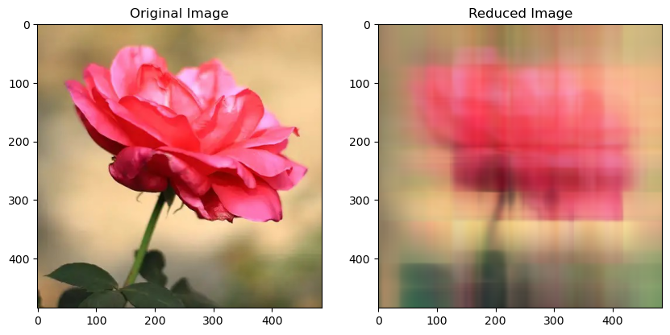
Original vs Reduced Image Before and After Kernel PCA
The Same Action performed through Kernel PCA (Polynomial Kernel) produces a worse result due to the linearity in the image matrix. The code done in Python is once again attached in the report.

Slide 44
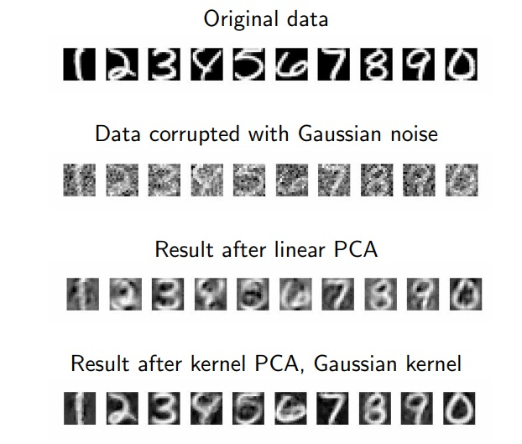
Kernel PCA however can be a much better option for face-image recognition and image de-noising as illustrated in the following example:
Ordinary PCA vs Kernel PCA for de-noising an image

Slide 45
Conclusion
Through this study we can conclude that for the visualisation or classification of realistic datasets which have an underlying non-linear pattern, Kernel Principal Component Analysis is by far the more viable option as it has marginally higher computational complexity while providing significantly higher accuracy than Ordinary Principal Component Analysis. On the other hand Ordinary Principal Component Analysis is better at handling relatively linear data. In Image processing, Ordinary PCA yields better results for the compression of realistic high quality pictures while Kernel PCA can prove much better for de-noising corrupted pictures. Both PCA and KPCA find significant applications in Machine Learning and Data Analytics and are hence the most widely used dimensionality reduction techniques used in ML. Dimensionality Reduction in general is one of the most demanding applications of Linear Algebra providing a handy tool for dealing with complex data to the data scientists.

Slide 46


