Slide 1
Using a Morlet function based kernel in Kernel PCA to de-noise images
Presented By,
Biswajit Rana
MSc Big Data Analytics (B2330026)
And
Uddalak Mukherjee
MSc Big Data Analytics (B2330042)

Slide 2
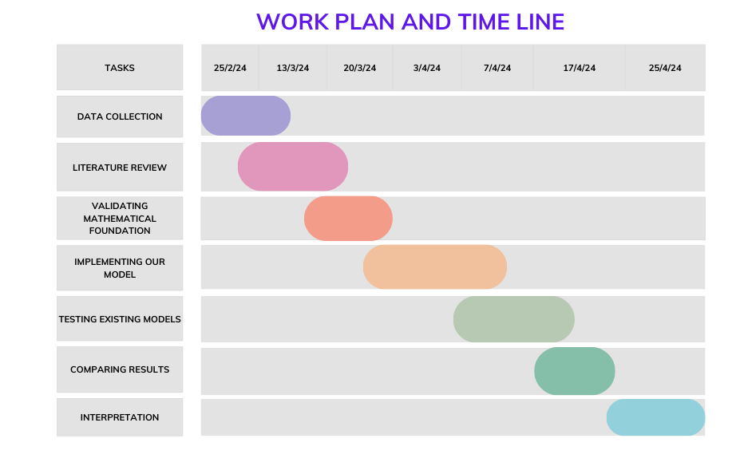

Slide 3
Work plan and Time line :
Data Collection – 1week
Literature Review -1week
Validating Mathematical Foundation – 1 weeks
Testing existing models – 3 days
Implementing our proposed algorithm in Python – 2weeks
Comparing Results – 2 days
Interpretation - 1 week

Slide 4
Work plan division in our group:
Data Collection : Uddalak Mukherjee
Literature Review : Both
Validating Mathematical Foundations : Uddalak Mukherjee
Implementation in Python : Biswajit Rana
Comparison with other models : Biswajit Rana
Interpretation of Results : Both

Slide 5
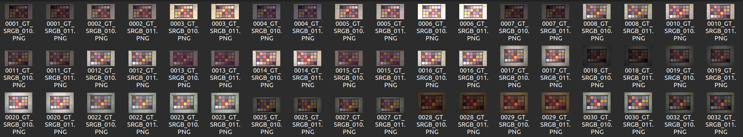
Data Collection:
We have collected the data from https://abdokamel.github.io/sidd/
Data contains 320 pairs of Noisy and True images.
Images are from various scene with
different brightness, Exposureand lighting.
Zoomed Noisy Image
Zoomed True Image

Slide 7
Thank You

