Slide 1
Using a Morlet function based kernel in Kernel PCA to de-noise images
Presented By,
Biswajit Rana
MSc Big Data Analytics (B2330026)
And
Uddalak Mukherjee
MSc Big Data Analytics (B2330042)

Slide 2
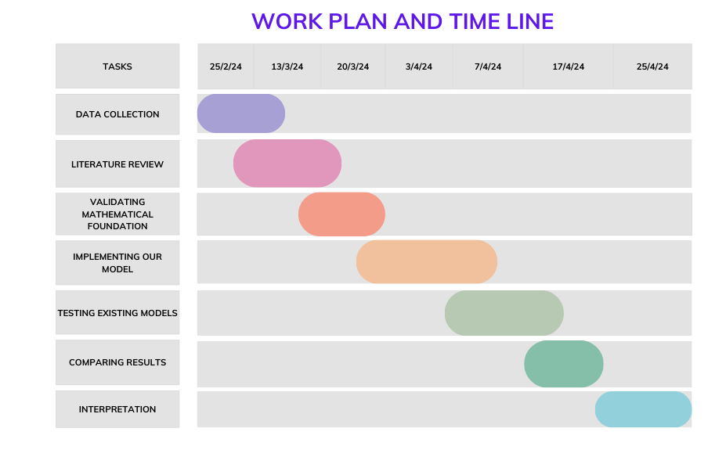

Slide 3
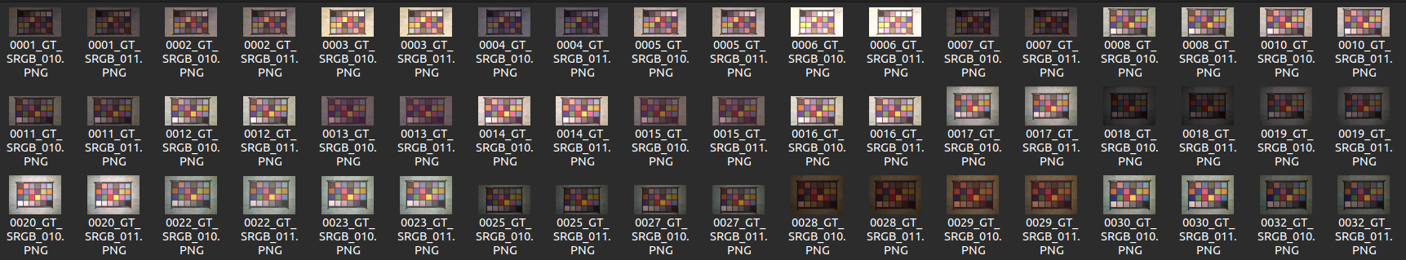

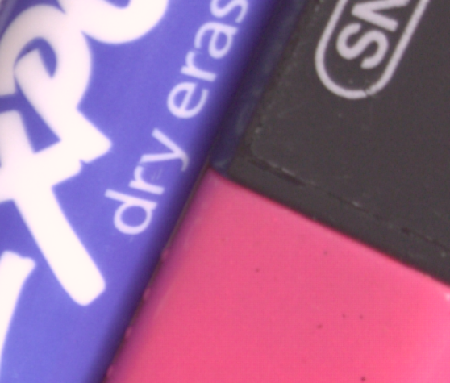
Data Collection:
We have collected the data from https://abdokamel.github.io/sidd/
Data contains 320 pairs of Noisy and True images.
Images are from various scenes with
different brightness, Exposure and lighting. Given sample of one scene.
Zoomed Noisy Image
Zoomed True Image

Slide 4
Literature Review :
We Are studying these 3 papers to get more knowledge about the Data and the Dimentionality Reduction model.
[1] S.Krishnan P.Lio S.Xie, A.T.Lawniczak. “Wavelet kernel principal component analysis in noisy multiscale data classification.” ISRN Computational Mathematics, 259:4–6,2012.
[2] P.Li Y.Tang T.You, Y.Hu. “An improved imperialist competitive algorithm for global optimization.” Turkish Journal of Electrical Engineering and Computer Science, pages 5–6, 2019.
[3]Abdelhamed, Abdelrahman, Stephen Lin, and Michael S. Brown. "A HighQuality Denoising Dataset for Smartphone Cameras." Proceedings of the IEEE Conference on Computer Vision and Pattern Recognition. 2018, pp. 1692-1700.

Slide 5
Validating Mathematical Foundation:

Slide 6
Thank You

