Slide 1

TableTalk
Question Answering on Tabular Data
$$T^{3}$$
The Table Turners
Anurag Joardar Biswajit Rana Rakesh Nemu

Slide 2
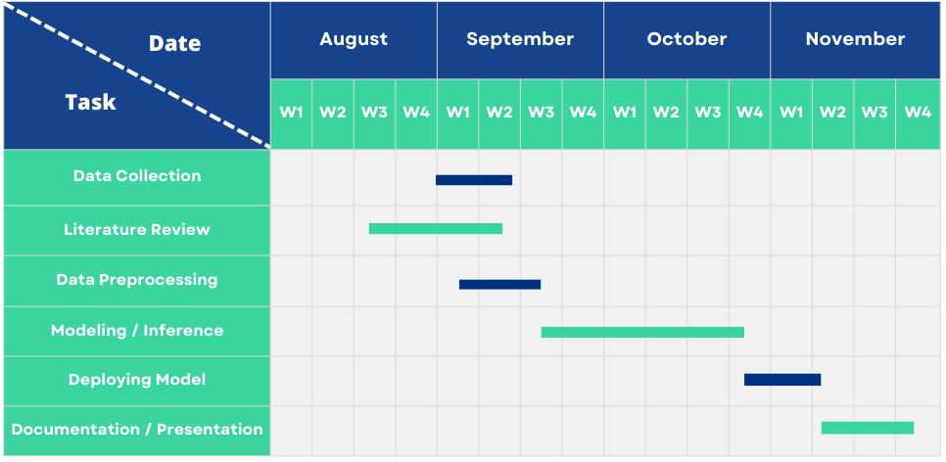
Timeline

Slide 3
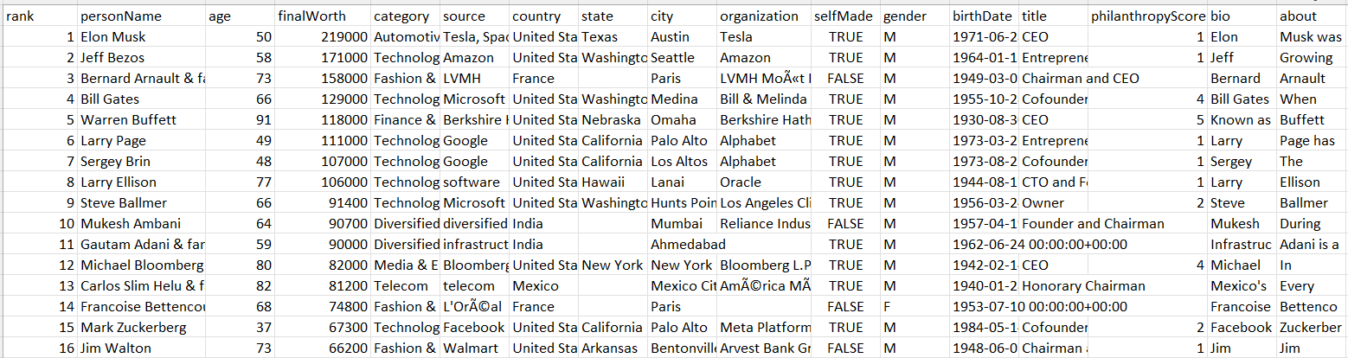
Dataset (Released)
FEATURES (with example)
QUESTION : Does the youngest billionaire identify as male?
ANSWER : True
TYPE : Boolean
COLUMNS_USED : ['age', 'gender']
COLUMN TYPES : ['number[UInt8]', 'category']
SAMPLE ANSWER : True
DATASET : '001_Forbes
Total Datasets : 64
Total No. of Questions : 1200 Approx
Sample Dataset

Slide 4
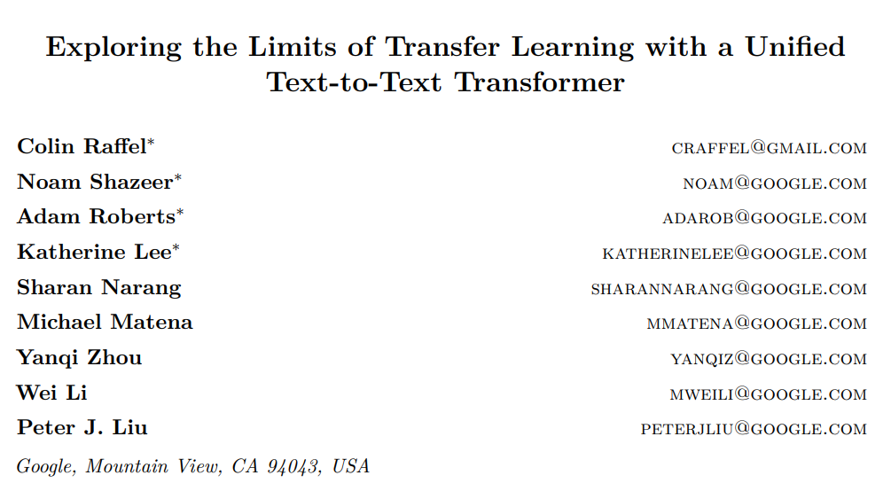
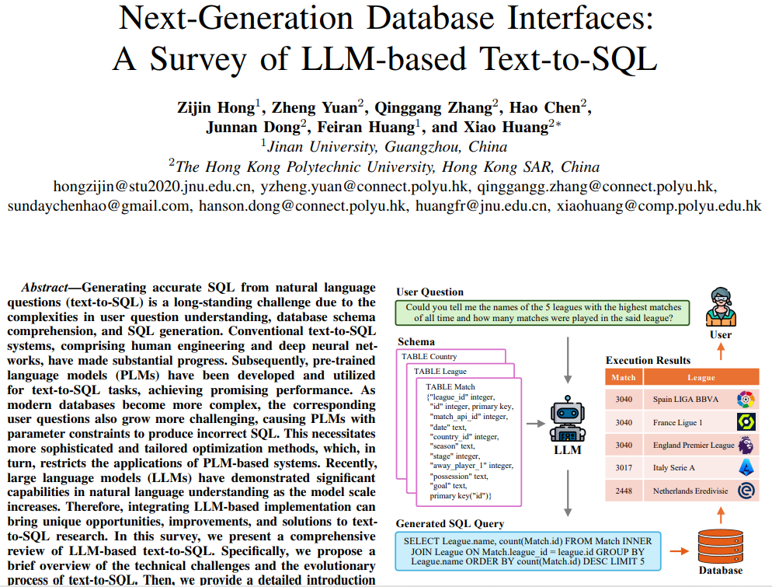
Literature Review
Exploring the Limits of Transfer Learning with a Unified Text-to-Text Transformer, Colin Raffel, Noam Shazeer, Adam Roberts, Katherine Lee, Sharan Narang, Michael Matena, Yanqi Zhou, Wei Li and Peter J. Liu,2023
Next-Generation Database Interfaces: A Survey of LLM-based Text-to-SQL, Zijin Hong, Zheng Yuan, Qinggang Zhang, Hao Chen, Junnan Dong, Feiran Huang and Xiao Huang,2024

Slide 5



Model Pipeline
INPUT: DATASET
USER
OUTPUT : Result on Query
INPUT : Schema
OUTPUT : Query
INPUT: Natural Language Question

Slide 6
Model
Pre – Trained Model : T5-LM-Large-text2sql-spider trained on Spider 1.0 Dataset.
Question : How many concerts in India ?
Schemas :
Stadium : "Stadium_ID" int , "Location" text , "Name" text , "Capacity" int , "Highest" int , "Lowest" int , "Average" int , foreign_key: primary key: "Stadium_ID"
Singer : "Singer_ID" int , "Name" text , "Country" text , "Song_Name" text , "Song_release_year" text , "Age" int , "Is_male" bool , foreign_key: primary key: "Singer_ID"
Concert : "concert_ID" int , "concert_Name" text , "Theme" text , "Year" text , foreign_key: "Stadium_ID" text from "stadium" "Stadium_ID" , primary key: "concert_ID“
Singer_in_concert : foreign_key: "concert_ID" int from "concert" "concert_ID" , "Singer_ID" text from "singer" "Singer_ID" , primary key: "concert_ID" "Singer_ID"
SQL Query : "SELECT count(*) FROM concert WHERE country = 'India'"

Slide 7
Work Division
Data Collection : Rakesh Nemu and Biswajit Rana
Literature Review : All
Modelling : Biswajit Rana and Anurag Joardar

Slide 8
Thank you
Any Query?

