Slide 1

TableTalk
Question Answering on Tabular Data
$$T^{3}$$
The Table Turners
Anurag Joardar Biswajit Rana Rakesh Nemu

Slide 2

Motivation
Organizations rely heavily on structured data stored in tabular formats, such as databases and spreadsheets, to make informed decisions
Accessing this data often requires technical expertise, particularly in querying languages like SQL.
Creates a barrier for non-technical users who need to interact with data quickly and effectively.

Slide 3

Objective
To develop a model that accurately answers natural language questions by extracting and interpreting relevant information from structured tabular data.
Develop a deep learning model or use a pre-trained one for extracting and interpreting relevant information from structured tabular data
Integrate the model into a user-friendly system, ensuring it handles various types of questions and table formats accurately.

Slide 4
INPUT Table Question Answering Model Output
Rank | Name | No.of reigns | Combined days
1 | lou Thesz | 3 | 3749
2 | Ric Flair | 8 | 3103
3 | Harley Race | 7 | 1799
Question: What is the number of reigns for Harley Race?
Result : 7

Slide 5
Methodology
Data Collection and Preprocessing
Collection of Dataset will be released on 2nd of September, 2024 (Databench, SemEval25)
Model Development
Structured Query Model: Design a model that translates natural language questions into structured queries like SQL. The model could be a seq2seq transformer that generates SQL queries based on input questions.
Pre-trained Language Models with Structured Data: Leverage pre-trained language models with additional structured data representations. This can be done by converting tabular data into a text format that the model can process.
Graph-based Approach: Convert the table into a graph, with nodes representing cells or entire rows and edges representing column relationships. Use the GNN to predict answers or relevant nodes.
Model Deployment
Develop a web-based application for real-time QA over any input tabular data.

Slide 6
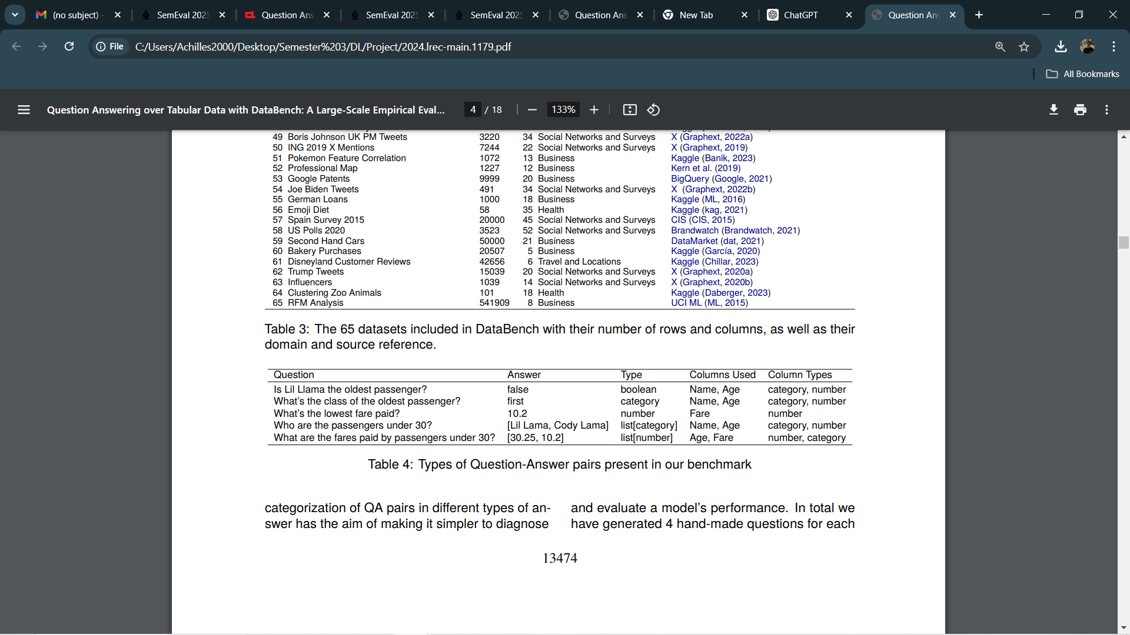
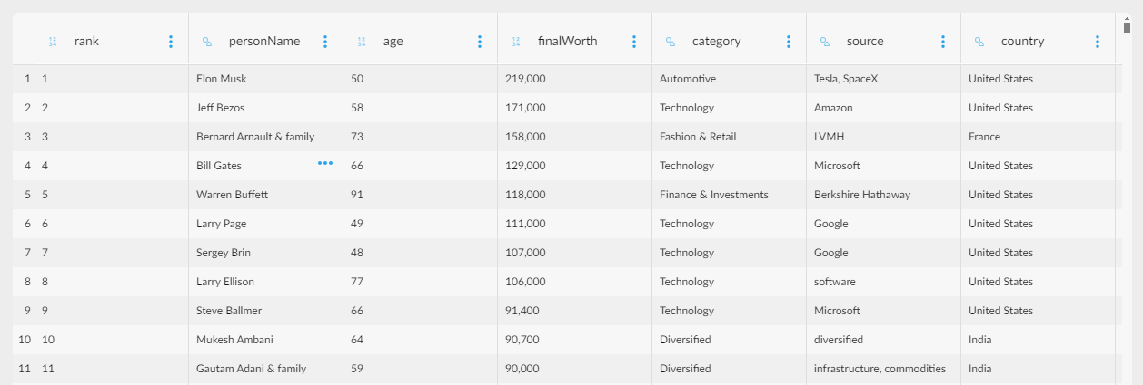
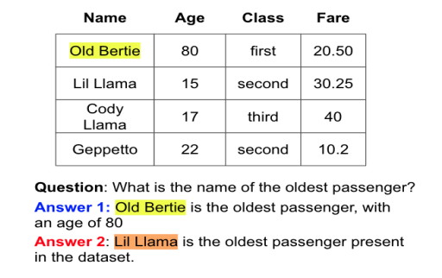
Dataset
The paper proposes DataBench, a benchmark composed of
65 real-world datasets over several domains, including
20 human-generated questions per dataset, totaling
1300 questions and answers overall.
Sample Data

Slide 7
SemEval 2025 Tasks
Subtask I: DataBench QA involves answering questions using data from a dataset of any size. The focus is on accurately extracting and interpreting information from the entire dataset to provide a correct response.
Subtask II: DataBench Lite QA requires answering questions using a sampled version of the dataset, limited to a maximum of 20 rows. This task emphasizes efficiency and precision in handling smaller datasets, particularly useful for models with smaller window sizes.

Slide 8
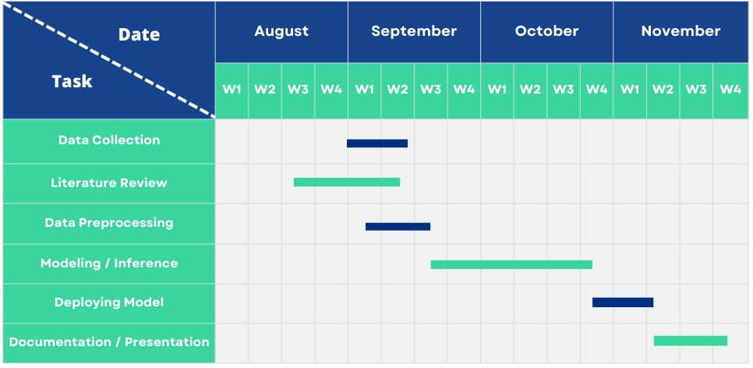
Timeline

Slide 9
Work Division
We plan on working collaboratively and later we would divide the tasks based on each other's strength and weakness.

Slide 10
Thank you
Any Query?

