Slide 1

Question Answering on Tabular Data
$T^{3}$
The Table Turners
Anurag Joardar Biswajit Rana Rakesh Nemu

Slide 2

Motivation
Organizations rely heavily on structured data stored in tabular formats, such as databases and spreadsheets, to make informed decisions
Accessing this data often requires technical expertise, particularly in querying languages like SQL.
Creates a barrier for non-technical users who need to interact with data quickly and effectively.

Slide 3

Objective
To develop a model that accurately answers natural language questions by extracting and interpreting relevant information from structured tabular data.
Develop a deep learning model or use a pre-trained one for extracting and interpreting relevant information from structured tabular data
Integrate the model into a user-friendly system, ensuring it handles various types of questions and table formats accurately.

Slide 4
Methodology
Data Collection and Preprocessing
Collection of Dataset will be released on 2nd of September, 2024 (Databench, SemEval25)
Model Development
Structured Query Model: Design a model that translates natural language questions into structured queries like SQL. The model could be a seq2seq transformer that generates SQL queries based on input questions.
Pre-trained Language Models with Structured Data: Leverage pre-trained language models with additional structured data representations. This can be done by converting tabular data into a text format that the model can process.
Graph-based Approach: Convert the table into a graph, with nodes representing cells or entire rows and edges representing column relationships. Use the GNN to predict answers or relevant nodes.
Model Deployment
Develop a web-based application for real-time phishing QA over any input tabular data.

Slide 5
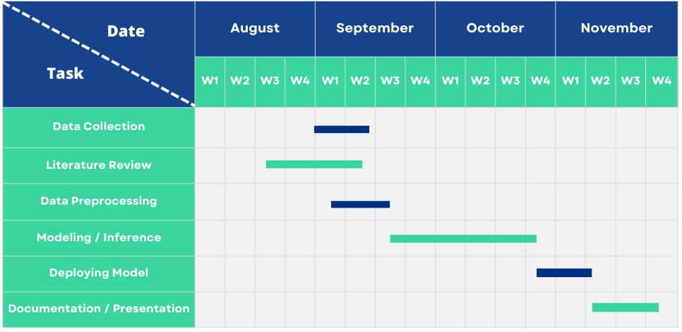
Timeline

Slide 6
Work Division
We plan on working collaboratively and later we would divide the tasks based on each other's strength and weakness.

Slide 7
Thank you
Any Query?

