Slide 1

TableTalk
Question Answering on Tabular Data
$$T^{3}$$
The Table Turners
Anurag Joardar Biswajit Rana Rakesh Nemu

Slide 2
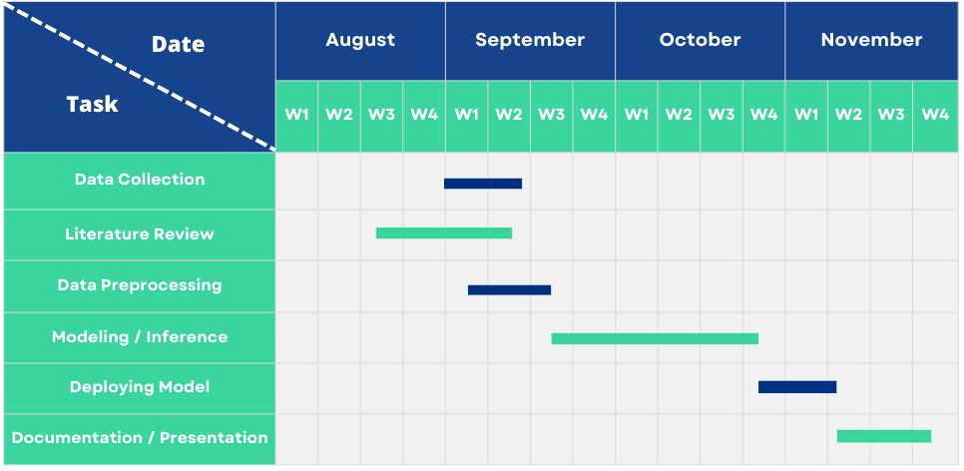
Timeline

Slide 3

Motivation
To adapt techniques to effectively handle the unique characteristics of tabular data.
Organizations rely heavily on structured data stored in tabular formats, such as databases and spreadsheets, to make informed decisions
Accessing this data often requires technical expertise, particularly in querying languages like SQL.
Creates a barrier for non-technical users who need to interact with data quickly and effectively.

Slide 4

Objective
To develop a model that accurately answers natural language questions by extracting and interpreting relevant information from structured tabular data.
Develop a model using a fine-tuned Small-T5 large language model (LLM) to translate natural language queries into SQL.
Develop an end-to-end application using Streamlit, enabling users to interact seamlessly with the system in a user-friendly interface

Slide 5
Literature Review
Several advancements have been made in natural language-to-SQL (text-to-SQL) systems:
Seq2SQL,Victor Zhong et al.(2017): A sequence-to-sequence model designed for text-to-SQL tasks, with a focus on generating structured queries from natural language inputs.
SQLNet ,Xiaojun Xu et al.(2018): This paper addresses the "order-matters" problem in SQL query synthesis by replacing sequence-to-sequence models with a sketch-based approach where the sketch contains a dependency graph so that one prediction can be done by taking into consideration only the previous predictions that it depends on and a sequence-to-set model, enhancing accuracy in converting natural language to SQL for tabular data

Slide 6
Literature Review
Spider Dataset, Tao Yu et al.(2018): A complex dataset designed to evaluate cross-domain text-to-SQL performance, promoting the development of models like RAT-SQL(Relation-Aware Transformer for SQL),a model designed to improve text-to-SQL tasks by incorporating relational awareness. It enhances the ability of models to understand the relationships between tables and columns in a database when translating natural language queries into SQL.
T5, Colin Raffel et al.(2019):Due to its text-to-text framework, pretraining on diverse text tasks, and sequence-to-sequence architecture, which enable it to effectively convert natural language into structured SQL queries.

Slide 7
Literature Review
Instruction Tuning for LLM,Shengyu Zhang et al.(2023): Instruction tuning (IT) is a method for enhancing the performance of large language models (LLMs) by fine-tuning them on datasets consisting of (instruction, output) pairs, bridging the gap between LLMs' next-word prediction objectives and users' task-specific goals. It has been applied across various domains, improving model controllability and alignment with human intent. However, challenges such as dataset size, task diversity, and generalization remain, with ongoing research focusing on addressing these issues. Critics highlight the risk of overfitting and the need for more robust and diverse training strategies to improve IT outcomes.

Slide 8
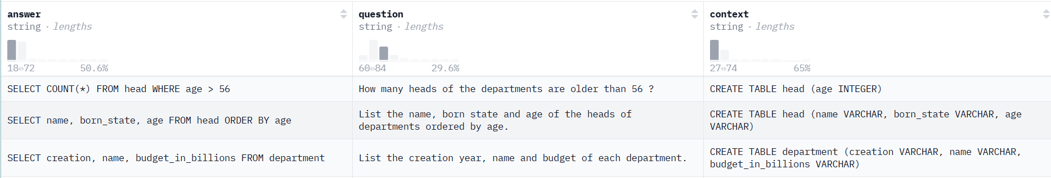
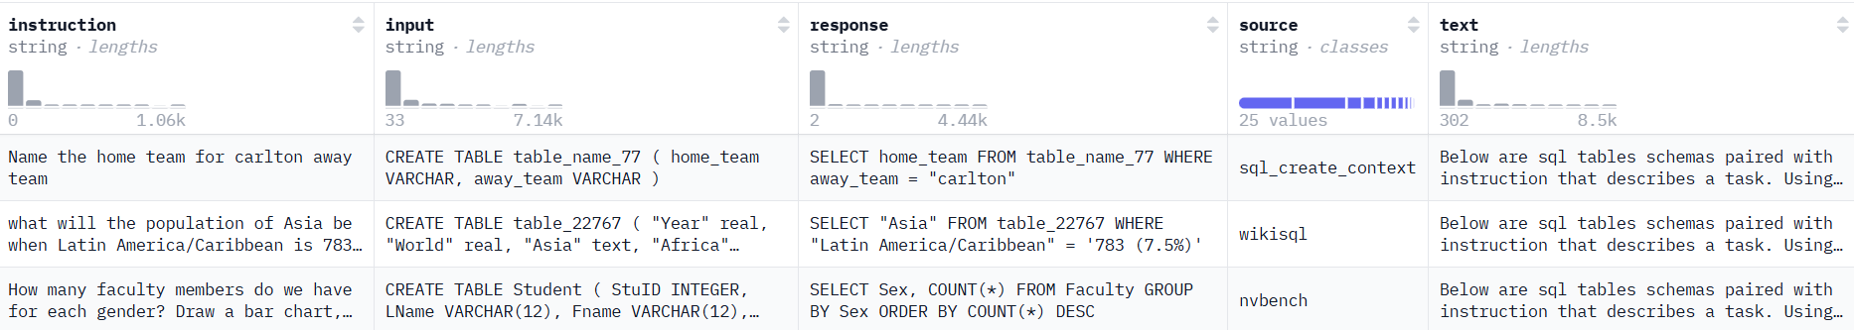
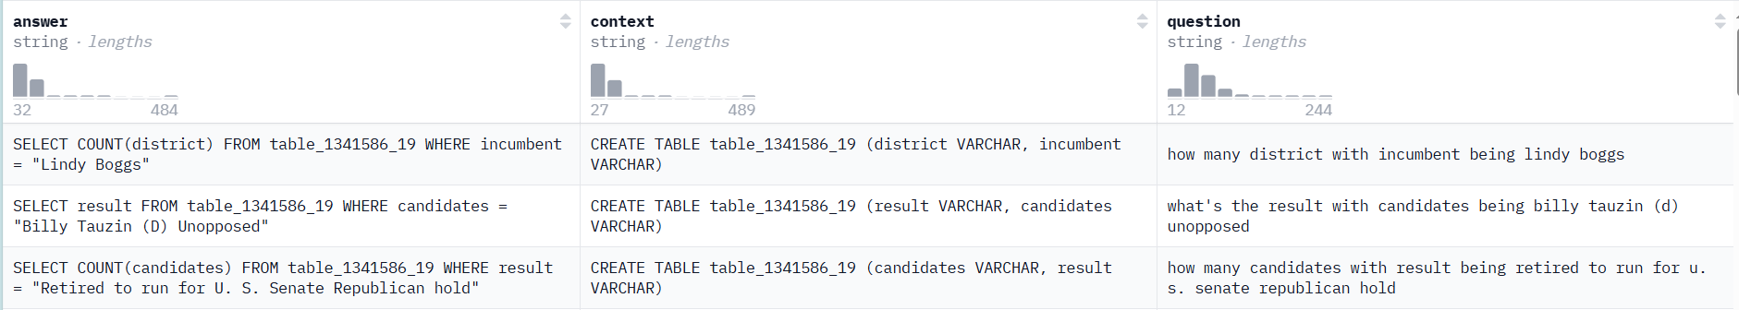
Dataset
SCC (SQL Create Context):
Focus: SQL query generation from given contexts.
Source: Hugging Face repository.
TTS (Text-to-SQL):
Focus: SQL queries derived from natural language instructions.
Preprocessing: Retained essential columns – question, context, and answer.
KS (Know-SQL):
Focus: Validation data split into training, validation, and testing subsets.

Slide 9
Dataset Handling
Loading Pre-trained Model and Tokenizer
Model: t5-small model (60 million parameters).
Tokenizer: Loaded AutoTokenizer for tokenizing input and output sequences.
Tokenization
Input Construction:
For each example, constructs a prompt in the format:
Tables:\n<CONTEXT>\n\nQuestion:\n<QUESTION>\n\nAnswer:\n.
Converts the prompts into input IDs using the tokenizer, with padding and truncation.
Output Tokenization:
Tokenizes the answer column as labels for the model output.

Slide 10



Model Pipeline
INPUT: DATASET
USER
OUTPUT : Result on Query
INPUT : Schema
OUTPUT : Query
INPUT: Natural Language Question

Slide 11
Methodology
Input:
Natural Language Query (NLQ): A user-friendly question or request.
Table Name: Identifies the relevant table within the database.
Processing:
The NLQ is fed into a fine-tuned Small-T5 LLM.
Schema information of the target table (columns, data types, etc.) is retrieved from the MySQL database and fed to the LLM alongside the NLQ.
The LLM generates a corresponding SQL query.

Slide 12
Methodology
Execution :
The generated SQL query is executed against the MySQL database to fetch results.
The results are returned to the user in a structured format.
Fine-Tuning :
The pretrained LM, Small-T5 model is fine-tuned using the instruction based full fine tune technique on 3 standard text-to-SQL datasets named sql-create-context, know sql, Text-to-sqlv1 from Hugging Face.

Slide 13
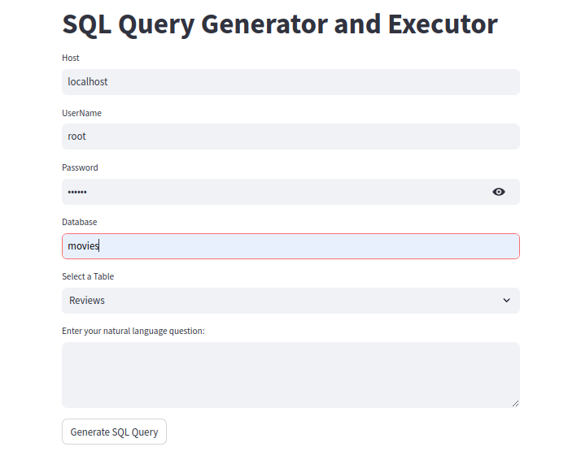
Methodology
Application Development:
An end-to-end application was developed using Streamlit to provide a user-friendly interface. The application allows users to input their natural language queries and table names, view the corresponding SQL query generated, and access the results retrieved from the MySQL database seamlessly.

Slide 14
Experimental Setting
Environment: Kaggle notebook equipped with a Tesla P100 GPU.
Training Processing Time: Around 12 hours, running for nearly 1 epoch due to resource constraints.
Hyperparameters:
•Pre-trained Model: t5-small
• Optimizer: AdamW (Adam with Weight Decay Regularization: 0.01)
• Batch Size: 16.
• Learning Rate: 0.005.
• Evaluation Steps: 500.

Slide 15
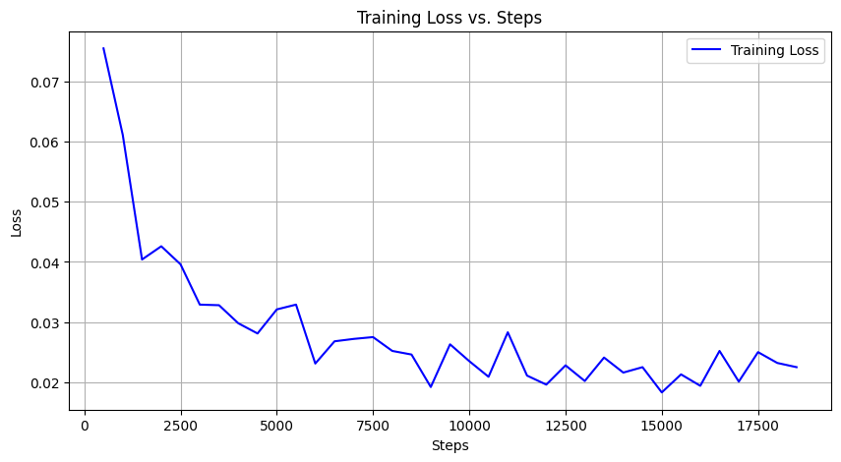
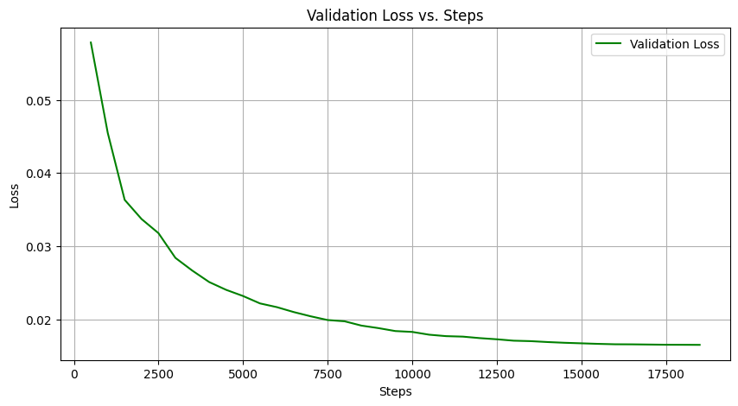
Results
Training Loss Vs Validation Loss

Slide 16
Results
Evaluation Metrics : ROUGE scores, which are widely used for text generation tasks.
ROUGE Score:
• ROUGE-1: 0.9964
• ROUGE-2: 0.9961
• ROUGE-L: 0.9964
• ROUGE-Lsum: 0.9964
Both ROUGE-1 and ROUGE-2 scores reflect strong unigram and bigram overlap .
ROUGE-L and ROUGE-Lsum scores highlight the model's ability to generate syntactically correct and contextually meaningful output.
Testing Dataset : A dataset of 39,023 instances.

Slide 17
Time Complexity
The time complexity of the model during inference depends on the size of the input and the maximum number of tokens generated.
Tokenization: O(n), where n is the length of the input text.
Model Inference: O(n2d + mnd) per layer, where d is the model's embedding size and maximum number of tokens to be generated m.
Decoding: O(m)
Inference Processing Time per Instance : Including context and a input question, took approximately 2.3 seconds on an NVIDIA GTX 1650 GPU.

Slide 18
Future Works
User will be able to input structured data to be loaded into the SQL Database without any Schema Knowledge.
Multi Table Question Answering.
Train Model with more datasets and more epochs.

Slide 19
DEMO

Slide 20
Thank you
Any Query?

