Slide 1

Software Development Work on various Voice Technology Based Platform
Supervisor : Mousmita Sarma
Name : Biswajit Rana
Roll No.: B2330026
M.Sc. Big Data Analytics

Slide 2

Contents
1
CALL AI : Implementing notes feature in CallAI Project.
TRANSCRIPTION TOOL :
Implementing Spellchecking for different regional languages in transcription tool project along with several updates in the website.
ASR model testing.

Slide 3
Call AI
Implementing a notes saving feature in the transcribe page
TRANSCRIPTION TOOL :
Implementing Spellchecking for different regional languages in transcription tool project along with several updates in the website.
ASR model testing.

Slide 4
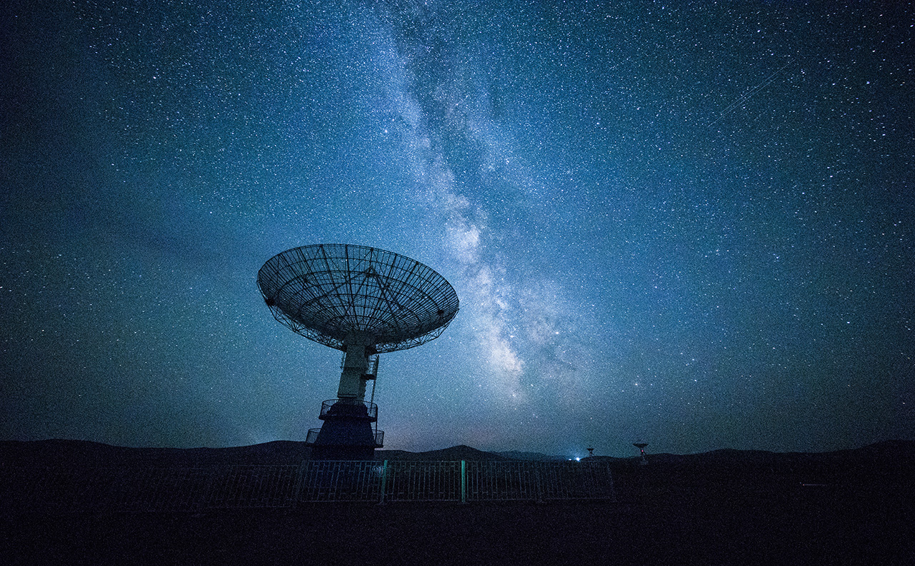
Network Technology
Problem Solving
Algorithm
Automation

Slide 5

Thank You!
someone@example.com

