Slide 1
Di-Gait-Tron
Bipedal Walker with DeepRL algorithm
Biswajit Rana
B2330026
Debayan Datta
B2330027

Slide 2
Details of the Agent and Environment

Slide 3
Details of the Agent and Environment :
Description: This is a simple 4-joint walker robot environment. There are two versions:
Normal, with slightly uneven terrain.
Hardcore, with ladders, stumps, pitfalls.
Hull
Hip Joint
Knee Joint
Lidar
Ground

Slide 4
Details of the Agent and Environment :
Action Space: Actions are motor speed values in the [-1, 1] range for each of the 4 joints at both hips and knees.
Observation Space: State consists of hull speed, angular velocity, horizontal speed, vertical speed, position of joints and joints angular speed, legs contact with ground, and 10 lidar rangefinder measurements. There are no coordinates in the state vector.
Rewards: Reward is given for moving forward, totaling 300+ points up to the far end. If the robot falls, it gets -100. Applying motor torque costs a small amount of points. A more optimal agent will get a better score.
Starting State: The walker starts standing at the left end of the terrain with the hull horizontal, and both legs in the same position with a slight knee angle.
Episode Termination: The episode will terminate if the hull gets in contact with the ground or if the walker exceeds the right end of the terrain length.
Observation space = [-3.14 -5. -5. -5. -3.14 -5. -3.14 -5. -0. -3.14 -5. -3.14 1. 0. -1. -1. -1. -1. -1. -1. -1. -1. ],
hull speed, angular velocity
horizontal speed, vertical speed
position of joints and joints angular speed
legs contact with ground
10 lidar rangefinder measurements

Slide 5
ALGORITHMS

Slide 6
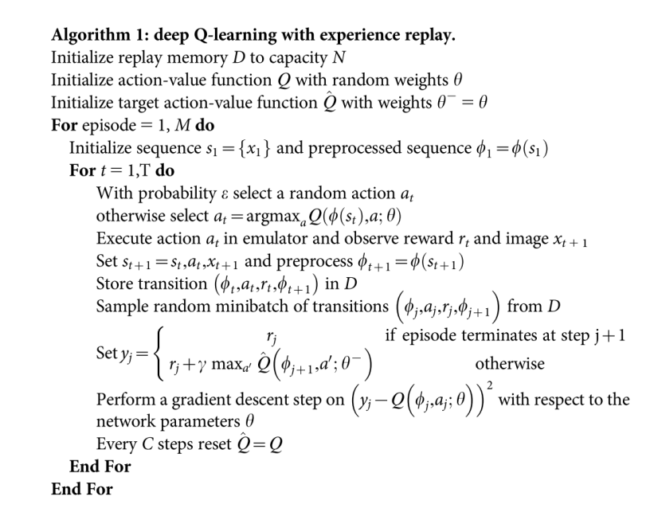
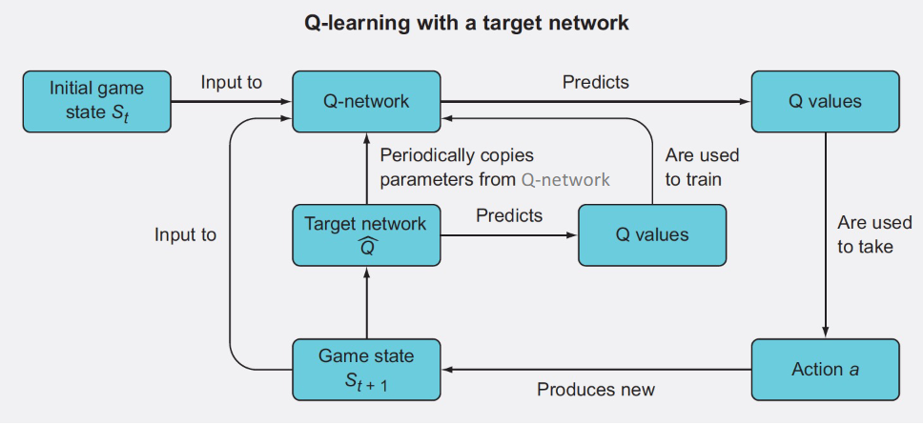
Deep Q-Learning :
and target network
Paper : Human-level control through deep reinforcement learning

Slide 7
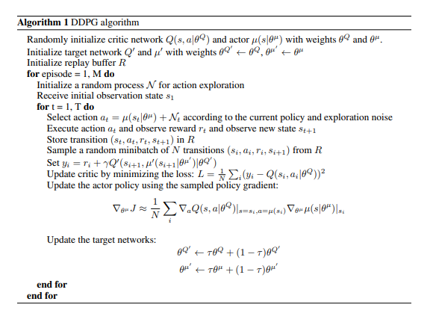
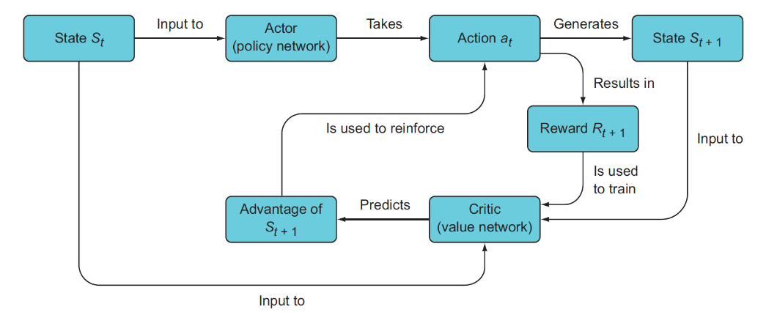
Deep Deterministic Policy Gradient :
Paper : CONTINUOUS CONTROL WITH DEEP REINFORCEMENT LEARNING

Slide 8
IMPLEMENTATION

Slide 9
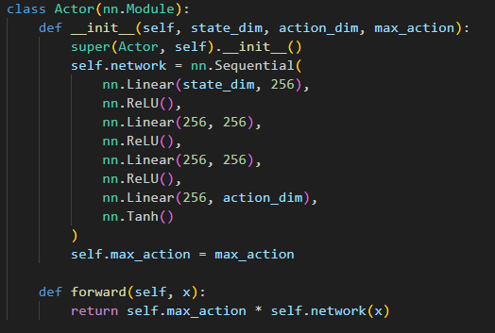
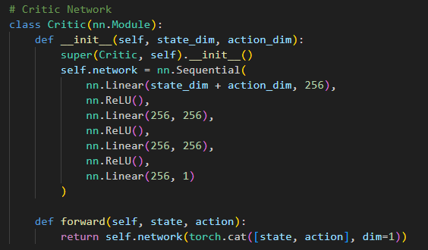
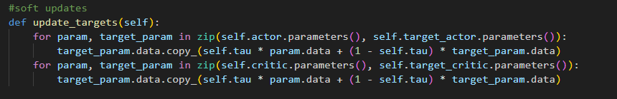

Using Pytorch to implement the algorithm.
Making separate classes for actor network ,critic network ,replay buffer
Trained for 3500 episodes.
Github : https://github.com/biswajit-github-2022/bipedal-walker-with-ddpg

Slide 10
Thank You

