Slide 1
Audio-Visual Generation From Text Input
Supervisor : Champak Dutta
Name : Biswajit Rana
Roll No.: B2330026
M.Sc. Big Data Analytics

Slide 2
Contents
1
Literature Reviews : Reviewing existing works on generative models for text-to-layout.
Methodologies
For text to music :Using a transformer-based text encoder (BART) combined with a U-Net architecture for conditioned music generation.
For text to layout : Use of DINOv2 and CodeLlama to create the Layout from a given text by incorporating the use of adaptors.
Results on text to music model : The model effectively generates coherent music sequences, matching textual descriptions in terms of mood and structure.
Results on text to layout model : The model generates the layout of the texts to be present on theimage.

Slide 3
Literature review
3
[1] Simple and Controllable Music Generation, Jade Copet, Felix Kreuk, Itai Gat, Tal Remez, David Kant, Gabriel Synnaeve, Yossi Adi, Alexandre Défossez, 2024.
[2] Natural TTS Synthesis by Conditioning WaveNet on Mel Spectrogram Predictions, Jonathan Shen, Ruoming Pang, Ron J. Weiss, Mike Schuster, Navdeep Jaitly, Zongheng Yang, Zhifeng Chen, Yu Zhang, Yuxuan Wang, RJ Skerry-Ryan, Rif A. Saurous, Yannis Agiomyrgiannakis, Yonghui Wu, 2018.
[3] TextDiffuser: Diffusion Models as Text Painters, Jingye Chen, Yupan Huang, Tengchao Lv, Lei Cui, Qifeng Chen, Furu Wei, 2023.
[4] TextDiffuser-2: Unleashing the Power of Language Models for Text Rendering, Jingye Chen, Yupan Huang, Tengchao Lv, Lei Cui, Qifeng Chen, Furu Wei, 2023.
[5] PosterLlama: Bridging Design Ability of Langauge Model to Contents-Aware Layout Generation, Jaejung Seol, Seojun Kim, Jaejun Yoo, 2024.

Slide 4
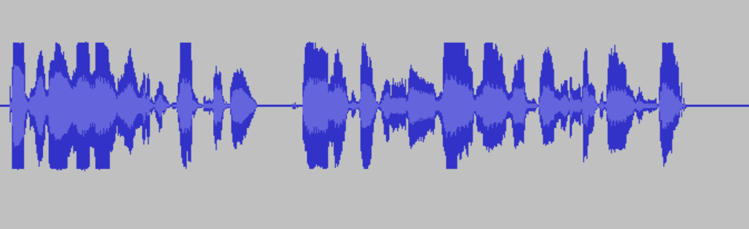
Methods
Text to Music model :
Used a Transformer based model .
In the process of training given a audio and text both are converted to vectors.
Text input is converted to Context embedding vector using BART (Bidirectional and Auto-Regressive Transformers).
The embedding vector is used in the Decoder layer of the model.
Text embedding vector is used for conditioning the audio with the text input .
text embedding is integrated through the Cross Attention Layer.
The input Audio is converted to the vector in the following process
Each number represents amplitude of the audio waveform at corresponding time stamp.
[ 0 , 10 , 6 , ……. , 20 ,……., 0]
Vector of length 32K

Slide 5

Sample Data
4
A Json file containing information of Music
corresponding .mp3 file.
Example :
{"key": "",
"artist": "Voyager I",
"sample_rate": 48000,
"file_extension": "mp3",
"description": "A cool song from Voyager.",
"keywords": "bright, pulsing, cool",
"duration": 15.0,
"bpm": "",
"genre": "electronic",
"title": "Enracinement",
"name": "electro_1",
"instrument": "Mix",
"moods": ["uplifting", "motivational"]
}
{"key": "",
"artist": "Voyager I",
"sample_rate": 44100,
"file_extension": "mp3",
"description": "This is an electronic song sending positive vibes.",
"keywords": "",
"duration": 20.0,
"bpm": "",
"genre": "electronic",
"title": "Untitled song",
"name": "electro_2",
"instrument": "Mix",
"moods": []
}

Slide 6
Auto Regressive
Transformer
6
Architecture:
Audio vector Form (Fₛ)
Encodec(CNN Encoder)
Latent space representation
…. … …..
Flatten
Encoded Vector rep. of Audio
Reverse Tokenization and Residual Vector Quantization
(Fᵣ)
Residual Vector Quantization
Fᵣ
Text Embedding Conditioning
Latent space representation
Tokenization
CNN Decoder
…. … …..
Fₛ
Predicted Music Amplitudes

Slide 7
7
Residual Vector Quantization:
Transforms vector form Continuous space to Discrete space as the goal of music generation is to generate music from discrete tokens , which is not possible for continuous time stamps.
It transforms the vector in multiple vectors using codebooks.
Which Vector from the code book is closer to the Audio Vector representation is found by RVQ.
Fᵣ
Audio Vector(Fᵣ)
N
:
CodeBook
CB1
R1
Encoded Vector rep. of Audio
CB2
R2
CB3
…. … …..
R3
Tokens
CB4

Slide 8
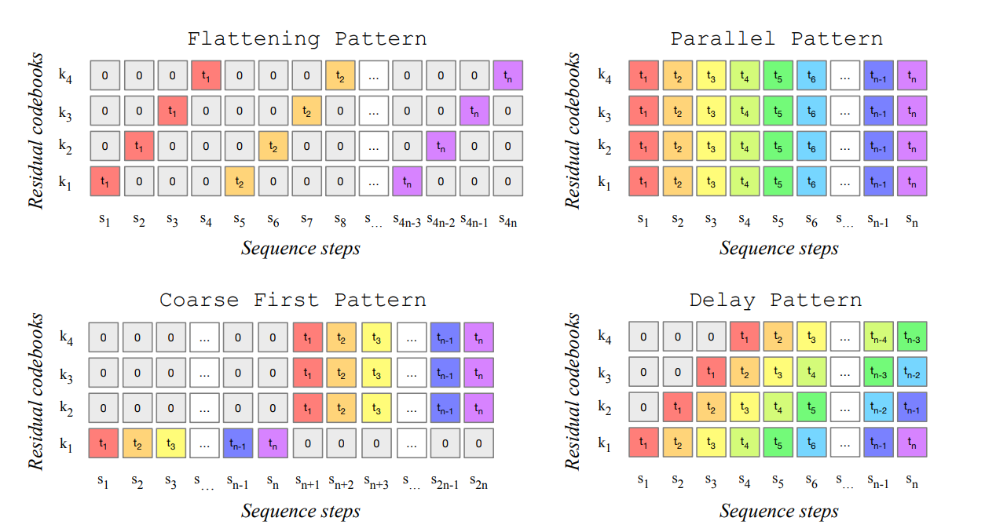
8
Different patters of input tokens :
Each tokens contains a part of one entry of the codebook
Generating tokens this way takes more time .
Each tokens contains one entry of the codebook
Each token of a entry of codebook is generated irrespective of previous token.
Generating tokens this way takes more time .
First s steps are used to generate first tokens of each entries of codebook.
Next other steps are similar as parallel pattern.
Generates tokes in a sequential manner .
More accurate than other patterns.

Slide 9
Methods
Text to Layout model :
Represents layouts as HTML sequences to leverage design priors embedded in LLMs
Enhancing expressive capability compared to numeric formats.
Utilized the Vision transformer DINOv2 and CodeLlama for generating the boundaries of the texts on the Image.
Training is done in 2 stages.
Stage1: Trains an adapter to align the visual encoder (DINOv2) with the language model treating image feature as <img> tag.
Stage2: Fine-tunes the LLM using HTML-formatted layouts with cross-entropy loss while keeping the visual adaptor frozen.

Slide 10
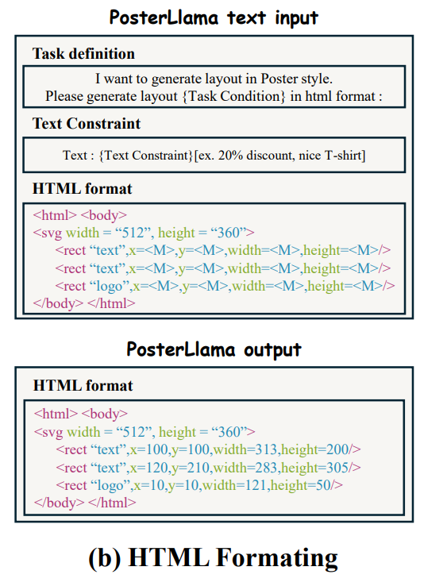
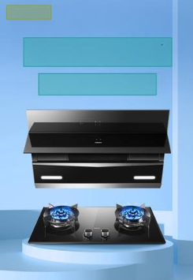
Input and output Formatting :
Output of the model containing the complete HTML format with the proper coordinates of the boundaries.
A format of the input text prompt in the stage2 training.
Task Definition: It is used to give a description to the model as an initial prompt.
Text constraints : The texts to be put in side the boundaries.
HTML Formatting : The HTML format with empty coordinates of <rect> tag.
Output image by rendering the output HTML formal on the image.

Slide 11
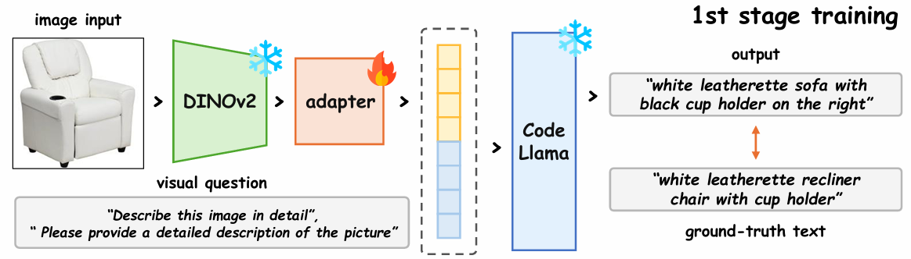
Architecture :
In the first stage of training , the input image is send through a vision transformer DINOv2, to extract the important features.
Output of the DINOv2 is send to an adaptor . It is used to bring the dimention of the extracted feature to the dimention of the input space of the CodeLLama, with Layernormalization and positional encoding.
The input text prompt then is tokenized and the embeddings are concatenated with the output of the adaptor.
The output feature space representation is then sent to the CodeLLama to generate the Decription of the image.
The stage1 training is done to train the adaptor , so that we can get the special context of the image and use it in the 2nd stage of training to generate the layout.

Slide 12
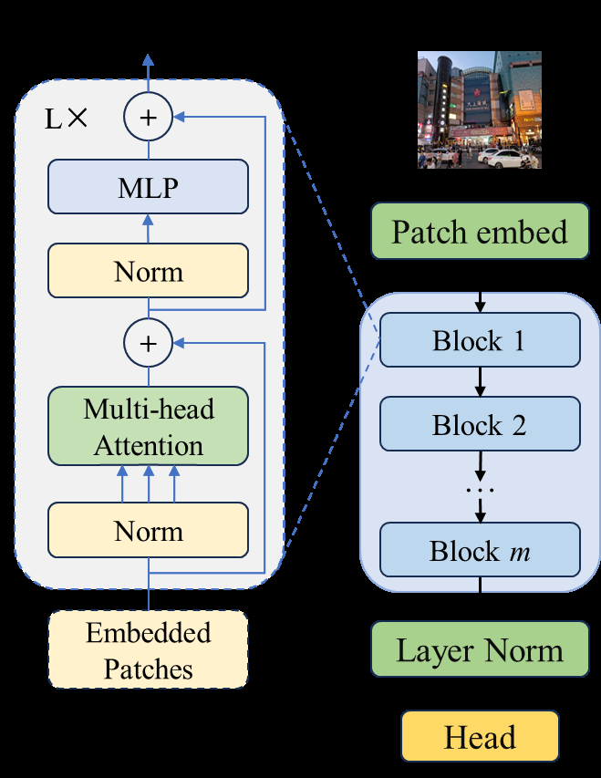
DINOv2 :
Input : Input is a Patchified image. Image is divided into non-overlapping patches.
Patch Embedding : The fixed size patches are then flattened and linearly embedded into a vector, creating a sequence of patch embeddings.
ViT : The main architecture of the DINOv2 is Vision transformer which contains the MHA, Feed Forward Neural network and Layer normalization.
Global Pooling : After the image passes through the transformer blocks, the model performs global pooling (often a [CLS] token or an average pool) to aggregate information from all the patches, generating a global image feature vector.
Projection Head : A projection head (often a multi-layer perceptron, MLP) maps the output feature from the global pooling step into a representation space where it can be used for downstream tasks.

Slide 13
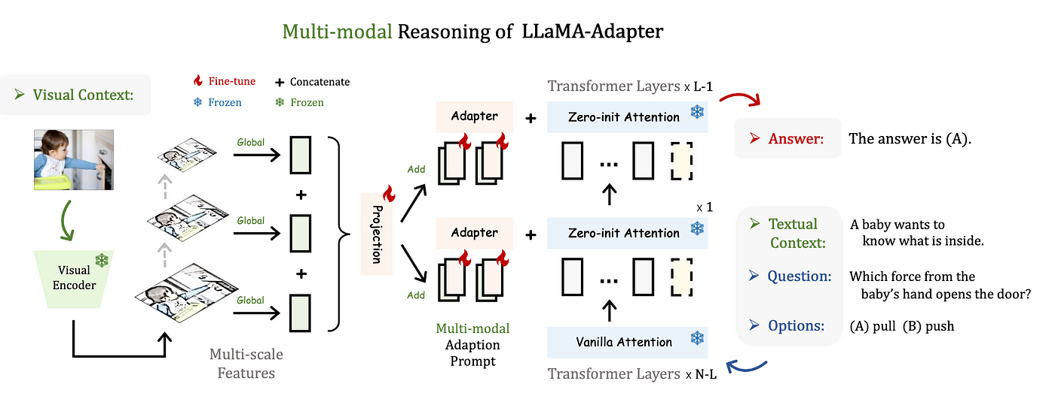
Adaptor :
A lightweight adaption method to efficiently finetune a Llama model in to an instruction following model.
We fix the Llama model, then prepend a learnable set of adaption prompts to the input instruction token.
Extract multiple features from the input image and concatenate all of then, then we concatenate the Text prompt and the feature vectors and send it through the adaptors to create a vector same as the embedding dimension of the llama model.

Slide 14
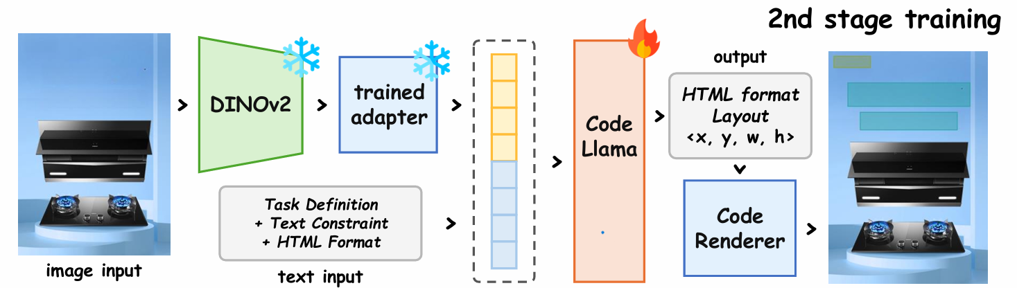
Architecture :
In the second stage of training , the input is an image, a set of text prompts containing Task Definition,Text Constraint, HTML Format.
Input image is sent through the DINOv2 and then to the trained adapter to get the important features
The input text prompt then is tokenized and the embeddings are concatenated with the output of the adaptor.
The output feature space representation is then sent to the CodeLLama to generate the complete HTML Format .
The HTML format is sent through the Code renderer to get the boundaries on the image.
The stage1 training is done to train the CodeLLama , so that we can train the Llama model for different images and get the proper boundaries.

Slide 15
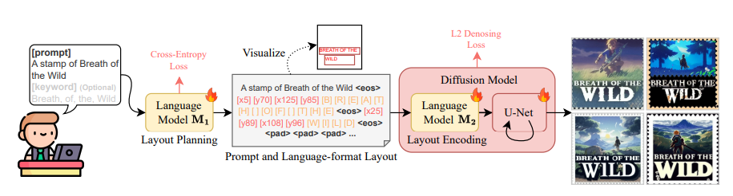
10
Text to Layout model(TextDeffuser-2) :
Diffusion models are good for generating images .But those models face challenges to create visual texts.
TextDiffuser-2, is such model which aims to unleash the power of language models for text rendering.
It uses two LLM model for layout planning and layout encoding then uses a diffusion model for generating the image.

Slide 16
Results of T2M
9
Text input: "Meditational music , om sound in background.“
Text input: "90's ukalele guiterist plaiying blue "

Slide 17
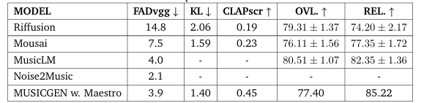
Results of T2M
FAD (Fréchet Audio Distance): Measures similarity between generated and ground-truth music using feature statistics; lower is better.
KL (Kullback-Leibler Divergence): Quantifies divergence between generated and real music probability distributions; lower is better.
CLAP Score: Evaluates semantic alignment of generated music with text prompts using cosine similarity; higher is better.
OVL (Overlap Score): Assesses temporal overlap and rhythmic alignment between generated and real music; higher is better.
REL (Relevance Score): Gauges thematic or stylistic adherence of music to the text prompt, often based on subjective scoring; higher is better.

Slide 18


Results of T2L
Sample Result :
Task Definition
I want to generate layout in poster design format. Please recover the layout html
according to the bbox , categories, size, image I provide (in html format)
Text Constraint
Text :Buy one get one free & 50% off on the first order.
HTML Format
###bbox html:
<html>
<body>
<svg width = "513", height = "750">
<rect data-category=“Embellishment", x=“<M>", y=“<M>", width="<M>", height="<M>"/>
<rect data-category="Text", x=“<M>", y="<M>", width="<M>", height=“<M>"/>
<rect data-category="Text", x="<M>", y=“<M>", width="<M>", height=“<M>"/>
<rect data-category="Logo", x="<M>", y=“<M>", width="<M>", height=“<M>"/>
</svg>
</body>
</html>
+
Input
Output

Slide 19
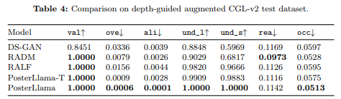
Results of T2l
Validity (val):
Ratio of valid layout elements greater than 0.1% of the canvas area.
Overlap (ove):
Measures the extent of overlap between layout elements. Lower values are better.
Alignment (ali):
Indicates how well layout elements are aligned on the canvas.
Readability Score (rea):
Evaluates how easily text elements can be read.
Occlusion (occ):
Quantifies the extent to which layout elements (like text, images, or other components) obstruct or overlap salient objects on the canvas.

Slide 20
13
Thank You

