Slide 1
Audio-Visual Synthesis From Text Input
Supervisor : Champak Dutta
Name : Biswajit Rana (B2330026)
Roll No.: B2330026
M.Sc. Big Data Analytics

Slide 2
Introduction
1
Discussion of Problem statement : Investigating the generation of music from textual descriptions and exploring layout generation based on text prompts.
Literature Reviews : Reviewing existing works on generative models for text-to-music, music generation techniques, and related cross-modal research.
Methods used
For text to music :Using a transformer-based text encoder (BART) combined with a U-Net architecture for conditioned music generation.
For text to layout (ongoing) :Exploring transformer-based architectures to generate visual layouts conditioned on descriptive text inputs.
Results on text to music model : The model effectively generates coherent music sequences, matching textual descriptions in terms of mood and structure.
Application idea: A sample Application layout for text to music and text to layout as futurework.

Slide 3
2
Problem statement
AudioVisual synthesis from text input
Audio : Generate Music from text input
Visual : Generate Layout from the text input
Application : Create an User Application (UI) combining both the models.

Slide 4
Literature review
3
[1] Simple and Controllable Music Generation, Jade Copet, Felix Kreuk, Itai Gat, Tal Remez, David Kant, Gabriel Synnaeve, Yossi Adi, Alexandre Défossez, 2024.
[2] Natural TTS Synthesis by Conditioning WaveNet on Mel Spectrogram Predictions, Jonathan Shen, Ruoming Pang, Ron J. Weiss, Mike Schuster, Navdeep Jaitly, Zongheng Yang, Zhifeng Chen, Yu Zhang, Yuxuan Wang, RJ Skerry-Ryan, Rif A. Saurous, Yannis Agiomyrgiannakis, Yonghui Wu, 2018.
[3] TextDiffuser-2: Unleashing the Power of Language Models for Text Rendering, Jingye Chen, Yupan Huang, Tengchao Lv, Lei Cui, Qifeng Chen, Furu Wei, 2023.

Slide 5

Sample Data
4
A Json file containing information of Music
corresponding .mp3 file.
Example :
{"key": "",
"artist": "Voyager I",
"sample_rate": 48000,
"file_extension": "mp3",
"description": "A cool song from Voyager.",
"keywords": "bright, pulsing, cool",
"duration": 15.0,
"bpm": "",
"genre": "electronic",
"title": "Enracinement",
"name": "electro_1",
"instrument": "Mix",
"moods": ["uplifting", "motivational"]
}
{"key": "",
"artist": "Voyager I",
"sample_rate": 44100,
"file_extension": "mp3",
"description": "This is an electronic song sending positive vibes.",
"keywords": "",
"duration": 20.0,
"bpm": "",
"genre": "electronic",
"title": "Untitled song",
"name": "electro_2",
"instrument": "Mix",
"moods": []
}

Slide 6
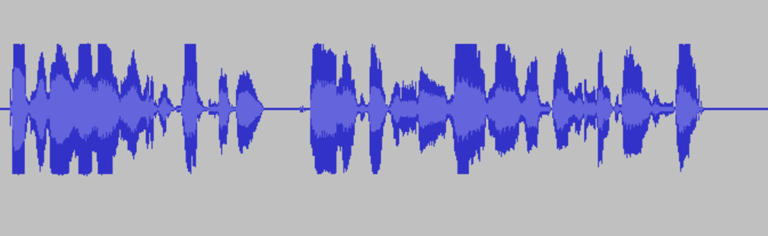
Methods
5
Text to Music model :
Used a Transformer based model .
In the process of training given a audio and text both are converted to vectors.
Text input is converted to Context embedding vector using BART (Bidirectional and Auto-Regressive Transformers).
The embedding vector is used in the Decoder layer of the model.
Text embedding vector is used for conditioning the audio with the text input .
text embedding is integrated through the Cross Attention Layer.
The input Audio is converted to the vector in the following process
Each number represents amplitude of the audio waveform at corresponding time stamp.
[ 0 , 10 , 6 , ……. , 20 ,……., 0]
Sampling rate :32KHz
Vector of length 32K

Slide 7
Auto Regressive
Transformer
6
Architecture:
Audio vector Form (Fₛ)
Encodec(CNN Encoder)
Latent space representation
…. … …..
Flatten
Encoded Vector rep. of Audio
Reverse Tokenization and Residual Vector Quantization
(Fᵣ)
Residual Vector Quantization
Fᵣ
Text Embedding Conditioning
Latent space representation
Tokenization
CNN Decoder
…. … …..
Fₛ
Predicted Music Amplitudes

Slide 8
7
Residual Vector Quantization:
Transforms vector form Continuous space to Discrete space as the goal of music generation is to generate music from discrete tokens , which is not possible for continuous time stamps.
It transforms the vector in multiple vectors using codebooks.
Which Vector from the code book is closer to the Audio Vector representation is found by RVQ.
Fᵣ
Audio Vector(Fᵣ)
N
:
CodeBook
CB1
R1
Encoded Vector rep. of Audio
CB2
R2
CB3
…. … …..
R3
Tokens
CB4

Slide 9
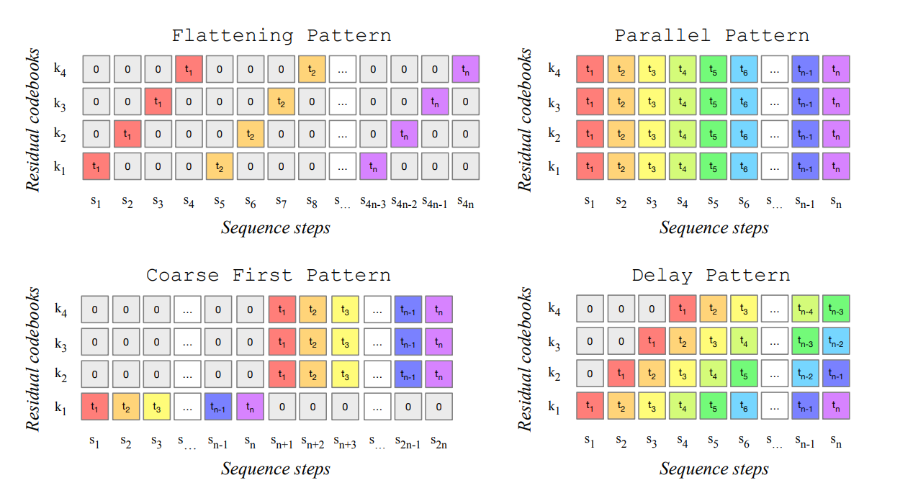
8
Different patters of creating Codebooks :
Each tokens contains a part of one entry of the codebook
Generating tokens this way takes more time .
Each tokens contains one entry of the codebook
Each token of a entry of codebook is generated irrespective of previous token.
Generating tokens this way takes more time .
First s steps are used to generate first tokens of each entries of codebook.
Next other steps are similar as parallel pattern.
Generates tokes in a sequential manner .
More accurate than other patterns.

Slide 10
Results of T2M
9
Text input: "Meditational music , om sound in background.“
Text input: "90's ukalele guiterist plaiying blue "

Slide 11
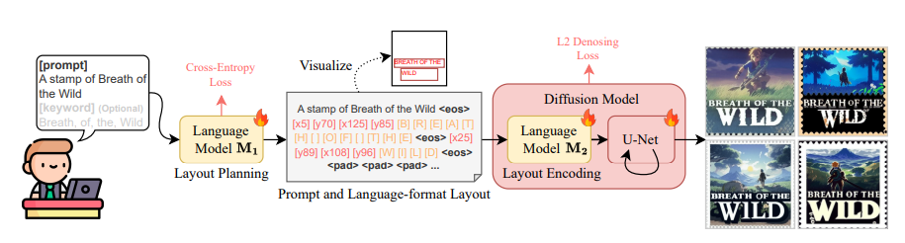
10
Text to Layout model :
Diffusion models are good for generating images .But those models face challenges to create visual texts.
TextDiffuser-2, is such model which aims to unleash the power of language models for text rendering.
It uses two LLM model for layout planning and layout encoding then uses a diffusion model for generating the image.

Slide 12
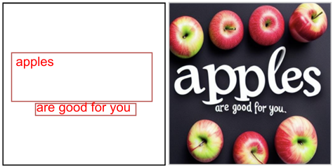
11
Example :
"Given a prompt that will be used to generate an image, plan the layout of visual text for the image. The size of the image is 128x128. Therefore, all properties of the positions should not exceed 128, including the coordinates of top, left, right, and bottom. All keywords are included in the caption. You dont need to specify the details of font styles. At each line, the format should be keyword left, top, right, bottom. So let us begin. Prompt: Double Layer Pumpkin Cheesecake Pie | Pumpkin Cheesecake | Pumpkin Dessert | Double layer pumpkin cheesecake pie has two layers of pumpkin cheesecake inside a convenient store-bought graham cracker crust. This is an easy cheesecake recipe that even beginners can make. Top with some fresh whipped cream for the ultimate Fall dessert or add it to your Thanksgiving dessert table. #pumpkin #pumpkinrecipes #pumpkinspice #cheesecake #dessert #easydessertrecipes #recipeoftheday"
PUMPKIN
GPT
"PUMPKIN 8,55,
cheesecake pie 65,126"
cheesecake
pie
Diffusion
Image with text

Slide 13
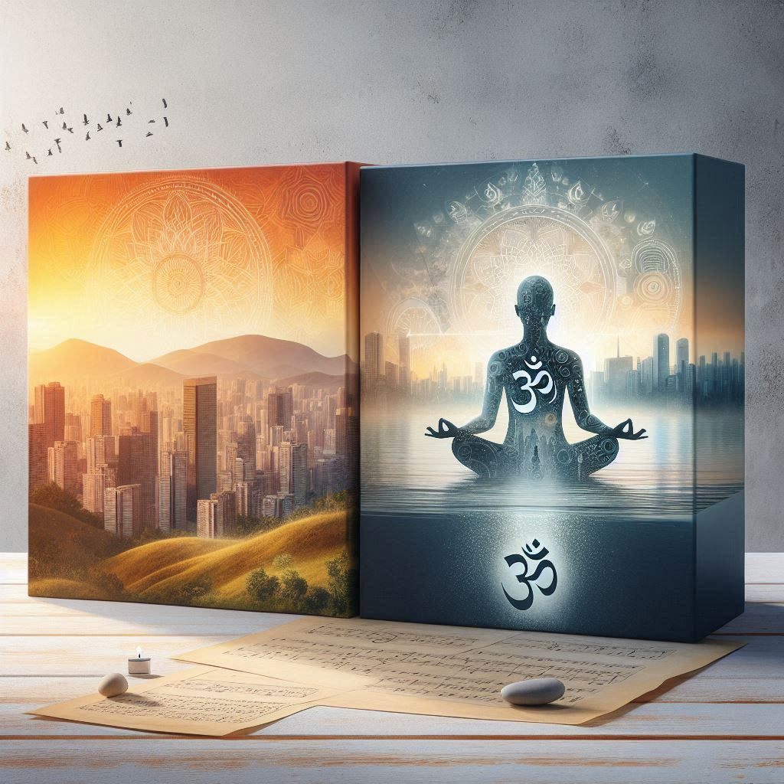
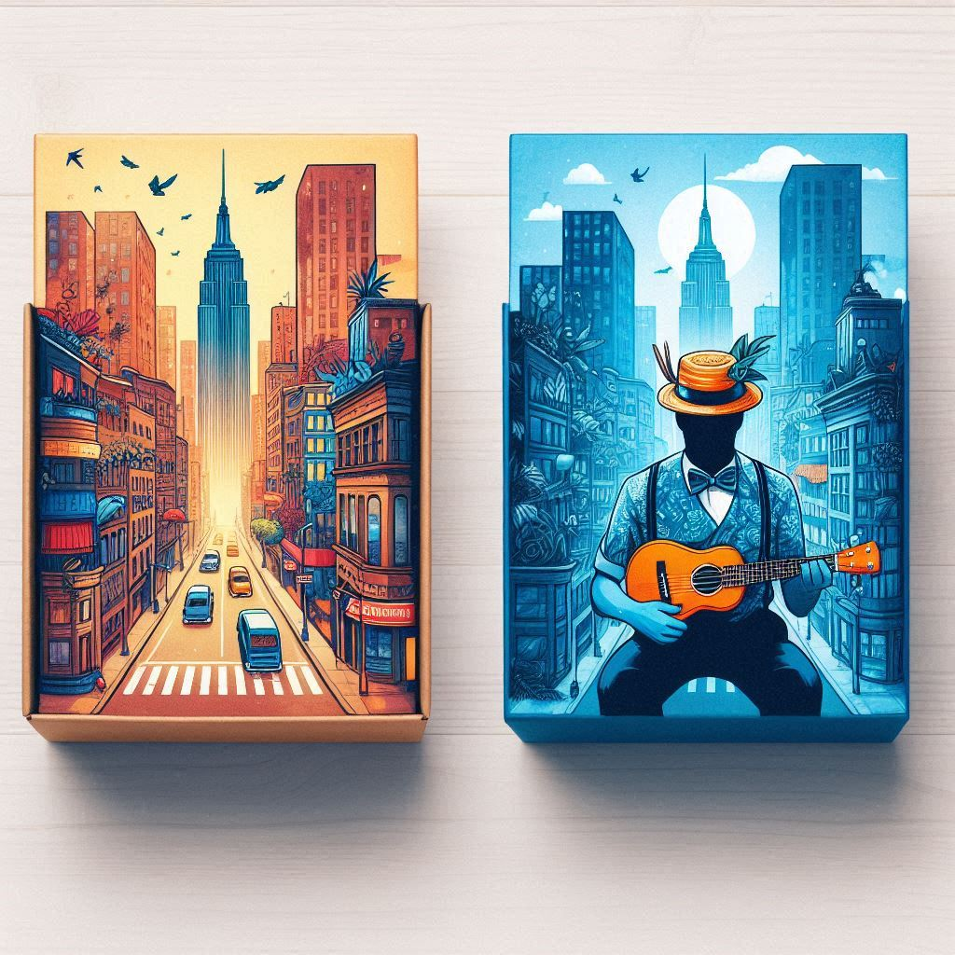
Application Idea
12
Two different modules will be used .
One text input section .
Text will be given by a tag of whether music or layout or both has to be generated .
Same or different text can be given for two modules.
A Layout of multiple items can be generated that matches with the prompt of the music.
Example :
a layout of 2 items(a personality, a cityscape) that matches with “Meditational music , om sound in background.”
a layout of 2 items(a personality, a cityscape) that matches with “90's ukalele guiterist plaiying blue”.
Image form Microsoft Copilot
Image form Microsoft Copilot

Slide 14
13
Thank You

