Slide 1

Online Retail Sales & Customer Segmentation
Data Extraction, Data Cleaning, Exploratory Analysis & RFM-Based Customer Insights
Project GitHub Link : Online-Retail-EDA-Pipeline
Presented By : BISWAJIT SASMAL
Date : 02-04-2026

Slide 2

Table of Content
Project Overview
Dataset Overview
Data Extraction & Data Cleaning
Key Business Analysis Performed
Monthly Sales Tend
Top Products Insights
Top Country Insights
Customer RFM Analysis & Segmentation
Strategic Recommendation
Tool Used

Slide 3
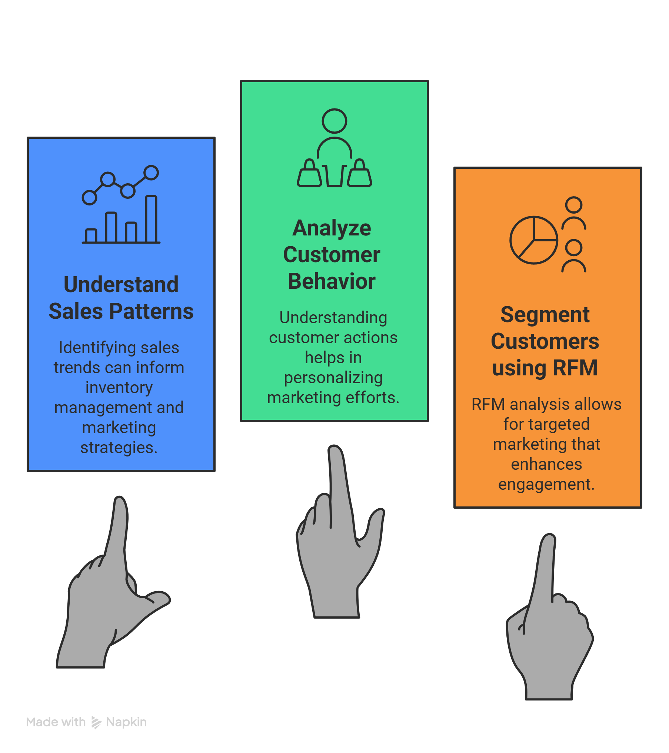
Project Overview
Analyze Online Retail Transaction Data
Understand Sales Pattern and Customer Behaviour
Identify Key Business Insights
Segment Customers Using RFM

Slide 4
Dataset Overview
This dataset contains real-world online retail transactions, including product details, customer information, and purchase Invoice records. It is large and unclean, making it suitable for practical data analysis and business insights. This is a transactional data set which contains all the transactions occurring between 01/12/2010 and 09/12/2011 for a UK-based and registered non-store online retail. The company mainly sells unique all-occasion gifts. Many customers of the company are wholesalers.
Data Source : UCI Machine Learning Repository
Rows : 500K + transactions
Columns : InvoiceNo, InvoiceDate, StockCode, Description, Quantity, UnitPrice, CustomerID, Country

Slide 5
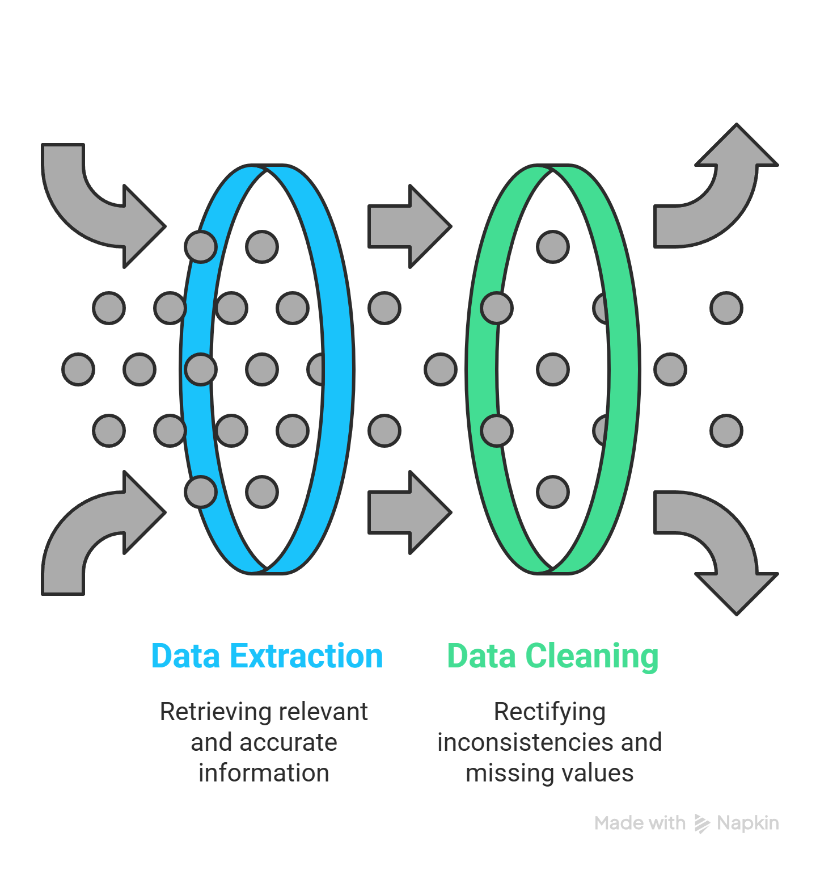
Data Extraction & Data Cleaning
Data was extracted from the UCI Machine Learning Repository using a Python-based approach and stored in a structured csv format for further processing and analysis.
Python Code For Data Extraction : Data-Extraction
Data Cleaning Steps
Remove Missing Values
Remove Cancelled Invoice Transactions
Remove Duplicates
Fix Inconsistent Product Description
Handled Negative Quantity & Invalid Unit Price
Create TotalPrice = Quantity × UnitPrice for line of Invoice
Extract Month Number and Month Name from Invoice Date
Prepared Dataset For Further Analysis
Python Code For Data Cleaning : Data-Cleaning

Slide 6
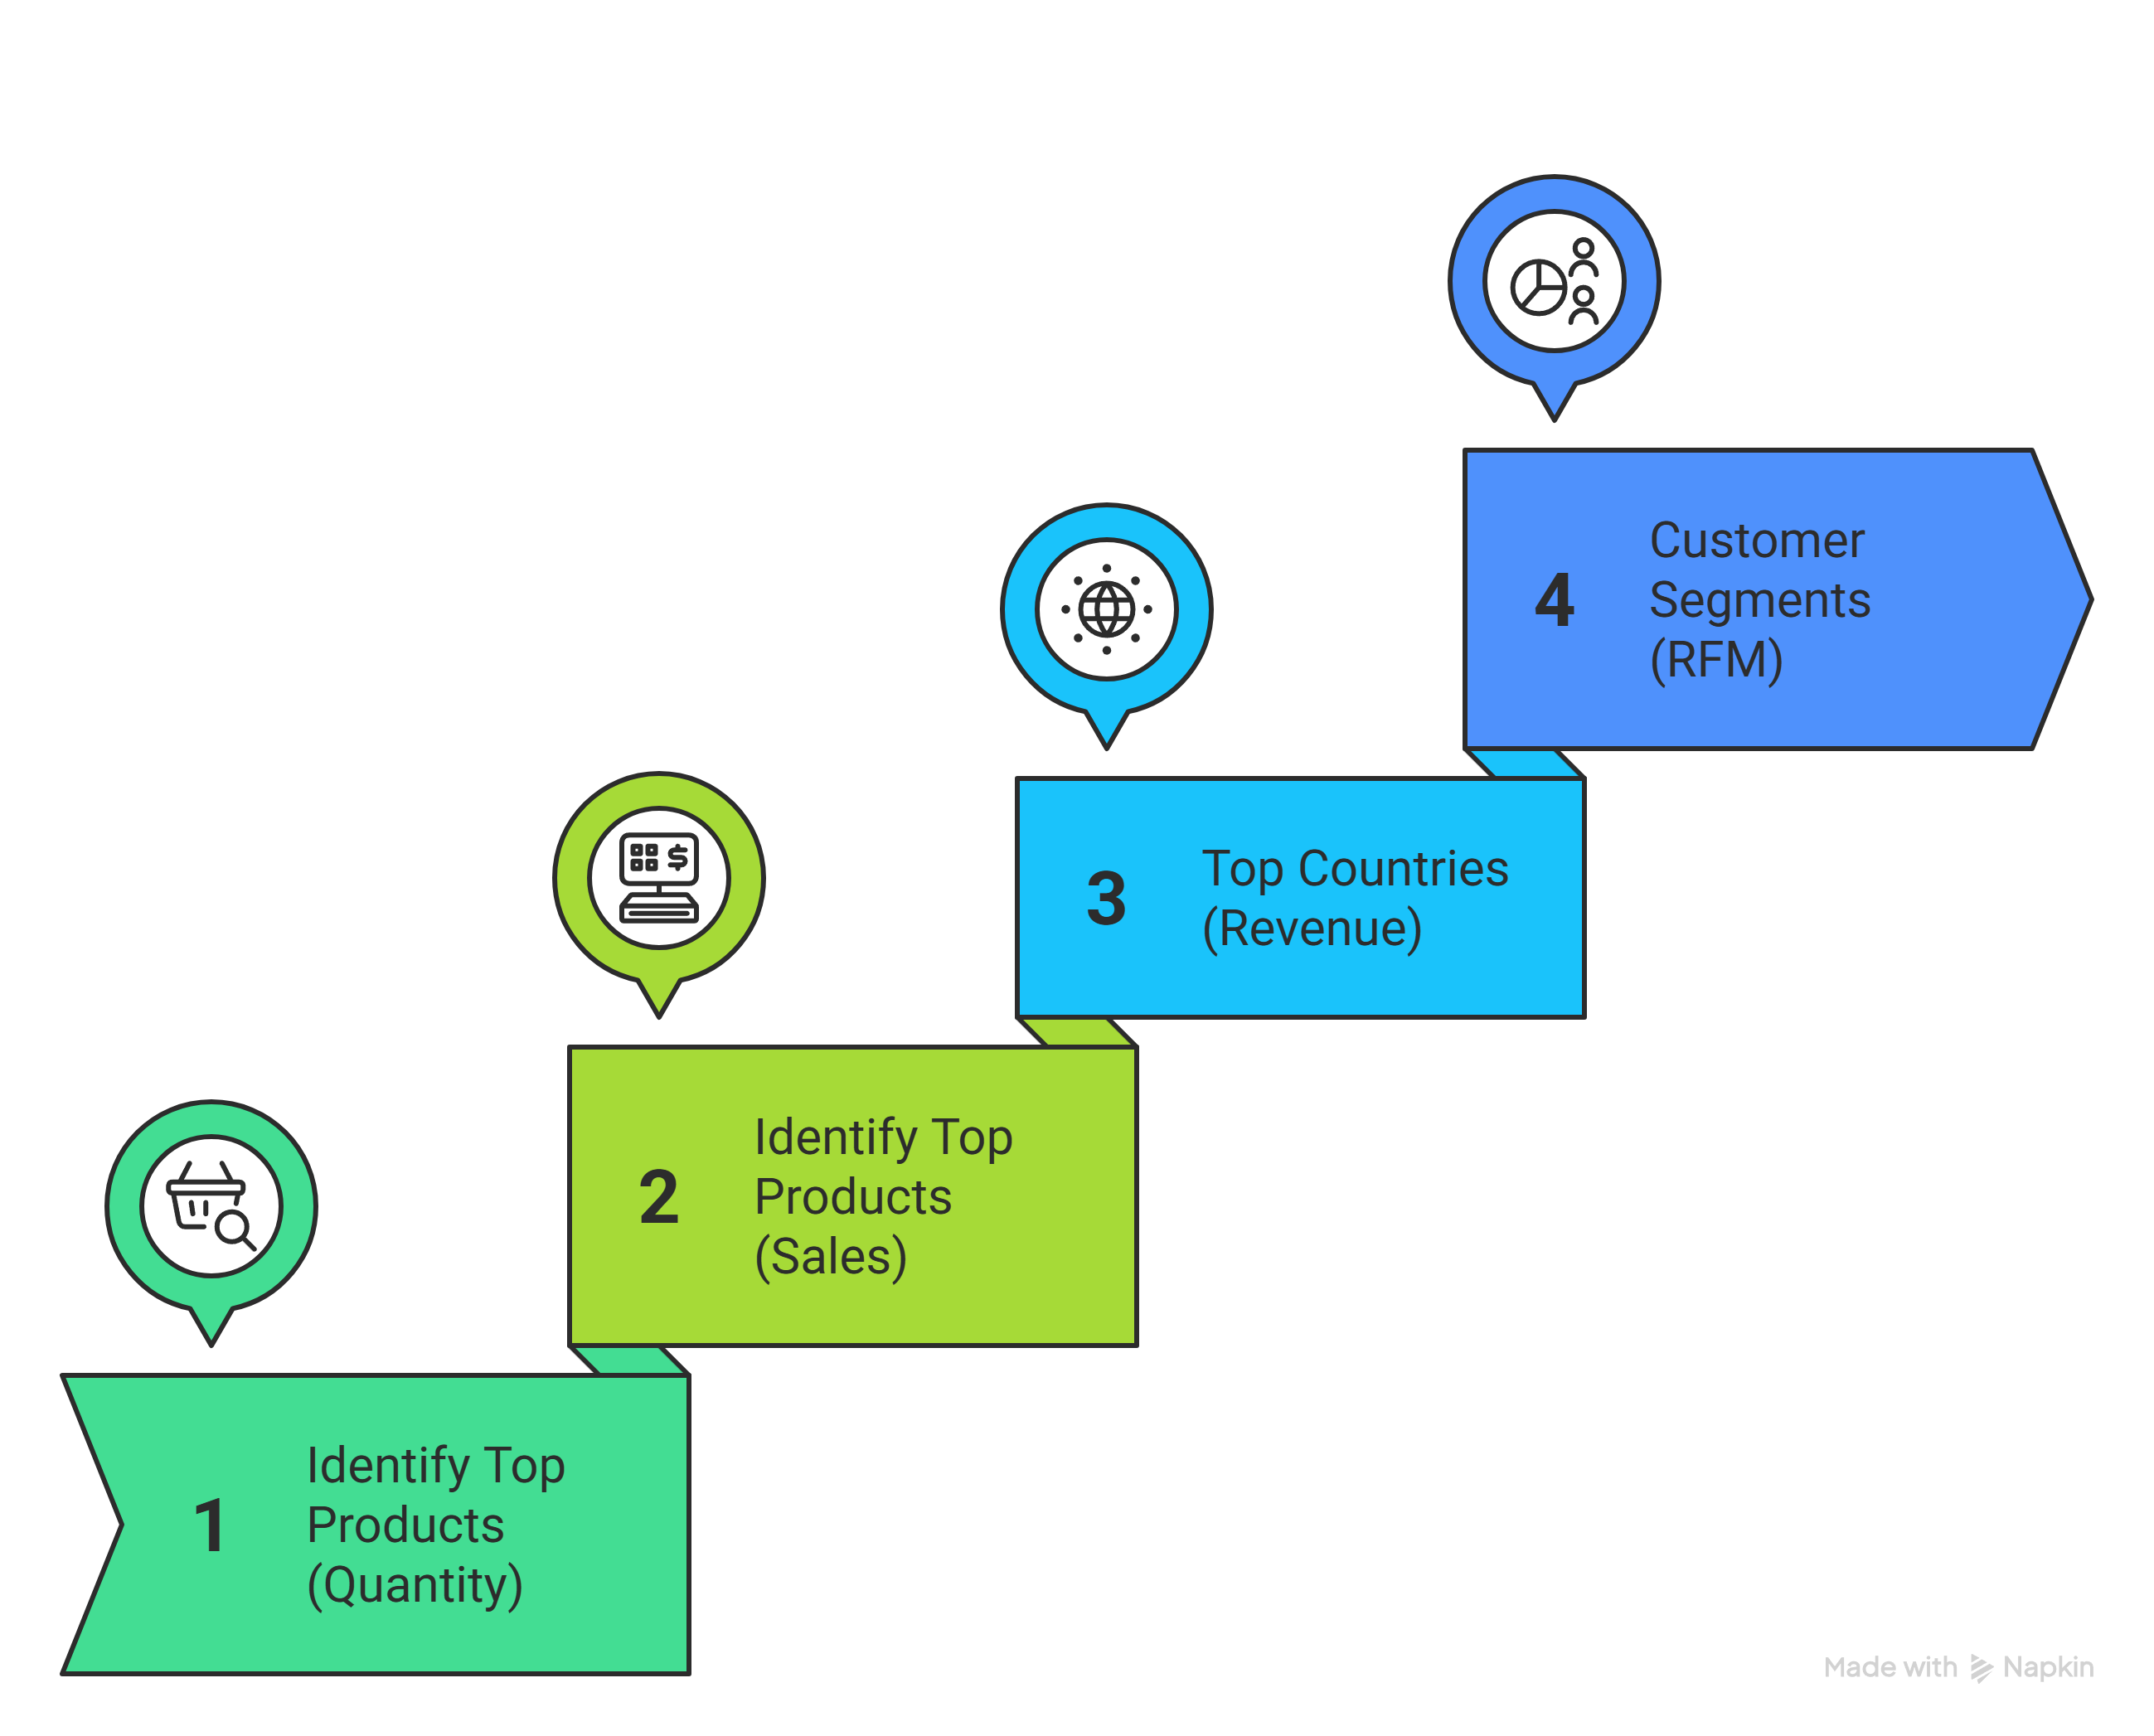
Key Business Analysis Performed
Identify Top 5 Products Based on Quantity Sold
Identify Top 5 Products Based on Sales Amount
Top 5 Country Based on Revenue
Customer Segment Based on RFM

Slide 7
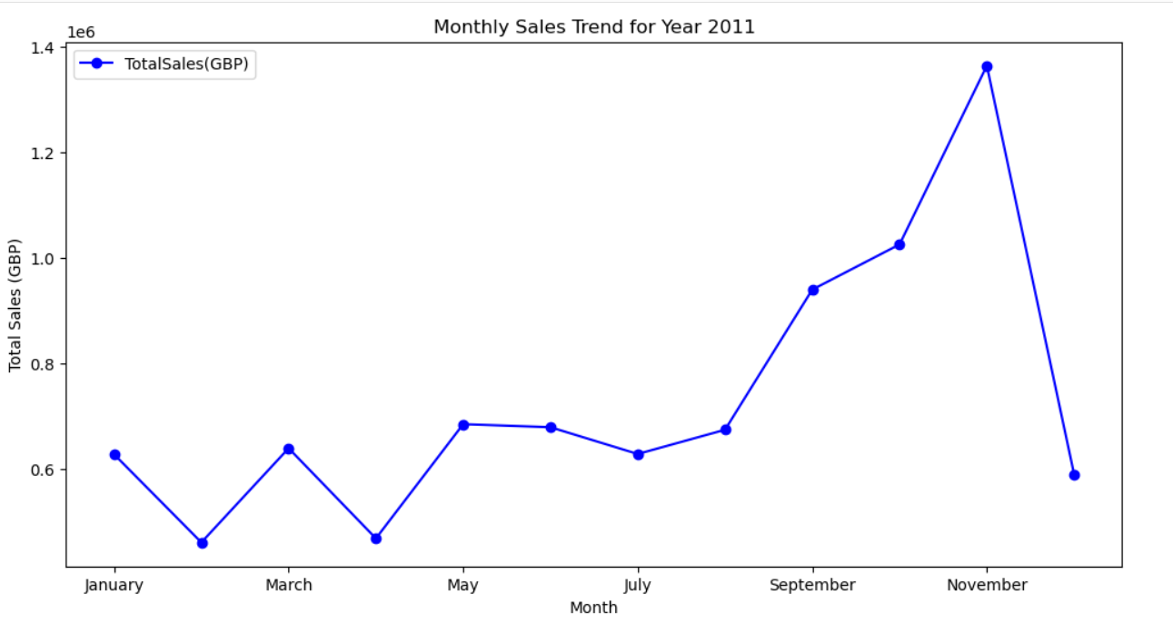
Monthly Sales Trend
Total Sales Rising Up From August 2011 and have reached Peak in November 2011. This is likely due to Holiday season sales at end of the Year. A Seasonal trends observed.

Slide 8
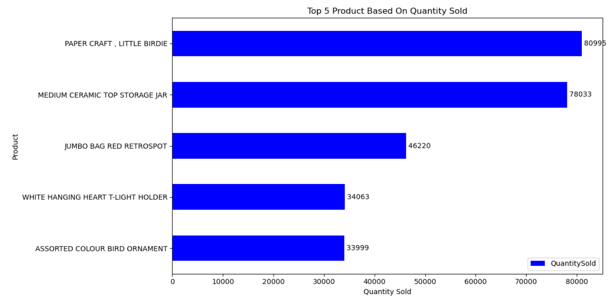
Top Products Insights
Top Demanding Products Based on Quantity Sold in 2011 which indicates Customer Products Preference

Slide 9
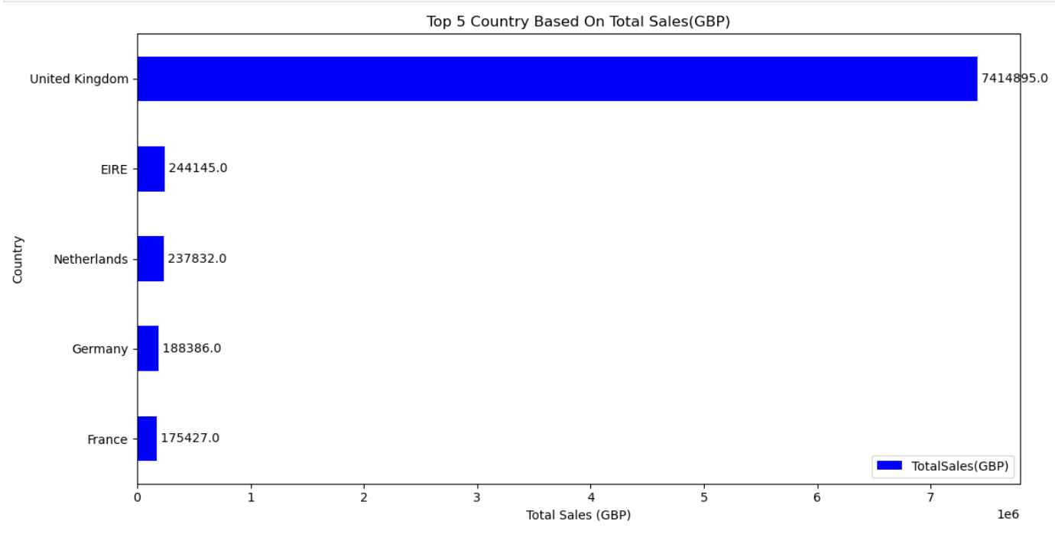
Top Country Insights
UK (United Kingdom) Dominate Revenue in 2011 more than 💷7M. Few Countries Countries Contribute majority of sales.

Slide 10
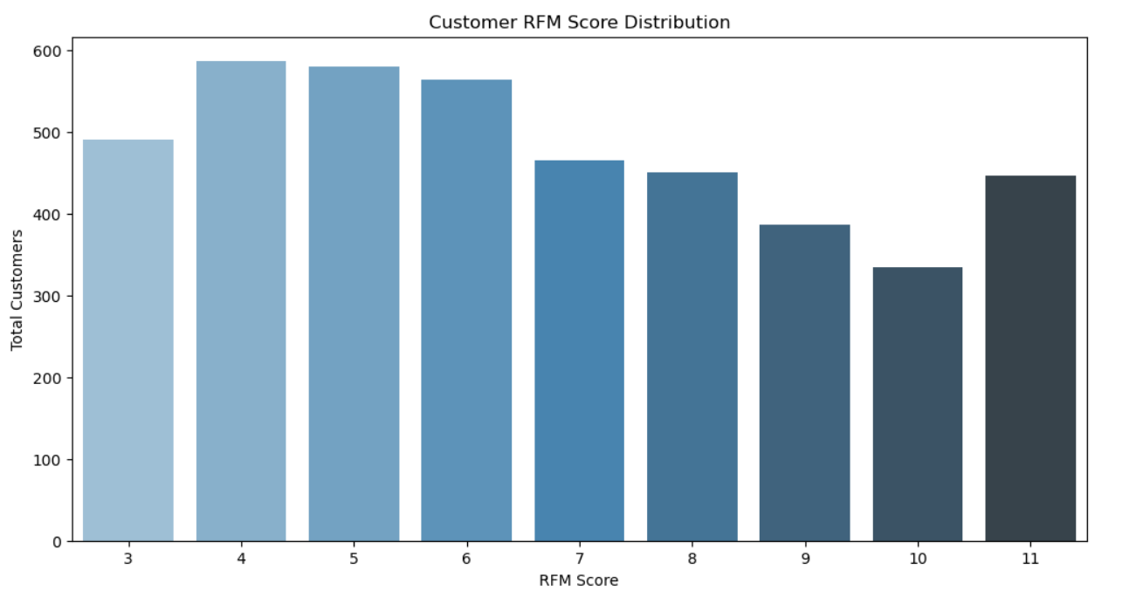
Customer RFM Analysis &Segmentation
Most customers fall within mid-range RFM scores (5–8), indicating a large group of moderately engaged customers.
Fewer customers have very high RFM scores (9–11), suggesting a smaller segment of highly valuable, loyal customers.

Slide 11
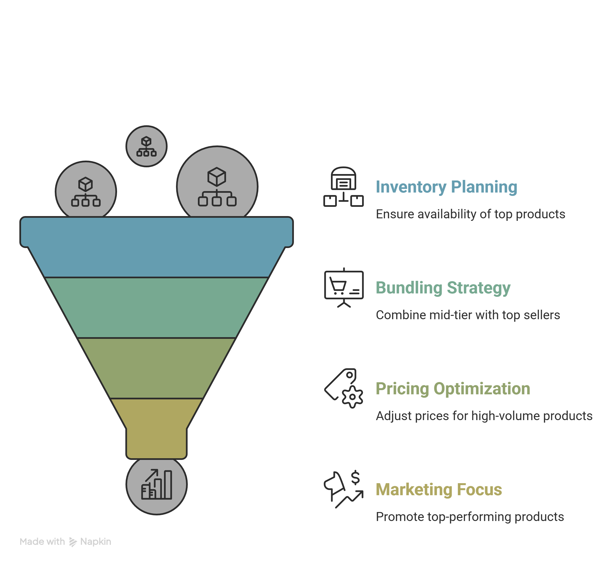
Strategic Recommendation
Inventory Planning:
Prioritize stock availability for the top 2 products to avoid stockouts and lost sales.
Bundling Strategy:
Combine mid-tier products with top-selling items to increase their sales volume.
Pricing Optimization:
Analyze whether high-volume products have lower margins and explore pricing adjustments.
Marketing Focus:
Promote top-performing products in campaigns since they already have proven demand.

Slide 12





Tools Used
Python as a Programming Language
Pandas as Data Cleaning & Data Manipulation
Jupyter Notebook For EDA & RFM Analysis
Visual Studio Code For Creating .py scripts
Git & GitHub For Version Control & Project Collaboration

Slide 13




Thank You
BISWAJIT SASMAL
Aspiring Data Analyst
Connect With Me

