Slide 1
Claude AI Training Program
Transform Your Workforce with AI

Slide 2
What is Claude?
✓ Advanced AI assistant by Anthropic
✓ Trained to be helpful, harmless, honest
✓ Can write, analyze, code, research
✓ Context window: 200K tokens
✓ Available 24/7 via web & API

Slide 3
Why Claude for Business?
✓ 70% faster content creation
✓ 60% reduction in manual tasks
✓ Higher quality outputs
✓ Cost-effective AI solution
✓ Enterprise-grade security

Slide 4
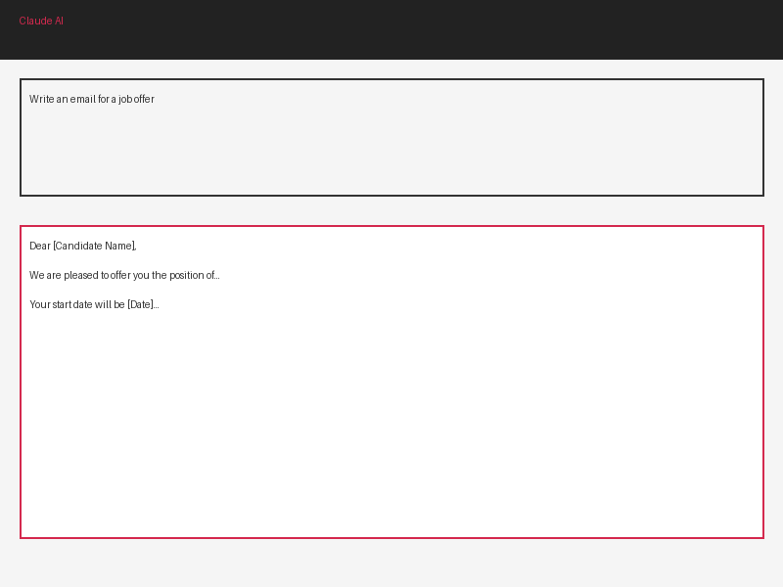
Claude Interface Demo
Simple, intuitive interface
Type your request
Get instant responses
Refine and iterate

Slide 5
The Prompt Formula
CONTEXT + TASK + FORMAT = RESULTS
❌ Bad: 'Write an email'
✅ Good: 'Write a professional 3-paragraph email',
' offering a job to [Name] for [Role]'
' Include start date and next steps'

Slide 6
Prompt Examples by Department
HR: Screening resumes, creating job posts
Marketing: Content ideas, email campaigns
Sales: Proposal templates, objection handling
Support: Response templates, FAQs
Finance: Report writing, analysis summaries

Slide 7
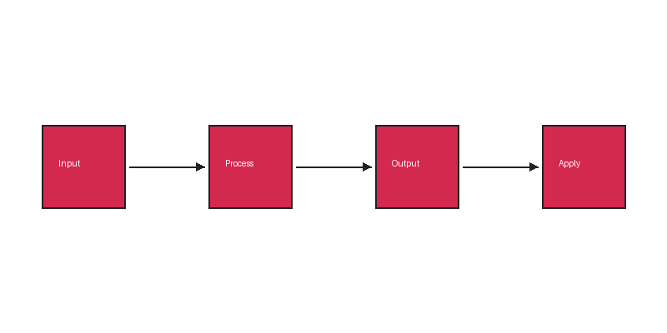
Business Workflow
Identify task →
Create prompt →
Test & refine →
Deploy & measure

Slide 8
Department Impact
HR: 60% faster hiring
Marketing: 70% faster content, 5x output
Sales: 4x faster proposals
Support: 40% faster response time
Operations: 80% faster documentation

Slide 9
Advanced Claude Features
✓ Projects: Organize with custom instructions
✓ Knowledge Files: Add company documents
✓ Artifacts: Create standalone content
✓ Code Execution: Run Python directly
✓ File Analysis: Process documents & images

Slide 10
ROI & Metrics
Investment: $50-75K Year 1
Expected Return: $500K+ savings
ROI Multiple: 7:1 to 10:1
Payback Period: 1-2 months
Adoption Target: 80%+ of employees

Slide 11
Ready to Transform Your Organization?
Let's make Isharya AI-fluent!

